Slide 1
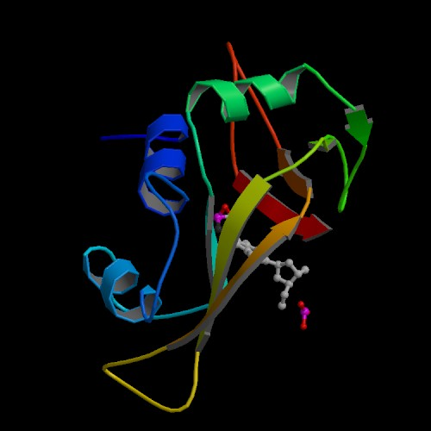
Protein Secondary Structure Prediction
Some of the slides are adapted from Dr. Dong Xu’s lecture notes

Slide 2
Why secondary structure prediction?
Accurate secondary structure prediction can be an important information for the tertiary structure prediction
Protein function prediction
Protein classification
Predicting structural change
An easier problem than 3D structure prediction (more than 40 years of history).

Slide 3
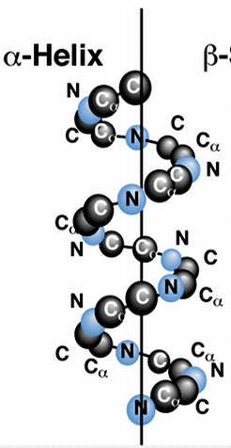
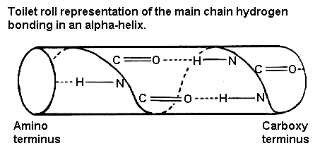
α helix
α-helix (30-35%)
  Hydrogen bond between C=O (carbonyl) & NH (amine) groups within strand (4 positions apart)
  3.6 residues / turn, 1.5 Å rise / residue
  Typically right hand turn
  Most abundant secondary structure
  α-helix formers: A,R,L,M,E,Q,K

Slide 4
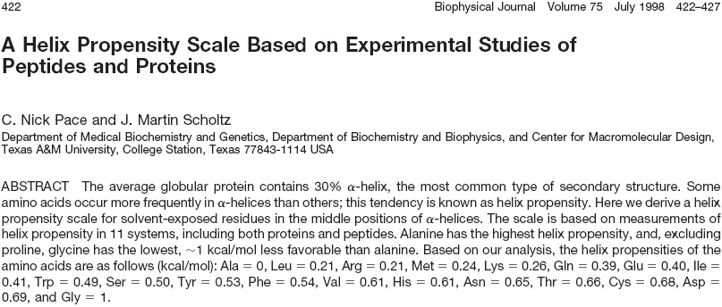

Slide 5
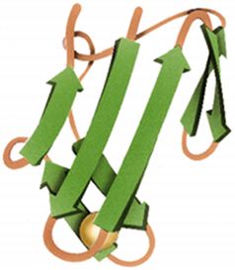
β sheet & β turn
β-sheet / β-strand (20-25%)
  Hydrogen bond between groups across strands
  Forms parallel and antiparallel pleated sheets
  Amino acids less compact – 3.5 Å between adjacent residues
  Residues alternate above and
  below β-sheet
  β-sheet formers: V,I,P,T,W
β-turn
  Short turn (4 residues)
  Hydrogen bond between C=O &
  NH groups within strand
  (3 positions apart)
  Usually polar, found near surface
  β-turn formers: S,D,N,P,R

Slide 6
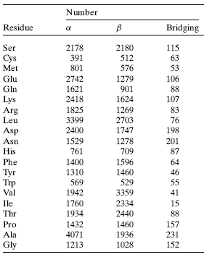



Slide 7
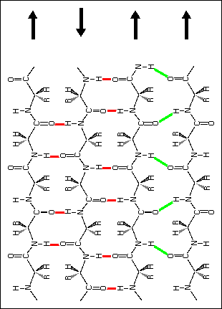
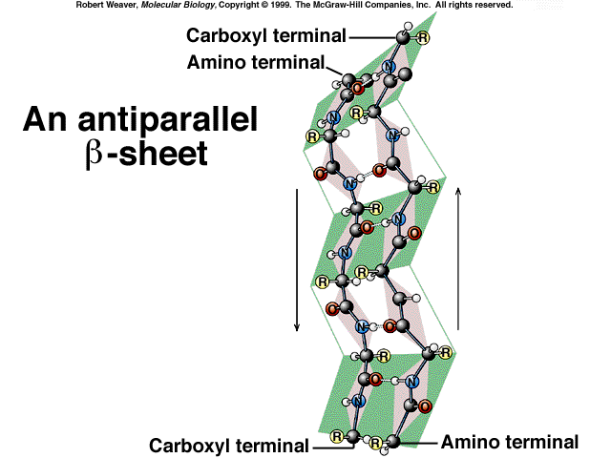
-sheet
(parallel, anti-parallel)

Slide 8
Others
Loop (bridging region)
  Regions between α-helices and β-sheets
  On the surface, vary in length and 3D configurations
  Do not have regular periodic structures
  Loop formers: small polar residues
Coil (40-50%)
  Generally speaking, anything besides α-helix, β-sheet, β-turn

Slide 9
Proteins – Structural Classes
Proteins can be classified by dominant structures
SCOP (Structural Classification Of Proteins)
  Class α α-helices connected by loops
  Class β antiparallel sheets
  Class α / β parallel β-sheets with intervening α-helices
  Class α + β segregated α-helices and antiparallel β-sheets
  Multidomain combinations of classes
  Membrane membranes & cell surface proteins
  Small proteins metal ligand, heme, and/or disulfide bridges
  Coiled coil 2-3 α-helices coiled around each other
  Low resolution
  Peptides not true classes
  Designed

Slide 10
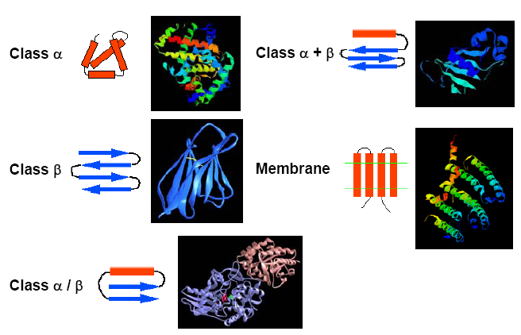
Proteins – Structural Classes

Slide 11
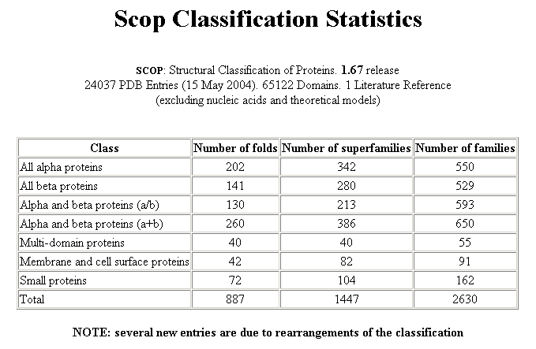

Slide 12
Assigning Secondary Structure
Defining features
  Dihedral angles
  Hydrogen bonds
  Geometry
Assigned manually by crystallographers or
Automatic
  DSSP (Definition of secondary structure of proteins, Kabsch & Sander,1983)
  STRIDE (Frishman & Argos, 1995)
  Continuum (Claus Andersen, Burkhard Rost, 2001)

Slide 13
Definition of secondary structure of proteins (DSSP)
The DSSP code
  H = alpha helix
  B = residue in isolated beta-bridge
  E = extended strand, participates in beta ladder
  G = 3-helix (3/10 helix)
  I = 5 helix (pi helix)
  T = hydrogen bonded turn
  S = bend
CASP Standard
  H = (H, G, I), E = (E, B), C = (T, S)

Slide 14
Secondary Structure Prediction
Given a protein sequence (primary structure)
GHWIATRGQLIREAYEDYRHFSSECPFIP
Predict its secondary structure content
  (C=Coils H=Alpha Helix E=Beta Strands)
  GHWIATRGQLIREAYEDYRHFSSECPFIP
  CEEEEECHHHHHHHHHHHCCCHHCCCCCC

Slide 15
Prediction Methods
Single sequence
  Examine single protein sequence
  Base prediction on
    Statistics – composition of amino acids
    Neural networks – patterns of amino acids
Multiple sequence alignment
  First create MSA
    Use sequences from PSI-BLAST, CLUSTALW, etc…
    Align sequence with related proteins in family
  Predict secondary structure based on consensus/profile
  Generally improves prediction 8-9%

Slide 16
Accuracy
Correctly predicted residues/total residues
Statistical method (single sequence)
  1974 Chou & Fasman ~50-53%
  1978 Garnier 63%
Statistical method (Multiple sequences)
  1987 Zvelebil 66%
  1993 Yi & Lander 68%
Neural network
  1988 Qian & Sejnowski 64.3%
  1993 Rost & Sander 70.8-72.0%
  1997 Frishman & Argos <75%
  1999 Cuff & Barton 72.9%
  1999 Jones 76.5%
  2000 Petersen et al. 77.9%

Slide 17
Assumptions
The entire information for forming secondary structure is contained in the primary sequence.
Side groups of residues will determine structure.
Examining windows of certain number of residues is sufficient to predict structure.
Basis for window size selection:
  a-helices 5 – 40 residues long
  b-strands 5 – 10 residues long

Slide 18
Algorithm
Chou-Fasman Method
Examining windows of 5 - 6 residues to predict structure

Slide 19
Secondary structure propensity
From PDB database, calculate the propensity for a given amino acid to adopt a certain ss-type
Index of aa
ss
Example:
  #Ala=2,000, #residues=20,000, #helix=4,000, #Ala in helix=500
  P=?

Slide 20
http://intro.bio.umb.edu/111-112/111F98Lect/folding.html
http://www.cs.ucl.ac.uk/staff/D.Jones/t42morph.html
http://www.youtube.com/watch?v=GzATbET3g54&mode=related&search=

Slide 21
CS Day
http://www.cs.uakron.edu/~csday/
Complete and e-mail to csday@cs.uakron.edu by Friday April 13

Slide 22
Secondary structure propensity
From PDB database, calculate the propensity for a given amino acid to adopt a certain ss-type
Example:
  #Ala=2,000, #residues=20,000, #helix=4,000, #Ala in helix=500
  P(α,aa_{i}) = 500/20,000, p(α) = 4,000/20,000, p(aa_{i}) = 2,000/20,000
  = 500 / (4,000/10) = 1.25

Slide 23
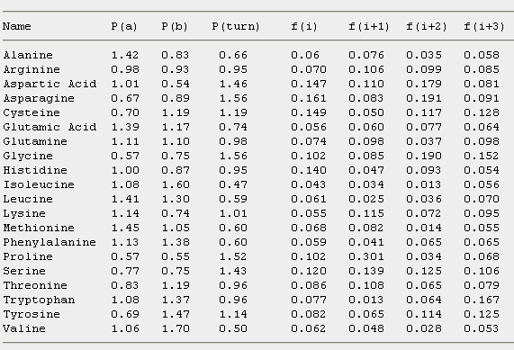
Chou-Fasman parameters
Note: The parameters given in the textbook are 100*P_{α}^{i}

Slide 24
Chou-Fasman algorithm
Helix:
  Scan through the peptide and identify regions where 4 out of 6 contiguous residues have P(H) > 1.00. That region is declared an alpha-helix.
  Extend the helix in both directions until a set of four contiguous residues that have an average P(H) < 1.00 is reached. That is declared the end of the helix.
  If the segment defined by this procedure is longer than 5 residues and the average P(H) > P(E) for that segment, the segment can be assigned as a helix.
  Repeat this procedure to locate all of the helical regions in the sequence.

Slide 25
Initiation
Identify regions where 4/6 have a P(H) >1.00 “alpha-helix nucleus”
T
S
P
T
A
E
L
M
R
S
T
G
P(H)
69
77
57
69
142
151
121
145
98
77
69
57
T
S
P
T
A
E
L
M
R
S
T
G
P(H)
69
77
57
69
142
151
121
145
98
77
69
57

Slide 26
Propagation
Extend helix in both directions until a set of four residues have an average P(H) <1.00.
T
S
P
T
A
E
L
M
R
S
T
G
P(H)
69
77
57
69
142
151
121
145
98
77
69
57
If the average P(H) > P(E) for that segment,
the segment can be assigned as a helix.

Slide 27
Chou-Fasman algorithm
B-strand:
  Scan through the peptide and identify a region where 3 out of 5 of the residues have a value of P(E)>1.00. That region is declared as a beta-sheet.
  Extend the sheet in both directions until a set of four contiguous residues that have an average P(E) < 1.00 is reached. That is declared the end of the beta-sheet.
  Any segment of the region located by this procedure is assigned as a beta-sheet if the average P(E)>1.05 and the average P(E)>P(H) for that region.
  Any region containing overlapping alpha-helical and beta-sheet assignments are taken to be helical if the average P(H) > P(E) for that region. It is a beta sheet if the average P(E) > P(H) for that region.

Slide 28
Chou-Fasman algorithm
Beta-turn
  To identify a bend at residue number j, calculate the following value
  p(t) = f(j)f(j+1)f(j+2)f(j+3)
  If
    (1) p(t) > 0.000075,
    (2) the average value for P(turn) > 1.00 in the tetrapeptide and
    (3) the averages for the tetrapeptide obey the inequality
    P(H) < P(turn) > P(E),
  then a beta-turn is predicted at that location.

Slide 29
Exercise
Predict the secondary structure of the following protein sequence:
Ala Pro Ala Phe Ser Val Ser Leu Ala Ser Gly Ala
142 57 142 113 77 106 77 121 142 77 57 142
83 55 83 138 75 170 75 130 83 75 75 83
66 152 66 60 143 50 143 59 66 143 156 66

Slide 30
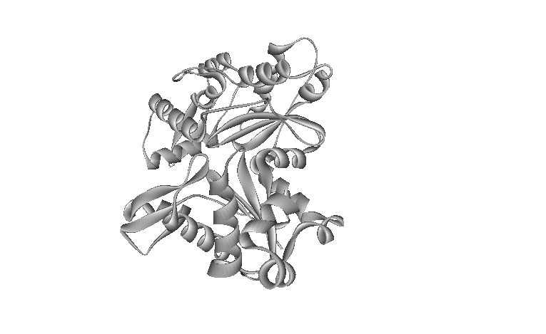
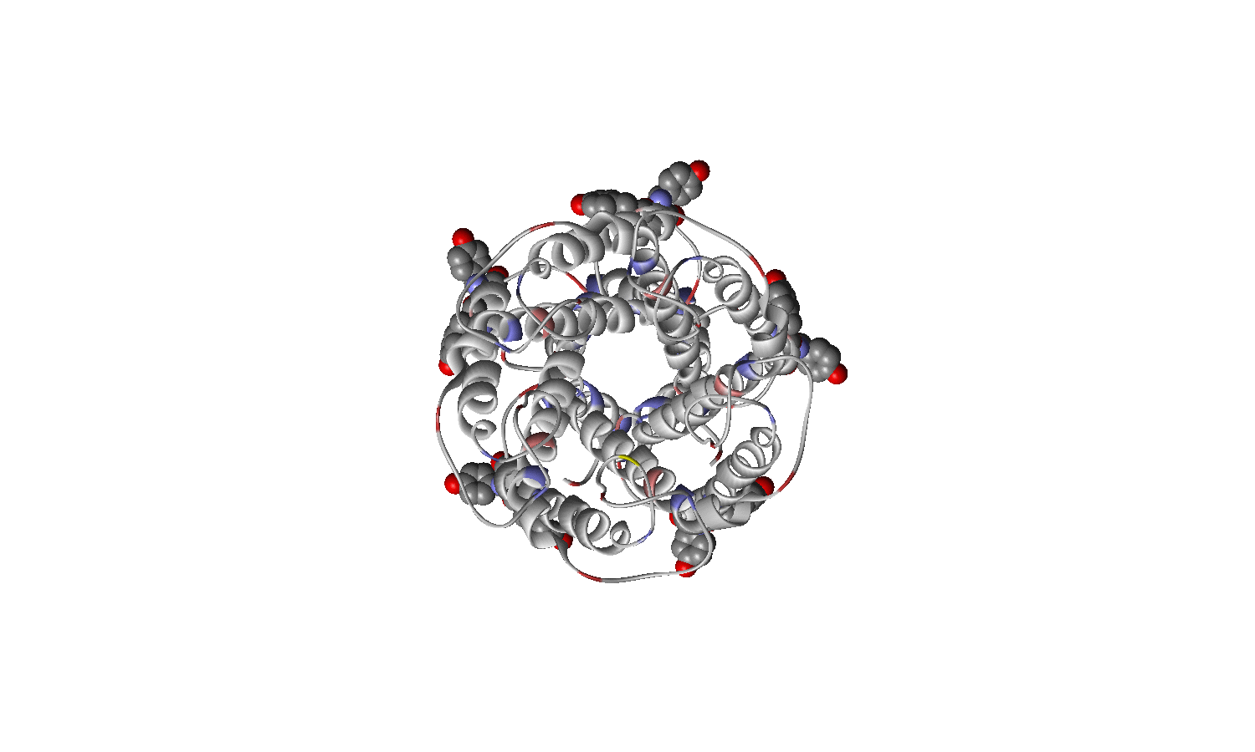
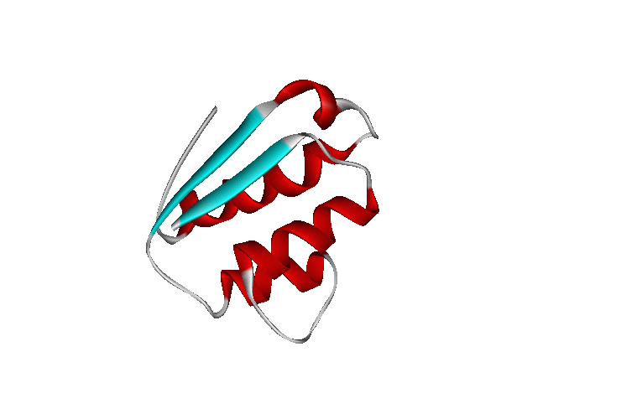
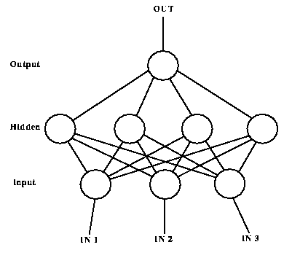
Neural network training
Compare Prediction to Reality
Adjust Weights
Enter sequences

Slide 31
Neural net for secondary structure
D (L)
R (E)
Q (E)
A
C
G (E)
D
E
F
F (E)
G
H
H
V (E)
I
K
L
P (E)
E
M
N
P
A (H)
Q
L
R
S
A (H)
T
V
Y (H)
W
Y
.
V (E)
K (E)
K (E)

Slide 32
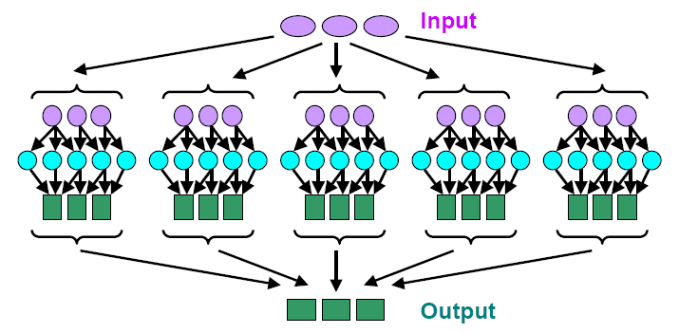
Neural net for SS Prediction
Jury decisions
  Use multiple neural networks & combine results
    Average output
    Majority decision

Slide 33
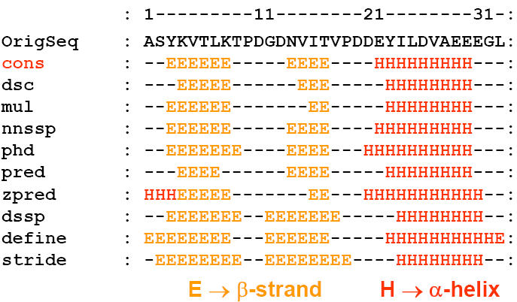
Neural net for SS Prediction
JPRED [Cuff+ 1998]
  Finds consensus from PHD, PREDATOR, DSC, NNSSP, etc…

