Slide 1
Protein motifs and
Prosite

Slide 2
Turning information into knowledge
The outcome of a sequencing project is masses of raw data
The challenge is to turn this raw data into biological knowledge
A valuable tool for this challenge is an automated diagnostic pipe through which newly determined sequences can be streamlined

Slide 3
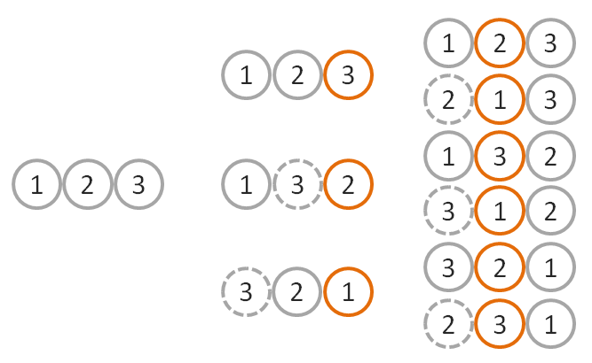
From sequence to function
Nature tends to innovate rather than invent
Proteins are composed of functional elements: domains and motifs
  Domains are structural units that carry out a certain function
  The same domains are
  shared between different
  proteins
  Motifs are shorter
  sequences with certain
  biological activity

Slide 4
What is a motif?
A sequence motif = a certain sequence that is widespread and conjectured to have biological significance
Examples:
KDEL – ER-lumen retention signal
PKKKRKV – an NLS (nuclear localization signal)

Slide 5
More loosely defined motifs
KDEL (usually)
+
HDEL (rarely)
=
[HK]-D-E-L:
H or K at the first position
This is called a pattern (in Biology), or a regular expression (in computer science)

Slide 6
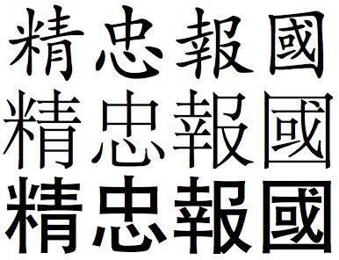
Syntax of a pattern
Example:
W-x(9,11)-[FYV]-[FYW]-x(6,7)-[GSTNE]

Slide 7
Patterns
W-x(9,11)-[FYV]-[FYW]-x(6,7)-[GSTNE]
Any amino-acid, between 9-11 times
F or Y or V
✓
✗
✗
WOPLASDFGYVWPPPLAWS
ROPLASDFGYVWPPPLAWS
WOPLASDFGYVWPPPLSQQQ

Slide 8
Patterns - syntax
The standard IUPAC one-letter codes.
‘x’ : any amino acid.
‘[]’ : residues allowed at the position.
‘{}’ : residues forbidden at the position.
‘()’ : repetition of a pattern element are indicated in parenthesis. X(n) or X(n,m) to indicate the number or range of repetition.
‘-’ : separates each pattern element.
‘‹’ : indicated a N-terminal restriction of the pattern.
‘›’ : indicated a C-terminal restriction of the pattern.
‘.’ : the period ends the pattern.

Slide 9
Profile-pattern-consensus
consensus
G | T | T | C | A | A
N | N | T | N | A | N
multiple alignment
pattern
G | T | T | C | A | A
G | C | T | G | A | A
C | T | T | C | A | C
[AC]-A-[GC]-T-[TC]-[GC]
profile
5 | 4 | 3 | 2 | 1
. | 0 | 0 | 1 | 0.66 | A
. | 1 | 0 | 0 | 0 | T
. | 0 | 0.66 | 0 | 0.33 | C
. | 0 | 0.33 | 0 | 0 | G

Slide 10
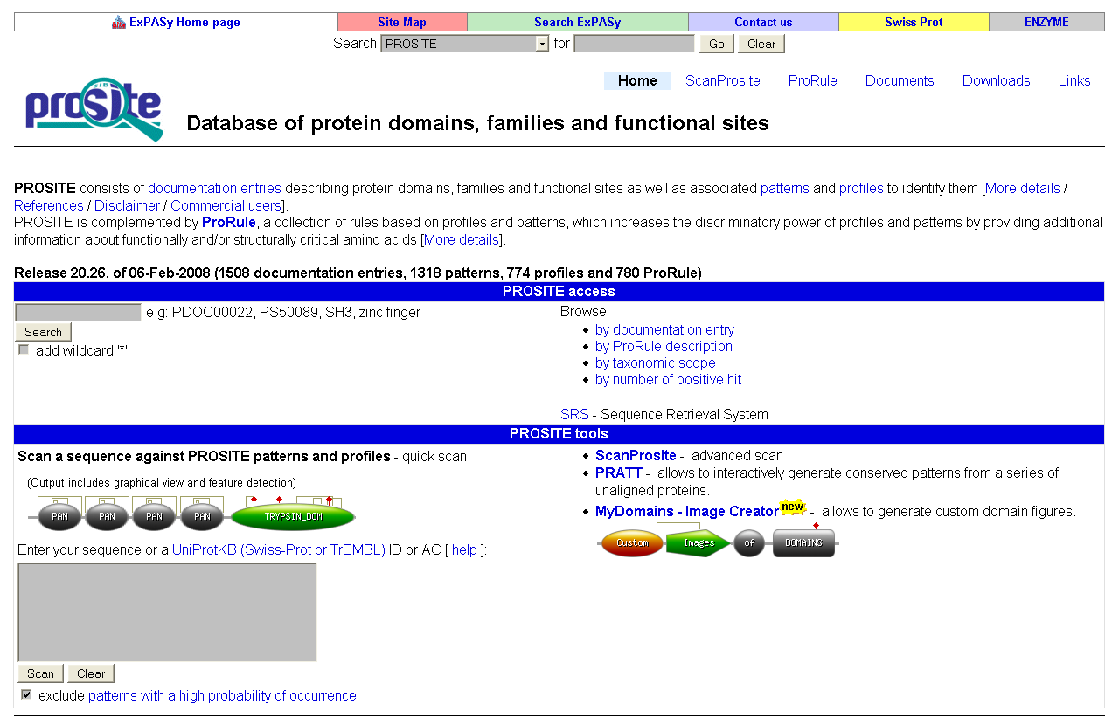
http://www.expasy.ch/prosite/

Slide 11
Prosite
A method for determining the function of uncharacterized translated protein sequences
Database of annotated protein families and functional sites as well as associated patterns and profiles to identify them

Slide 12
Prosite
Entries are represented with patterns or profiles
profile
5 | 4 | 3 | 2 | 1
. | 0 | 0 | 1 | 0.66 | A
. | 1 | 0 | 0 | 0 | T
. | 0 | 0.66 | 0 | 0.33 | C
. | 0 | 0.33 | 0 | 0 | G
pattern
[AC]-A-[GC]-T-[TC]-[GC]
Profiles are used in Prosite when the motif is relatively divergent and it is difficult to represent as a pattern

Slide 13
Scanning Prosite
Query: sequence
Query: pattern
Result: all patterns found in sequence
Result: all sequences which adhere to this pattern

Slide 14
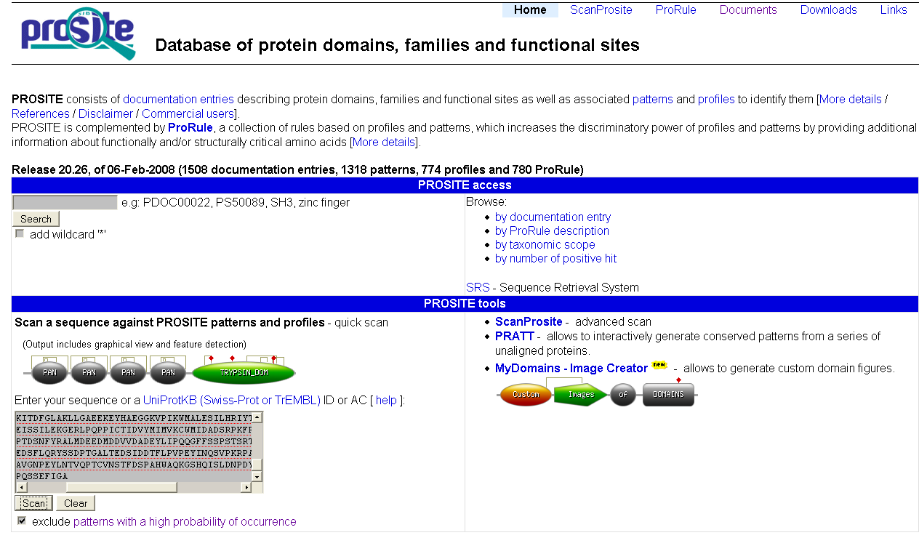
prosite sequence query

Slide 15
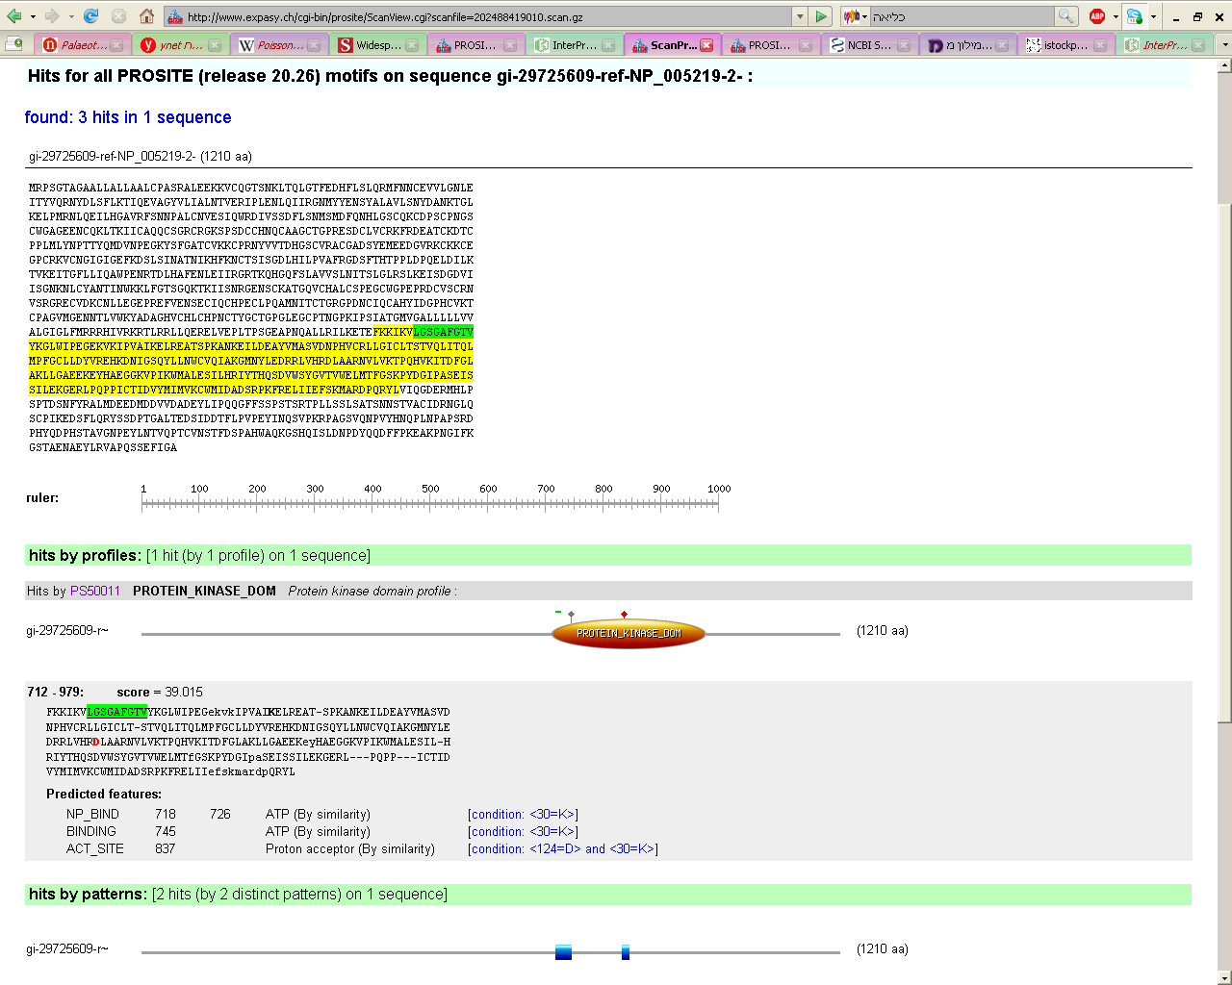
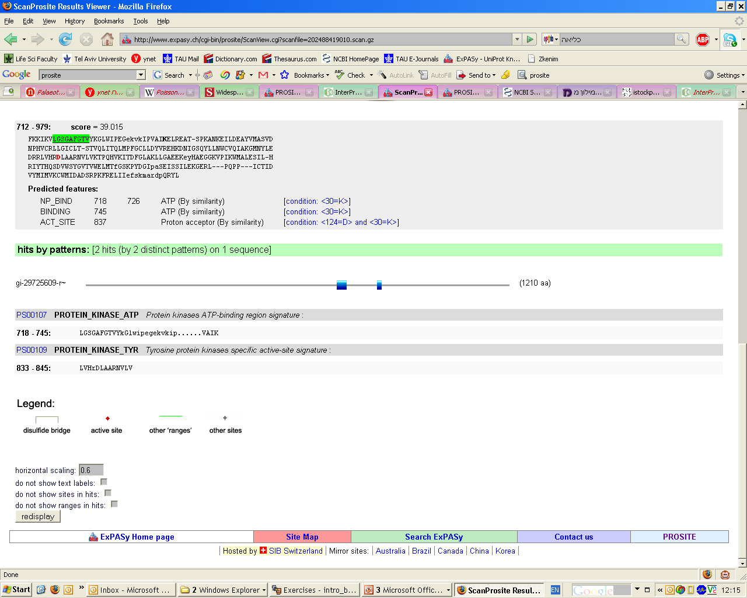

Slide 16
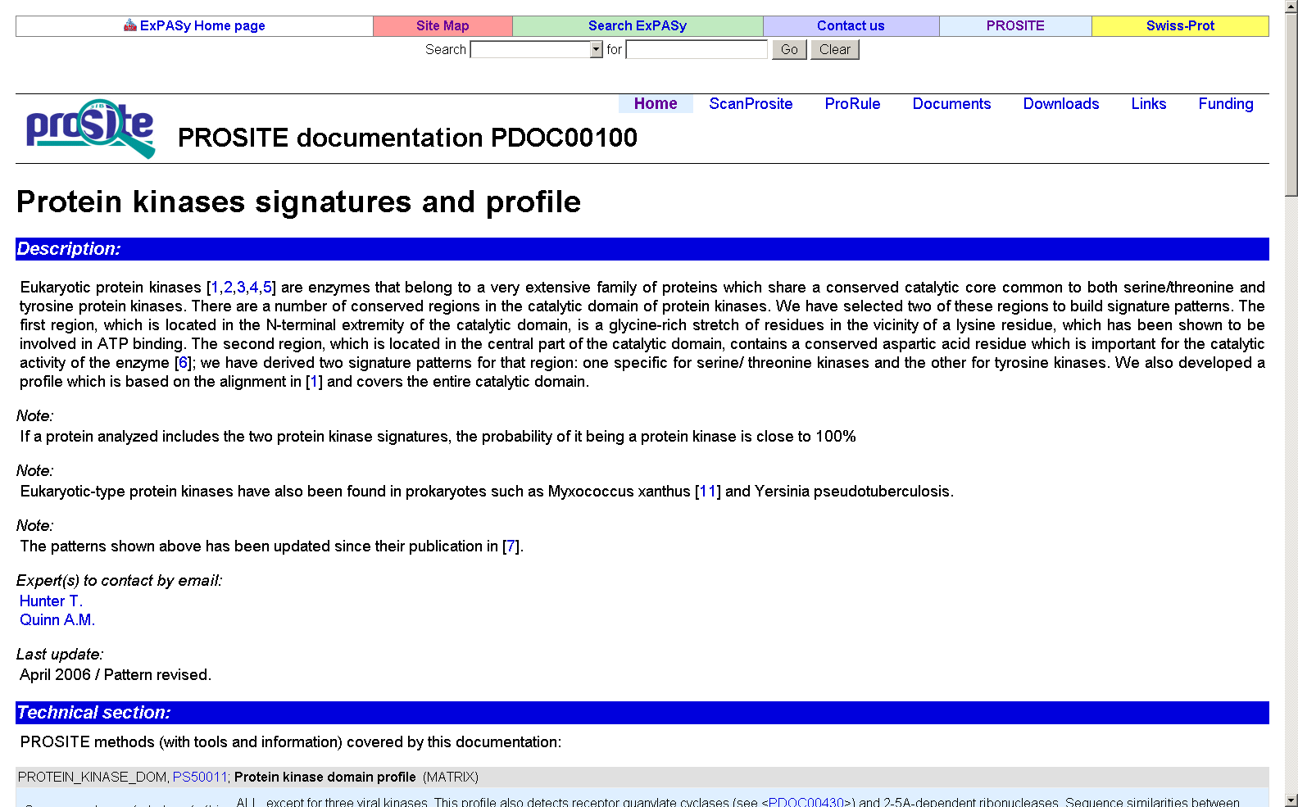
Prosite profile

Slide 17
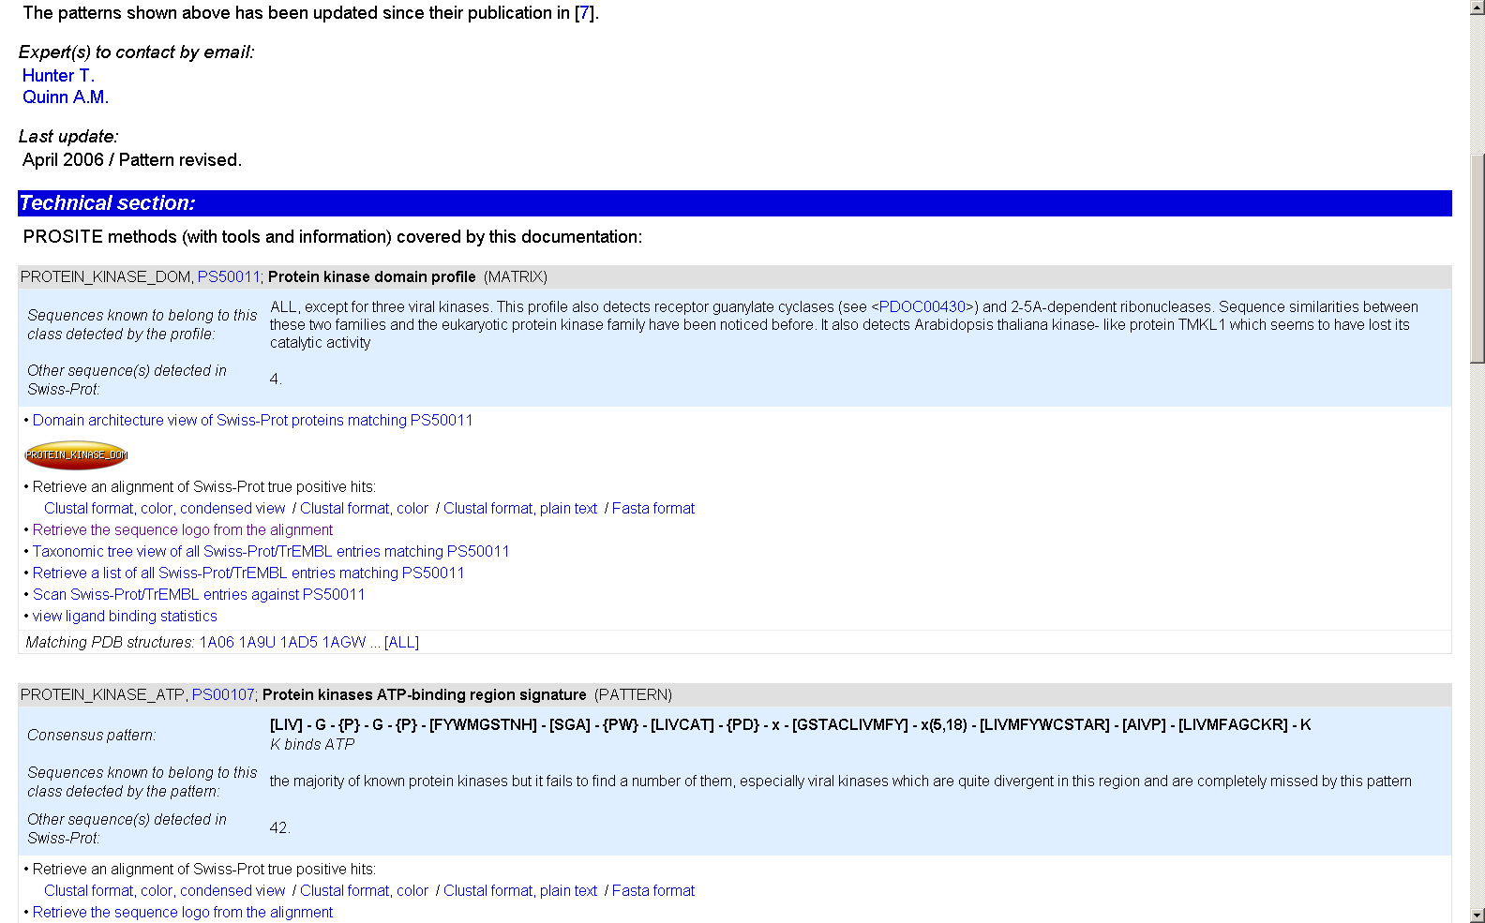
Prosite profile → sequence logo

Slide 18
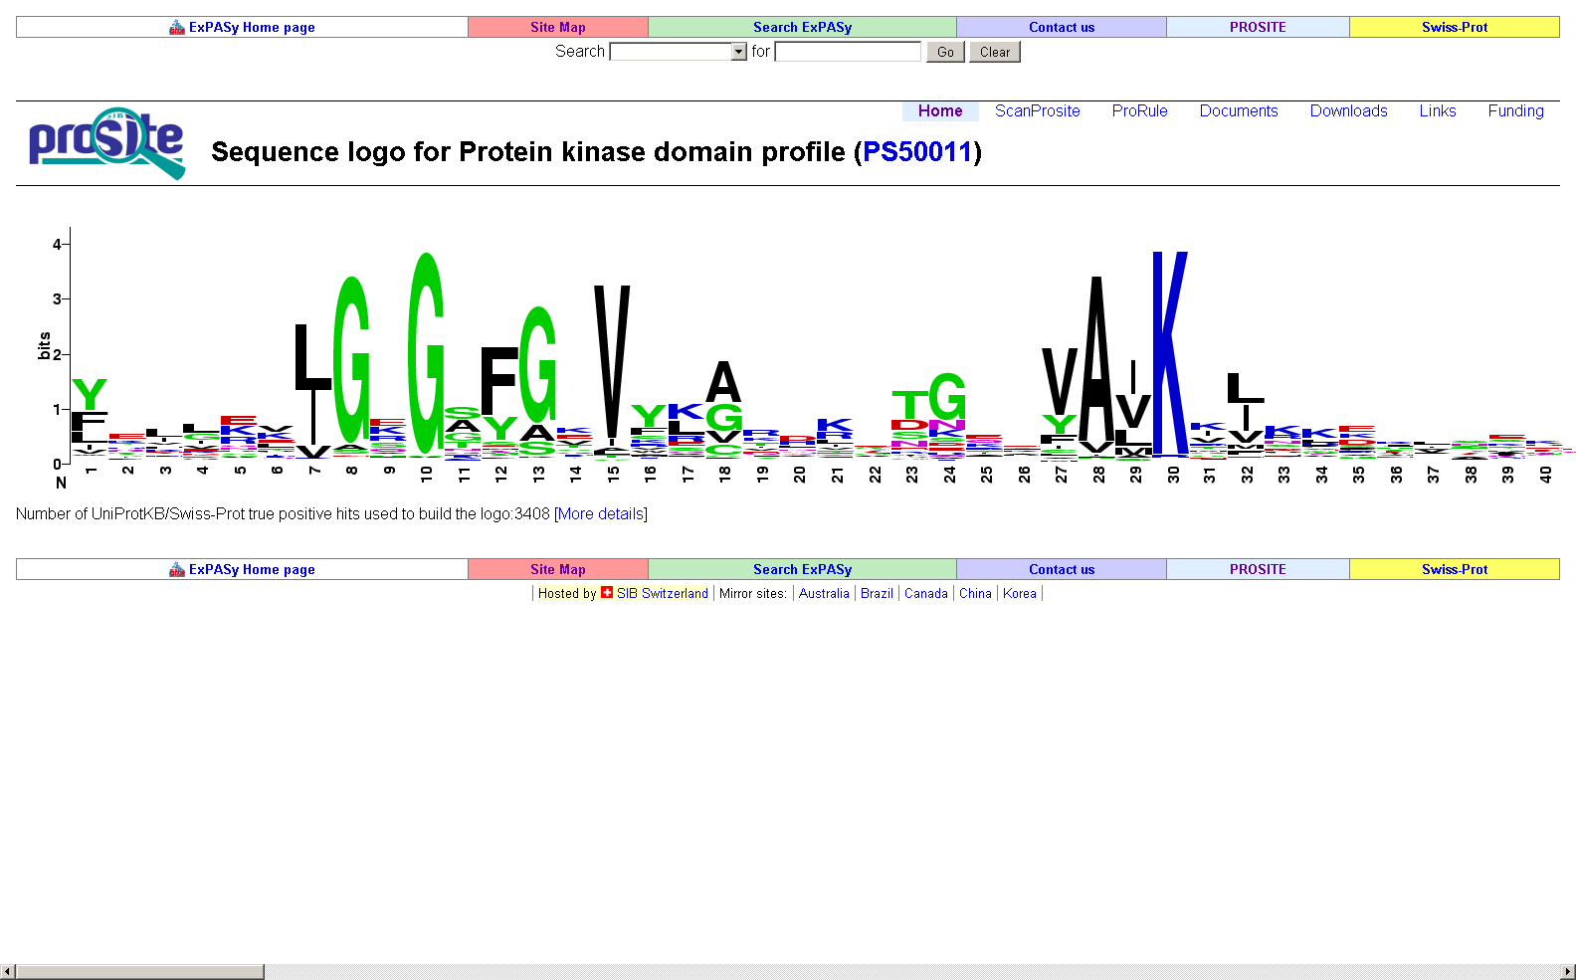
Sequence logo

Slide 19
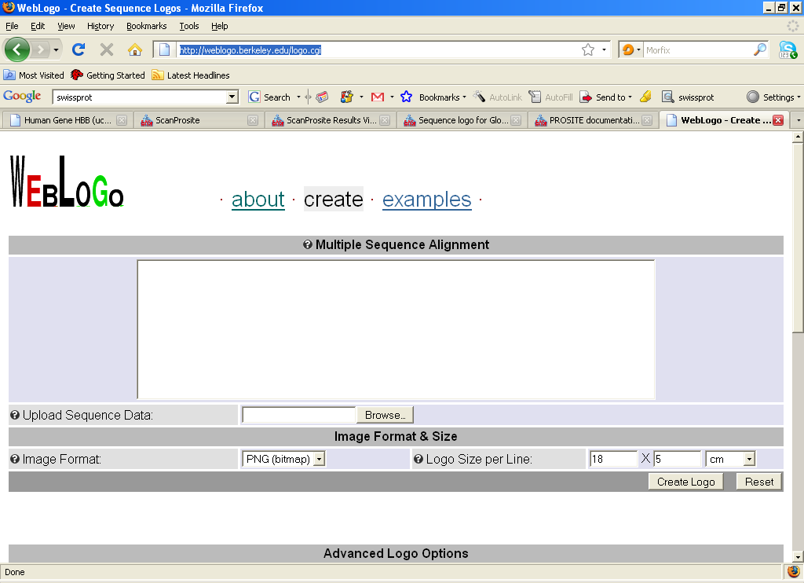
WebLogo
http://weblogo.berkeley.edu/logo.cgi

Slide 20
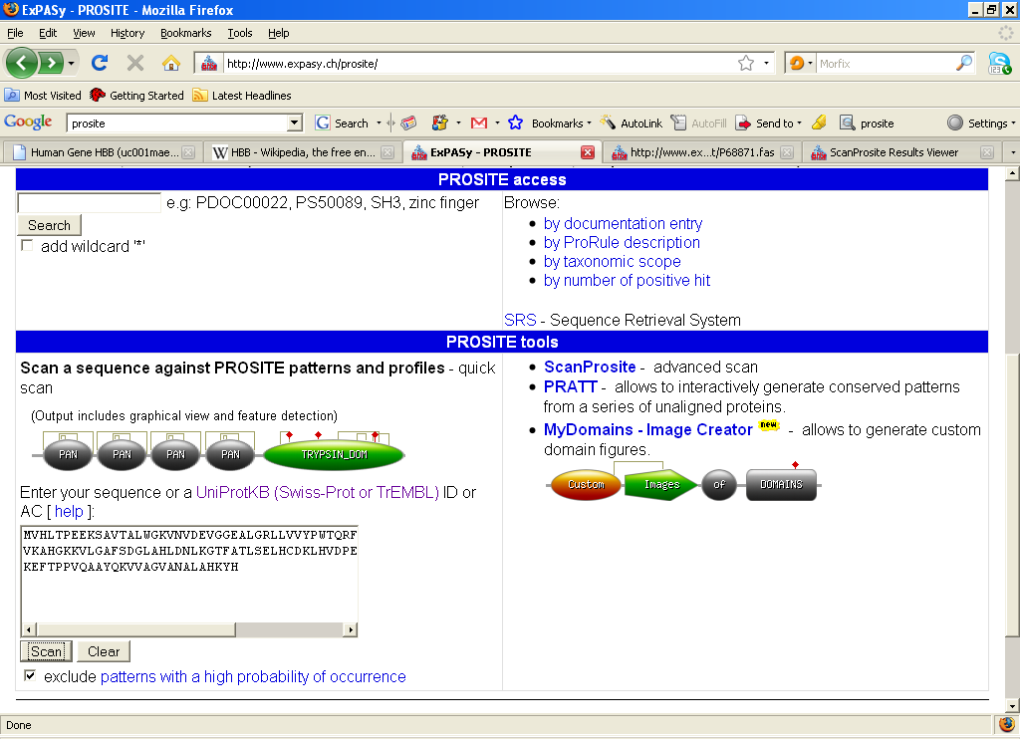
Searching Prosite with a sequence

Slide 21
Patterns with a high probability of occurrence
Entries describing commonly found post-translational modifications or compositionally biased regions.
Found in the majority of known protein sequences
High probability of occurrence

Slide 22
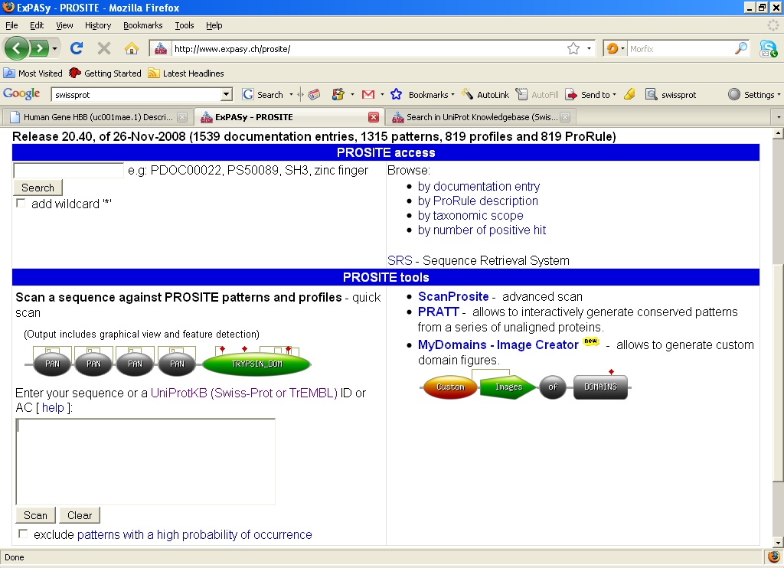
Searching Prosite with a pattern

Slide 23
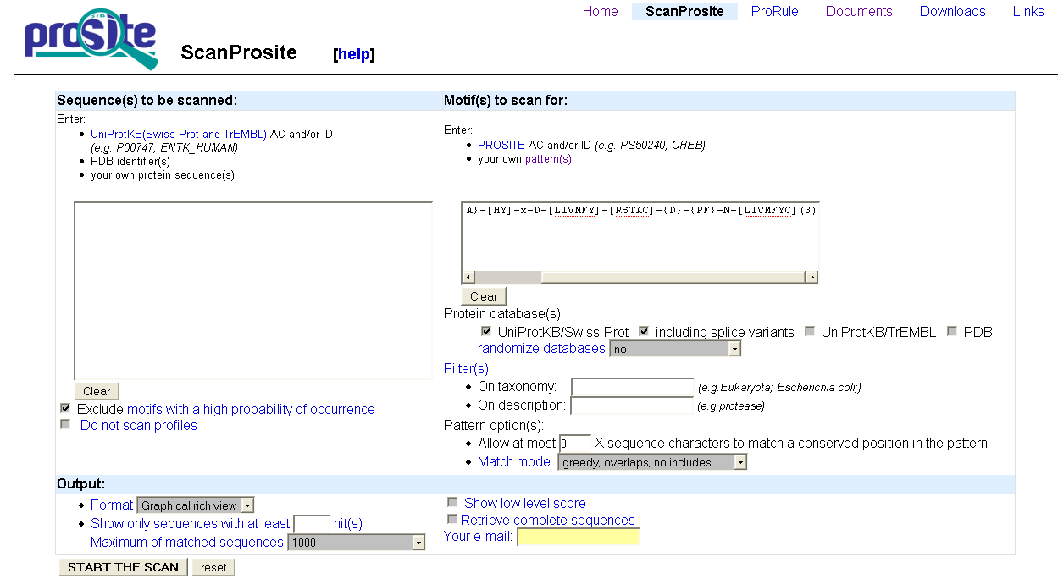
prosite pattern query

Slide 24
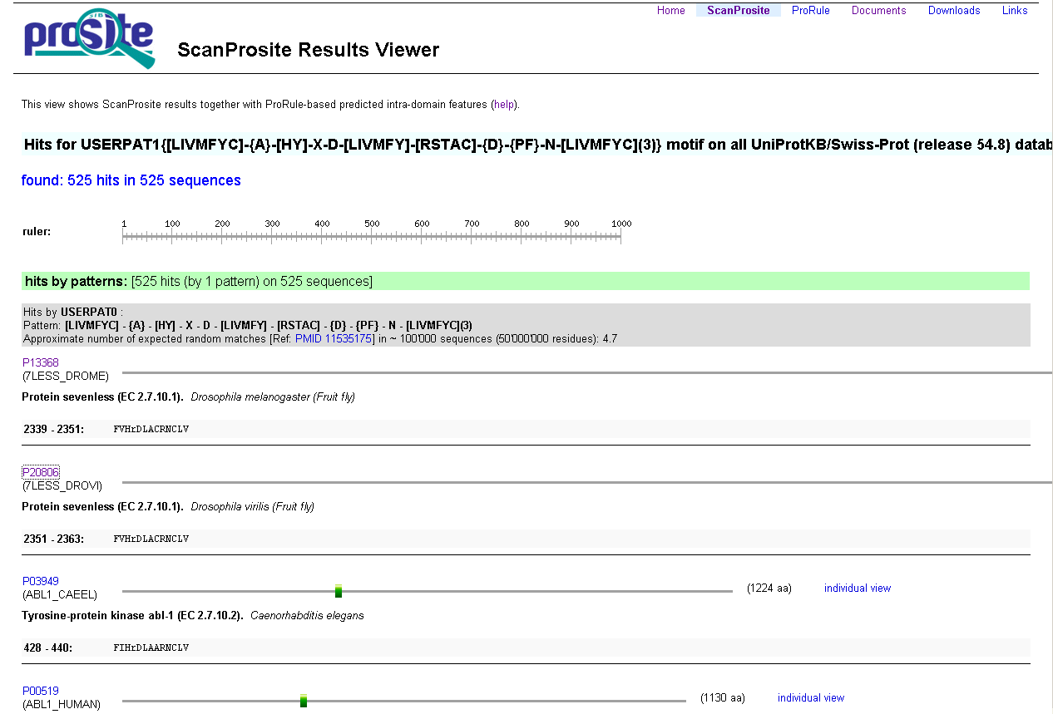

Slide 25
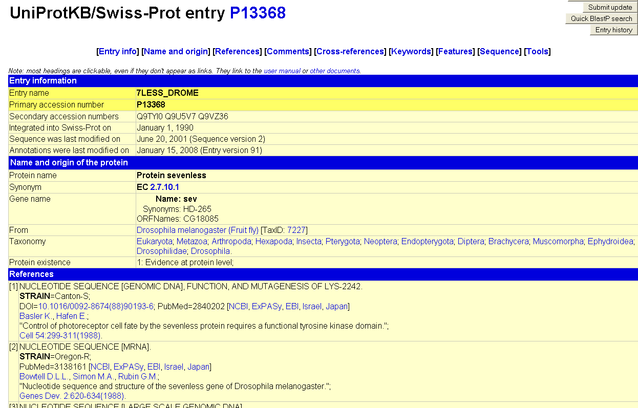

Slide 26
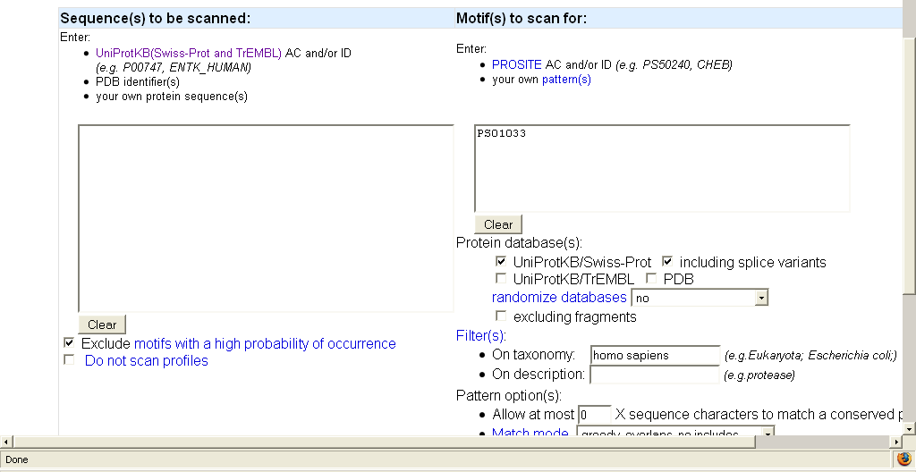
Searching Prosite with a Prosite AC

