Slide 1
Ab Initio Methods for Protein Structure Prediction

Slide 2
Motivation
homology modeling
  No knowledge about the physical nature of the protein folding and stability.
ab-initio methods can
  augment fold-recognition and homology (refinement, large loops, side chains).
it can ease experimental structure determination.
It can find new folds

Slide 3
Ab Initio Methods
Ab initio: “From the beginning”.
Assumption
  All the information about the structure of a protein is contained in its sequence of amino acids.
  The structure that a (globular) protein folds into is the structure with the lowest free energy.
  The native structure is contained in the search space
Finding native-like conformations require
  A scoring function (potential).
  A search strategy.

Slide 4
ab-initio protein structure prediction
Optimization problem
  Define some initial model.
  Define a function mapping structures to numerical values (the lower the better).
  Solve the computational problem of finding the global minimum.
Simulation of the actual folding process
  Build an accurate initial model (including energy and forces).
  Accurately simulate the dynamics of the system.
  The native structure will emerge.
  No hope due to large search space

Slide 5
Energy Minimization (Theory)
Treat Protein molecule as a set of balls (with mass) connected by rigid rods and springs
Rods and springs have empirically determined force constants
Allows one to treat atomic-scale motions in proteins as classical physics problems

Slide 6
Standard Energy Function
E =
K_{r}(r_{i} - r_{j})² +
K_{θ}(θ_{i} - θ_{j})² +
K_{φ}(1−cos(nφ_{j}))² +
q_{i}q_{j}/4πεr_{ij} +
A_{ij}/r⁶ - B_{ij}/r¹² +
C_{ij}/r¹⁰ - D_{ij}/r¹²
Bond length
Bond bending
Bond torsion
Coulomb
van der Waals
H-bond

Slide 7
Energy Terms
r
θ
φ
K_{r}(r_{i} - r_{j})²
K_{θ}(θ_{i} - θ_{j})²
K_{φ}(1−cos(nφ_{j}))²
Stretching Bending Torsional

Slide 8
Energy Terms
r
r
r
q_{i}q_{j}/4πεr_{ij}
A_{ij}/r⁶ - B_{ij}/r¹²
C_{ij}/r¹⁰ - D_{ij}/r¹²
Coulomb van der Waals H-bond

Slide 9
Reduced complexity models
No side chains
  sometimes no main chain atoms either
  Or represent the side chain with C_{β}
Reduced degrees of freedom
On-or off-lattice
Generally have an environment -based score and a knowledge-based residue-residue interaction term
Sometimes used as first step to prune the enormous conformational space, then resolution is increased for later fine-tuning

Slide 10
Basic element
electrons & protons
AMBR ECEP
CHARM OPLS
ENCAD GROMOS
atom
extended atom
Baker
(Rosetta)
Levitt,
Keasar
Levitt
1976
Scheraga
1998
half a residue
Skolnik
1998
Jones
Park &
Levitt
Osguthorpe
residue
Skolnik
2000
Some residues
Hinds &
Levitt
diamond
lattice
torsion angle lattice
fine square lattice
fragments
continuous

Slide 11
A Simple 2D Lattice
3.5Å

Slide 12
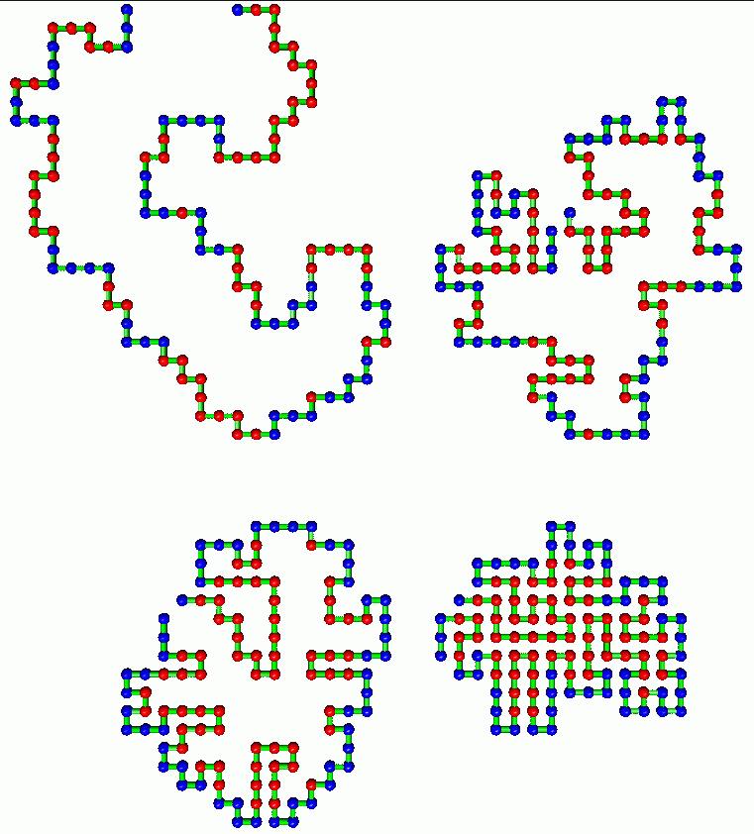
Lattice Folding

Slide 13
Lattice Algorithm
Build a “n x m” matrix (a 2D array)
Choose an arbitrary point as your N terminal residue (start residue)
Add or subtract “1” from the x or y position of the start residue
Check to see if the new point (residue) is off the lattice or is already occupied
Evaluate the energy
Go to step 3) and repeat until done

Slide 14
Lattice Energy Algorithm
Red = hydrophobic, Blue = hydrophilic
If Red is near empty space E = E+1
If Blue is near empty space E = E-1
If Red is near another Red E = E-1
If Blue is near another Blue E = E+0
If Blue is near Red E = E+0

Slide 15
More Complex Lattices

Slide 16
3D Lattices

Slide 17
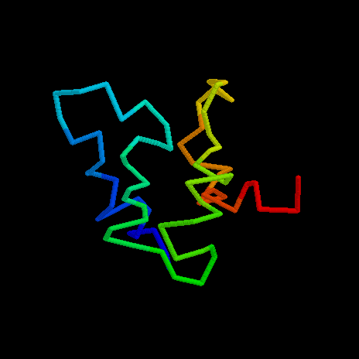
Really Complex 3D Lattices
J. Skolnick

Slide 18
Lattice Methods
Advantages
Disadvantages
Easiest and quickest way to build a polypeptide
More complex lattices allow reasonably accurate representation
At best, only an approximation to the real thing
Does not allow accurate constructs
Complex lattices are as “costly” as the real thing

Slide 19
Non-Lattice Models
3.5 Å
H
Res_{i}
R
C
H
1.53 Å
1.00 Å
1.32 Å
C
N
1.47 Å
1.24 Å
O
C
Res_{i+1}
H
R

Slide 20
Simplified Chain Representation
4
θ
3
φ
2
1
Spherical Coordinates

Slide 21
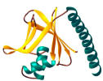

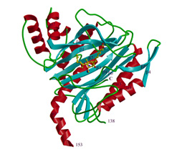
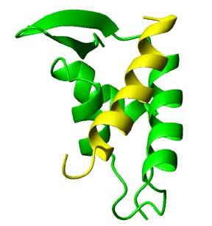
Assembly of sub-structural units
known
structures
fragment
library
protein
sequence
predicted
structure
…

Slide 22
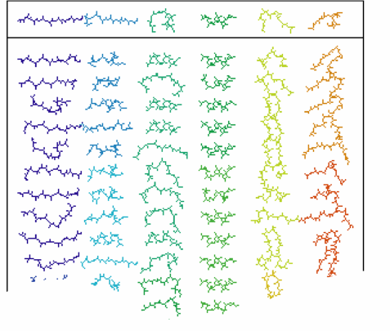
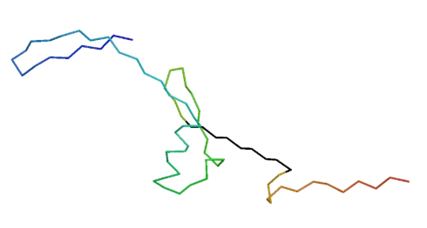
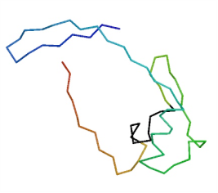
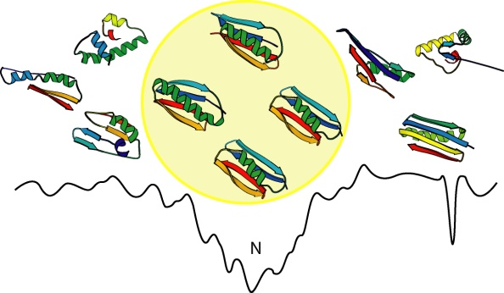
Structure Prediction with Rosetta
Select fragments consistent with local sequence preferences
Assemble fragments into models with native-like global properties
Identify the best model from the population of decoys

Slide 23
Modelling
Protein sequence
Model each candidate local structure as a node

Slide 24
Modelling
Protein sequence
Model each candidate local structure as a node
If two consecutive local structure are compatible, an edge joins them

Slide 25
Modelling
Protein sequence
Model each candidate local structure as a node
If two consecutive local structure are compatible, an edge joins them
Add a source s and sink t to the graph

Slide 26
Modelling
Protein sequence
Each path from s to t forms a candidate structure
  At least one of the s-t paths is native-like structure
  A good search strategy should pick up this path with less time consuming
  A good model should reduce the search space

Slide 27

Build the Fragment Library-Rosetta
Extract possible local structures from PDB

Slide 28
Generate the Fragment Library
Select PDB template
  Select Sequence Families
  Each Family has a single known structure (family)
  Has no more than 25% sequence identity between any two sequence
Clustering the fragments
  Generate all the fragments from the selected families

Slide 29
Find Local Structures
Given a subsequence, a local structure to be identified
  Represent each subsequence with a vector
    V={v₁, v₂, …, v_{k}}
    eg: V as a 20*l matrix, with the (i, j)-th entry represent the frequency of amino acid j occurs at position j
  Represent each substructure with a vector
    V’={v₁’, v₂’, …, v_{k}’ }
    eg: V as a 20*l matrix, with the (i, j)-th entry represent the frequency of amino acid j occurs at position j
  Rank the structure according to:
    ∑_{i}|v_{i}-v_{i}’|
    This implies that the entries of the vectors are independent.

Slide 30
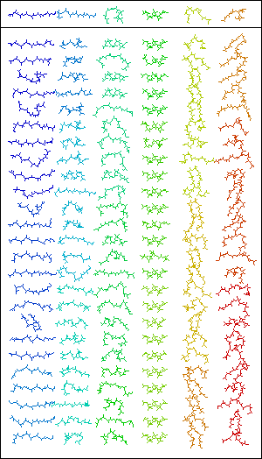
Rosetta Fragment Libraries
25-200 fragments for each 3 and 9 residue sequence window
Selected from database of known structures
    > 2.5Å resolution
    < 50% sequence identity
Ranked by sequence similarity and similarity of predicted and known secondary structure

Slide 31
Search Strategy
Reduce the Search Space
Design Better Search Strategies

Slide 32
Scoring Function
Ideal energy function
  Has a clear minimum in the native structure.
  Has a clear path towards the minimum.
  Global optimization algorithm should find the native structure.

Slide 33
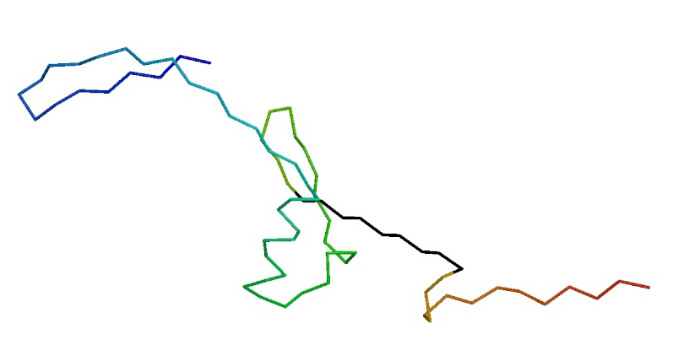
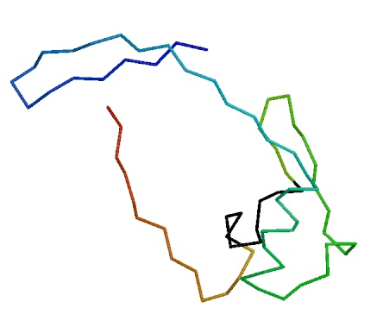
Rosetta Potential Function
Derived from Bayesian treatment of residue distributions in known protein structures
Reduced representation of protein used; one centroid per sidechain
Potential Terms:
    environment (solvation)
    pairwise interactions (electostatics)
    strand pairing
    radius of gyration
    Cβ density
    steric overlap

Slide 34

Decoy Discrimination: Identifying the Best Structure
1000-100,000 short simulations to generate a population of 'decoys'
Filter population to correct systematic biases
Fullatom potential functions to select the deepest energy minimum
Cluster analysis to select the broadest minimum
Structure-structure matches to database of known structures

Slide 35
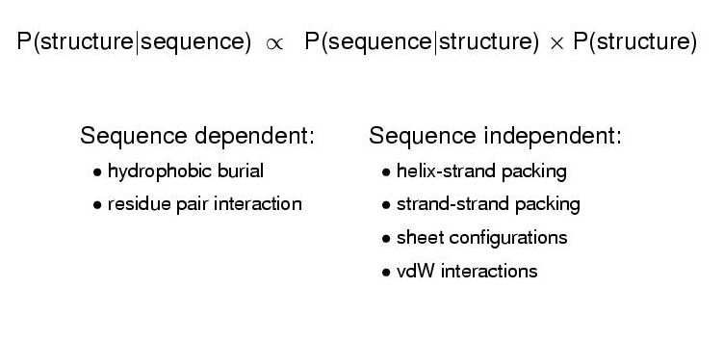
The Rosetta Scoring Function

Slide 36
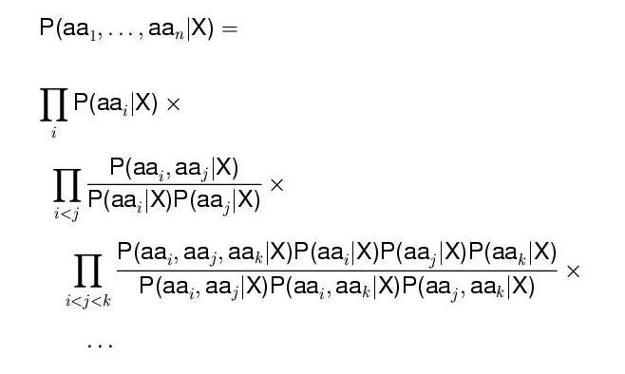
The Sequence Dependent Term

Slide 37
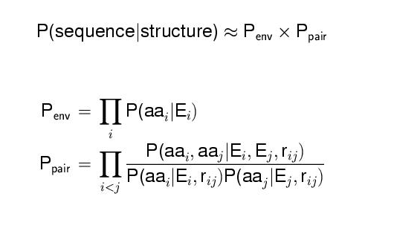
The Sequence Dependent Term

Slide 38
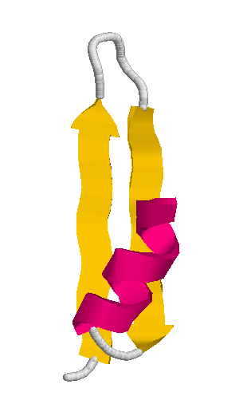
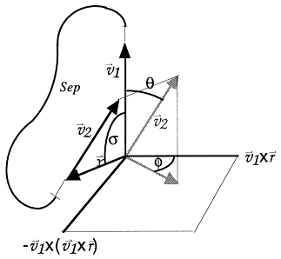
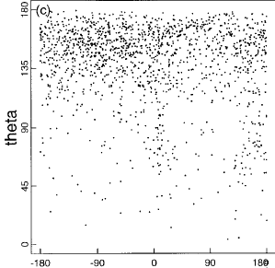
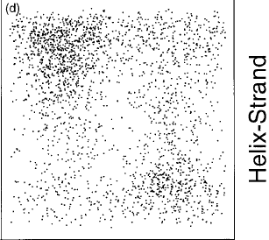

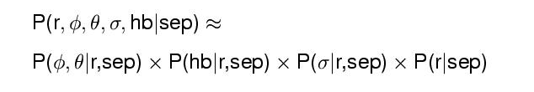
The Sequence Independent Term
vector representation

Slide 39
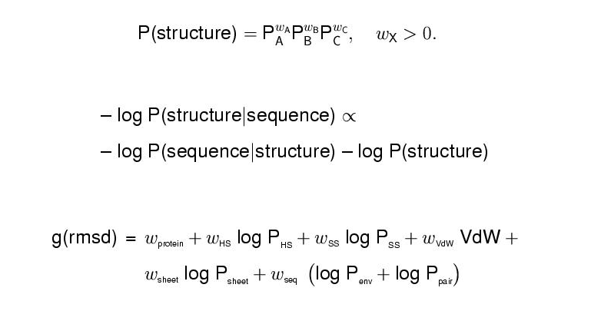
The Model

Slide 40
Search Strategy
Requirement
  Identify the native structure easily
    Filter out those non-native ones
  Eliminate the non-native candidates as early as possible
  Jumping out from the local minimum
  No repetitions
  …
Search Strategies
  Taboo search, simulated annealing, genetic algorithms, multi-agent, …

Slide 41
ROSETTA search algorithm
Monte Carlo/Simulated Annealing
Structures are assembled from fragments by:
  Begin with a fully extended chain
  Randomly replace the conformation of one 9 residue segment with the conformation of one of its neighbors in the library
  Evaluate the move: Accept or reject based on an energy function
  Make another random move, tabu list is built to forbidden some local minimums
  After a prescribed number of cycles, switch to 3-residue fragment moves

Slide 42
A Filter for Bad β-Sheets
Many decoys do not have proper sheets. Filtering those out seems to enhance the rmsd distribution in the decoy set. Bad features we see in decoys include:
  No strands,
  Single strands,
  Too many neighbors,
  Single strand in sheets,
  Bad dot-product,
  False sheet type (barrel),

Slide 43
ROSETTA Obstacles & Enhancements
generate lots of unrealistic decoys
  Filter based on contact order
  quality of β-sheets
  poor packing
large search space
  Bias fragment picking by predicted secondary structure, faster computational algorithms
low confidence in the result
  – Fold many homologs of the target, cluster the answers, report the cluster with highest occupancy

Slide 44
Our Works
Build Fragment Libraries (on the way)
  More comprehensive library
  Better method to pick up local structures
More accurate energy functions to identify native structures (on the way, joint work with Xin, Gao, and Dongbo, Bu)
  Systematic ways to build a promising energy function
Better search strategies
  Just have some initial ideas.

