Slide 1
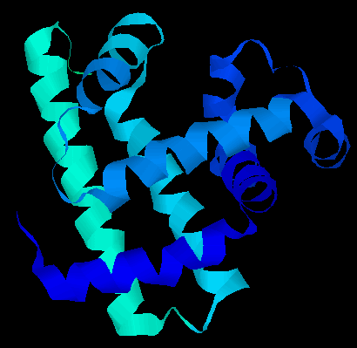
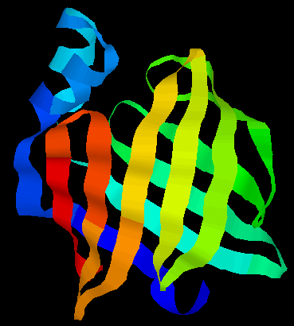
Protein Structures
Primary sequence
Secondary structures
Tertiary structures
MTYKLILNGKTKGETTTEAVDAATAEKVFQYANDNGVDGEWTYTE
helices
strands
loops
Three dimensional packing of secondary structures

Slide 2
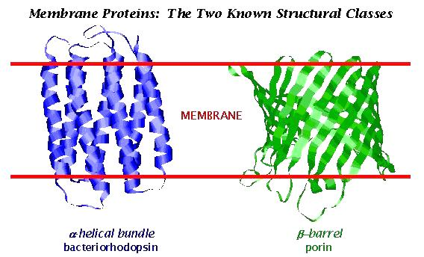
Protein Structures
Protein structures
  generally compact
Soluble structures
  individual domains are generally globular
  they share various common characteristics, e.g. hydrophobic moment profile
Membrane proteins
most of the amino acid sidechains of transmembrane segments must be non-polar
polar groups of the polypeptide backbone of transmembrane segments must participate in hydrogen bonds

Slide 3
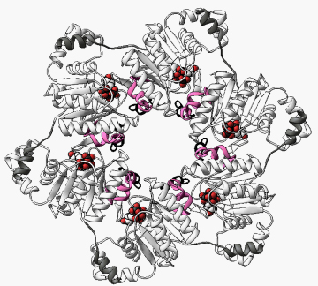
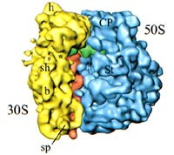
Protein Structure Determination
High-resolution structure determination
  X-ray crystallography (~1A)
  Nuclear magnetic resonance (NMR) (~1-2.5A)
Lower-resolution structure determination
  Cryo-EM (electron-microscropy) ~10-15A

Slide 4
Protein Structure Determination
X-ray crystallography
  most accurate
  in vitro
  need crystals proteins
  > ~100K per structure
NMR
  Fairly accurate
  in vivo
  No need for crystals
  Limited to small proteins
Cryo-EM
  Imaging technology
  Low-resolution

Slide 5
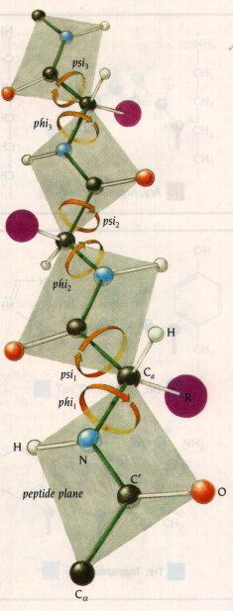
Protein Structure Determination
in theory, a protein structure can solved computationally
a protein folds into a 3D structure to minimizes its free potential energy
the problem can be formulated as a search problem for minimum energy
  the search space is defined by psi/phi angles of backbone and side-chain rotamers
  the search space is enormous even for small proteins!
  the number of local minima increases exponentially of the number of residues
Computationally it is an exceedingly difficult problem

Slide 6
Computational Methods for Protein Structure Prediction
An energy function to describe the protein
  bond energy
  bond angle energy
  dihedral angle energy
  van der Waals energy
  electrostatic energy
Calculating the structure through minimizing the energy function
Not practical in general
  Computationally very expensive
  Accuracy is poor
providing both folding pathway and folded structure

Slide 7
Computational Methods for Protein Structure Prediction
Comparative modeling
  Protein threading – make structure prediction through identification of “good” sequence-structure fit
  Homology modeling – identification of homologous proteins through sequence alignment; structure prediction through placing residues into “corresponding” positions of homologous structure models
providing folded structure only

Slide 8
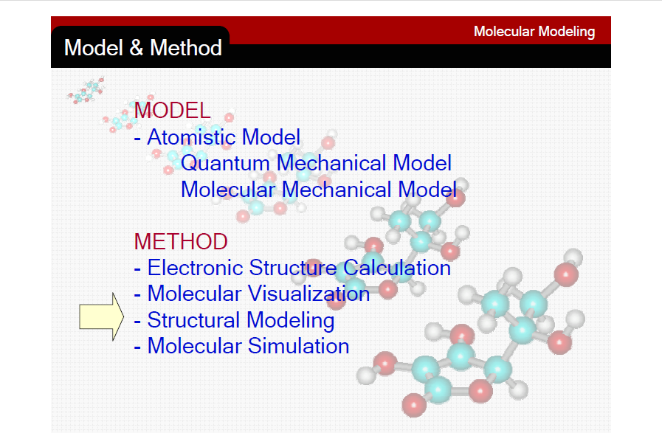

Slide 9
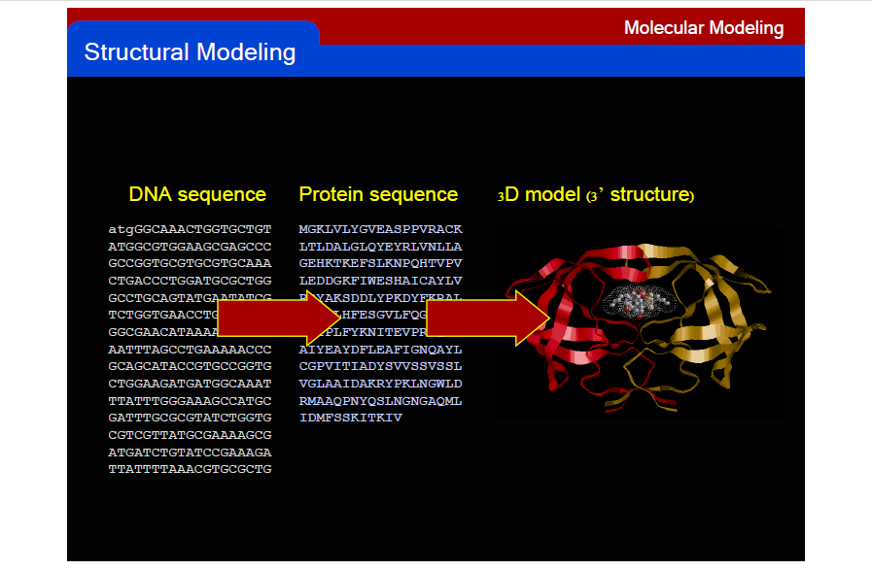

Slide 10
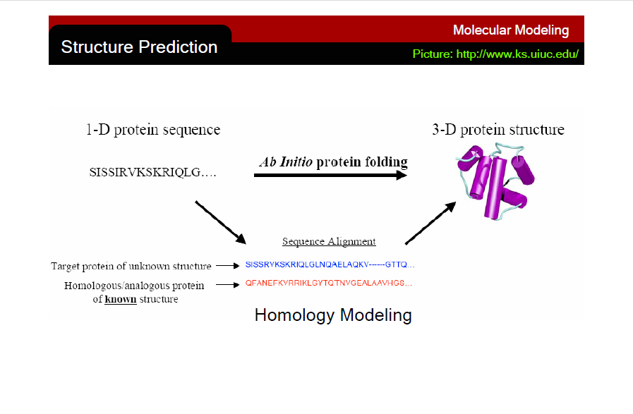

Slide 11
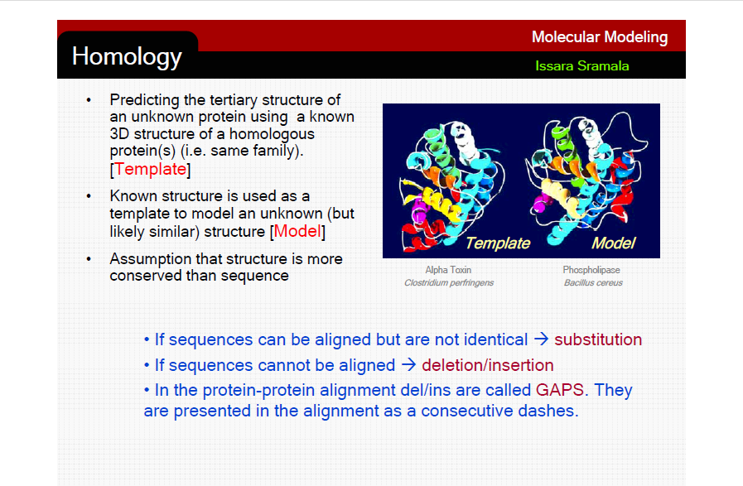

Slide 12
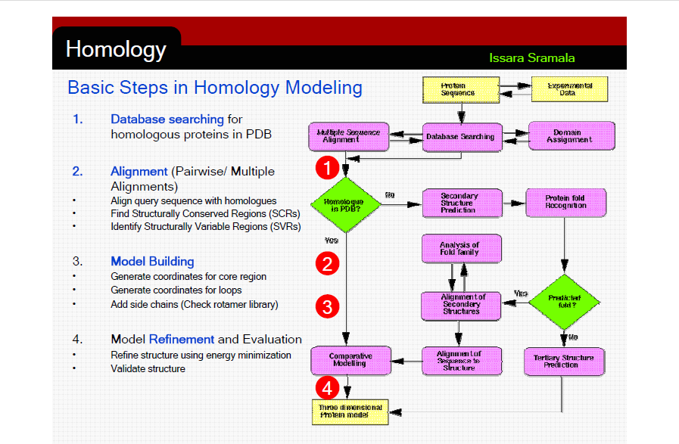

Slide 13
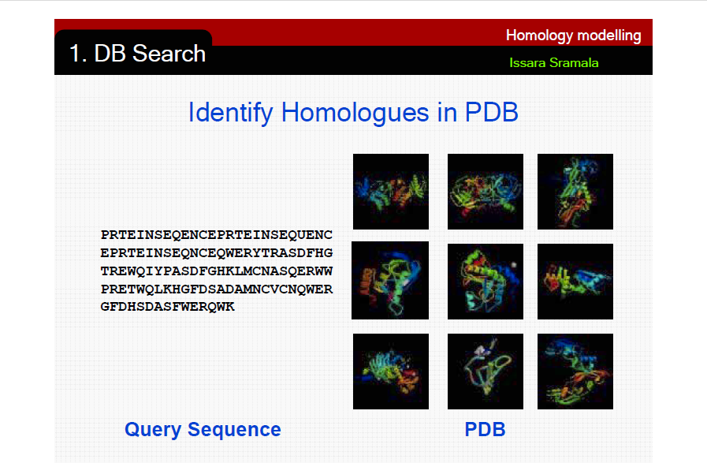

Slide 14
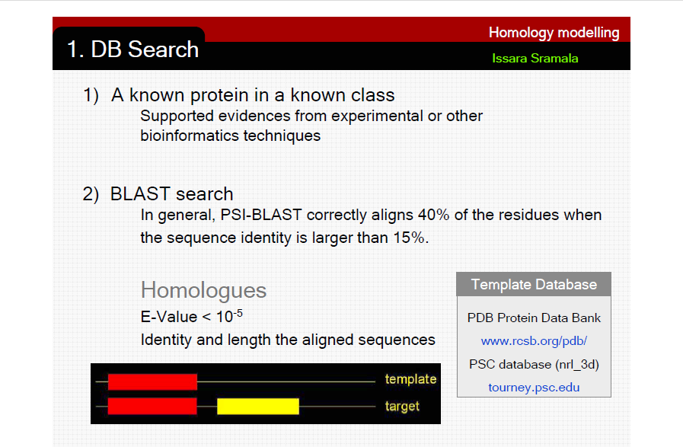

Slide 15
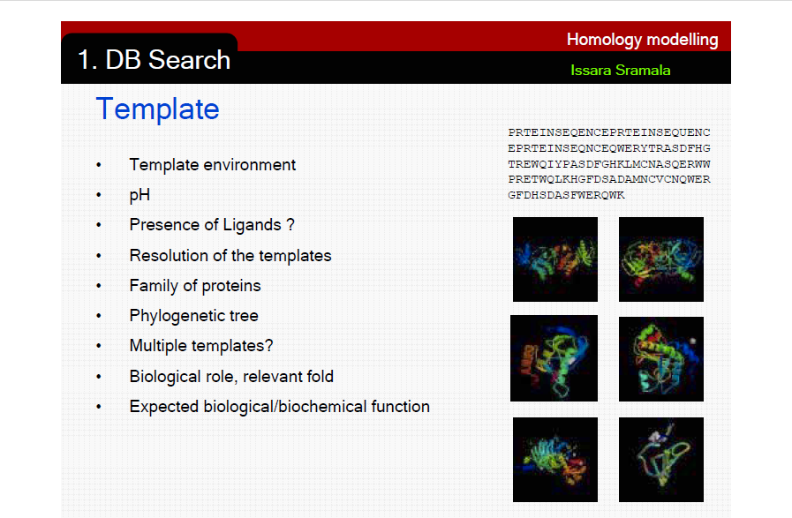

Slide 16
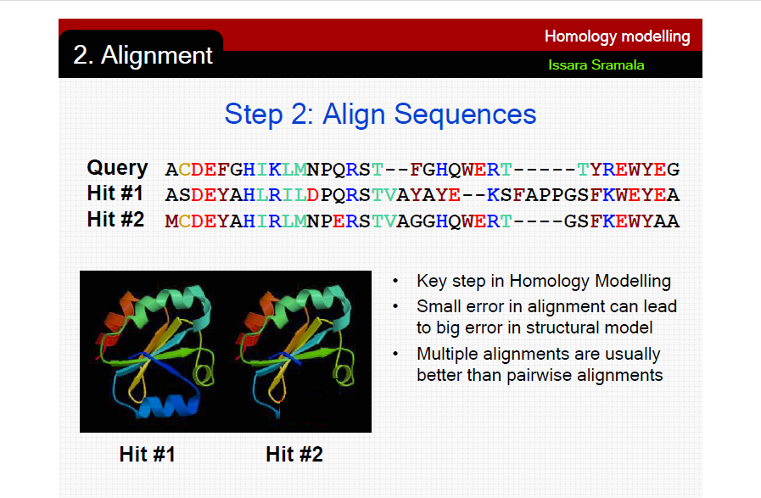

Slide 17
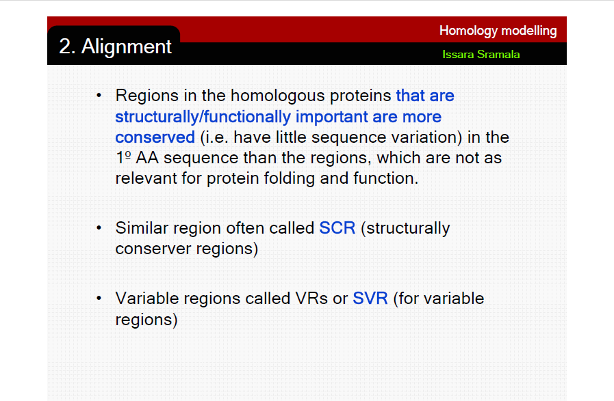

Slide 18
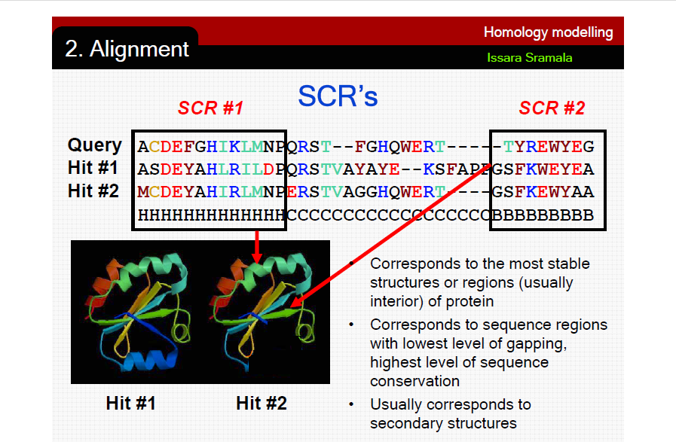

Slide 19
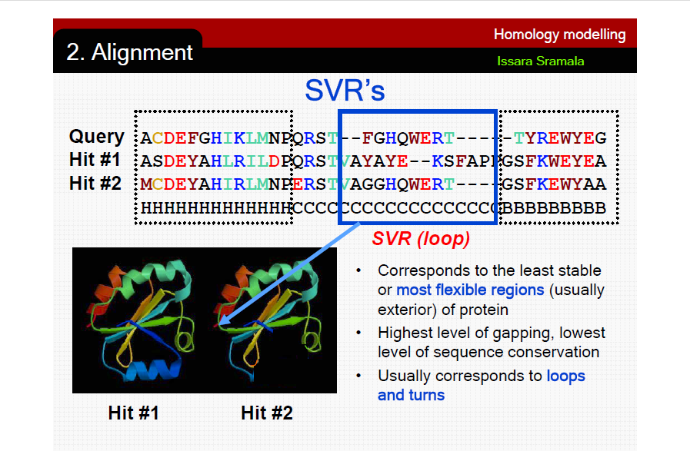

Slide 20
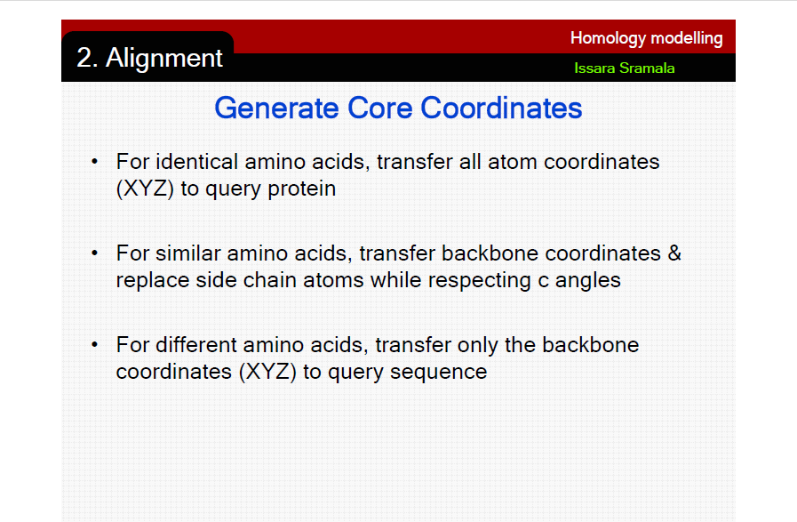

Slide 21
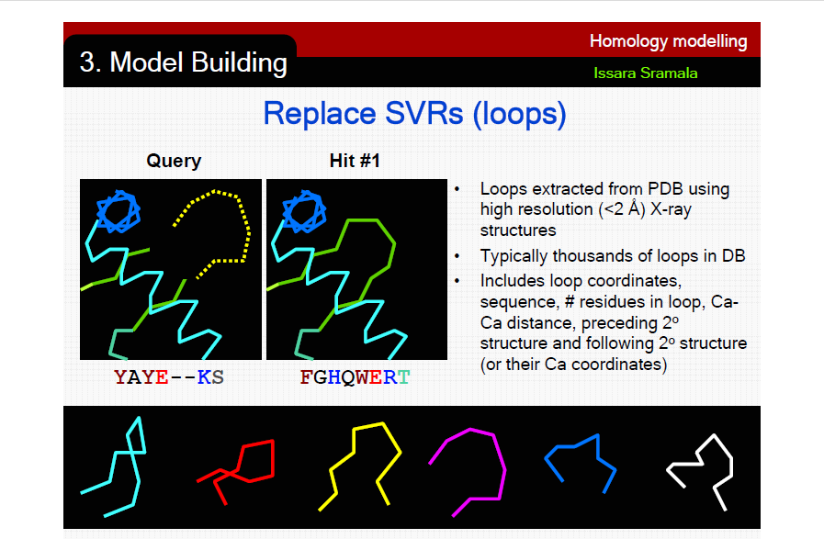

Slide 22
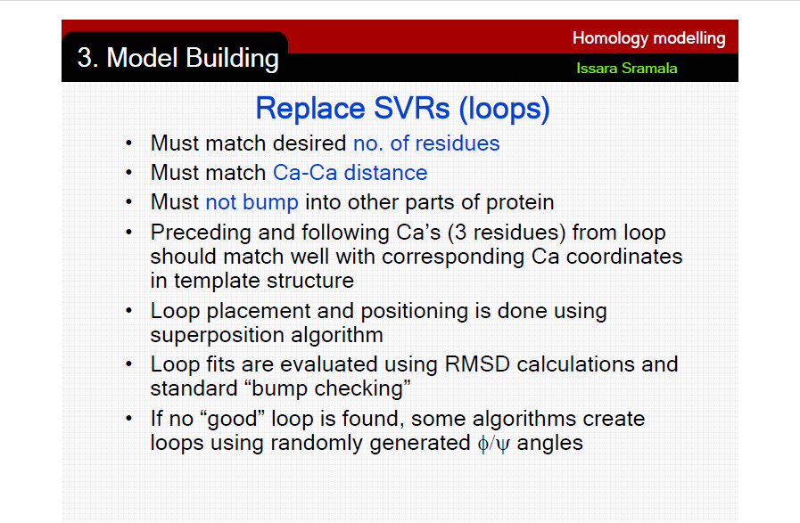

Slide 23
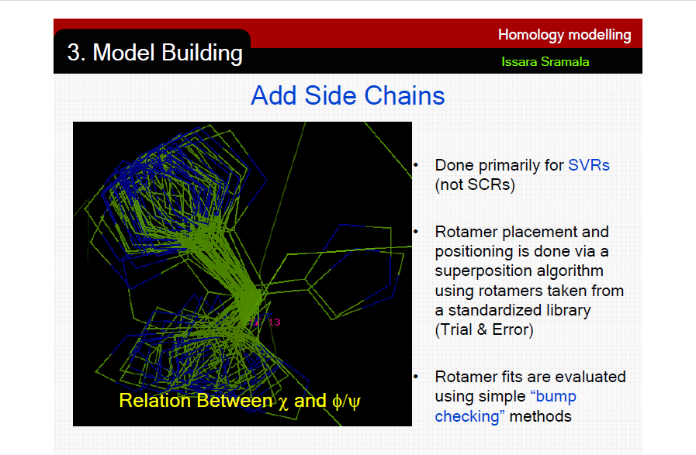

Slide 24
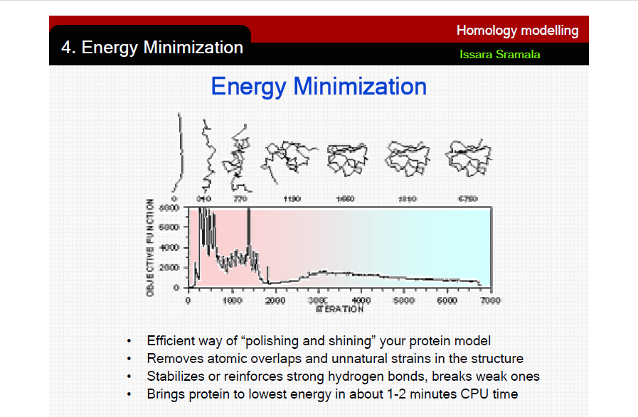

Slide 25
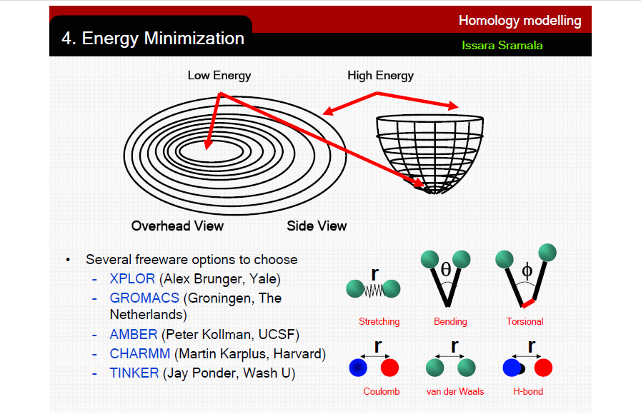

Slide 26
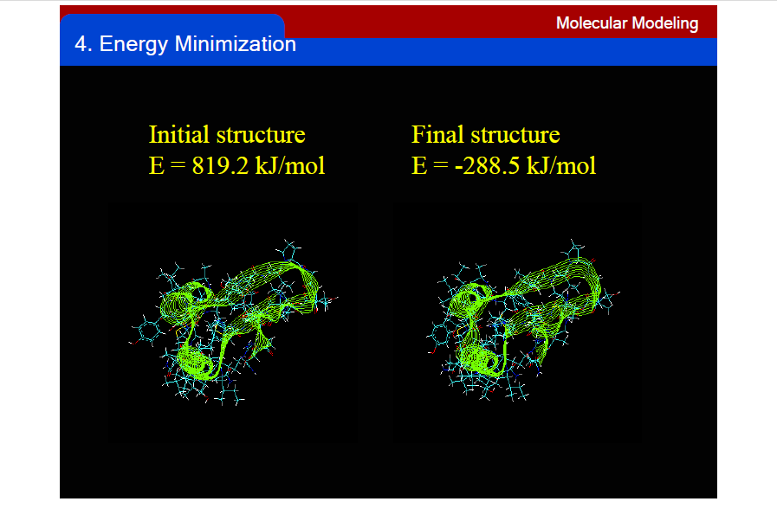

Slide 27
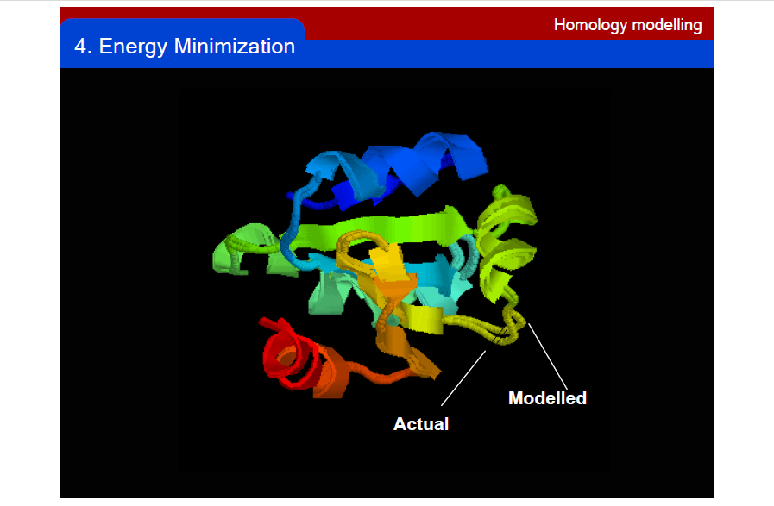

Slide 28
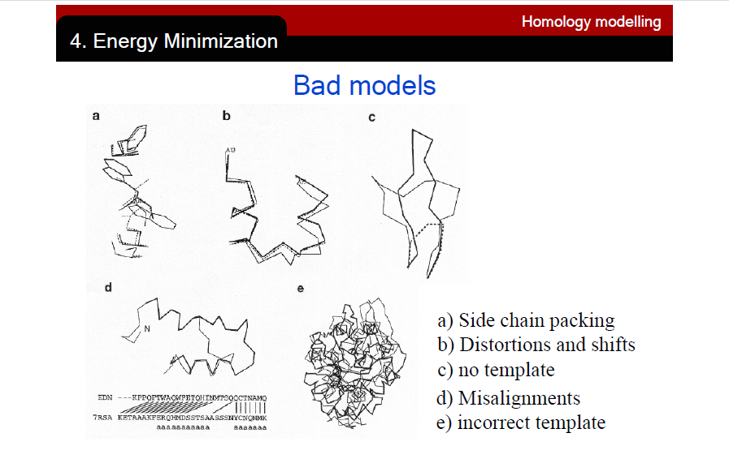

Slide 29
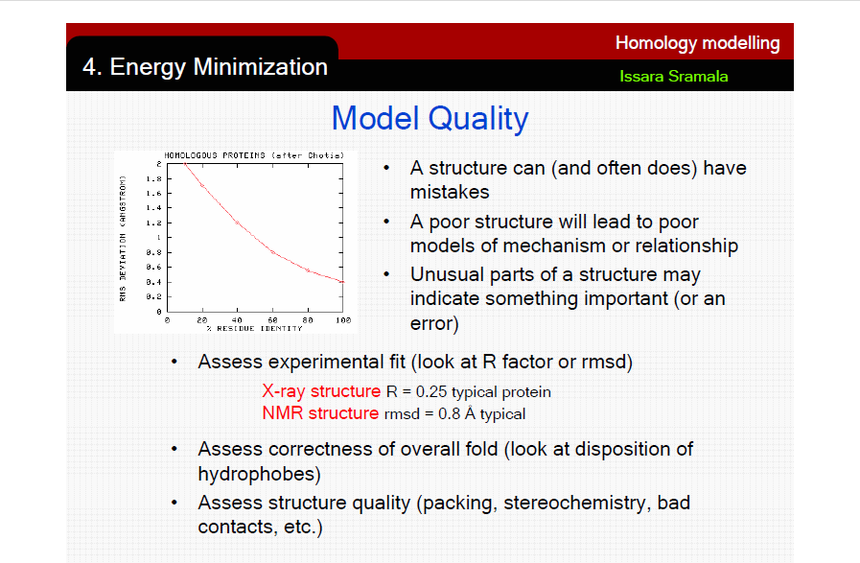

Slide 30
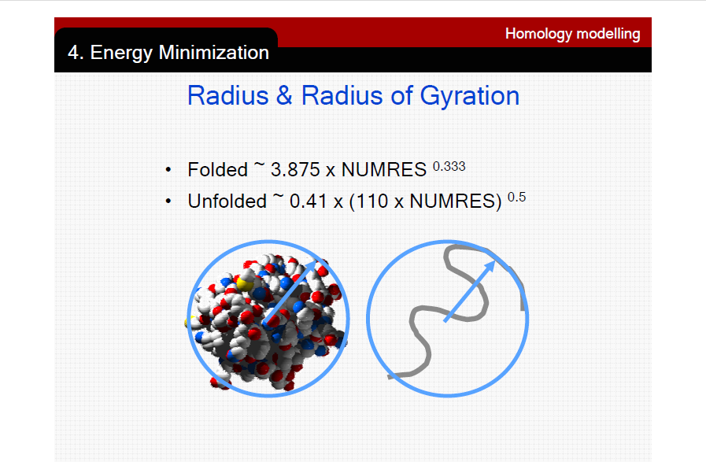

Slide 31
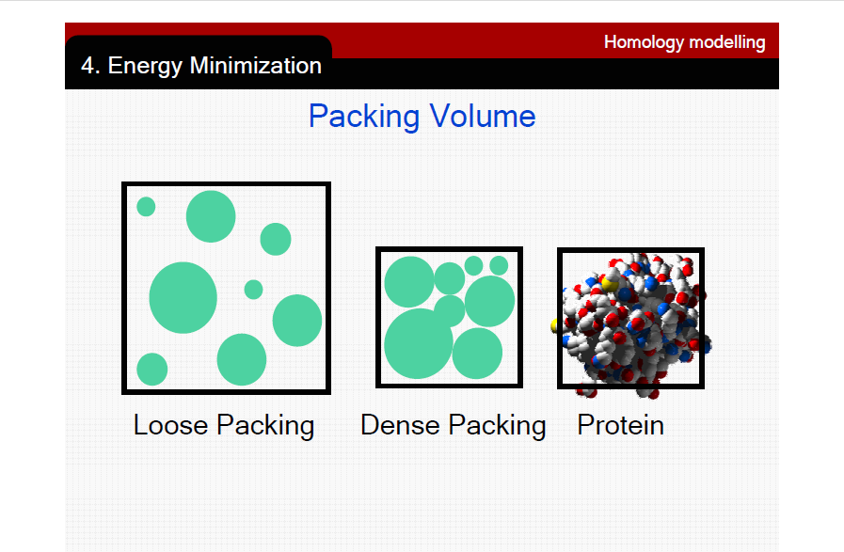

Slide 32
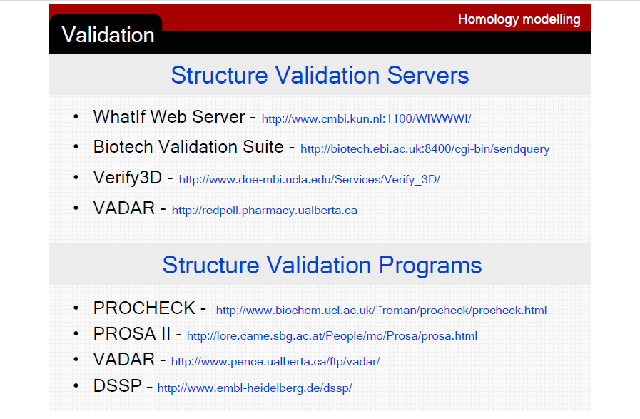

Slide 33
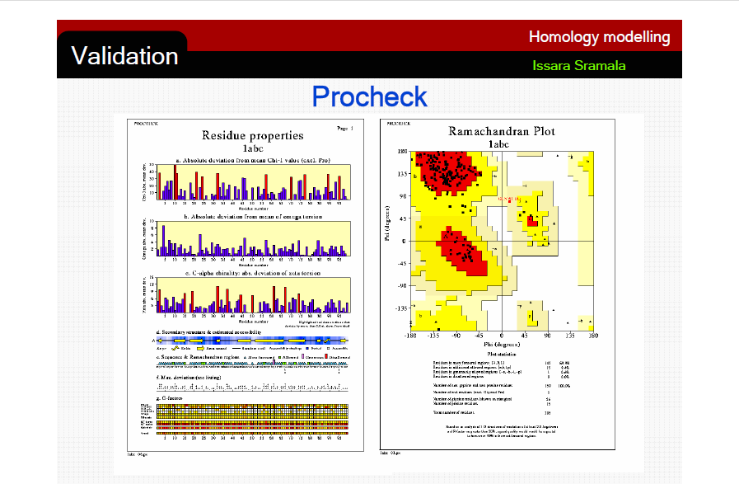

Slide 34
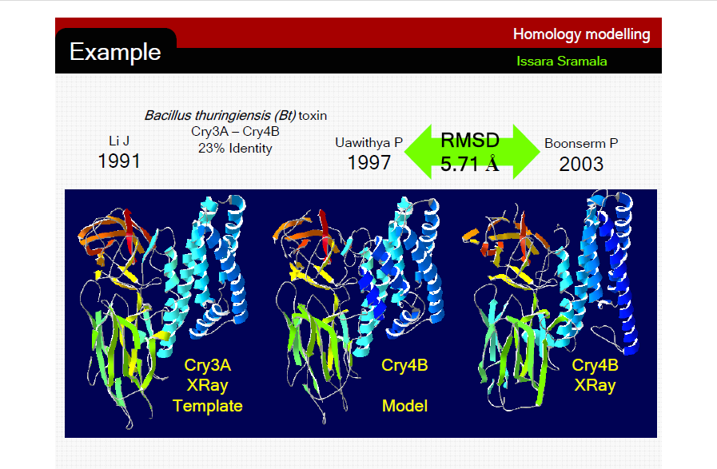

Slide 35
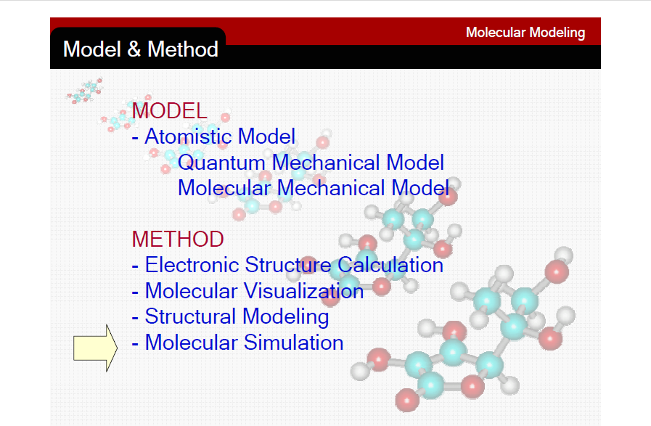

Slide 36
Homology Modeling Software?
Freely available packages perform as good as commercial ones at CASP (Critical Assessment of Structure Prediction)
Swiss Model (tutorial)
Modeller (http://guitar.rockefeller.edu)

Slide 37
Swiss-Model steps:
Search for sequence similarities
BLASTP against
EX-NRL 3D
Peitsch M & Guex N (1997) Electrophoresis 18: 2714

Slide 38
Swiss-Model steps:
Search for sequence similarities
Evaluate suitable templates
Identity: > 25%
Expected model :
> 20 resid.
Peitsch M & Guex N (1997) Electrophoresis 18: 2714

Slide 39
Swiss-Model steps:
Search for sequence similarities
Evaluate suitable templates
Generate structural alignments
Select regions of similarity and match in coordinate-space (EXPDB).
Peitsch M & Guex N (1997) Electrophoresis 18: 2714

Slide 40
Swiss-Model steps:
Search for sequence similarities
Evaluate suitable templates
Generate structural alignments
Average backbones
Compute weighted average coordinates for backbone atoms expected to be in model.
Peitsch M & Guex N (1997) Electrophoresis 18: 2714

Slide 41
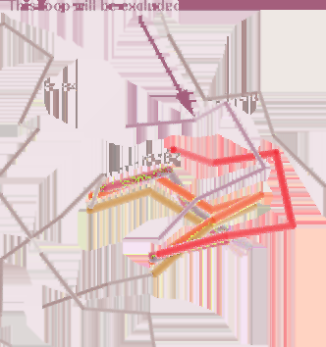
Swiss-Model steps:
Search for sequence similarities
Evaluate suitable templates
Generate structural alignments
Average backbones
Build loops
Pick plausible loops from library, ligate to stems; if not possible, try combinatorial search.
Peitsch M & Guex N (1997) Electrophoresis 18: 2714

Slide 42
Swiss-Model steps:
Search for sequence similarities
Evaluate suitable templates
Generate structural alignments
Average backbones
Build loops
Bridge incomplete backbones
Bridge with overlapping pieces from pentapeptide fragment library, anchor with the terminal residues and add the three central residues.
Peitsch M & Guex N (1997) Electrophoresis 18: 2714

Slide 43
Swiss-Model steps:
Search for sequence similarities
Evaluate suitable templates
Generate structural alignments
Average backbones
Build loops
Bridge incomplete backbones
Rebuild sidechains
Rebuild sidechains from rotamer library - complete sidechains first, then regenerate partial sidechains from probabilistic approach.
Peitsch M & Guex N (1997) Electrophoresis 18: 2714

Slide 44
Swiss-Model steps:
Search for sequence similarities
Evaluate suitable templates
Generate structural alignments
Average backbones
Build loops
Bridge incomplete backbones
Rebuild sidechains
Energy minimize
Gromos 96 -
Energy minimization
Peitsch M & Guex N (1997) Electrophoresis 18: 2714

Slide 45
Swiss-Model steps:
Search for sequence similarities
Evaluate suitable templates
Generate structural alignments
Average backbones
Build loops
Bridge incomplete backbones
Rebuild sidechains
Energy minimize
Write Alignment and PDB file
e-mail results
Peitsch M & Guex N (1997) Electrophoresis 18: 2714

Slide 46
Swissmodel in comparison
Manual alternatives:
Modeller
...
Automatic alternatives:
SwissModel
sdsc1
3djigsaw
pcomb_pcons
cphmodels
easypred
3D-Crunch:
211,000 sequences -> 64,000 models
Controls:
>50 % ID: ~ 1 Å RMSD
40-49% ID: 63% < 3Å
25-29% ID: 49% < 4Å
# 1 for RMSD and % correct aligned, #2 for coverage
Guex et al. (1999) TIBS 24:365-367
EVA: Eyrich et al. (2001) Bioinformatics 17:1242-1243 (http://cubic.bioc.columbia.edu/eva)

Slide 47
What structure elements change between similar sequence?
Subtle changes in protein backbone path
Changes in amino acid side-chain rotamer orientation
  backbone dependent
Loops added or truncated
Model may be incomplete

Slide 48
SwissModel in practice.
Notes:
Where are we with respect to our objectives ?

Slide 49
SwissModel ... first approach mode
http://www.expasy.org/swissmod

Slide 50
... enter the ExPDB template ID...

Slide 51
... run in Normal Mode (Except if defining a DeepView project )...

Slide 52
... successful submission.
Results come by e-mail.

Slide 53
Optimal sequence alignment
http://cbrmain.cbr.nrc.ca/EMBOSS/index.html
[...]
# Matrix: EBLOSUM35
# Gap_penalty: 10.0
# Extend_penalty: 0.5
#
# Length: 122
# Identity: 36/122 (29.5%)
# Similarity: 55/122 (45.1%)
# Gaps: 28/122 (23.0%)
# Score: 150.5
[...]
#=======================================
23 LNNKKTIAEGRRIPISKAVENPTATEIQDVCSAVGLNVFLEKNKMYSREW 72
|:.||:.|||||||...||.|....|:.:....:||. |..:.|.|.:.|
11 LDSKKSRAEGRRIPRRFAVPNVKLHELVEASKELGLK-FRAEEKKYPKSW 59
73 NRDVQYRGRVRVQLKQEDGSLCLVQFPSRKSVMLYAAEMIPKLKTRTQKT 122
.:..|||.|:.: .::..:|:..|..|.:::
60 ---WEEGGRVVVEKR-----------GTKTKLMIELARKIAEIR------ 89
123 GGADQSLQQGEGSKKGKGKKKK 144
:|..:| ||.|.||||
90 ---EQKREQ----KKDKKKKKK 104

Slide 54
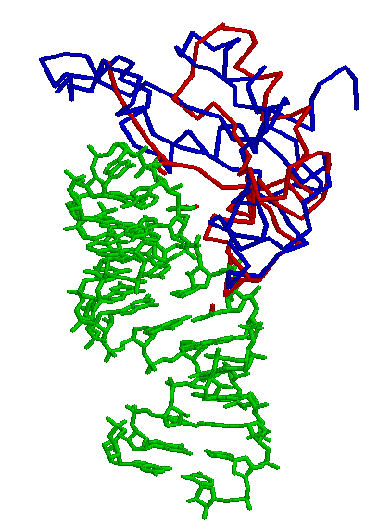
Optimal structural superposition
1.4Å
in 32 res.

Slide 55
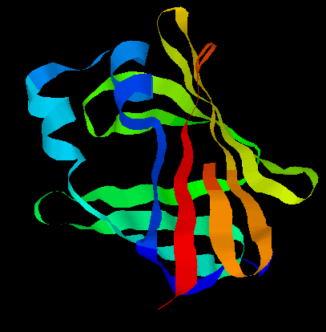
Protein Threading
The goal: find the “correct” sequence-structure alignment between a target sequence and its native-like fold in PDB
Energy function – knowledge (or statistics) based rather than physics based
  Should be able to distinguish correct structural folds from incorrect structural folds
  Should be able to distinguish correct sequence-fold alignment from incorrect sequence-fold alignments
MTYKLILN …. NGVDGEWTYTE

Slide 56
Protein Threading
Basic premise
Statistics from Protein Data Bank (~54,000 structures)
Chances for a protein to have a native-like structural fold in PDB are quite good (estimated to be 60-70%)
  Proteins with similar structural folds could be homologues or analogues
The number of unique structural (domain) folds in nature
is fairly small (possibly a few thousand)
90% of new structures submitted to PDB in the past
three years have similar structural folds in PDB

Slide 57
Protein Threading – four basic components
Structure database
Energy function
Sequence-structure alignment algorithm
Prediction reliability assessment

Slide 58
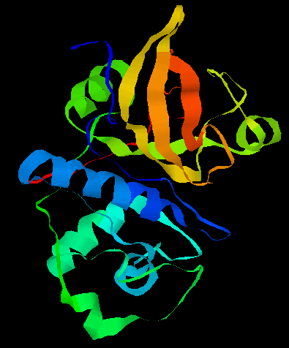
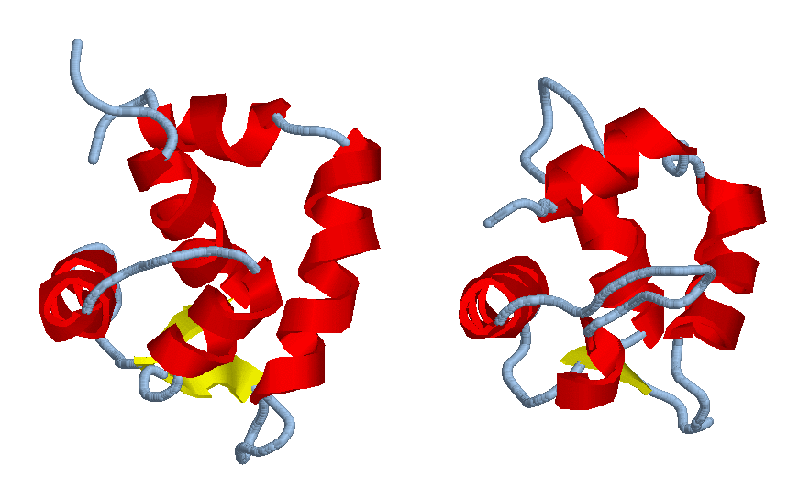
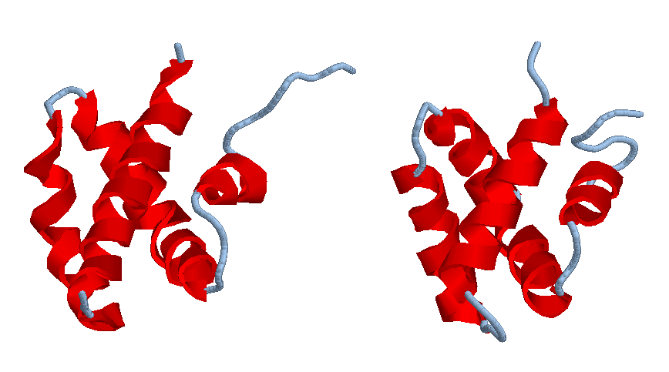
Protein Threading – structure database
Build a template database

Slide 59
Protein Threading – energy function
MTYKLILNGKTKGETTTEAVDAATAEKVFQYANDNGVDGEWTYTE
how preferable to put two particular residues nearby: E_p
how well a residue fits a structural environment: E_s
alignment gap penalty: E_g
total energy: E_p + E_s + E_g
find a sequence-structure alignment to minimize the energy function

Slide 60
Protein Threading – energy function
Calculating energy terms
  E_p for each pair of amino acids, e.g. (C, V)
  E_p(C, V) = log (E (C, V)/F (C, V))
    E(): expected frequency and F(): observed frequency
  E_s for each type of amino acid, e.g., A
  E_s(A) = log (E (A)/F(A))
    E(): expected frequency and F(): observed frequency
  E_g: alignment gap penalty

Slide 61
Protein Threading – energy function
Unlike sequence-sequence alignment where amino acids are aligned, a sequence-structure alignment aligns amino acids with structural environments
A simple definition of structural environment
  secondary structure: alpha-helix, beta-strand, loop
  solvent accessibility: 0, 10, 20, …, 100% of accessibility
  each combination of secondary structure and solvent accessibility level defines a structural environment
    E.g., (alpha-helix, 30%), (loop, 80%), …

Slide 62
Protein Threading – energy function
BLOSUM matrix
A
R
N
D
C
Q
E
G
H
I
L
K
M
F
P
S
T
W
Y
V
4
-1 5
-2 0 6
-2 -2 1 6
0 -3 -3 -3 9
-1 1 0 0 -3 5
-1 0 0 2 -4 2 5
0 -2 0 -1 -3 -2 -2 6
-2 0 1 -1 -3 0 0 -2 8
-1 -3 -3 -3 -1 -3 -3 -4 -3 4
-1 -2 -3 -4 -1 -2 -3 -4 -3 2 4
-1 2 0 -1 -3 1 1 -2 -1 -3 -2 5
-1 -1 -2 -3 -1 0 -2 -3 -2 1 2 -1 5
-2 -3 -3 -3 -2 -3 -3 -3 -1 0 0 -3 0 6
-1 -2 -2 -1 -3 -1 -1 -2 -2 -3 -3 -1 -2 -4 7
1 -1 1 0 -1 0 0 0 -1 -2 -2 0 -1 -2 -1 4
0 -1 0 -1 -1 -1 -1 -2 -2 -1 -1 -1 -1 -2 -1 1 5
-3 -3 -4 -4 -2 -2 -3 -2 -2 -3 -2 -3 -1 1 -4 -3 -2 11
-2 -2 -2 -3 -2 -1 -2 -3 2 -1 -1 -2 -1 3 -3 -2 -2 2 7
0 -3 -3 -3 -1 -2 -2 -3 -3 3 1 -2 1 -1 -2 -2 0 -3 -1 4
A R N D C Q E G H I L K M F P S T W Y V

Slide 63
Protein Threading – energy function
E_s: a scoring matrix of 30 structural environments by 20 amino acids
  E.g., E_s ((loop, 30%), A)
E_p: a scoring matrix of 20 amino acids by 20 amino acids
  Unlike BLOSUM matrix, this matrix measures how two amino acids prefer to be next to each other

Slide 64
Protein Threading -- algorithm
Threading algorithm – to find a sequence-structure alignment with the minimum energy
  considering only singleton energy and gap penalty
  considering all three energy terms
sequence
fold
links

Slide 65
Protein Threading -- algorithm
Considering only singleton energy + gap penalty
Represent a structure a sequence of “structural environments”
  (helix, 100%), (helix, 90%), ….. (strand, 0%)
Align a sequence MACKLPV …. with a structural sequence (helix, 100%), (helix, 90%), ….. (strand, 0%)

Slide 66
Protein Threading -- algorithm
 | (helix, 100%) | (helix, 90%) | (helix, 80%) | (loop, 80%)
M
L
V
A
Rule:
1: initialization– fill the first row and column with matching scores
2: fill an empty cell based on scores of its left, upper and upper-left neighbors + the matching of the current cell
3: if the score comes from left or up, deduct a gap penalty
4: chose the one giving the highest score

Slide 67
Protein Threading -- algorithm
Considering all three energy terms
Considering the pair-wise interaction energy makes the problem much more difficult to solve – dynamic programming algorithm does not work any more!
There are other techniques that can be used to solve the problem – integer programming, divide-and-conquer, etc

Slide 68
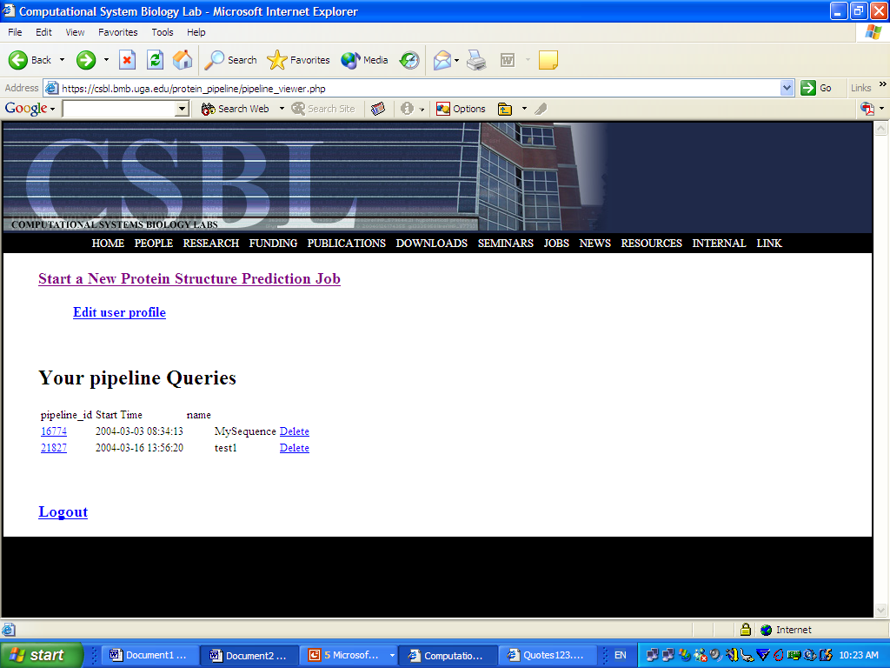
PROSPECT prediction server

Slide 69
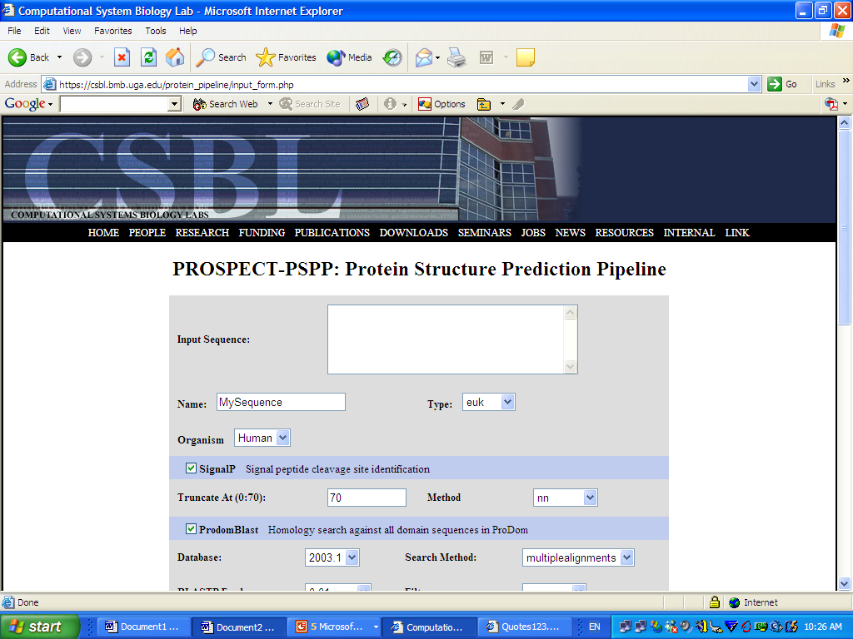
PROSPECT prediction server

Slide 70
Outline
Different levels of protein structures
Methods for solving protein structures: experimental versus computational methods
Ab initio folding versus comparative modeling
Protein threading: an introduction
Four key components in threading-based structure prediction
Methods for sequence-structure alignments

Slide 71
Outline
Assessing prediction reliability
Prediction of protein structure
Threading with constraints
Applications
Existing programs for protein structure prediction
CASP: structure prediction as a contest
Review

Slide 72
Assessing Prediction Reliability
MTYKLILNGKTKGETTTEAVDAATAEKVFQYANDNGVDGEWTYTE
Score = -1500
Score = -720
Score = -1120
Score = -900
Which one is the correct structural fold for the target sequence if any?
The one with the highest score ?

Slide 73
Assessing Prediction Reliability
Query sequence: AAAA
Template #1: AATTAATACATTAATATAATAAAATTACTGA
Better template?
Template #2: CGGTAGTACGTAGTGTTTAGTAGCTATGAA
Which of these two sequences will have better chance to have a good match with the query sequence after randomly reshuffling them?

Slide 74
Assessing Prediction Reliability
Different template structures may have different background scores, making direct comparison of threading scores against different templates invalid
Comparison of threading results should be made based on how standout the score is in its background score distribution rather the threading scores directly

Slide 75
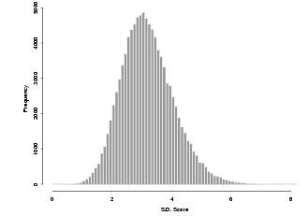
Assessing Prediction Reliability
Threading 100,000 sequences against a template structure provides the baseline information about the background scores of the template
By locating where the threading score with a particular query sequence, one can decide how significant the score, and hence the threading result, is!
E-value
Not significant
significant

Slide 76
Assessing Prediction Reliability
MTYKLILNGKTKGETTTEAVDAATAEKVFQYANDNGVDGEWTYTE
Score = -1500
E-value = e⁻¹
Score = -720
E-value = e⁻²
Score = -1120
E-value = 0.5 e⁻¹
Score = -900
E-value = e⁻²¹
If no predictions have non-significant e-values, a prediction program should indicate that it could not make a prediction!

Slide 77
Prediction of Protein Structures
Threading against a template database
Select the hits with good e-values, e.g., < e⁻¹⁰
Put the backbone atoms in the backbone into the corresponding positions in the aligned residues
FMFTAIGEEVVQRSRKIL- - - DDLVELVK
AVLTRYGQRLIQLYDLLAQIQQKAFDVLS
Unaligned residues will not have 3D coordinates

Slide 78
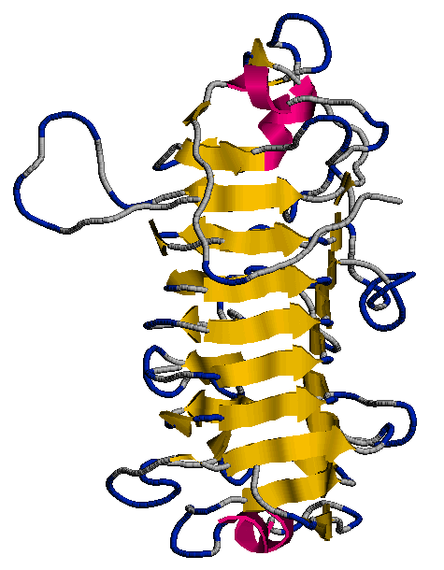
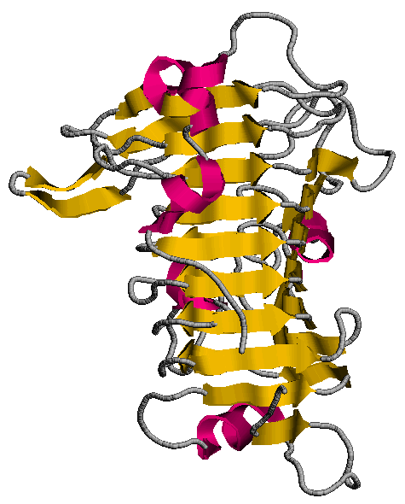
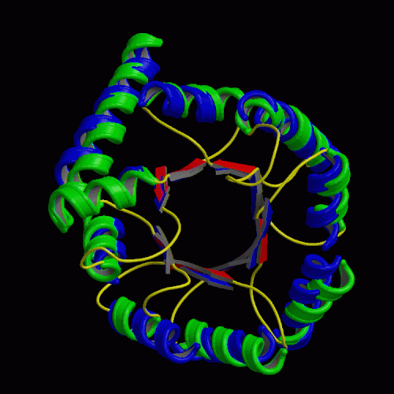
Prediction of Protein Structures
Protein threading can predict only the backbone structure of a protein (side-chains have to be predicted using other methods)
Typically the lower the e-value, the higher the prediction accuracy
Blue: actual structure
Green: predicted structure
predicted
actual

Slide 79
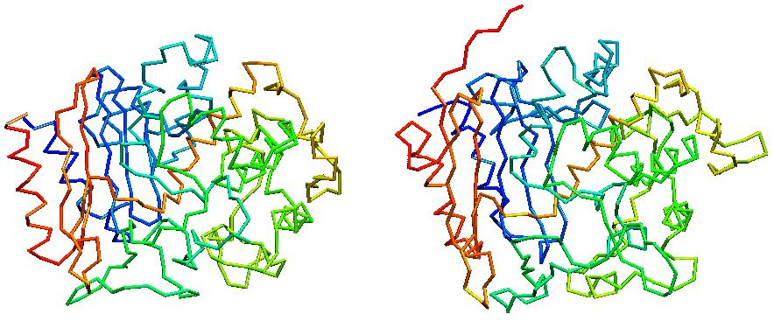
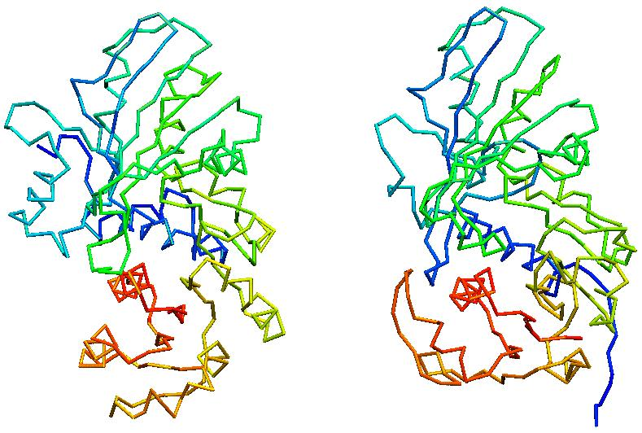
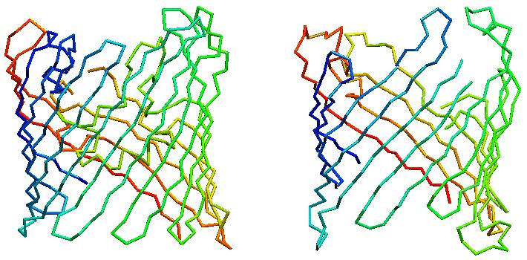
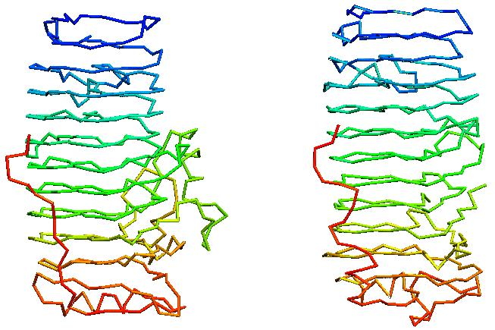
Prediction of Protein Structures
Examples – a few good examples
actual
predicted
actual
predicted
actual
predicted
actual
predicted

Slide 80

Prediction of Protein Structures
Not so good example

Slide 81
Prediction of Protein Structures
State of the art: ~50% of the soluble proteins in a microbial genome could have correct fold prediction and might be 50% of these proteins have good backbone structure prediction
Functional inference could be made based on
  accurately predicted structures:
  correctly identified structural folds:

Slide 82
Prediction of Protein Structures
All-atom structures could be predicted through prediction of
  prediction of backbone structure
  prediction of sidechain packing
    Backbone-dependent rotamers
    Ab initio prediction of sidechains
State of the art – accurate prediction of side chains remains a challenging problem

Slide 83
Structure prediction using additional information
Some structural information may be available before whole structure is solved
  disulfide bonds
  active sites
  residues identified buried/exposed
  (partial) secondary structure
  partial NMR data
  inter-residual distances by cross-linking and mass spec
  overall shape derived from cryo-EM
  …….
These data can provide highly useful constraints on threading prediction

Slide 84
Structure prediction using additional information
The basic idea
MTYKLILNGKTKGETTTEAVDAATAEKVFQYANDNGVDGEWTYTE
Distance or other types of constraints could be derived before the structure is solved, which could help to the structure prediction more accurate

Slide 85



Structure prediction using additional information
Victronectin: a three-domain protein
  various structural data have been derived through experiments, including disulfide bonds, active sites, heparin binding sites, cleavage sites, ....
  data-constrained threading/docking to its structure prediction

Slide 86
Applications
Many protein structures have been successfully predicted prior to the solution of their experimental structures (and later were verified by experimental structures)
There are numerous computer programs for protein structure predictions on the Internet

Slide 87

Applications
Structure predictions of all predicted genes in three microbial genomes, Synechococcus, Procholorococcus MIT/MED
~60% of predicted genes have structural fold assignments

Slide 88
Existing Prediction Programs
PROSPECT
  https://csbl.bmb.uga.edu/protein_pipeline
FUGU
  http://www-cryst.bioc.cam.ac.uk/~fugue/prfsearch.html
THREADER
  http://bioinf.cs.ucl.ac.uk/threader/

Slide 89
PROSPECT

Slide 90

PROSPECT
PROSPECT uses z-score to assess its prediction reliability
Z-score is > 8 is considered “reliable”
z-score

Slide 91

FUGU (http://www-cryst.bioc.cam.ac.uk/~fugue/prfsearch.html)

Slide 92

THREADER

Slide 93

CASP (http://predictioncenter.llnl.gov/)

Slide 94
Review
Computational methods for gene finding
  Prediction of coding potential based on biased di-codon frequency
  Prediction of translation starts, splice junction sites using position specific matrices
  Combining multiple pieces of information through discriminant analysis

Slide 95
Review
Identification of functional motifs in DNA and protein sequences
  Identification of conserved sequences
  Information content
  Popular prediction tools: prosite, prints, blocks
Microarray gene expression data analysis
  Data normalization
  Identification of differentially expressed genes
  Identification of co-expressed genes

Slide 96
Review
Sequence alignment
  Scoring matrix
  Dynamic programming
  Multiple sequence alignment
Functional prediction of proteins
  Functional classification
    Pfam, ENZYME databases
  Orthologs versus paralogs
  Sequence-based approach
  Motif-based approach
  Structure-based approach
  Phylogenetic profile-based approach
  Popular server

Slide 97
Review
Protein structure prediction
  Ab initio versus comparative modeling methods
  Energy functions
  Sequence-structure alignment
  Assessment of prediction reliability
  applications
The basic ideas of computational methods for solving biological problems
The popular computational tools
How to use them for solving simple problems

