Slide 1
Ab initio Protein Structure Prediction

Slide 2
Protein Structure Prediction
One popular model for protein folding assumes a sequence of events:
Hydrophobic collapse
Local interactions stabilize secondary structures
Secondary structures interact to form motifs
Motifs aggregate to form tertiary structure

Slide 3
Protein Structure Prediction
A physics-based approach:
- find conformation of protein corresponding to a
thermodynamics minimum (free energy minimum)
- cannot minimize internal energy alone!
Needs to include solvent
- simulate folding…a very long process!
Folding time are in the ms to second time range
Folding simulations at best run 1 ns in one day…

Slide 4
The Folding @ Home initiative
http://folding.stanford.edu/

Slide 5
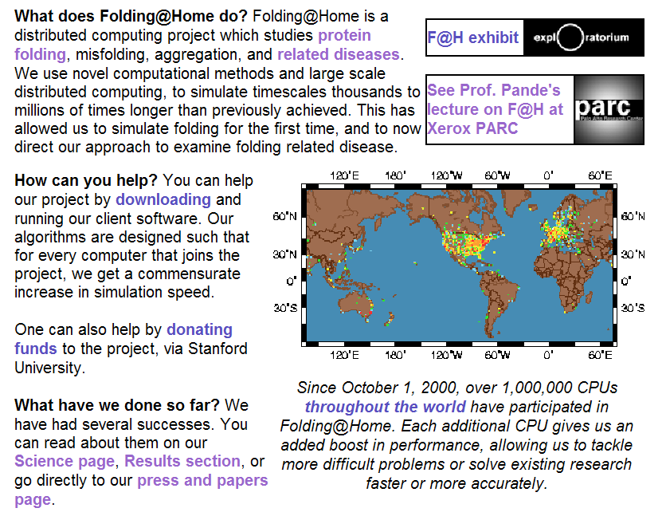
The Folding @ Home initiative

Slide 6
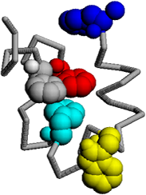
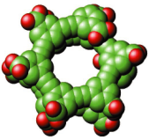
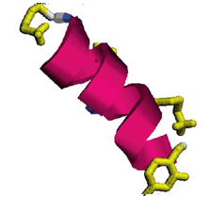
Folding @ Home: Results
100000
Experiments:
villin:
Raleigh, et al,
SUNY, Stony Brook
BBAW:
Gruebele, et al, UIUC
beta hairpin:
Eaton, et al, NIH
alpha helix:
Eaton, et al, NIH
PPA:
Gruebele, et al, UIUC
villin
BBAW
10000
beta
hairpin
1000
Predicted folding time
(nanoseconds)
100
alpha helix
10
PPA
1
1
10
100
1000
10000
100000
experimental measurement
(nanoseconds)
http://pande.stanford.edu/

Slide 7
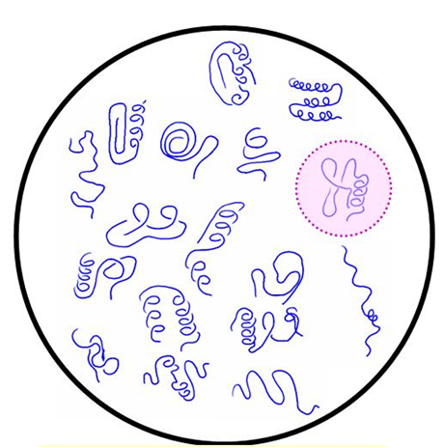
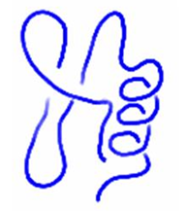
Protein Structure Prediction
DECOYS:
Generate a large number
of possible shapes
DISCRIMINATION:
Select the correct, native-like
fold
Need good decoy structures
Need a good energy function

Slide 8
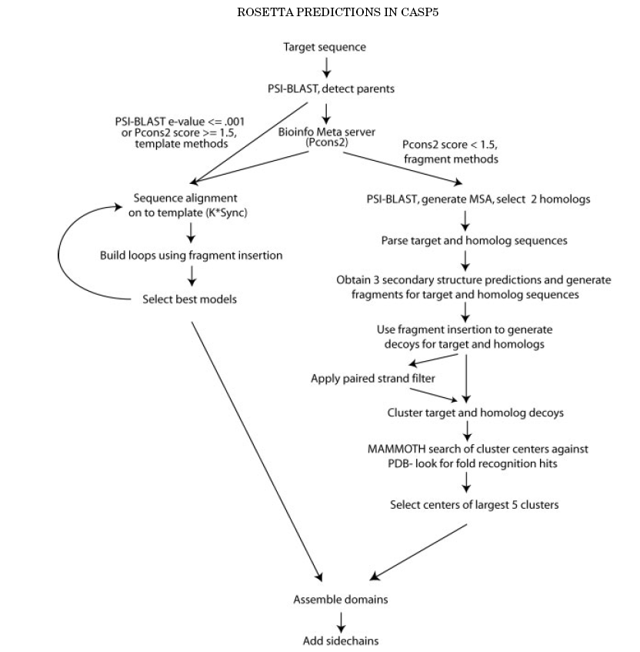
ROSETTA at CASP (David Baker)
Homology modeling
Ab initio prediction
Simultaneous modeling
of the target and 2 homologs
Secondary structure
prediction
Fragment based
approach to generate
decoys
Most successful
Method at CASP,
for fold recognition
and ab initio prediction
Select 5 decoys
For prediction
Rosetta predictions in CASP5:
Successes, failures, and prospect
for complete automation. Baker et
all, Proteins, 53:457-468 (2003)

Slide 9
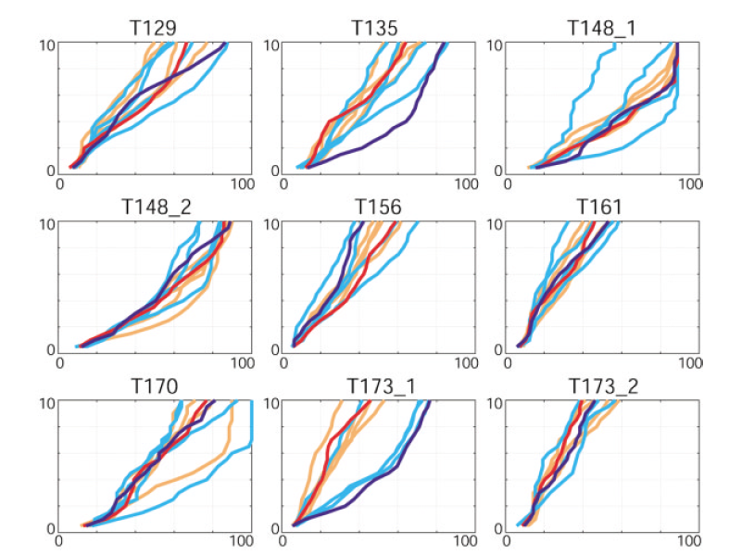
ROSETTA results at CASP5
Blue:
“human”
Orange:
“automatic
Server”
cRMS (model – experimental structure) cutoff (Å)
% of the full target protein

Slide 10
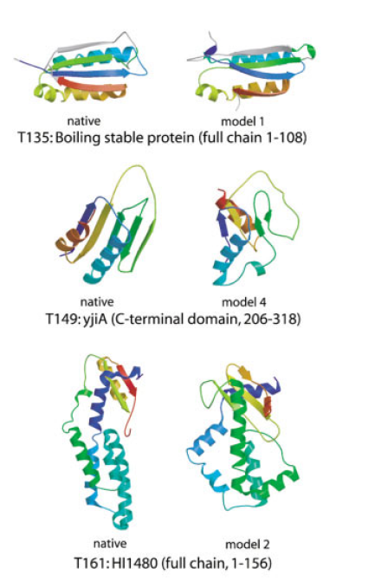
ROSETTA results at CASP5
 |  | # of residues with cRMS below 4Å/6Å
Name | Length | human | Automatic | Best decoy
T135 | 106 | 83/98 | 54/64 | 94/105
T149 | 116 | 52/71 | 44/62 | 76/92
T161 | 154 | 45/83 | 57/79 | 55/95
Rosetta predictions in CASP5:
Successes, failures, and prospect
for complete automation. Baker et
all, Proteins, 53:457-468 (2003)

Slide 11
Introduction to Protein Folding and Molecular Simulation
Background of protein folding
Molecular Dynamics (MD)
Brownian Dynamics (BD)
September, 2006
Tokyo University of Science Tadashi Ando

Slide 12
Protein Folding Problem
“Predict a three-dimensional structure of a protein from its amino acid sequence.”
“How does a protein fold into the structure?”
This question has not been solved since more than half a century ago.

Slide 13
Proteins Can Fold into 3D Structures Spontaneously
The three-dimensional structure of a protein is self-organized in solution.
The structure corresponds to the state with the lowest free energy of the protein-solvent system. (Anfinsen’s dogma)
If we can calculate the energy of the system precisely, it is possible to predict the structure of the protein!

Slide 14
Levinthal Paradox
We assume that there are three conformations for each amino acid (ex. α-helix, β-sheet and random coil). If a protein is made up of 100 amino acid residues, a total number of conformations is
3¹⁰⁰ = 515377520732011331036461129765621272702107522001 ≒ 5 x 10⁴⁷.
If 100 psec (10⁻¹⁰ sec) were required to convert from a conformation to another one, a random search of all conformations would require
5 x 10⁴⁷ x 10⁻¹⁰ sec ≒ 1.6 x 10³⁰ years.
However, folding of proteins takes place in msec to sec order. Therefore, proteins fold not via a random search but a more sophisticated search process.
We want to watch the folding process of a protein using molecular simulation techniques.

Slide 15
Why is the “Protein Folding” so Important?
Proteins play important roles in living organisms.
Some proteins are deeply related with diseases. And structural information of a protein is necessary to explain and predict its gene function as well as to design molecules that bind to the protein in drug design.
Today, whole genome sequences (the complete set of genes) of various organisms have been deciphered and we realize that functions of many genes are unknown and some are related with diseases.
Therefore, understanding of protein folding helps us to investigate the functions of these genes and to design useful drugs against the diseases efficiently.
In addition to that, the understanding opens the door to designing of proteins having novel functions as new nano machines.

Slide 16
Why is the “Protein Folding” Problem so Difficult?
From the view point of computer simulation,
It is difficult to simulate the whole process of protein folding at atomistic level using even state-of-the-art computers.
It is uncertain whether the accuracy of current energy functions and parameters are sufficient for protein folding simulation or not.
…, let me recount a conversation with Francis in 1975 (who won the Novel prize for discovering the structure of DNA). Crick stated that "it is very difficult to conceive of a scientific problem that would not be solved in the coming twenty years … except for a model of brain function and protein folding". Although Crick was more interested in brain function, he did state that both problems were difficult because they involve many cooperative interactions in three-dimensional space.
(Levitt M, “Through the breach.” Curr. Opin. Struct. Biol. 1996, 1, 193-194)

Slide 17
Molecular Dynamics (MD)
In molecular dynamics simulation, we simulate motions of atoms as a function of time according to Newton’s equation of motion. The equations for a system consisting on N atoms can be written as Here, r_{i} and m_{i} represent the position and mass of atom i and F_{i}(t) is the force on atom i at time t. F_{i}(t) is given by where V（r₁, r₂, …, r_{N}) is the potential energy of the system that depends on the positions of the N atoms in the system. ∇_{i} is
(1)
(2)
(3)

Slide 18
Integration Using a Finite Difference Method
The positions at times (t + Δt ) and (t − Δt ) can be written using the Taylor expansion around time t, The sum of two equations is Using eq. (1), the following equation is obtained: We should calculate eq. (6) iteratively to obtain trajectories of atoms in the system (Verlet algorithm).
(4a)
(4b)
(5)
(6)

Slide 19
Forces Involved in the Protein Folding
Electrostatic interactions
van der Waals interactions
Hydrogen bonds
Hydrophobic interactions (Hydrophobic molecules associate with each other in water solvent as if water molecules is the repellent to them. It is like oil/water separation. The presence of water is important for this interaction.)

Slide 20
Energy Functions used in Molecular Simulation
r
Θ
Φ
Bond stretching term
Angle bending term
Dihedral term
The most time demanding part.
H-bonding term
Van der Waals term
Electrostatic term
O
H
＋
r
ー
r
r

Slide 21
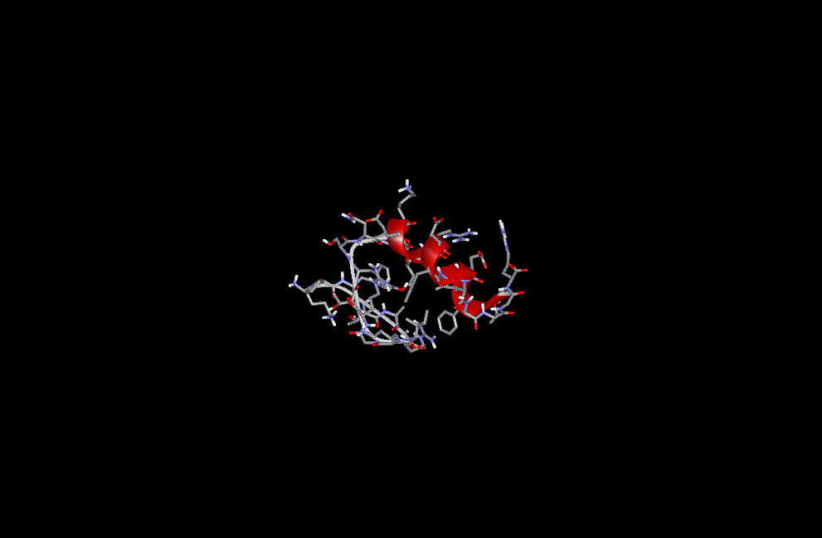
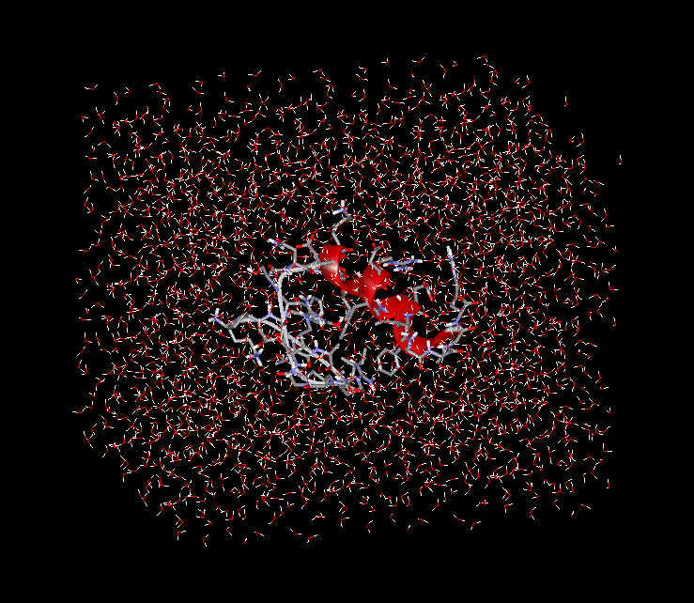
System for MD Simulations
Without water molecules
With water molecules
# of atoms: 304
# of atoms: 304 + 7,377 = 7,681

Slide 22
MD Requires Huge Computational Cost
Time step of MD (Δt) is limited up to about 1 fsec (10⁻¹⁵ sec). ← The size of Δt should be approximately one-tenth the time of the fastest motion in the system. For simulation of a protein, because bond stretching motions of light atoms (ex. O-H, C-H), whose periods are about 10⁻¹⁴ sec, are the fastest motions in the system for biomolecular simulations, Δt is usually set to about 1 fsec.
Huge number of water molecules have to be used in biomolecular MD simulations. ← The number of atom-pairs evaluated for non-bonded interactions (van der Waals, electrostatic interactions) increases in order of N ² (N is the number of atoms).
It is difficult to simulate for long time. Usually a few tens of nanoseconds simulation is performed.

Slide 23
Time Scales of Protein Motions and MD
Permeation of an ion in Porin channel
Elastic vibrations of proteins
α-Helix folding
β-Hairpin folding
Bond stretching
Protein folding
10⁻¹⁵
10⁻¹²
10⁻⁹
10⁻⁶
10⁻³
10⁰
(fs)
(ps)
(ns)
(μs)
(ms)
(s)
MD
Time
It is still difficult to simulate a whole process of a protein folding using the conventional MD method.

Slide 24
Much Faster, Much Larger!
Special-purpose computer
Calculation of non-bonded interactions is performed using the special chip that is developed only for this purpose.
For example;
MDM (Molecular Dynamics Machine) or MD-Grape: RIKEN
MD Engine: Taisho Pharmaceutical Co., and Fuji Xerox Co.
Parallelization
A single job is divided into several smaller ones and they are calculated on multi CPUs simultaneously.
Today, almost MD programs for biomolecular simulations (ex. AMBER, CHARMm, GROMOS, NAMD, MARBLE, etc) can run on parallel computers.

Slide 25
Brownian Dynamics (BD)
The dynamic contributions of the solvent are incorporated as a dissipative random force (Einstein’s derivation on 1905). Therefore, water molecules are not treated explicitly.
Since BD algorithm is derived under the conditions that solvent damping is large and the inertial memory is lost in a very short time, longer time-steps can be used.
BD method is suitable for long time simulation.

Slide 26
System for BD Simulations
Without water molecules
With water molecules
# of atoms: 304
# of atoms: 304 + 7,377 = 7,681

Slide 27
Algorithm of BD
The Langevin equation can be expressed as Here, r_{i} and m_{i} represent the position and mass of atom i, respectively. ζ_{i} is a frictional coefficient and is determined by the Stokes’ law, that is, ζ_{i} = 6πa_{i}^{Stokes}η in which a_{i}^{Stokes} is a Stokes radius of atom i and η is the viscosity of water. F_{i} is the systematic force on atom i. R_{i} is a random force on atom i having a zero mean <R_{i}(t)> = 0 and a variance <R_{i}(t)R_{j}(t)> = 6ζ_{i}kTδ_{ij}δ(t); this derives from the effects of solvent.
For the overdamped limit, we set the left of eq.7 to zero, The integrated equation of eq. 8 is called Brownian dynamics; where Δt is a time step and ω_{i} is a random noise vector obtained from Gaussian distribution.
(7)
(8)
(9)

Slide 28
Computational Time of BD
Computational time required for 1 nsec simulation of a peptide
 | Algorithm | Computer | # of atoms | Time (sec) | Efficiency
 | MD | Pentium4 2.8 GHz | 7,681 | 2,057 | 1.00
 | BD | Pentium4 2.8 GHz | 304 | 38.8 | 53.0
 | BD +MTS† | Pentium4 2.8 GHz | 304 | 12.8 | 161
 | BD +MTS† | IBM Regatta 8 CPU | 304 | 3.4 | 605
†MTS(Multiple time step) algorithm: This method reduces the frequency of calculation of the most time-demanding part （non-bonded energy terms）.

Slide 29
Folding Simulation of an α-Helical Peptide using BD
1.0
0.8
0.6
The fraction of native contacts
0.4
0.2
0
100
200
400
0
300
Simulation time (nsec)

Slide 30
Folding Simulation of an β-Hairpin Peptide using BD
1.0
0.8
0.6
The fraction of native contacts
0.4
0.2
0
0
100
200
300
400
Simulation time (nsec)

Slide 31
Time Scales of Protein Motions and BD
Permeation of an ion in Porin channel
Elastic vibrations of proteins
α-Helix folding
β-Hairpin folding
Bond stretching
Protein folding
10⁻¹⁵
10⁻¹²
10⁻⁹
10⁻⁶
10⁻³
10⁰
Time
(fs)
(ps)
(ns)
(μs)
(ms)
(s)
MD
BD method allows us to simulate for long time.
BD

Slide 32
Conclusions
Protein folding problem is one of the historic problems in biology. And solving the problem opens the door to new phase of genomic biology.
In MD, Newton’s equations of motions of atoms in a system are integrated using a finite difference method.
In MD, time step is limited to approximately one fsec and treatment of huge number of water molecules is essential. In these respects, it is difficult to simulate for long time.
On the other hand, the folding of proteins requires msec to sec time scales.
Developments of parallelization algorithms and special-purpose computers allow us to simulate much larger systems and much faster.
BD method is a prospective approach to simulate for long time.

