Slide 1
Introduction to Proteins
Amino acids
Proteins 1º, 2º, 3º and 4º structure
Proteins: Structural Parameters

Slide 2
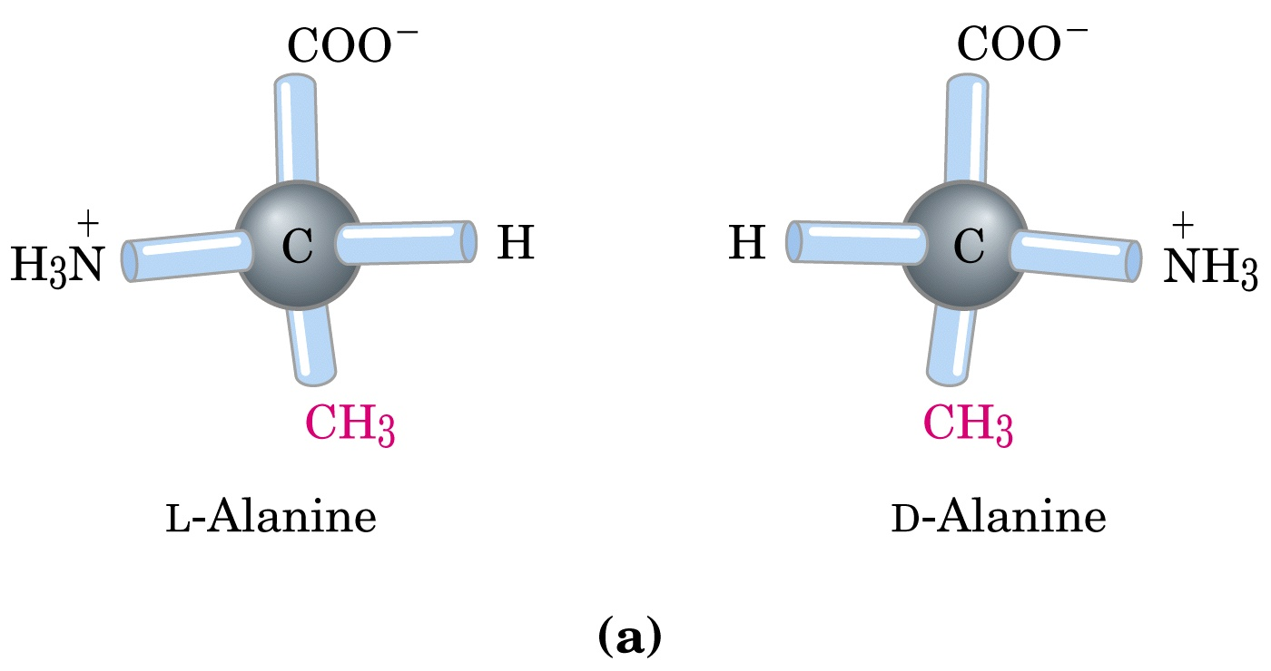
Found in nature
Not used in nature
Lehninger ch. 3

Slide 3
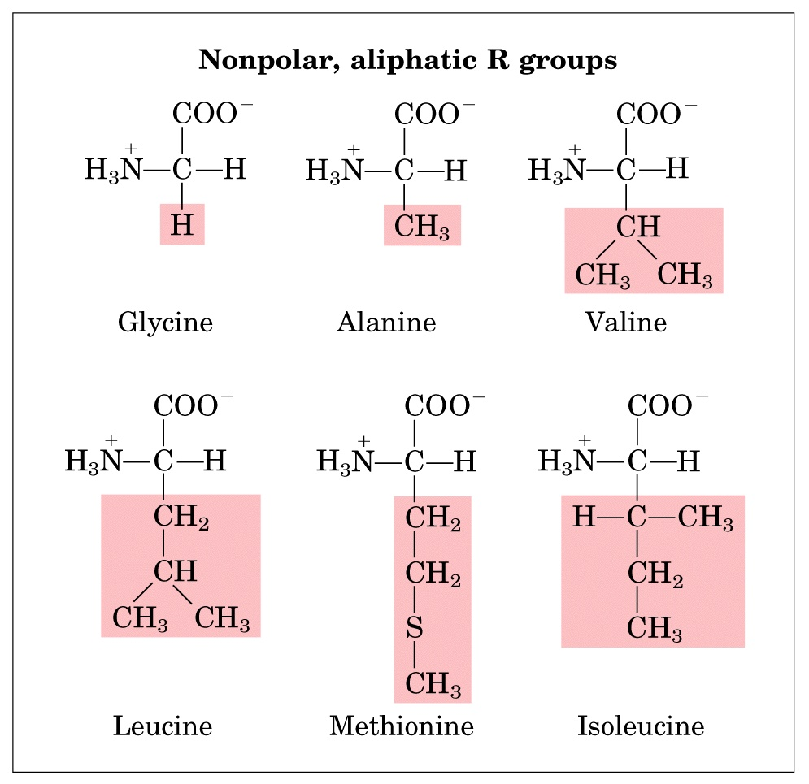
Generally found in the interior of proteins.
G
A
V
M
P
L
I

Slide 4
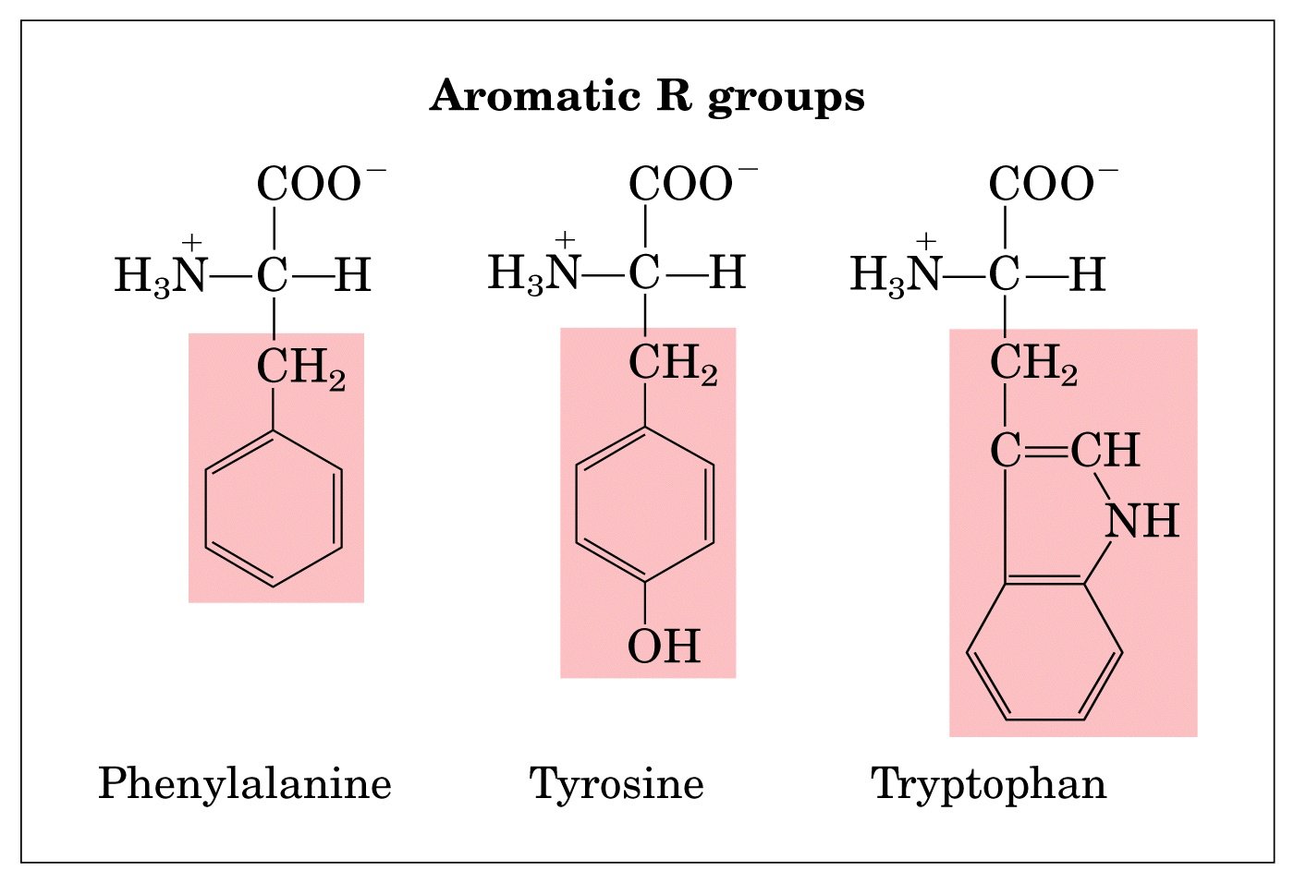
F
Y
W
Interior
Surface/Interior

Slide 5
Generally found on the exterior of proteins. Note: I have moved proline from this group to the non-polar group.
S
T
C
N
Q

Slide 6
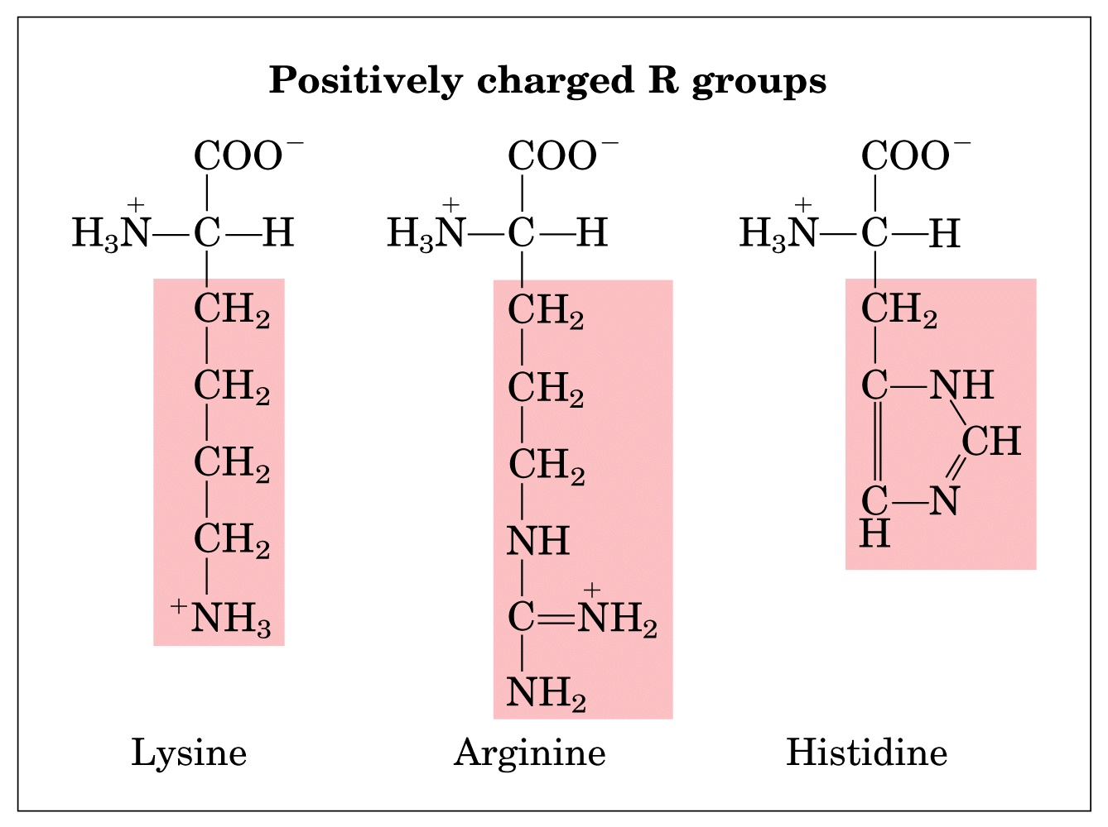
Generally found on the exterior of proteins. Sometimes in the interior but then always combined with a negatively charged aa in order to form a salt bridge.
H
K
R

Slide 7
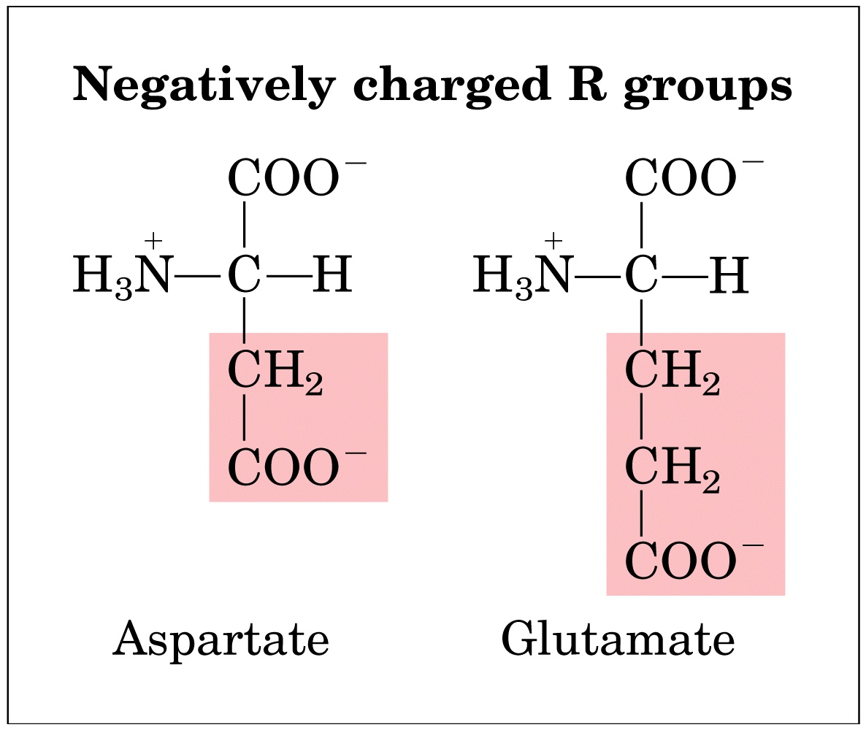
Generally found on the exterior of proteins. Sometimes in the interior but then always combined with a positively charged aa in order to form a salt bridge.
D
E

Slide 8
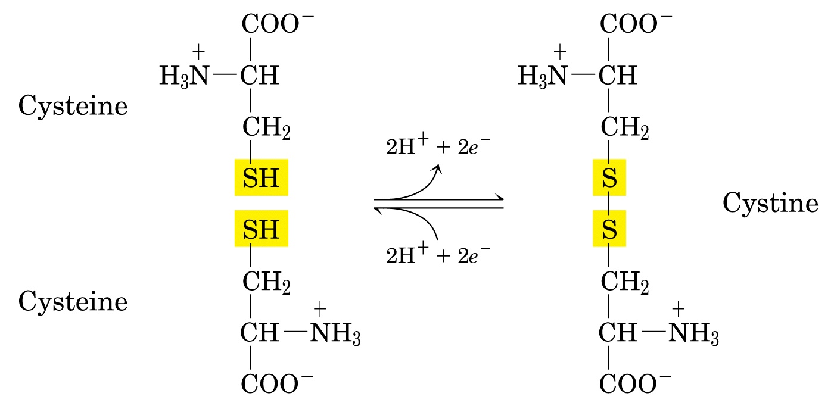
Interior of the cell is reducing so cysteine is usually in the sulfhydryl form.

Slide 9
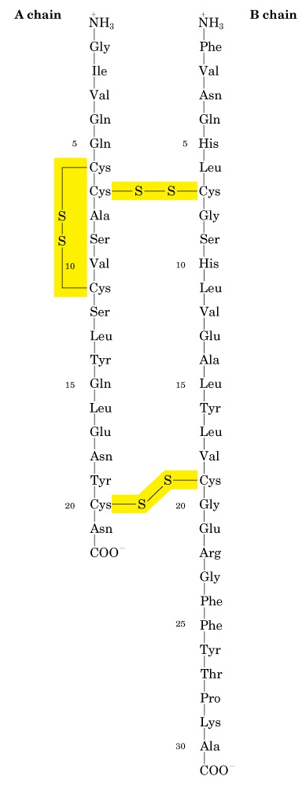
An example of a disulfide containing protein, the peptide hormone insulin. The active form of insulin is initially made from a single polypeptide (proinsulin) and cleaved into the final form. Upon cleavage it is excreted into the extracellular millieu where the cysteines are oxidized to form disulfide bridges.

Slide 10
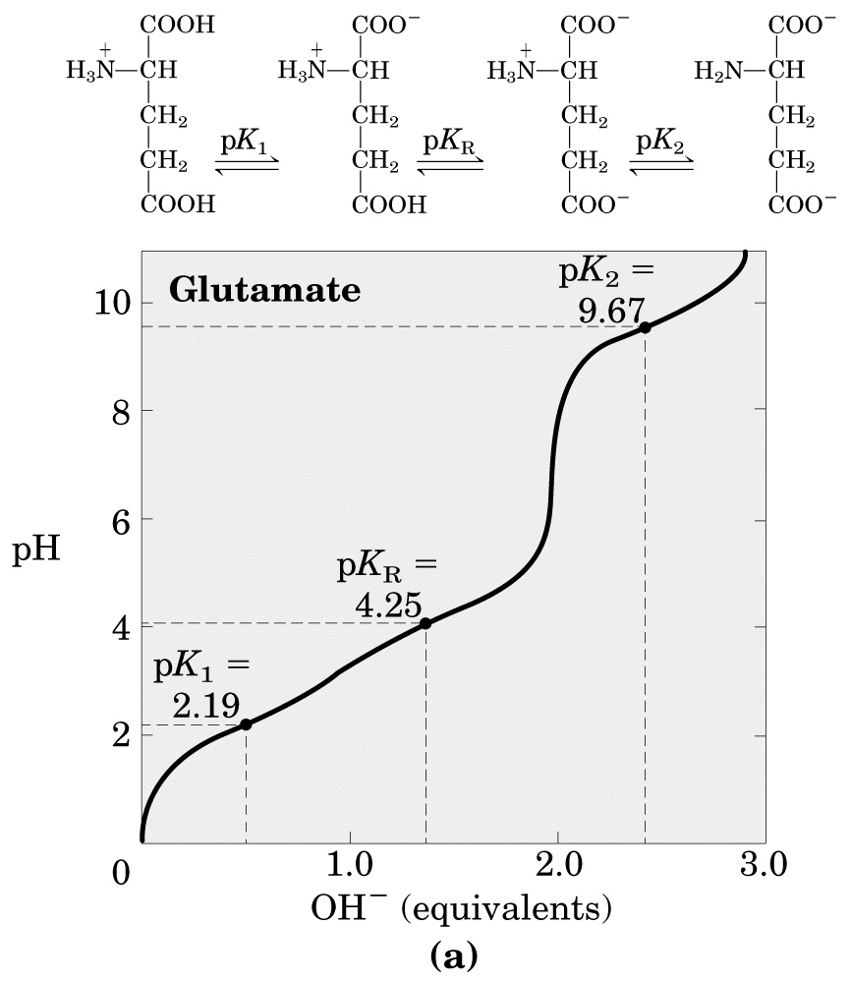
The ionization state of aa’s. Some aa’s can be protonated/deprotonated depending on the pH. The midpoint of this process is called the pK. You can ignore pK1 and pK2 since they don’t occur in proteins (except for the N and C termini respectively).

Slide 11
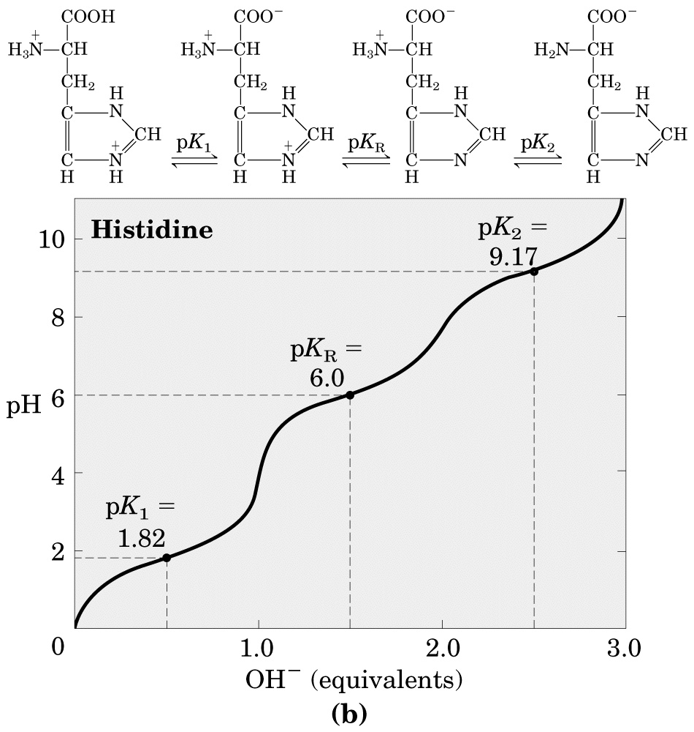

Slide 12
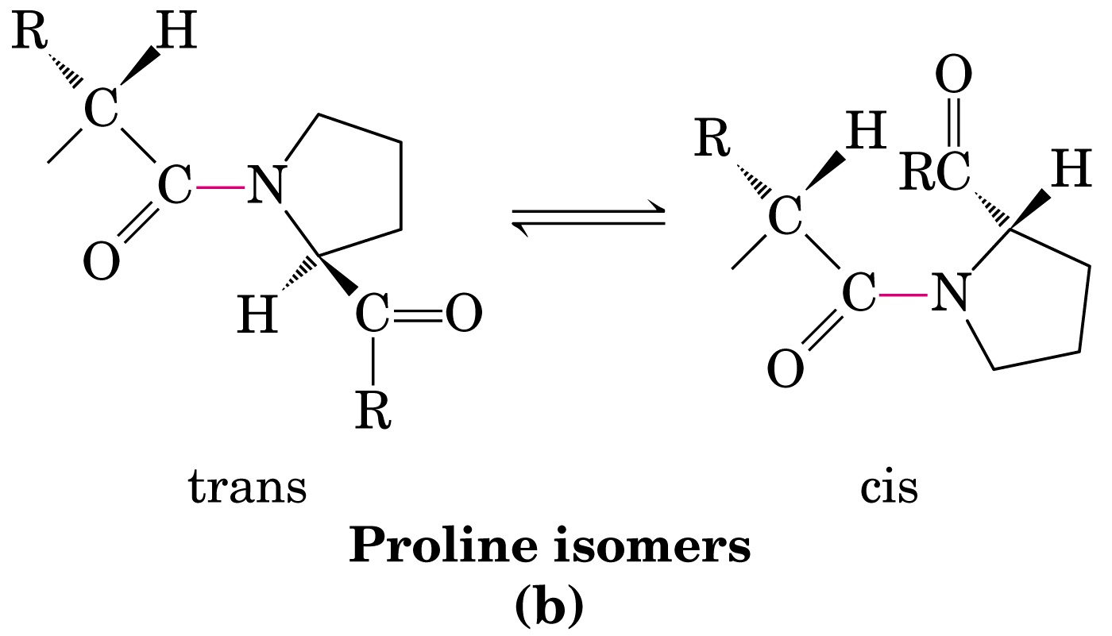
δ
γ
α
β
α
β
γ
δ
Proline has 2 conformers that are related by rotation about peptide bond. This occurs because the e-’s of the N form part of a σ bond with the δ carbon. The rotation is slow so that to distinct populations can be found in proteins. Trans is usually 90-95%.

Slide 13
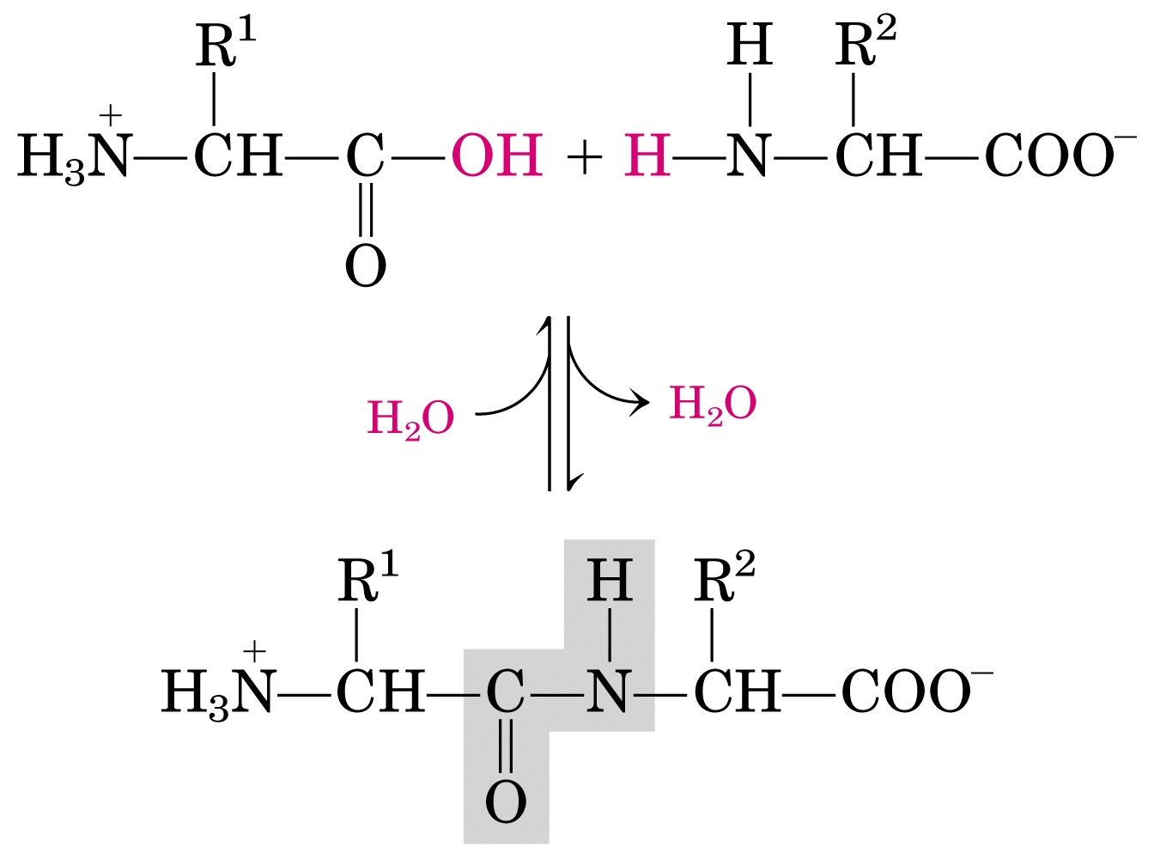
Formation of the peptide bond. Condensation reaction forms the bond and releases water. Resonance structures indicate a partial π structure for the N-C bond and therefore there is no rotation.

Slide 14
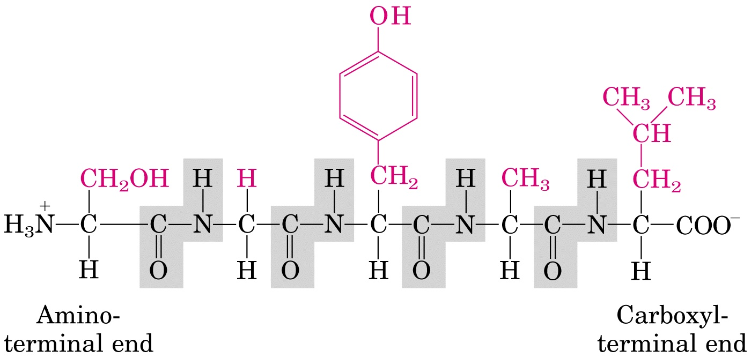
Y
V
G
S
A

Slide 15
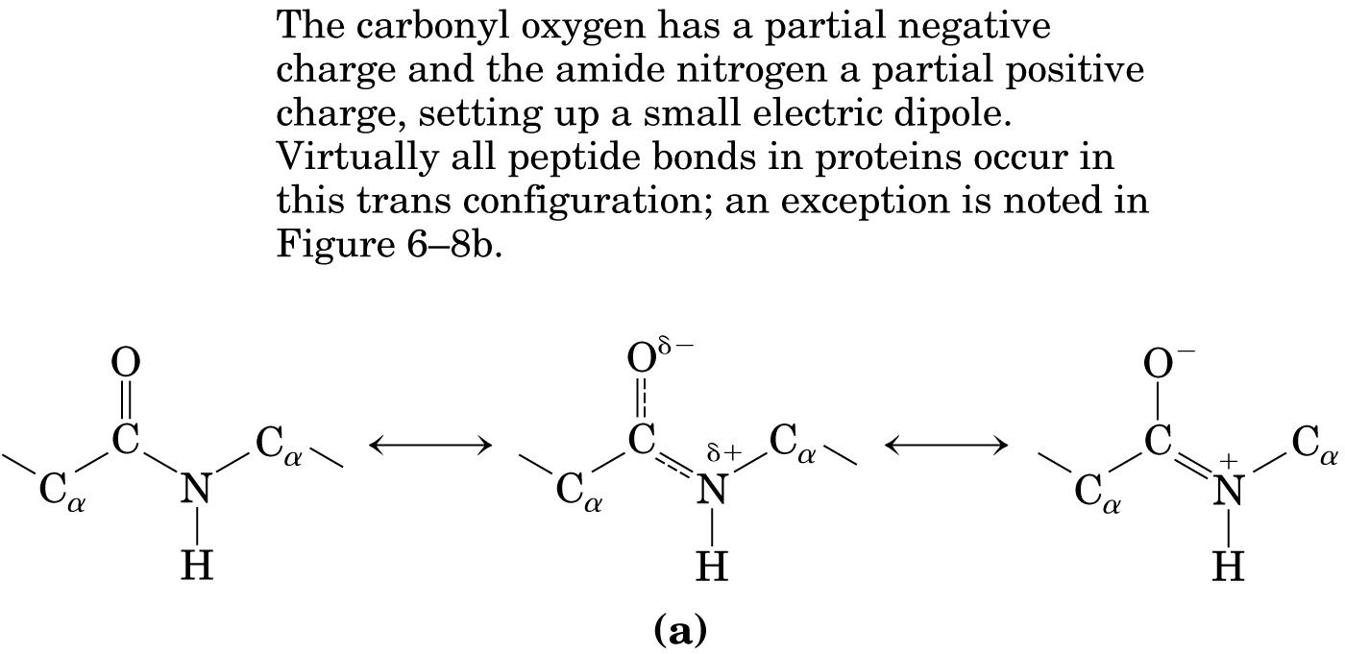
Due to the partial double bond character of the N-C bond, peptide bonds are planar!

Slide 16
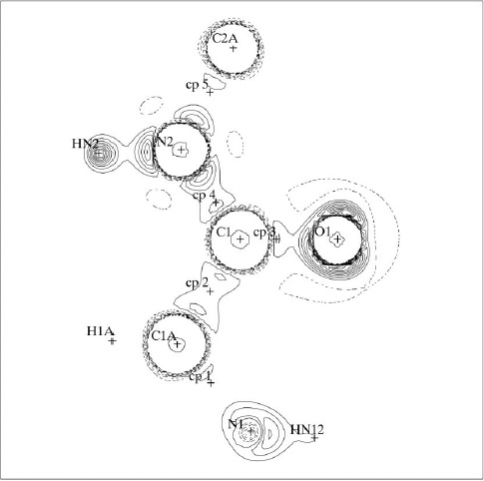
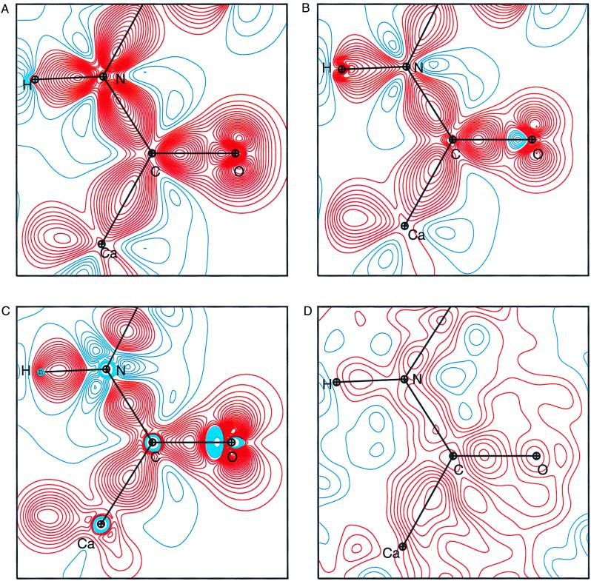
Electron distribution in a peptide bond.
Calculated
Determined from 0.54Å structure.

Slide 17
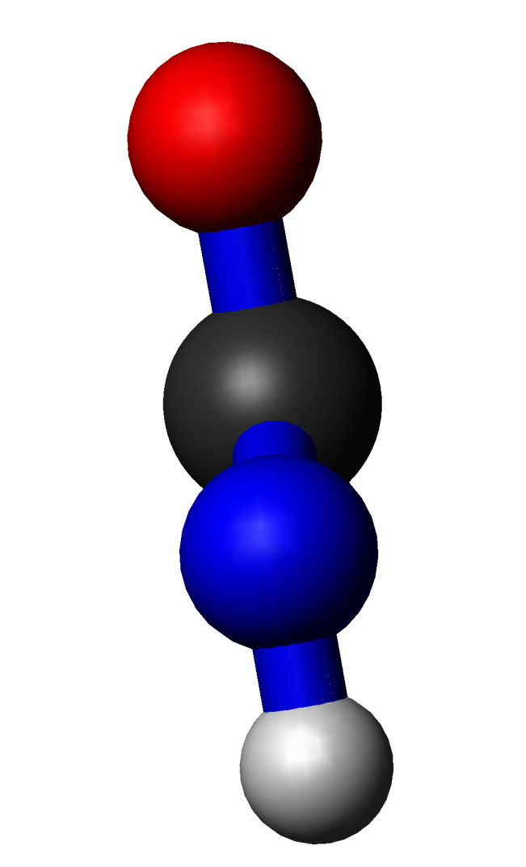
Structure of the peptide bond
Electron density of a high resolution xtal structure. The backbone can readily be seen. At right, the location of the backbone atoms in a peptide bond from the structure above. N,C,O, HN.

Slide 18
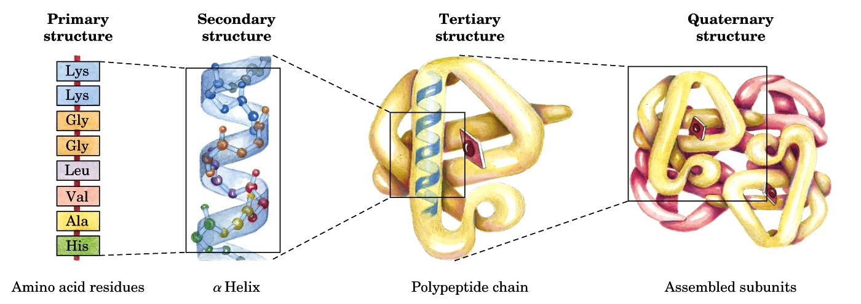
The levels of protein structure
Molten globule

Slide 19
The dihedral angles of the protein backbone.
Phi (φ) is defined as the four atoms C(i-1) - >N(i) - Cα(i) - C(i).
Psi (ψ) is composed of the four atoms N(i) - Cα(i) - C(i) >- N(i+1).
The blue rectangles indicate the plane of the peptide bond.

Slide 20
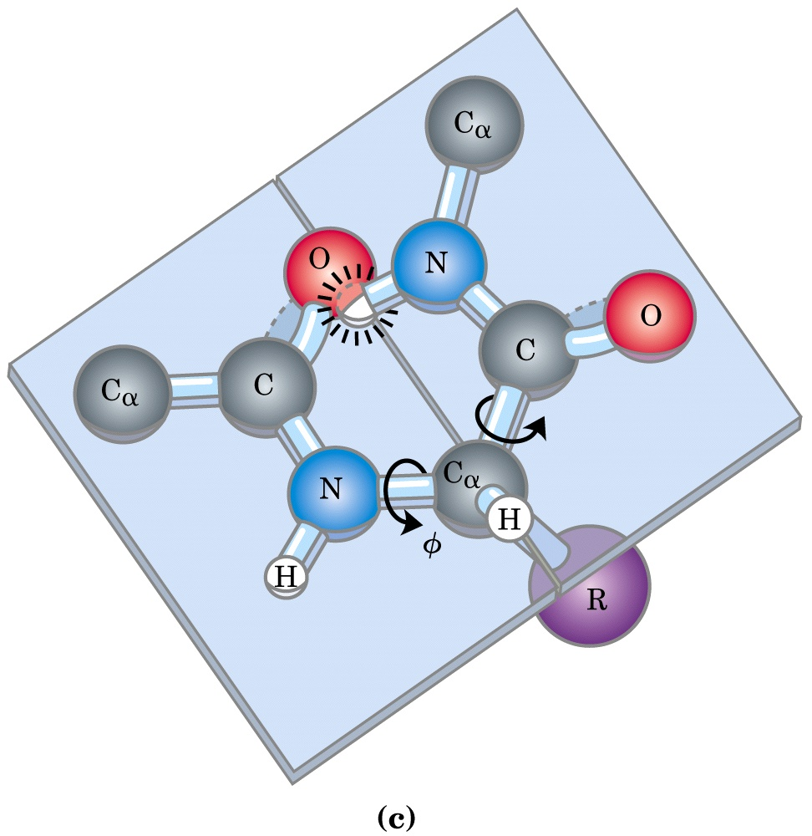
The range of the dihedral angles is limited by steric clash.

Slide 21
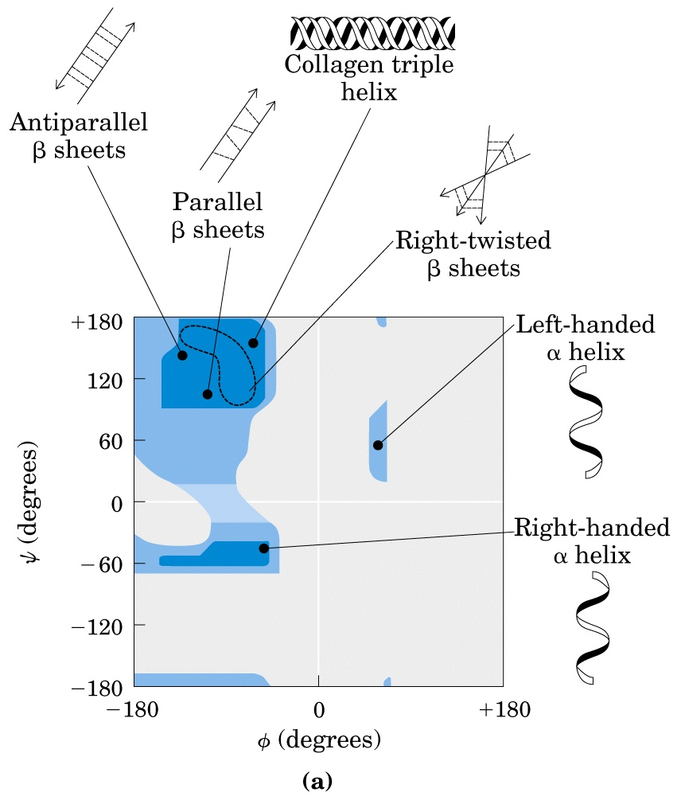
Glycine
Only right handed α-helices are observed in proteins.
The Ramachandran plot

Slide 22
The Elements of Secondary Structure I. The α-Helix

Slide 23
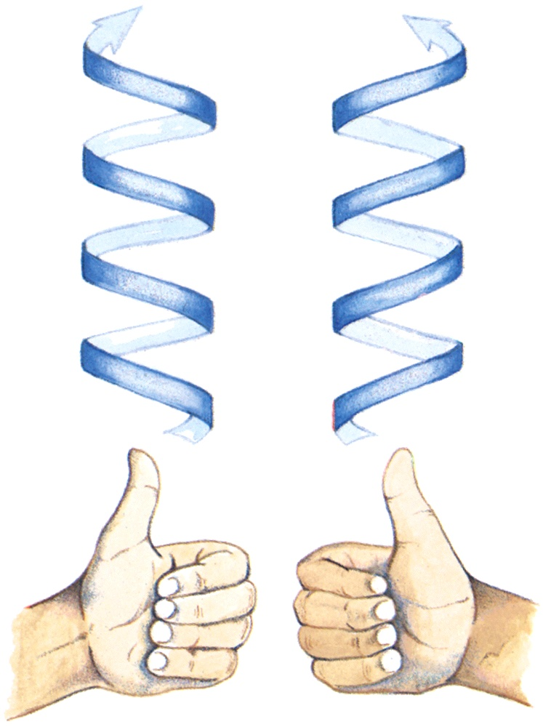
C-terminus
N-terminus
Left vs Right
Handed
Helices in proteins are right handed.

Slide 24
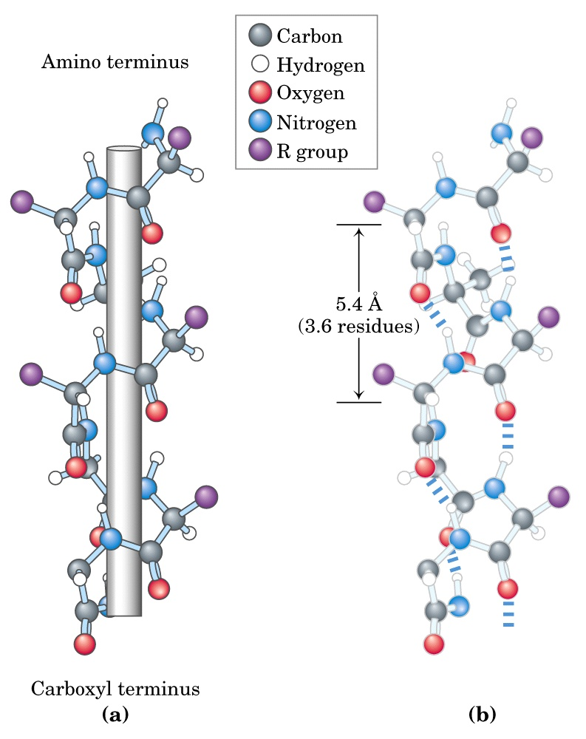
In α-helices, the CO of residue I H-bonds to the HN of residues i+3 and i+4. Because all the HN’s and all the CO’s point in the same direction, an α-helix has a net dipole (electric charge).
2
1
3
4
5
H-bond

Slide 25
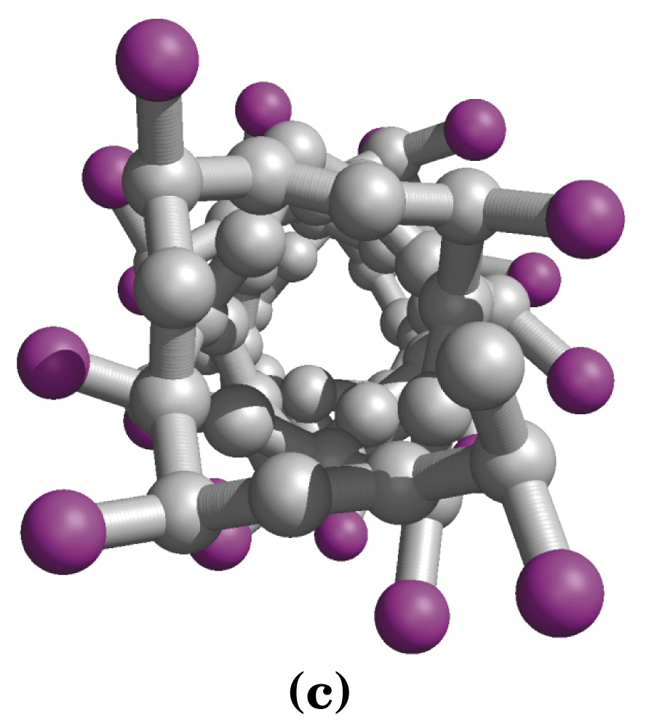
Helices have a straight axis. Here you are looking down the axis of a helix. Clearly the sidechains (represented by the purple balls) are on the OUTSIDE of the helix. A helix is not really hollow, the atoms are not shown with their real van der Waal’s radii for clarity.

Slide 26
CPK or space filling view of the same α-helix. So you see that the helix is essentially solid.

Slide 27
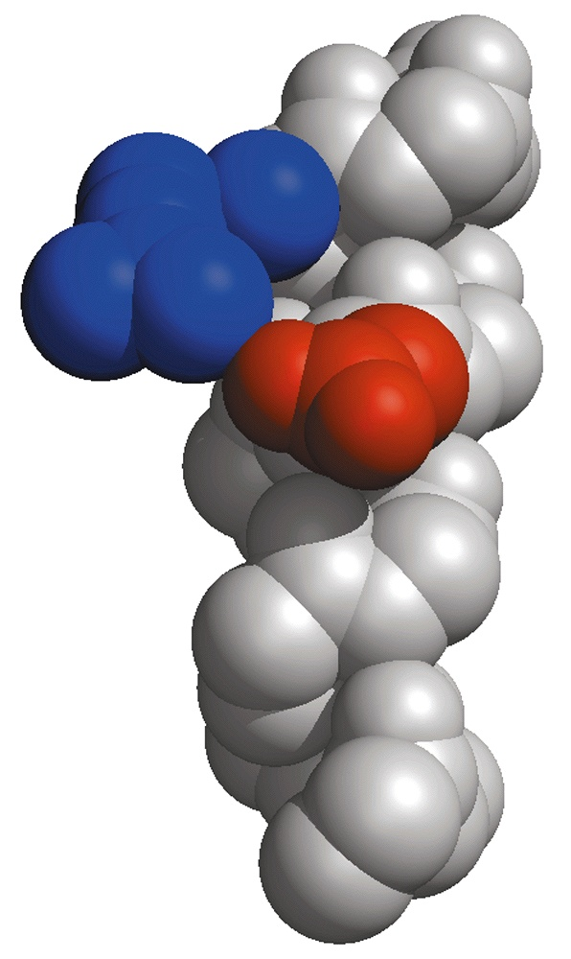
Side chain interactions within the α-helix. Just as the backbone of residues i and i+3 interact, so do the sidechains. Here you see a blue R forming a salt bridge with a red D.
i+4
i

Slide 28
The Elements of Secondary Structure I. The β-Sheet

Slide 29
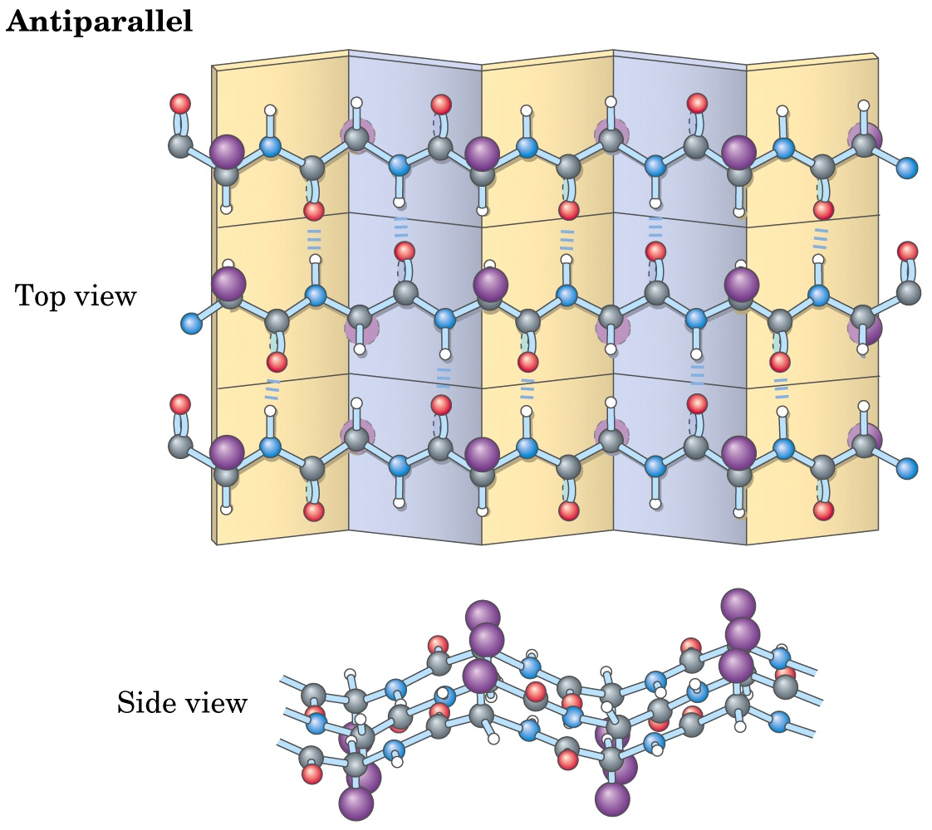
Most common!
N-term
C-term
C-term
N-term
C-term
N-term
Note: the arrows in Lehninger are wrong!

Slide 30
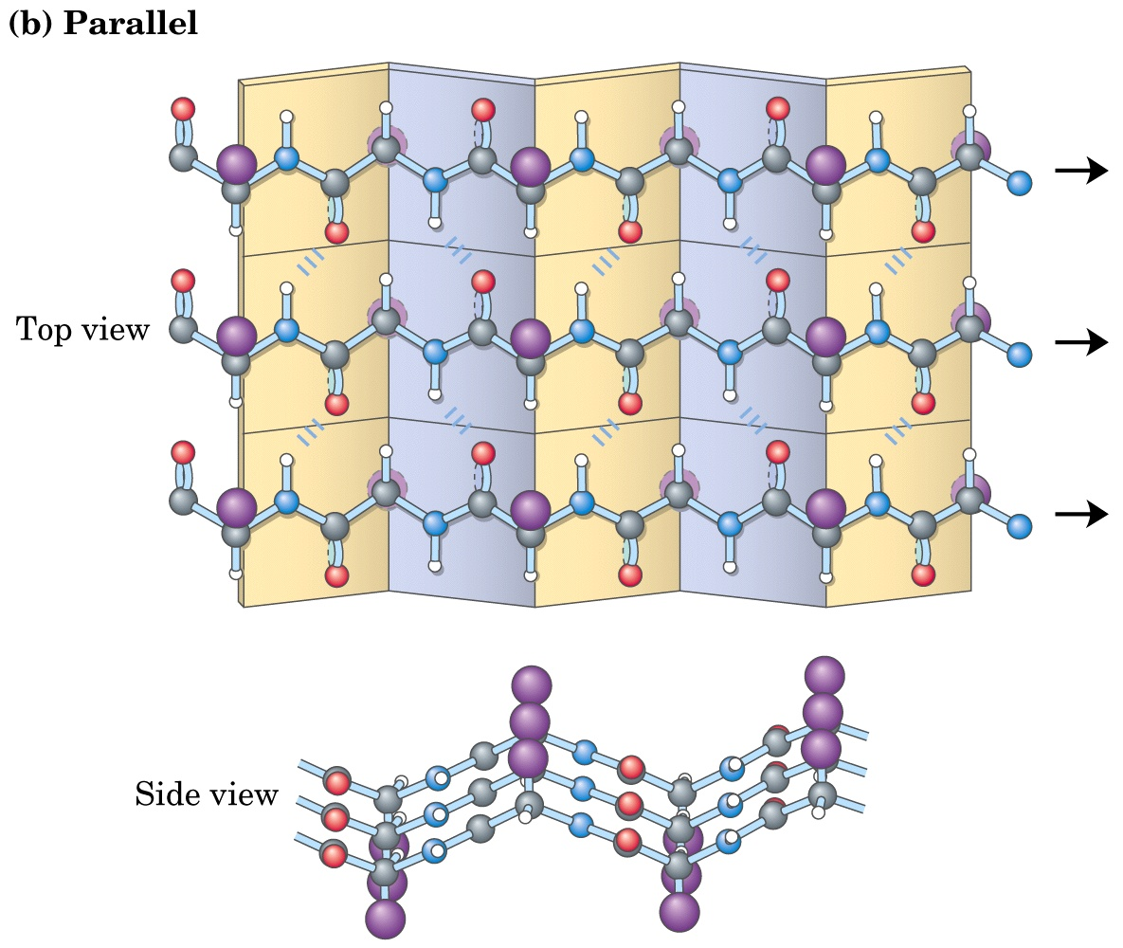
Less common.
C-term
C-term
C-term
Note: the arrows in Lehninger are wrong!

Slide 31
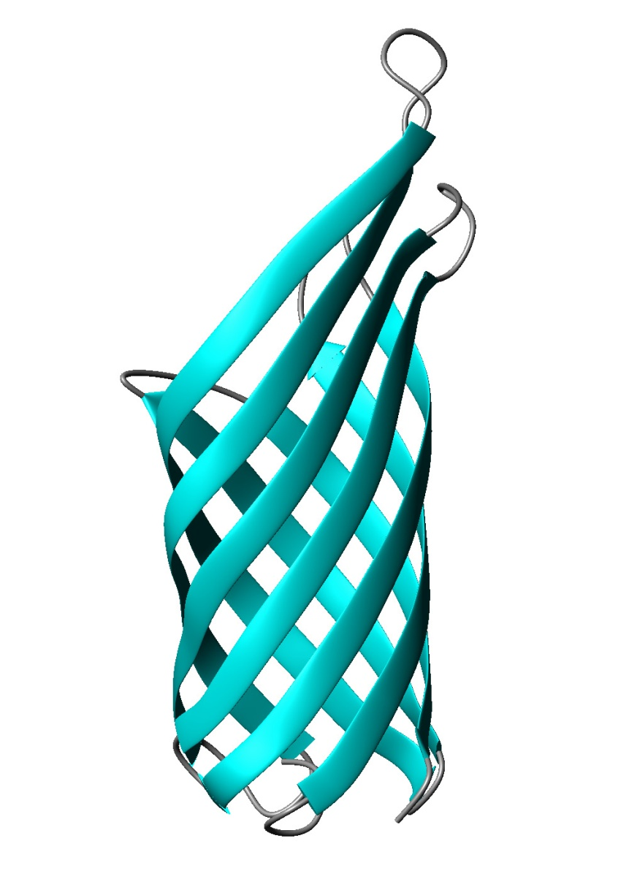
β-sheets are almost never flat!
One continuous β-sheet that wraps around into a β-barrel.

Slide 32
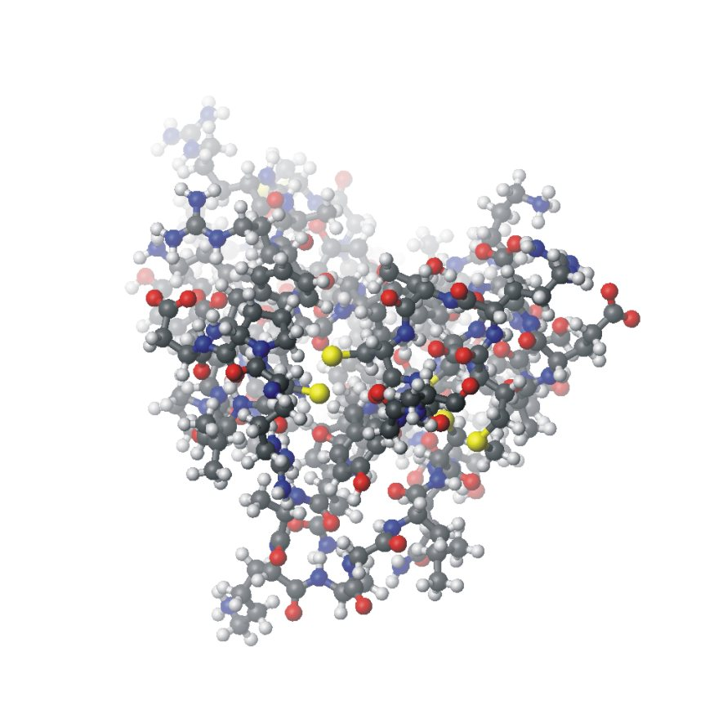
Tertiary Structure Representations
Ball and stick
Kind of usefull. Shows where atoms are but gives misleading idea of protein density. Does not reveal 2º structure.

Slide 33
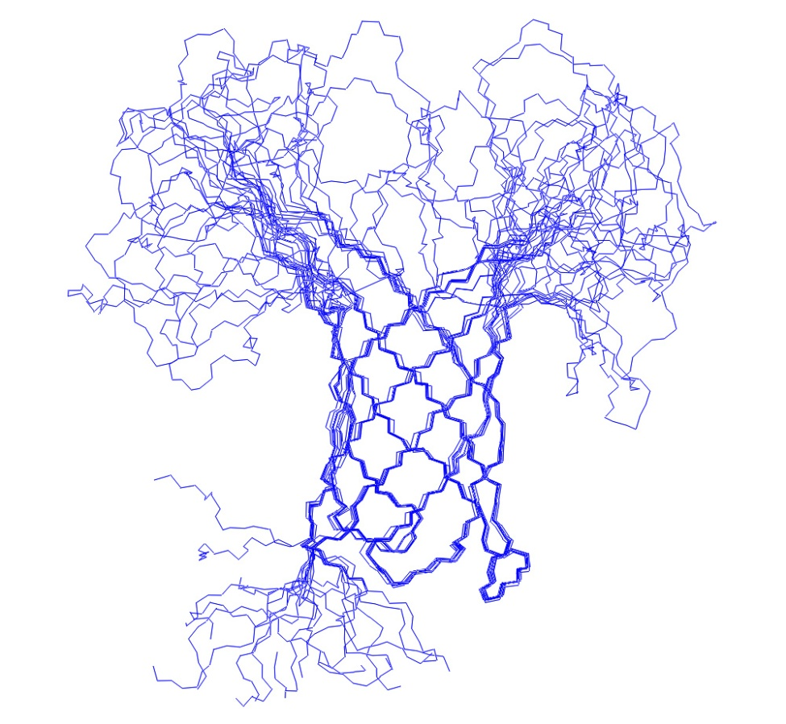
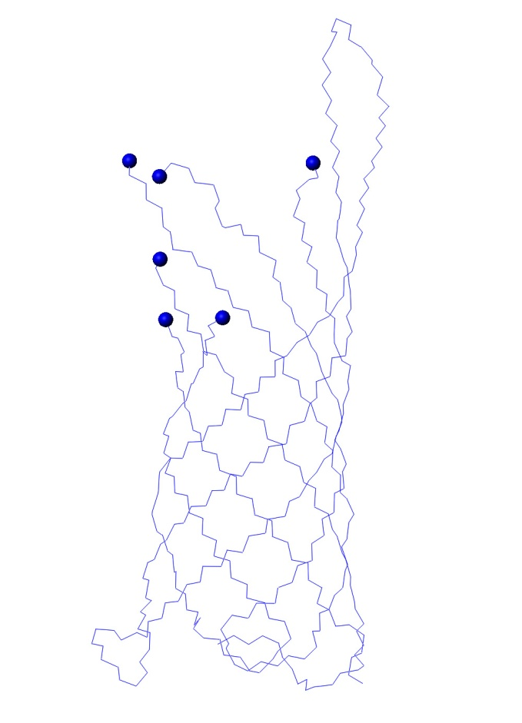
Tertiary Structure Representations: bond
The backbone bonds only are shown in these views of the E. coli membrane protein OmpA. Missing portions of the crystal structure are highlighted by the blue balls. The secondary structure is obvious.
Helix
10 Best NMR Structures
of the protein OmpA
Crystal Structure

Slide 34
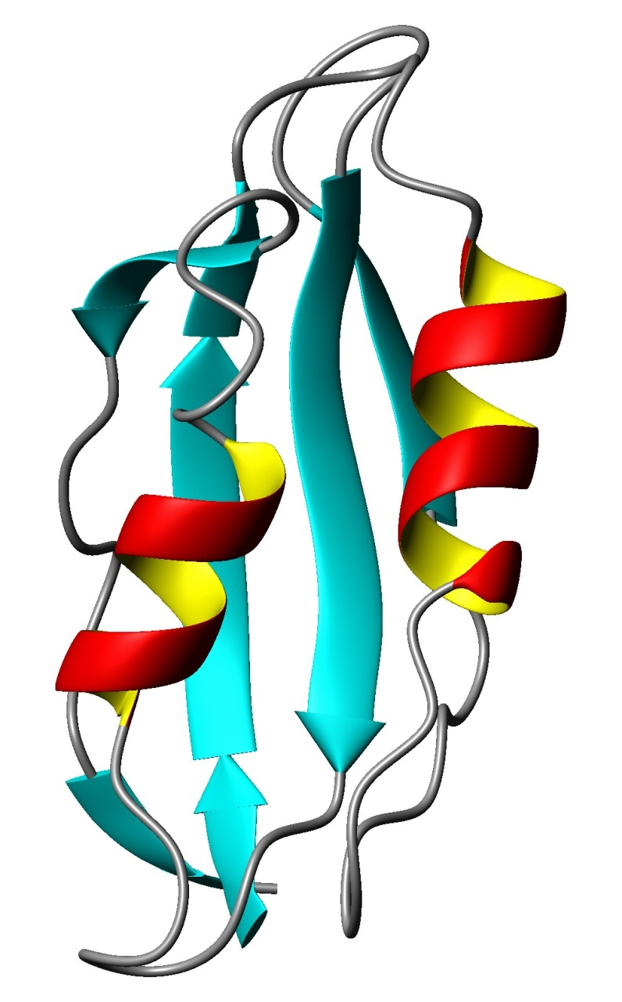
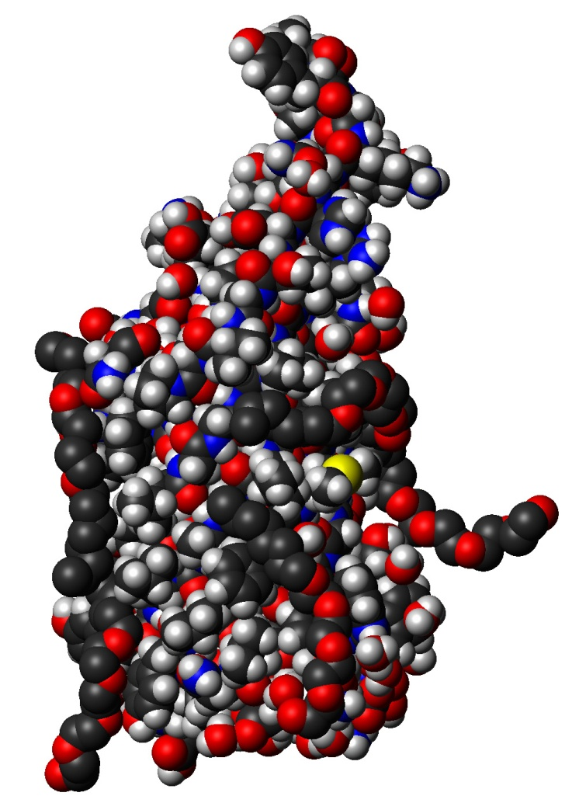
Tertiary Structure Representations: Ribbon/CPK
Helix
Sheet
While not a good way of analyzing how a protein folds, the CPK view does give an accurate feel for how dense folded proteins are (note that there are no holes in the structure).
An extremely common view of the architecture of proteins.

Slide 35
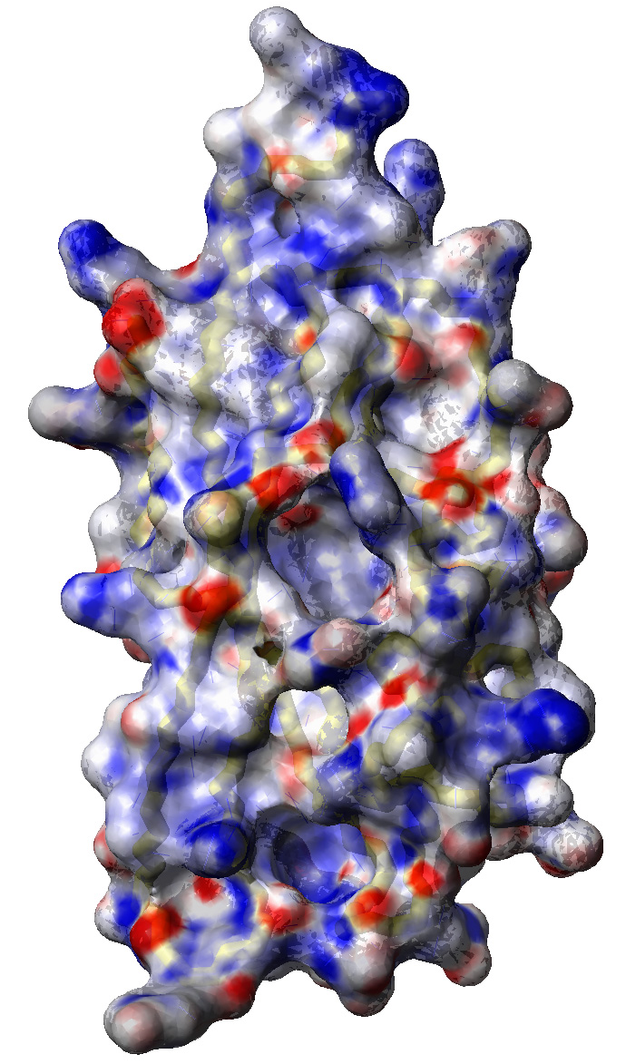
Tertiary Structure Representations: Surface
Surface with transparency and backbone bonds visible.
Surface is colored according to electrostatic potential.
Positive
Negative

Slide 36
Structural Motifs
In proteins, a structural motif is a three-dimensional structural element or fold within the chain, which also appears in a variety of other proteins. The term is sometimes used interchangeably with "structural domain," although a domain need not be a motif nor, if it contains a motif, need not be made up of only one.
Structural alignment is a major method for discovering significant structural motifs.
Motifs exhibit both tertiary and secondary structure, and may be regarded as a configuration of secondary structures. Such a description is the basis for many of the names that structural biologists give to particular kinds, such as the helix-turn-helix motif. This is not always true, however, as in the case of the EF-hand.
Because the relationship between primary structure and tertiary structure is not straightforward, two biopolymers may share the same motif yet lack appreciable primary structure similarity.
Modified from the Wikipedia.

Slide 37
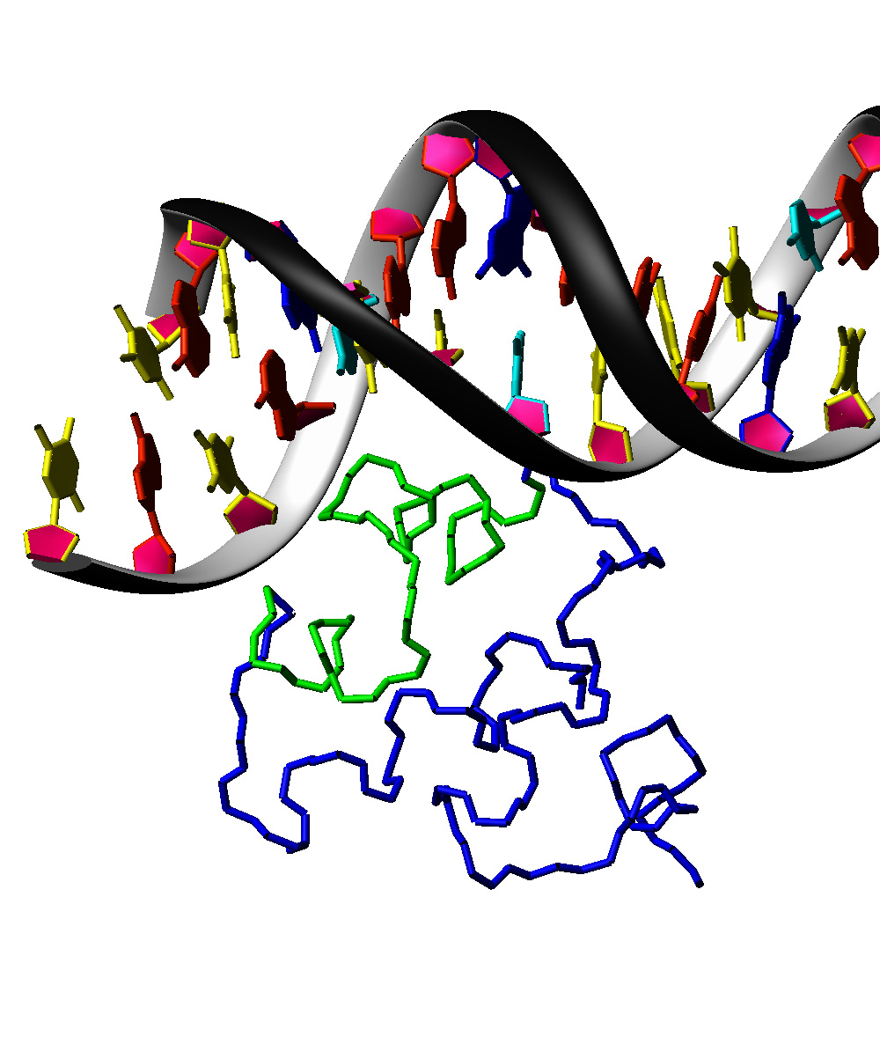
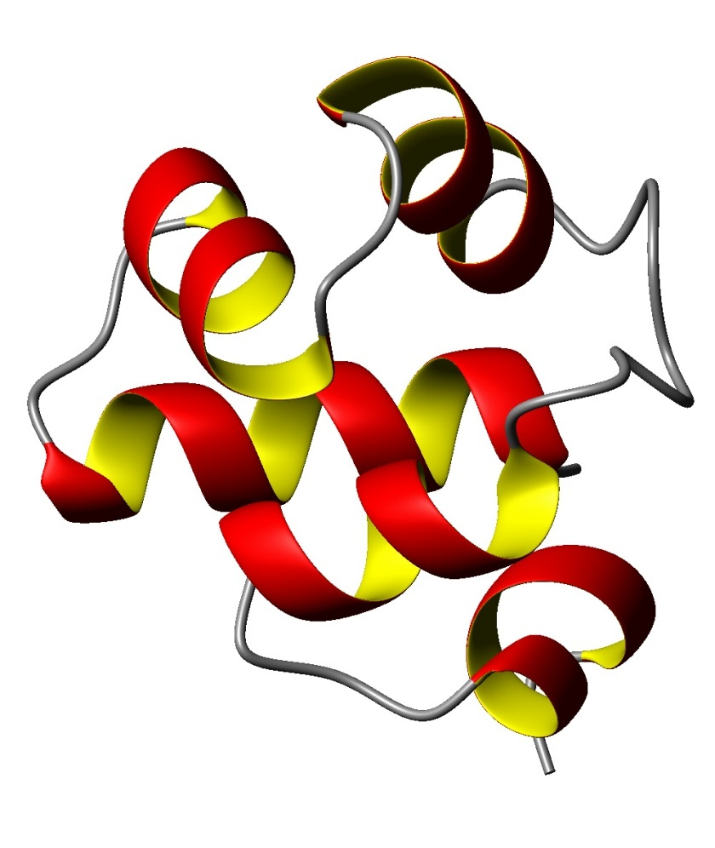
A few examples of common 3º structural motifs
H
H
T
Helix-turn-Helix: a basic nucleic acid binding structure. This motif (green on left) and the exact relationship between the helices is conserved from bacteria to man.

Slide 38
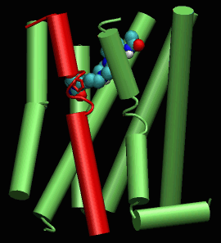
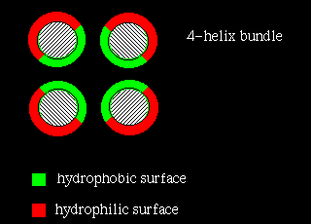
The helical bundle bundle.
membrane
7 Transmembrane helical bundle
A GPCR
This arrangement of hydrophobic and hydrophyllic interfaces is for a soluble protein.
http://swissmodel.expasy.org/course/text/chapter4.htm

Slide 39
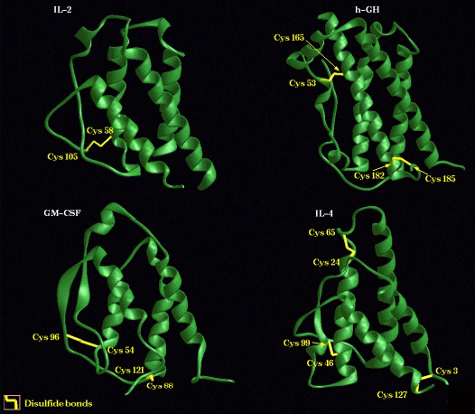
Some 4 helix bundle proteins
Cytokines: secreted proteins that regulate cellular function.

Slide 40
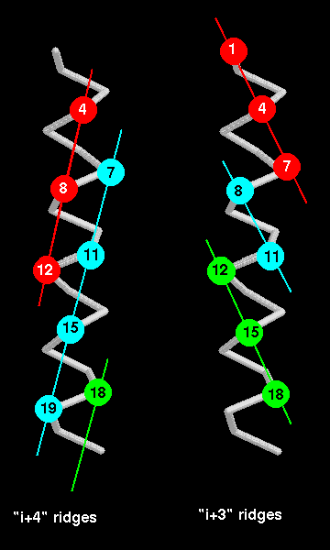
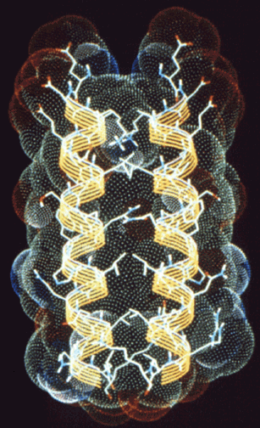
Helix-Helix Interactions
θ
θ = 26⁰
Helix Packing
The Leucine “Zipper”

Slide 41
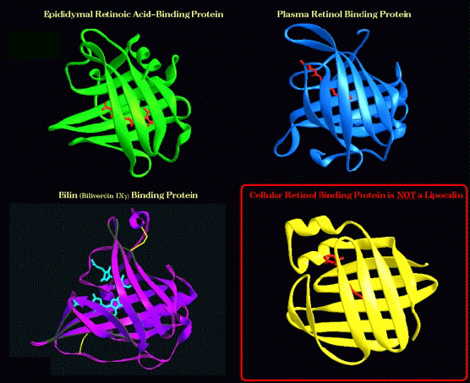
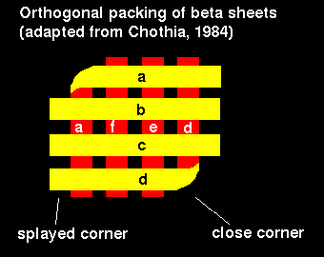
β-sheets
Orthogonal – 1 sheet folded back onto itself

Slide 42
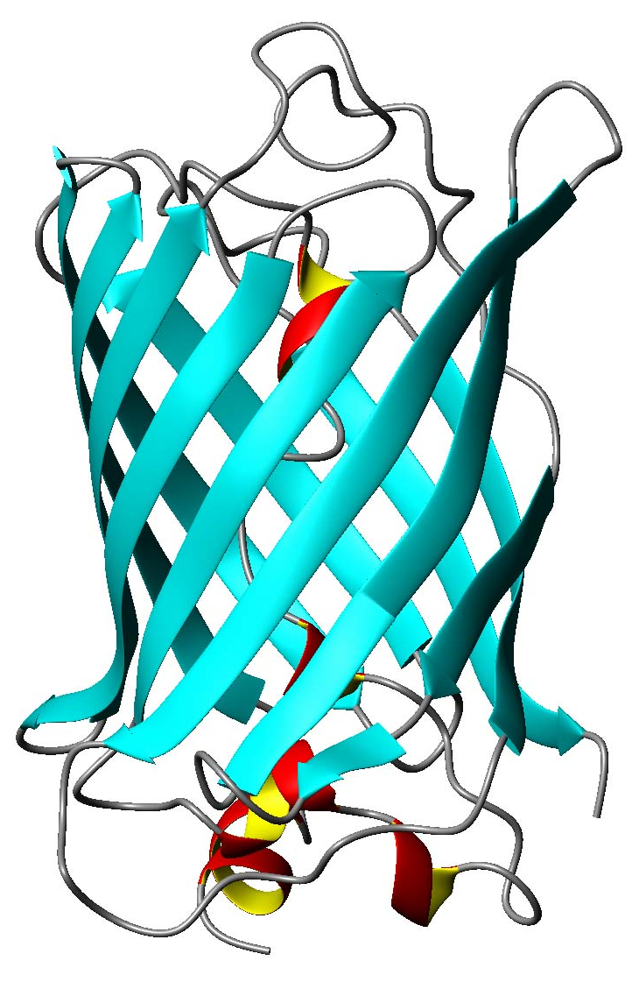
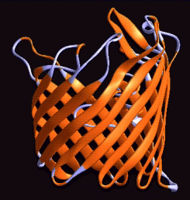
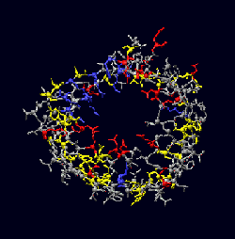
The β-barrel
Green Fluorescent Protein

Slide 43
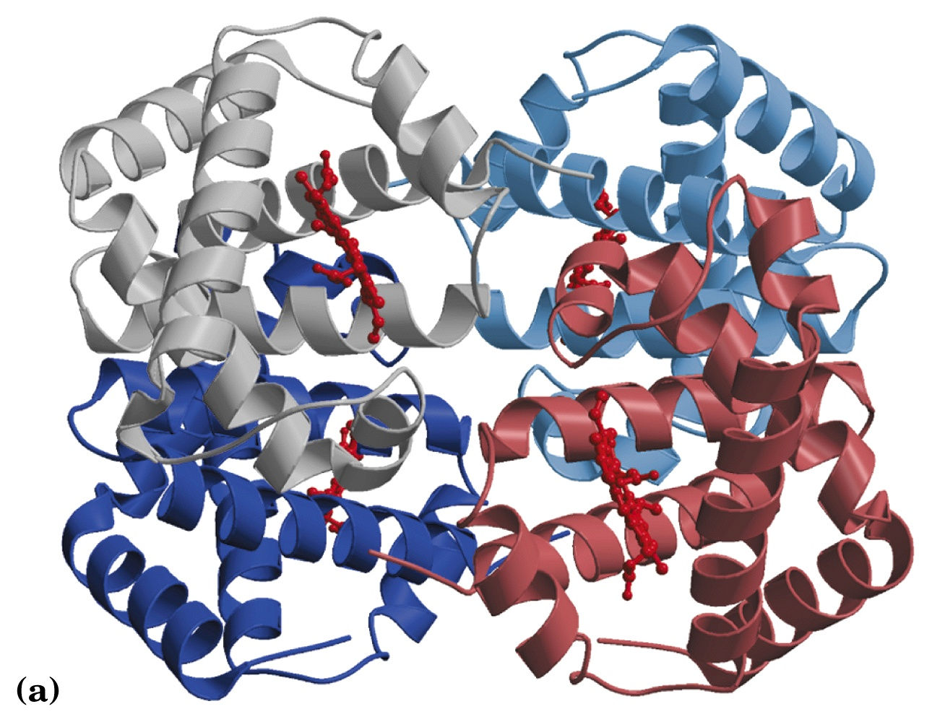
Haemoglobin-An example of quaternary structure i.e. complex formation by multiple subunits.

Slide 44
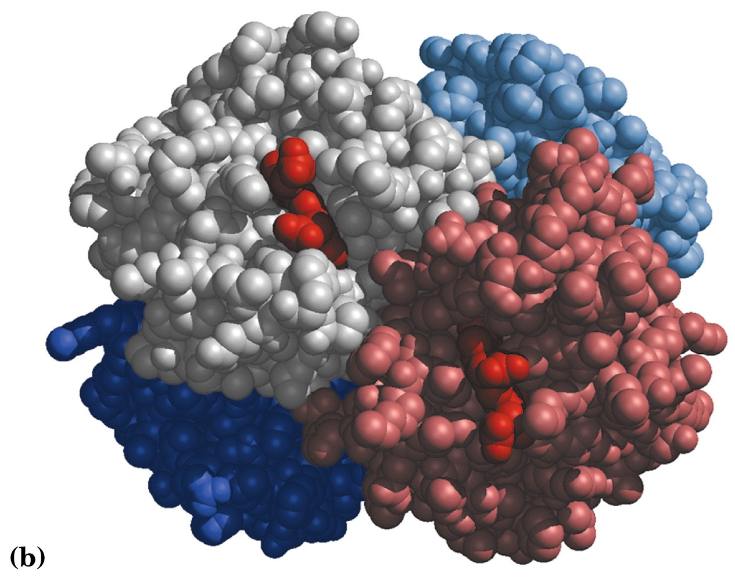

Slide 45
Protein domains
Pairwise sequence comparison of proteins led to strange results
A domain is an independent folding unit
A domain is the next step up in complexity from a motif
There appear to be a limited number of folds (domains) that can be made from the 20 natural aa’s
Domain unit of evolution
Mixing and matching can create new function and regulation
Most proteins involved in cell signalling consist exclusively of small domains interspersed by linker regions. The linkers may be unstructured as described in the following section.

Slide 46
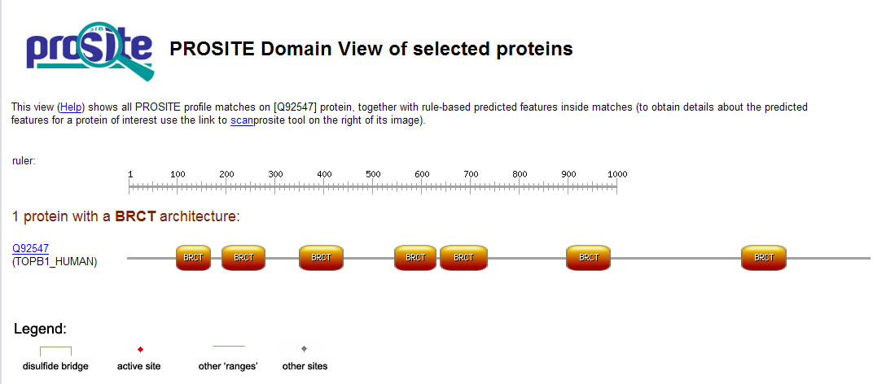
How proteins are made from domains.
Some proteins consist only of domains that have no enzymatic activity. It is thought that they function as scaffolds for specific complex formation.
SH3
SH3
GRB2
BRCT domains are a good example of divergent evolution. An ancient domain found in pro- and eukaryotes, it is characterised by a conserved fold despite significant sequence divergence. BRCTs are known to bind DNA and other proteins. Protein-protein interactions included self binding, binding BRCTs on other proteins, binding non-BRCT domains and binding to phosphoserine peptides.

Slide 47
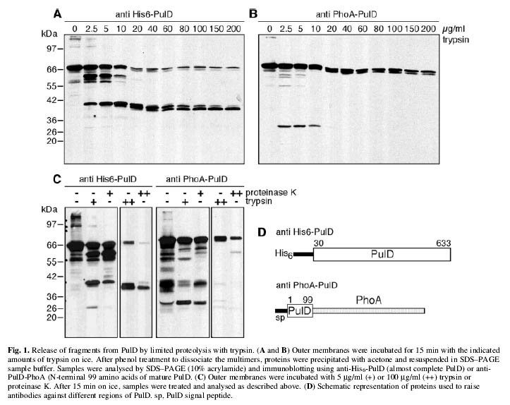
Determining Domain Structure by Limited Proteolysis

Slide 48
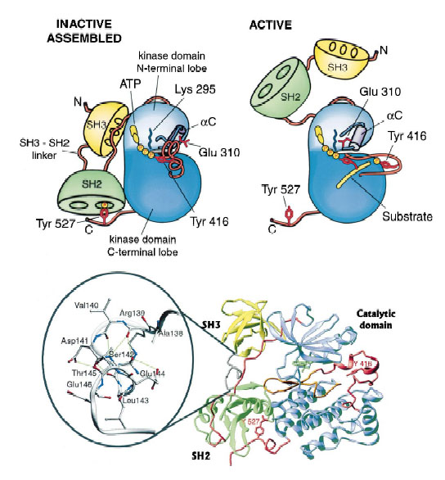
Protein regulation by coordinated action of domains
Having multiple domains in one protein can serve a variety of functions, one of which is illustrated here. The kinases, Src, Lck and Hck, all of which can cause aberrent growth signalling, are regulated by an internal Y phophorylation.
When Y527 is phosphorylated, SH2 and SH3 are “locked”, forcing lobes of kinase down and blocking access to the active site.
Young et al., 2001, Cell, v. 105, p.115

Slide 49
Not all proteins are structured: Intrinsically Unstructured Proteins
What are unstructured proteins? Proteins (segments of proteins) that are lacking well-structured 3-dimentional fold. They are referred as “natively denatured/unfolded”, “intrinsically unstructured/unfolded”.
Why are they relatively obscure? Our view of protein universe was strongly determined by the tools we had: X-ray crystallography will not “see” such proteins, as they difficult to crystallize.
How prevalent are unstructured proteins? About 35-51% of the proteins have unstructured regions that are longer than 50 residues; 6-17% of proteins in the Swiss-Prot are probably fully disordered.
Determined by neural networks predictors (based on the protein sequence).
This section of the lecture is not supported by any textbooks since it contains very new information.

Slide 50
What determines if the protein will be folded or unfolded? There is a sequence signature that describes unfolded regions.
Signature:
low sequence complexity
bias toward polar and charged amino acids (Gln, Ser, Pro, Glu, Lys, and occasionally Ala and Pro)
bias away from bulky hydrophobic residues (Val, Leu, Met, Phe, Trp, Tyr)
An array of programs are available now to predict disordered regions:
PONDR (Dunker’s group)
FoldIndex (Uversky’s group)
DisEMBL (Gibson’s group)
GLOBPLOT (Gibson’s group)
DISOPRED (David Jones’s group)
IUPred (Tompa’s group)

Slide 51
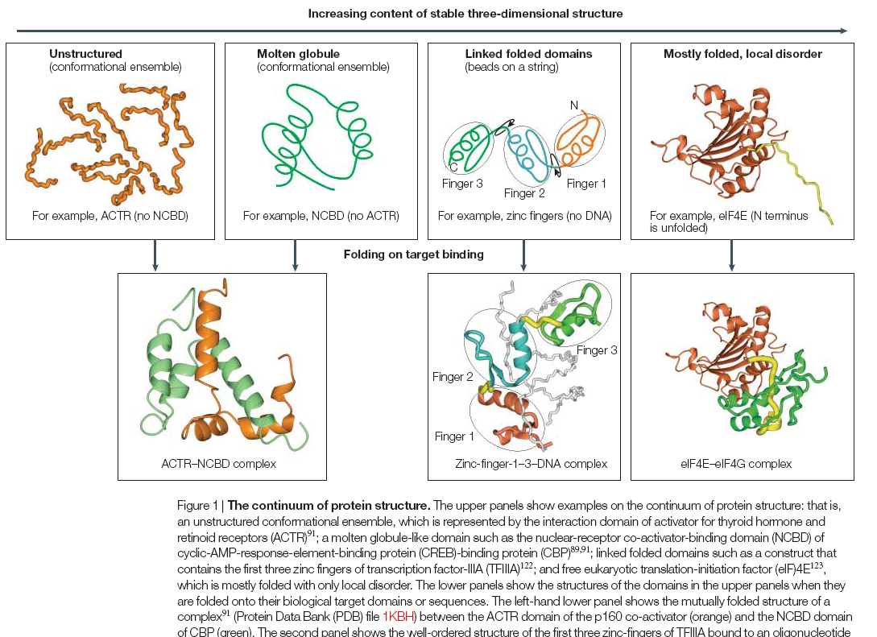
A continuum of protein structures
Dyson and Wright, “Intrinsically unstructured proteins and their functions” (2005) Nature Review Molecular Cell Biology 6: 197-208

Slide 52
Coupling of folding to target binding
KID domain of CREB
pKID bound to KIX domain of CBP (CREB binding protein).
Can provide tighter binding than similar sized, folded proteins.
Enthalpy-Entropy compensation.
Allows post-translational modification.
Predicted α-helices in free peptide
Experimentally determined α-helices in complex

Slide 53
Unstructured proteins can adopt multiple structures upon target binding- they are “plastic”
Hif1α peptide bound to the TAZ1 domain of CBP. Here the peptide forms an α-helix.
Hif1α peptide bound to asparagine hydroxylase. Here the peptide binds in an extended conformation.

Slide 54
Take-Home Lessons
Proteins are polymers of 20 naturally occurring, L-amino acids (aa).
The sequence of aa’s defines the structure and hence function, of a protein.
The aa’s can be divided into hydrophobic, polar and charged groups depending on the sidechain chemistry. This defines where in the 3D protein structure a given aa is likely to be found.
Because of the sidechain, the rotation around the backbone bonds, defined by the dihedral angles φ and ψ, is hindered with certain values being preferred.
Proteins fold into different levels of structure referred to as secondary through quaternary. You should know what each refers to.
Large proteins generally do not consist of one large structure but multiple, independently folding domains that not only provide specific functions, but interact to add a further level of regulation to protein function.

Slide 55
Take Home Lessons (cont)
Many proteins or portions of proteins within the cell are intentionally disordered.

