Slide 1
Bioinformatics
From a Sequence to the Structure
OUTLINE of the Course
Proteins – general context, central dogma, source of data
Databases
Proteins building blocks (properties, statistics)
Alignment – and the reason to make it well!
Analysis of a protein sequence – physical properties, SS elements, IUP
Secondary structure prediction
Principles of Protein Folding
Structural prediction of Proteins – homology, threading, ab initio
MD Simulations as a tool for 3D prediction; pros and cons
Principles of Protein-Protein Interaction, Docking
Drug Design
SPDBV, Modeller, Erin, IFold, Cluspro – how to make them work
Internet services for molecular modeling

Slide 2
Our Focus: Proteins
1) Proteins: the molecules of life
2) Protein molecules: geometry
3) Protein molecules: chemistry and physics

Slide 3
Our Focus: Proteins
1) Proteins: the molecules of life
2) Protein molecules: geometry
3) Protein molecules: chemistry and physics

Slide 4
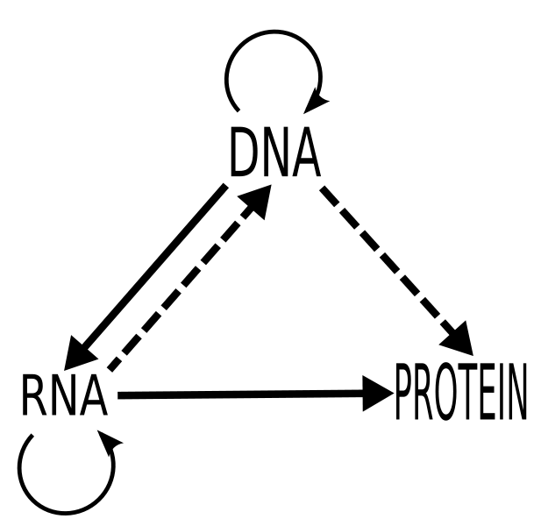
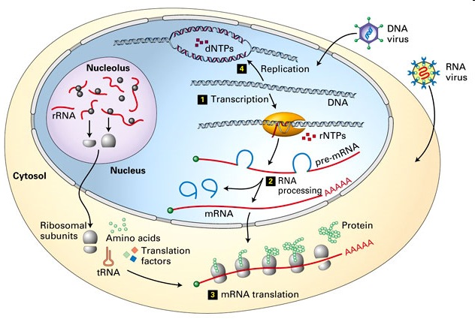

Slide 5
Central Dogma of Molecular Biology
Genotype
Replication
DNA
Transcription
RNA
Translation
Protein
Phenotype

Slide 6
Proteins: The Molecules of Life
Ubiquitous molecules that are involved in all
cellular functions
Communication agents between cells
Failure of a protein (missing, inactive, …)
can lead to serious health problems
(prions, …)

Slide 7
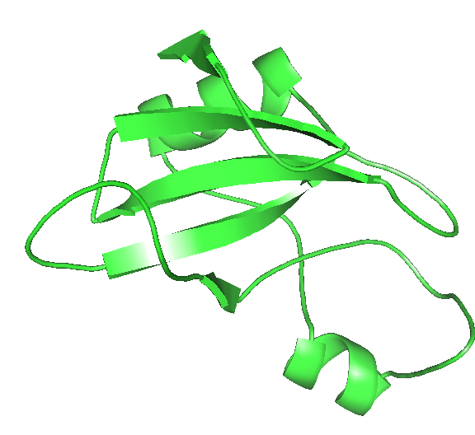
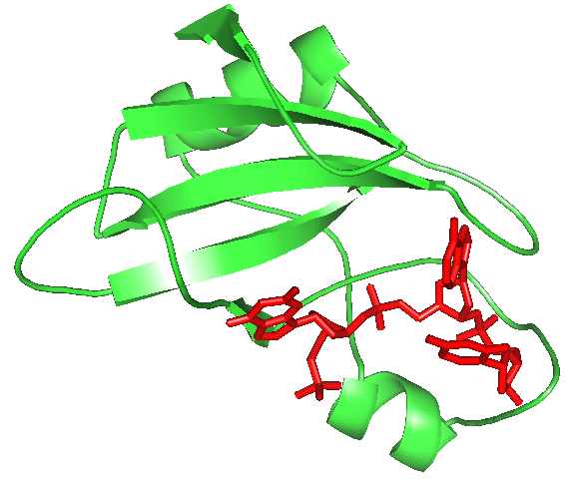
The Cycle of Life
Structure
Function
Sequence
KKAVINGEQIRSISDLHQTLKK
WELALPEYYGENLDALWDCLTG
VEYPLVLEWRQFEQSKQLTENG
AESVLQVFREAKAEGCDITI
Evolution
ligand
From Sequence to Function and Back…

Slide 8
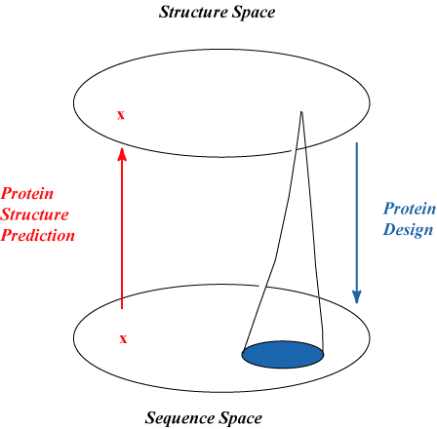
Structure is Central
Structure Space
Protein
Sequence
Design
Protein
Structure
Determination
NMR
X-Ray
Neutron Diffraction
Prediction
Directed evolution
Computational Design
Sequence Space

Slide 9
Structure is Central
Function depends
On protein shape
Specific associations
Precise reactions

Slide 10
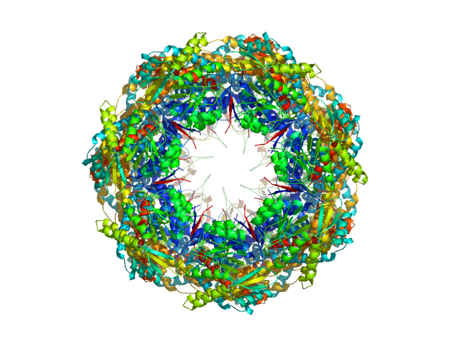
Protein Engineering
“Nano” Engineering
- Can make any sequence
- Really small features (0.1 nm)
- Molecular machines
Recruit Proteins for New Tasks
- Industrial enzymes
- Bio-remediation
- Pharmacology
- Material Sciences
10 nm
Shewanella Genome

Slide 11
Our Focus: Proteins
1) Proteins: the molecules of life
2) Protein molecules: geometry
3) Protein molecules: chemistry and physics

Slide 12
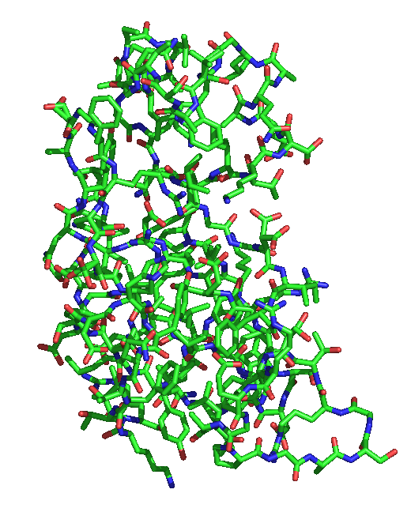
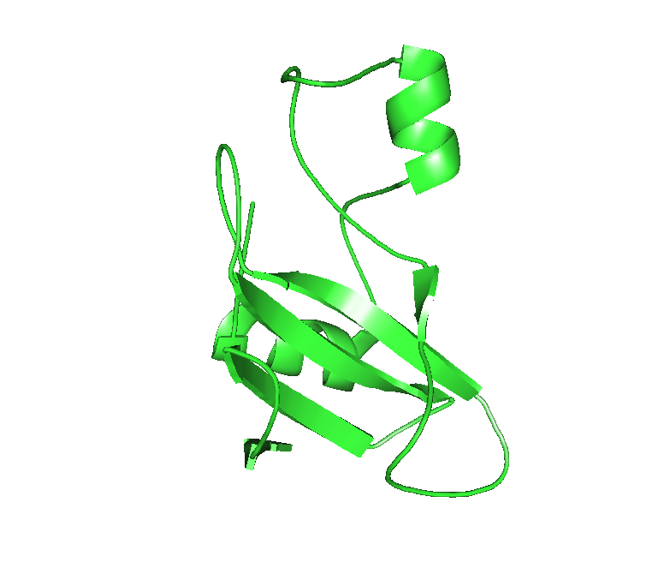
Protein Structure Representation
CPK: hard sphere model
Ball-and-stick
Cartoon

Slide 13
Protein Structure
Primary structure
Secondary Structure
Tertiary Structure
Sequence of Amino acids
Local interactions
Native protein

Slide 14
Protein Structure
Structure
Sidechains
Backbone
Sequence:
….Gly Phe Asp ….

Slide 15
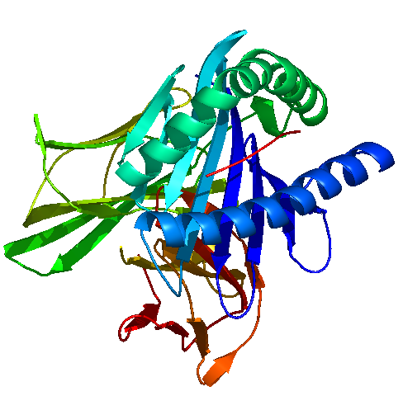
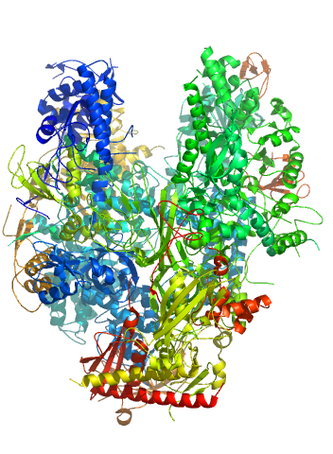
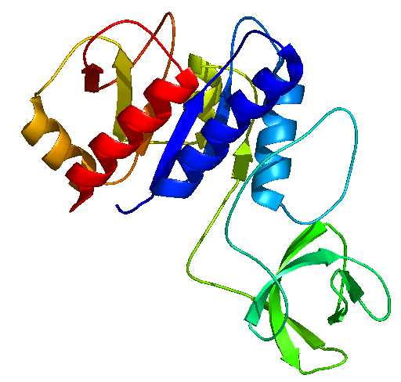
Protein Structure Diversity
1CTF
1TIM
1A1O
1K3R
1NIK
1AON

Slide 16
Our Focus: Proteins
1) Proteins: the molecules of life
2) Protein molecules: geometry
3) Protein molecules: chemistry and physics

Slide 17
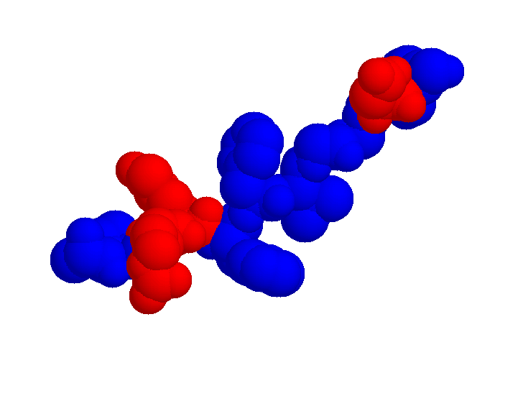
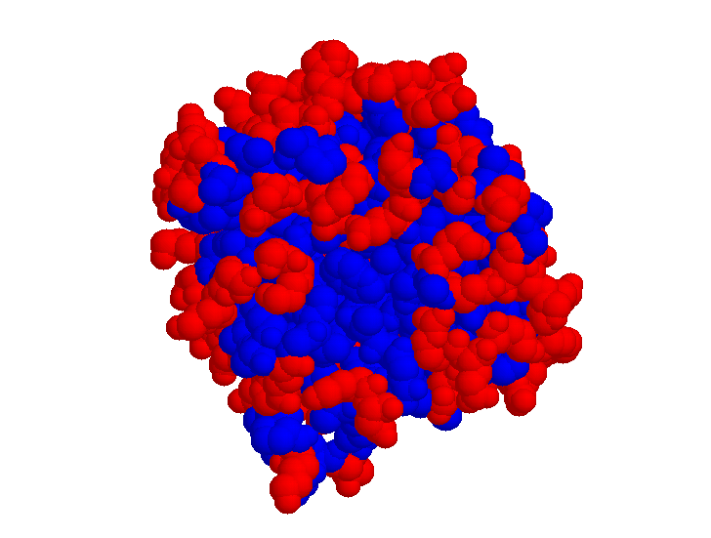
Why do proteins fold?
Unfolded State
Protein backbone is a linear chain
Chain is self-avoiding
Protein is closely packed
Amino Acid preferences:
- inside (hydrophobic)
/ outside (hydrophilic)
- Specific interactions
Folded State

Slide 18
What is an atom?
Classical mechanics: a solid object
Defined by its position (x,y,z)
Carries an electric charge (positive or negative), usually partial (less than an electron)

Slide 19
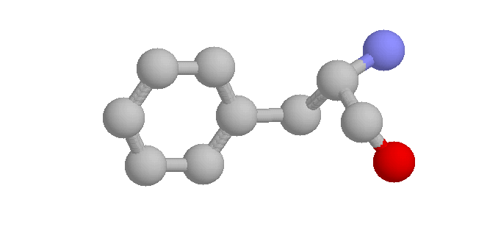
Atomic Interactions
Non-bonded
pair
Torsion angles
Are 4-body
Angles
Are 3-body
Bonds
Are 2-body

Slide 20
Atomic Interactions
Strong bonded interactions
Non bonded interactions
b
r
θ
q₁
q₂
φ

Slide 21
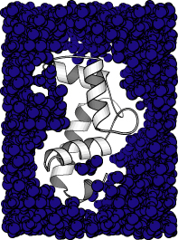
Interaction with solvent
- Hydrophobic effect
(entropic effect)
Interaction with ions
Concentration?

Slide 22
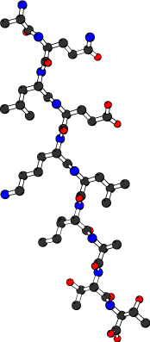
Energy Landscape
1 ms to 1s
Barrier crossing time
~ exp[Barrier Height]
1 μs
Barrier
Height
Unfolded State
Expanded, disordered
Molten Globule
Compact, disordered
Native State
Compact, Ordered

Slide 23
Molecular Graphics
Many software available!
I recommend
-Rasmol
http://www.umass.edu/microbio/rasmol/index2.htm
-Pymol
http://pymol.sourceforge.net
(Pymol tutorials:
http://www.microbiology.ubc.ca/eltis/pymol/
http://www.ebi.ac.uk/~gareth/pymol/ )
For Windows and Mac users, I also recommend
to get Chime:
http://www.umass.edu/microbio/chime/getchime.htm

