Slide 1
Protein Denaturation

Slide 2
Goals
Denaturation
Balance of forces
Consequences of denaturation

Slide 3
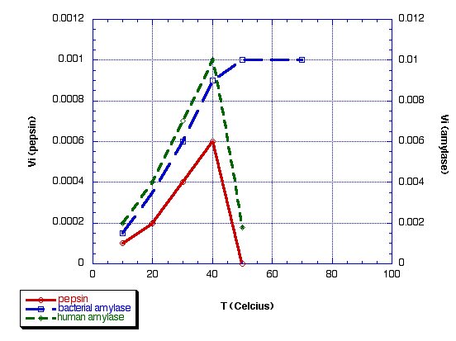
Effect of Temperature on Rate of Enzyme Action
rate
denaturant

Slide 4
Denaturation
Denaturation is a phenomenon that involves transformation of a well-defined, folded structure of a protein, formed under physiological conditions, to an unfolded state under non-physiological conditions.
  Occurs suddenly and completely over a narrow range of conditions
  Slowly reversible (if at all)

Slide 5
Hydrophobic Interactions
“Clathrate” water
Increased solvent entropy
Increased chain entropy
Peptide chain

Slide 6
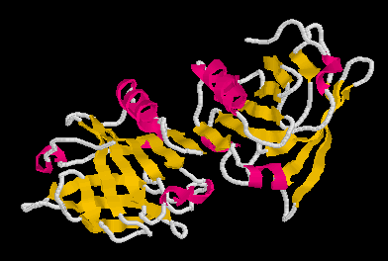
Chain Entropy
One native state
S=k ln Ω
Increased chain entropy
Many denatured states

Slide 7
Other Factors
Hydrogen bonds
Electrostatic interactions
Consider how the total number and strength of these bonds changes as a result of denaturation

Slide 8
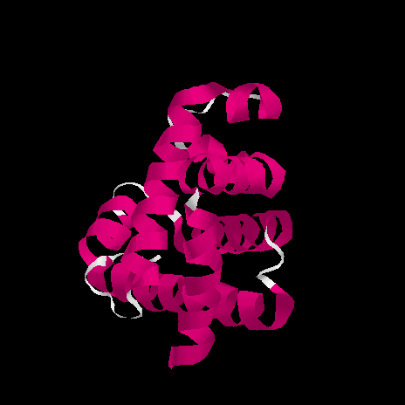
Balance of Forces
Chain entropy
ΔG=ΔH-TΔS
Solvent entropy
ΔG=ΔH-TΔS
other forces

Slide 9
Effect of T on Balance of Forces
Solvent entropy effect
+ (oppose)
Free energy change for denaturation
T
- (favor)
Chain entropy effect

Slide 10
Thermal Denaturation
Trypsinogen 55°C
Pepsinogen 60°C
Lysozyme 72°C
Myoglobin 79°C
Soy Glycinin 92°C
Oat globulin 108°C
Affected by pH, water, solutes
Table 11

Slide 11
Why is Denaturation Sudden?
COOPERATIVE PROCESS
Partly denatured structure is weaker so begins to change faster
100%
Native Structure
0%
Critical value
Concentration of denaturant or temperature

Slide 12
Types of Denaturation
Temperature
Organic solvents
Surface
pH
Shear

Slide 13
Reversibility?
One native form
Refolding is a complex process – particularly for large proteins or complex proteins
Many denatured forms

Slide 14
Energy Surface
Many secondary minima amongst denatured states
Free energy
One native state
(true energy minimum)
Changes in Conformation

Slide 15
Behavior of Denatured Protein
Hydrophobic core
Hydrophilic surface
DENATURED
Fast under non-physiological conditions
Slow under physiological conditions
NATIVE
Unfolding forces some hydrophobic AA to surface
AGGREGATED
or other ingredient interactions

Slide 16
Consequences of Denaturation
Loss of enzymatic activity (death)
Destruction of toxins
Improved digestibility
Loss of solubility
Changes in texture

Slide 17
Denaturation
The conversion of a biologically functional molecule into a non-functional form
There are many denatured states but one native state
Proteins can regenerate to their native state but slowly
Denatured proteins have a greater tendency to aggregate.

