Slide 1
Protein Folding & Biospectroscopy
Lecture 5
F14PFB
David Robinson

Slide 2
Protein Folding
Introduction
Protein Structure
Interactions
Protein Folding Models
Biomolecular Modelling
Bioinformatics

Slide 3
Classical Molecular Dynamics Simulations of Proteins

Slide 4

“everything that living things do can be understood in terms of the jigglings and wigglings of atoms.”
The Feynman Lectures in Physics vol. 1, 3-6 (1963)

Slide 5
What is Molecular Dynamics?
“The science of simulating the motions of a system of particles” (Karplus & Petsko)
From systems
  As small as an atom
  As large as a galaxy
Equations of motion
Time evolution

Slide 6
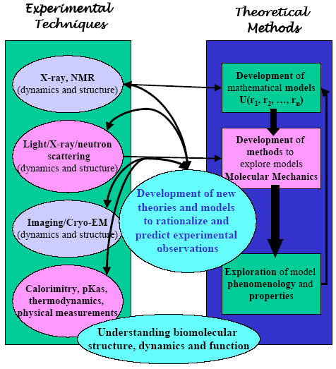
Why?

Slide 7
Essential Elements
Knowledge of the interaction potential for the particles Forces
Classical Newtonian equations of motion
Many particle systems simulation
Maxwell-Boltzmann averaging process for thermodynamic properties: time averaging
Many particles impossible analytically
One particle
easy analytically

Slide 8
Basis: Molecular Mechanics
Theoretical foundation
Potential energy functions
Energy minimization
Molecular dynamics

Slide 9
Uses of simulation & modelling
Conformational searching with MD and minimization
Exploration of biopolymer fluctuations and dynamics & kinetics
MD as an ensemble sampler

Slide 10
Free energy simulations
Example applications
Energy minimization as an estimator of binding free energies
Protein stability
Approximate association free energy of molecular assemblies
Approximate pKa calculations

Slide 11
Theoretical Foundations
Force field parameters for families of chemical compounds
System modelled using Newton’s equations of motion
Examples: hard spheres simulations (Alder & Wainwright, 1959); Liquid water (Rahman & Stillinger, 1970); BPTI (McCammon & Karplus, 1976); Villin headpiece (Duan & Kollman, 1998)

Slide 12
Protein Motion
Protein motions of importance are torsional oscillations about the bonds that link groups together
Substantial displacements of groups occur over long time intervals
Collective motions either local (cage structure) or rigid-body (displacement of different regions)
What is the importance of these fluctuations for biological function?

Slide 13
Effect of fluctuations
Thermodynamics: equilibrium behaviour important; e.g., energy of ligand binding
Dynamics: displacements from average structure important; e.g., local sidechain motions that act as conformational gates in oxygen transport myoglobin, enzymes, ion channels

Slide 14
Local Motions
0.01-5 Å, 1 fs -0.1s
Atomic fluctuations
  Small displacements for substrate binding in enzymes
  Energy “source” for barrier crossing and other activated processes (e.g., ring flips)
Sidechain motions
  Opening pathways for ligand (myoglobin)
  Closing active site
Loop motions
  Disorder-to-order transition as part of virus formation

Slide 15
Rigid-Body Motions
1-10 Å, 1 ns – 1 s
Helix motions
  Transitions between substates (myoglobin)
Hinge-bending motions
  Gating of active-site region (liver alcohol dehydrogenase)
  Increasing binding range of antigens (antibodies)

Slide 16
Large Scale Motion
> 5 Å, 1 microsecond – 10000 s
Helix-coil transition
  Activation of hormones
  Protein folding transition
Dissociation
  Formation of viruses
Folding and unfolding transition
  Synthesis and degradation of proteins
Role of motions sometimes only inferred from two or more conformations in structural studies

Slide 17
Typical Time Scales ....
Bond stretching: 10⁻¹⁴ - 10⁻¹³ sec.
Elastic vibrations: 10⁻¹² - 10⁻¹¹ sec.
Rotations of surface sidechains: 10⁻¹¹ - 10⁻¹⁰ sec.
Hinge bending: 10⁻¹¹ - 10⁻⁷ sec.
Rotation of buried side chains: 10⁻⁴ - 1 sec.
Protein folding: 10⁻⁶ - 10² sec.
Timescale in MD:
A Typical timestep in MD is 1 fs (10⁻¹⁵ sec)
(ideally 1/10 of the highest frequency vibration)

Slide 18
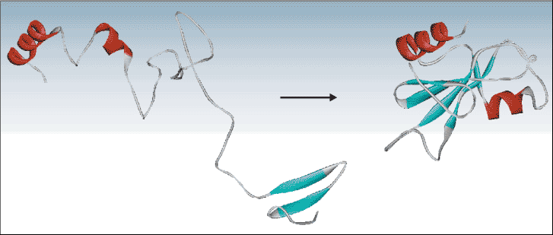

Ab initio protein folding simulation
Physical time for simulation 10^{–4} seconds
Typical time-step size 10^{–15} seconds
Number of MD time steps 10¹¹
Atoms in a typical protein and water simulation 32,000
Approximate number of interactions in force calculation 10⁹
Machine instructions per force calculation 1000
Total number of machine instructions 10²³
BlueGene capacity (floating point operations per second) 1 petaflop (10¹⁵)
➔ Blue Gene will need 3 years to simulate 100 μsec.
[ http://www.research.ibm.com/bluegene/ ]

Slide 19
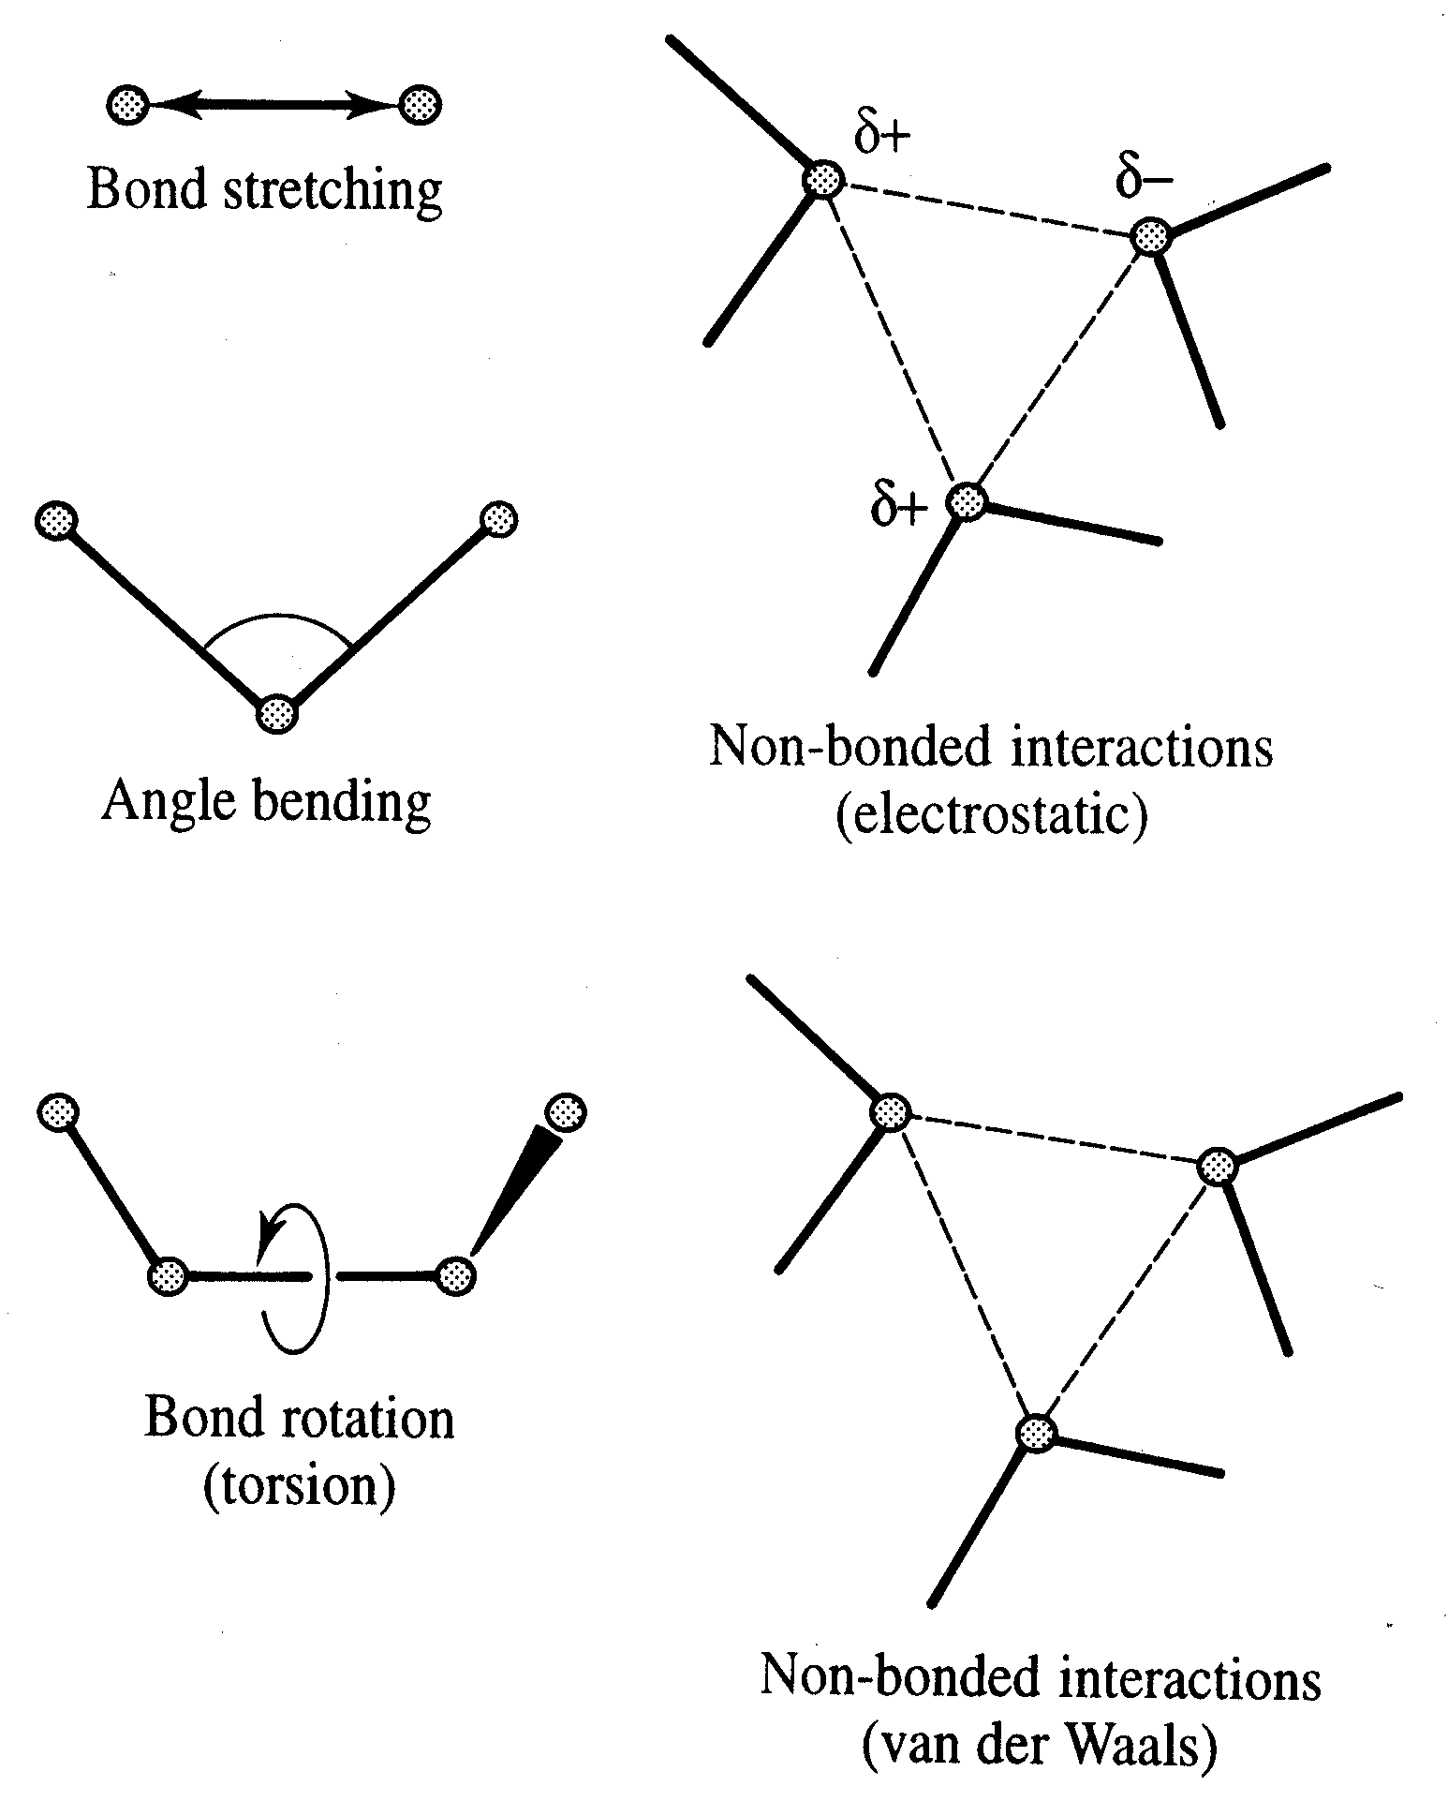
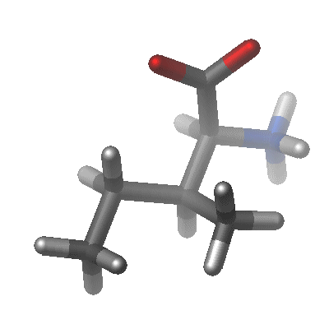
Empirical Force Fields and Molecular Mechanics
describe interaction of atoms or groups
the parameters are “empirical”, i.e. they are dependent on others and have no direct intrinsic meaning

Slide 20
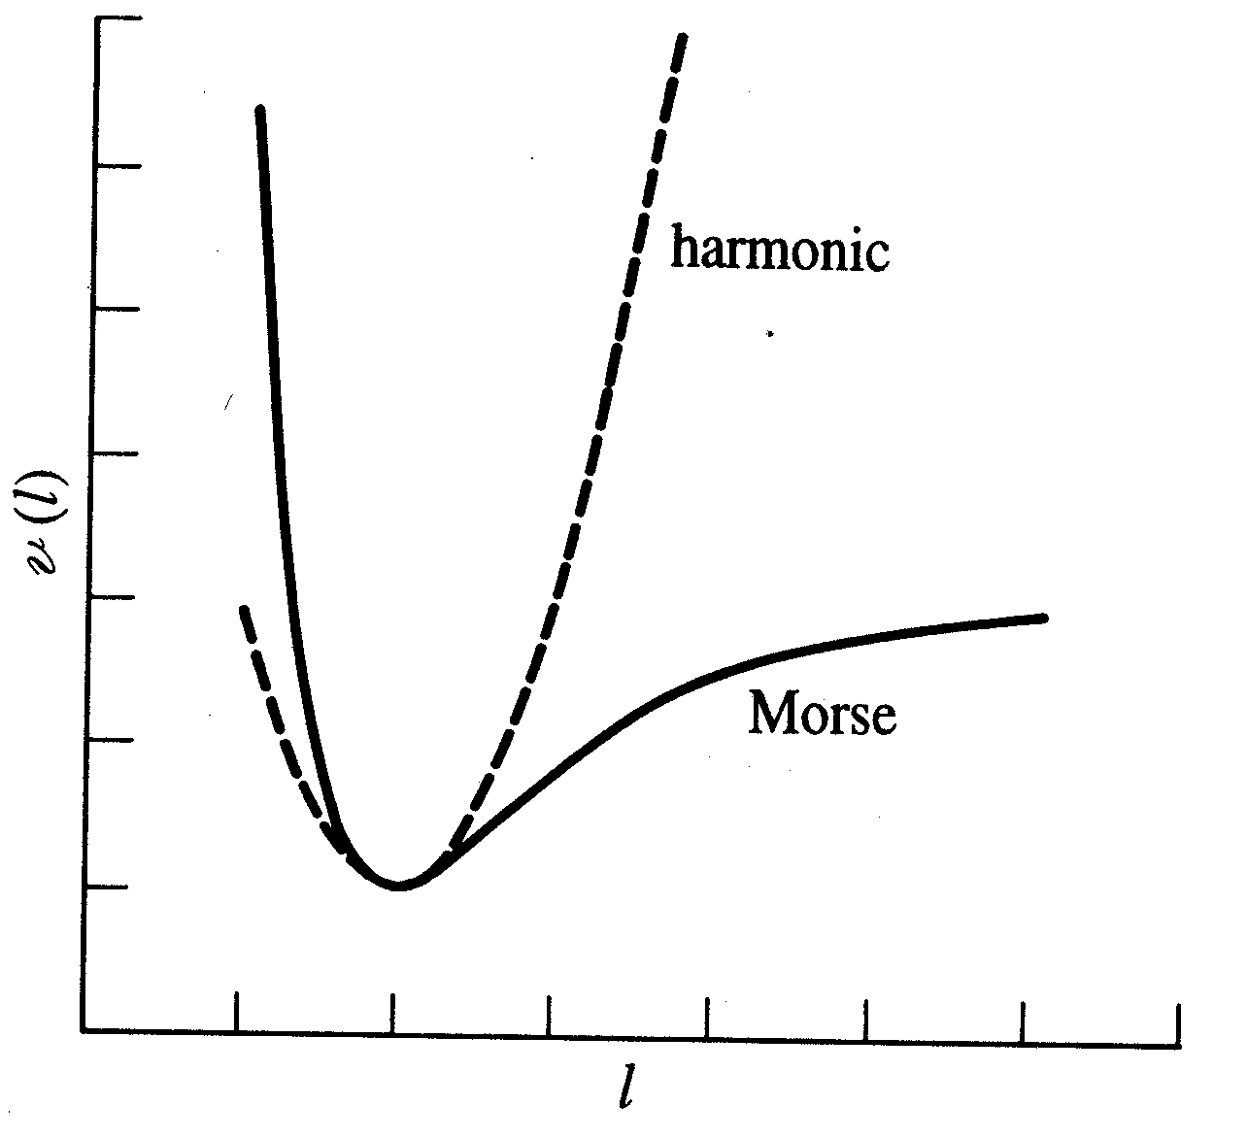
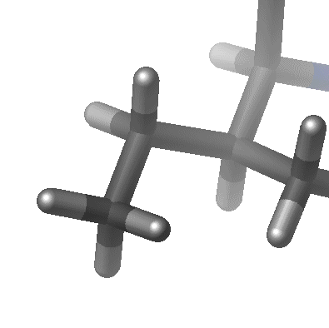
Bond stretching
Approximation of the Morse potential by an “elastic spring” – model
Hooke’s law as reasonable approximation close to reference bond length l₀
k : Force constant
l : distance
l

Slide 21
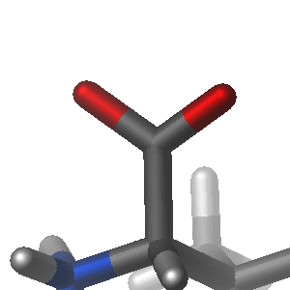
Angle Bending
Deviation from angles from their reference angle θ₀ often described by Hooke’s law:
θ
k : Force constant
θ : bond angle
Force constants are much smaller than those for bond stretching

Slide 22
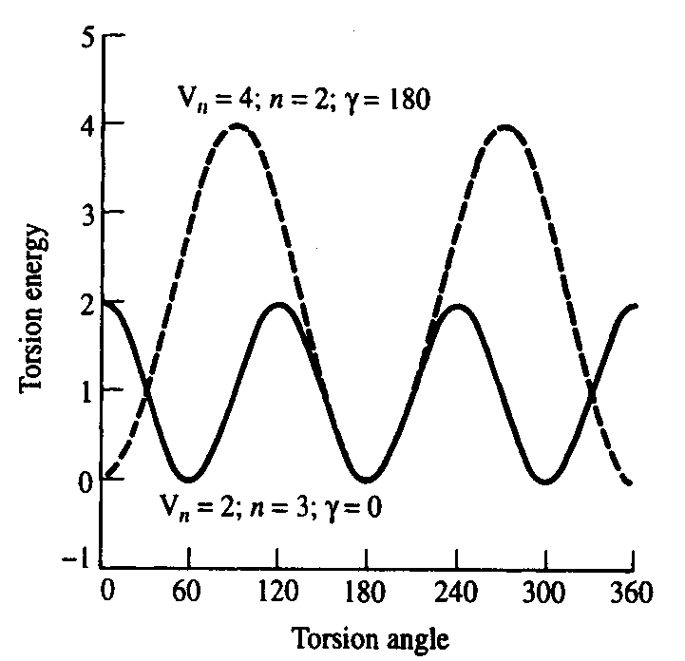
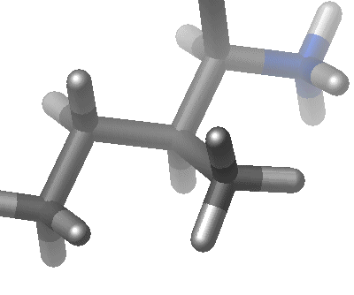
Torsional Terms
Hypothetical potential function for rotation around a chemical bond:
V_{n} : ‘barrier’ height
n : multiplicity (e.g. n=3)
ω : torsion angle
γ : phase factor
Need to include higher terms for non-symmetric bonds
(i.e. to distinguish trans, gauche conformations)

Slide 23
Electrostatic interactions
Electronegative elements attract electrons more than less electronegative elements
Unequal charge distribution is expressed by fractional charges
Electrostatic interaction often calculated by Coulomb’s law:
q
+
+
r
-

Slide 24
Example for a (very) simple Force Field:

Slide 25
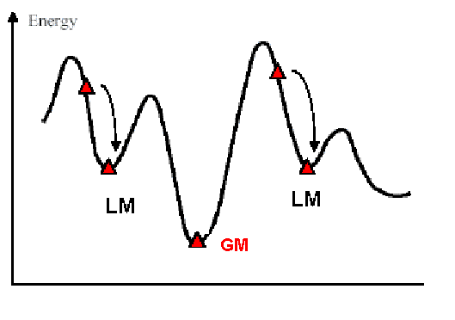
Molecular Mechanics - Energy Minimization
The energy of the system is minimized. The system tries to relax
Typically, the system relaxes to a local minimum (LM).

Slide 26
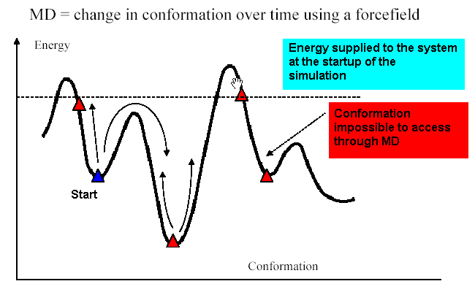
Molecular Dynamics (MD)
In molecular dynamics, energy is supplied to the system, typically using a constant temperature (i.e. constant average constant kinetic energy).

Slide 27
Newton’s Laws of Motion
A body maintains its state of rest or of uniform motion in a straight line, unless acted upon by a force.
The applied force is equal to the rate of change of momentum.
Two isolated bodies acting upon each other experience equal and opposite forces.

Slide 28
Molecular Dynamics (MD)
Use Newtonian mechanics to calculate the net force and acceleration experienced by each atom.
Each atom i is treated as a point with mass m_{i} and fixed charge q_{i}
Determine the force F_{i} on each atom:
Use positions and accelerations at time t (and positions from t - δ t) to calculate new positions at time t +δ t

Slide 29

Cutoffs

Slide 30
(a) Estimate the total number of possible structures of a polypeptide consisting of 10 amino acid residues. State and justify any assumptions that you make.
(b) Calculate the number of pairwise interactions which need to be evaluated to calculate the energy of a 10-residue peptide, stating any assumptions you make. If a computer capable of calculating one million pairwise interactions per second is used, and the time to perform a systematic search of all conformations is one structure per 10⁻¹³ seconds, estimate both the simulation time required to fold the peptide and the time it would take to calculate the energy of all the conformers.

