Slide 1
Molecular Modeling Methods &
Ab Initio Protein Structure Prediction

Slide 2
Contents
Molecular modeling methods and applications in ab initio protein structure prediction
  Potential energy function
  Energy Minimization
  Monte Carlo
  Molecular Dynamics
Ab initio protein loop modeling
  Challenge
  Recent progress
  CLOOP

Slide 3
Molecular Modeling Methods
Molecular modeling methods are the theoretical methods and computational techniques used to simulate the behavior of molecules and molecular systems
Molecular Forcefields
Conformational Search methods
  Energy Minimization
  Molecular Dynamics
  Monte Carlo simulation
  Genetic Algorithm

Slide 4
Ab Initio Protein Structure Prediction
Ab initio protein structure prediction methods build protein 3D structures from sequence based on physical principles.
Importance
  The ab initio methods are important even though they are computationally demanding
  Ab initio methods predict protein structure based on physical models, they are indispensable complementary methods to Knowledge-based approach
  eg.
  Knowledge-based approach would fail in following conditions:
    Structure homologues are not available
    Possible undiscovered new fold exists

Slide 5
Applications of MM in Ab Initio PSP
Basic idea
Anfinsen’s theory: Protein native structure corresponds to the state with the lowest free energy of the protein-solvent system.
General procedures
  Potential function
    Evaluate the energy of protein conformation
    Select native structure
  Conformational search algorithm
    To produce new conformations
    Search the potential energy surface and locate the global minimum (native conformation)

Slide 6
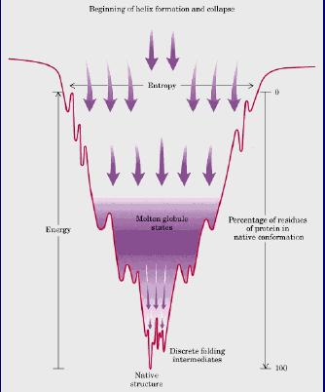
Protein Folding Funnel
Local mimina
Global minimum
Native Structure

Slide 7
Potential Functions for PSP
Potential function
  Physical based energy function
  Empirical all-atom forcefields: CHARMM, AMBER, ECEPP-3, GROMOS, OPLS
  Parameterization: Quantum mechanical calculations, experimental data
  Simplified potential: UNRES (united residue)
  Solvation energy
    Implicit solvation model: Generalized Born (GB) model, surface area based model
    Explicit solvation model: TIP3P (computationally expensive)

Slide 8
General Form of All-atom Forcefields
r
Θ
Φ
Bond stretching term
Angle bending term
Dihedral term
The most time demanding part.
H-bonding term
Van der Waals term
Electrostatic term
r
H
r
＋
r
ー
O

Slide 9
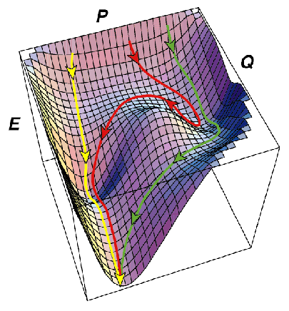
Search Potential Energy Surface
We are interested in minimum points on Potential Energy Surface (PES)
Conformational search techniques
  Energy Minimization
  Monte Carlo
  Molecular Dynamics
  Others: Genetic Algorithm, Simulated Annealing

Slide 10
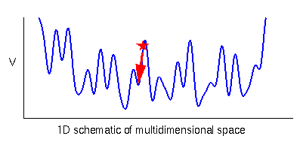
Energy Minimization
Local miminum
Energy minimization
Methods
  First-order minimization: Steepest descent, Conjugate gradient minimization
  Second derivative methods: Newton-Raphson method
  Quasi-Newton methods: L-BFGS

Slide 11
Monte Carlo
Monte Carlo
In molecular simulations, ‘Monte Carlo’ is an importance sampling technique.
  1. Make random move and produce a new conformation
  2. Calculate the energy change ΔE for the new conformation
  3. Accept or reject the move based on the Metropolis criterion
Boltzmann factor
If ΔE<0, P>1, accept new conformation;
Otherwise: P>rand(0,1), accept, else reject.

Slide 12
Monte Carlo
Monte Carlo (MC) algorithm
Generate initial structure R and calculate E(R);
Modify structure R to R’ and calculate E(R’);
Calculate ΔE = E(R’) − E(R);
IF ΔE<0, then R ← R’;
ELSE
Generate random number RAND = rand(0,1);
IF exp(− ΔE/KT) > RAND, then R ← R’;
ENDIF
ENDIF
Repeat for N steps;
Monte Carlo Minimization (MCM) algorithm
Parallel Replica Exchange Monte Carlo algorithm

Slide 13
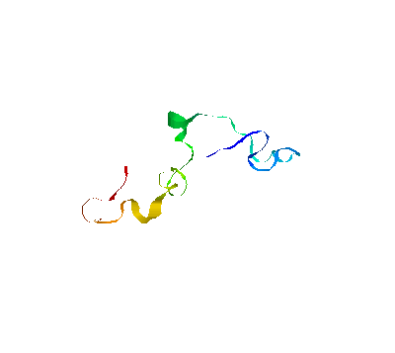
Molecular Dynamics
Molecular Dynamics (MD)
MD simulates the Movements of all the particles in a molecular system by iteratively solving Newton’s equations of motion.
MC view many frozen butterflies in a museum; MD watch the butterfly fly.

Slide 14
Molecular Dynamics
Algorithm
  For atom i, Newton’s equation of motion is given by
  Here, r_{i} and m_{i} represent the position and mass of atom i and F_{i}(t) is the force on atom i at time t. F_{i}(t) can also be expressed as the gradient of the potential energy
  V is potential energy. Newton’s equation of motion can then relate the derivative of the potential energy to the changes in position as a function of time.
(1)
(2)
(3)
(4)

Slide 15
Molecular Dynamics
Algorithm (continue)
  To obtain the movement trajectory of atom, numerous numerical algorithms have been developed for integrating the equations of motion. (Verlet algorithm, Leap-frog algorithm)
  Verlet algorithm
  The algorithm uses the positions and accelerations at time t, and the positions from the previous step to calculate the new positions
  Selection of time step
  Time step is approximately one order of magnitude smaller than the fastest motion
  Hydrogen vibration ~ 10 fs (10⁻¹⁵ s), time step = 1fs

Slide 16
Molecular Dynamics
MD Software
  CHARMM (Chemistry at HARvard Molecular Mechanics) is a program for macromolecular simulations, including energy minimization, molecular dynamics and Monte Carlo simulations.
  NAMD is a parallel molecular dynamics code designed for high-performance simulation of large biomolecular systems.
  http://www.ks.uiuc.edu/Research/namd/
Application in PSP
  Advantage: Deterministic; Provide details of the folding process
  Limitation: The protein folding reactions take place at ms level, which is at the limit of accessible simulation times
It is still difficult to simulate a whole process of a protein folding using the conventional MD method.

Slide 17
Time Scales of Protein Motions and MD
α-Helix folding
Elastic vibrations of proteins
β-Hairpin folding
Bond stretching
Protein folding
10⁻¹⁵
10⁻¹²
10⁻⁹
10⁻⁶
10⁻³
10⁰
(fs)
(ps)
(ns)
(μs)
(ms)
(s)
MD Time Scale

Slide 18
Other Conformational Search Algorithms
Global optimization algorithms
“Optimization” refers to trying to find the global energy minimum of a potential surface.
  Genetic Algorithm (GA)
  Simulated Annealing (SA)
  Tabu Search (TS)
  Ant Colony Optimization (ACO)
A model system: Lennard Jones clusters

Slide 19
Applications of MM methods in PSP
Application in PSP
  Combination of several conformational search techniques
  Recent developments
    Simplified force field: united residue force field
    Segment assembly
    Secondary structure prediction are quite reliable, so conformation can be produced by assemble the segments
Ab initio PSP software
  Rosetta is a five-stage fragment insertion Metropolis Monte Carlo method
  ASTRO-FOLD is a combination of the deterministic αBB global optimization algorithm, and a Molecular Dynamics approach in torsion angle space
  LINUS uses a Metropolis Monte Carlo algorithm and a simplified physics-based force field

Slide 20
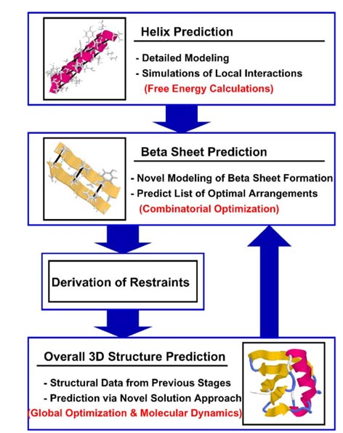
ASTRO-FOLD

Slide 21
References
Hardin C, et. al. Ab initio protein structure prediction. Curr Opin Struct Biol. 2002, 12(2):176-81.
Floudas CA, et. al. Advances in protein structure prediction and de novo protein design: A review. Chemical Engineering Science, 2006, 61: 966-988.
Klepeis JL, Floudas CA, ASTRO-FOLD: a combinatorial and global optimization framework for ab initio prediction of three dimensinal structures of proteins from the amino acid sequence, Biophysical Journal, 2003, 85: 2119-2146.

Slide 22
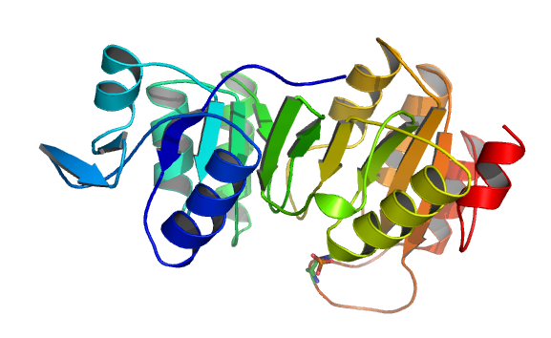
Ab Initio Protein Loop Prediction
Protein loop
Protein loops are polypeptides
connecting more rigid structural
elements of proteins like helices and strands.
Challenge in Loop Structure Prediction
  Loop is important to protein folding and protein function even though their size is small, usually <20 residues
  Loops exhibit greater structural variability than helices and strands
  Loop prediction is often a limiting factor on fold recognition methods

Slide 23
Ab Initio Protein Loop Prediction
Ab initio methods have recently received increased attention in the prediction of protein loop
Potential energy function
Molecular mechanics force field is usually better than statistical potential in protein loop modeling.
Recent progress
  Dihedral angle sampling
  Clustering
  Select representative structures from ensembles

Slide 24
Ab Initio Loop Prediction Methods
Loopy
  Random tweak
  Colony energy
Fiser’s method
  MM methods:
  Physical energy function
  Energy Minimization + MD + SA
Forrest & woolf
  Predict membrane protein loop
  MM methods: MC + MD
Review:
Floudas C.A. et al, Advances in protein structure prediction and de novo protein design: A review, Chemical Engineering Science, 2006, vol. 61, 966-988.

Slide 25
CLOOP: Ab Initio Loop Modeling Method
CLOOP build all-atom ensemble of protein loop conformations (it is not a real protein loop prediction method)
Paper
Haiyan Jiang, Christian Blouin, Ab Initio Construction of All-atom Loop Conformations, Journal of Molecular Modeling, 2006, 12, 221-228.
CLOOP methods
  Energy function: CHARMM
  Dihedral sampling
  Potential smoothing technique
  The designed minimization (DM) strategy
  Divided loop conformation construction

Slide 26
The Energy Function of CHARMM Forcefield
CHARMM

Slide 27
CLOOP
Dihedral sampling
  Loop main-chain dihedral φ and ψ are generated by sampling main-chain dihedral angles from a restrained φ/ψ set
  The restrained dihedral range has 11 pair of φ/ψ dihedral sub-ranges. It was obtained by adding 100 degree variation on each state of the 11 φ/ψ set developed by Mault and James for loop modeling.
  Side chain conformations are built randomly.

Slide 28
CLOOP
Potential smoothing technique
A soft core potential provided in CHARMM software package was applied to smooth non-bonded interactions
is the distance of the two interacting atoms
is the switching distance for the soft core potential

Slide 29
CLOOP
The designed minimization (DM) strategy
  Minimization methods:
  steepest descent, conjugate gradient, and adopted basis Newton-Raphson minimization method
  Two stages:
  1. Minimize the internal energy terms of loop conformations including bond, angle, dihedral, and improper
  2. The candidates were further minimized with the full CHARMM energy function including the van der Waal and electrostatic energy terms.

Slide 30
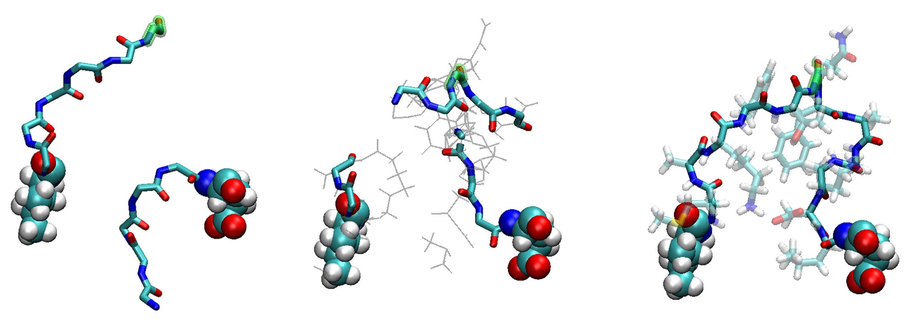
CLOOP
Divided loop conformation construction
  Generate position of middle residue
  Build initial conformation of main chain with dihedral sampling
  Build side chain conformation
  Run DM and produce closed loop conformation

Slide 31
CLOOP
Performance of CLOOP
CLOOP was applied to construct the conformations of 4, 8, and 12 residue long loops in Fiser’s loop test set. The average main-chain root mean square deviations (RMSD) obtained in 1000 trials for the 10 different loops of each size are 0.33, 1.27 and 2.77 Å, respectively.
The performance of CLOOP was investigated in two ways. One is to calculate loop energy with a buffer region, and the other is loop only. The buffer region included a region extending up to 10 Å around the loop atoms. In energy minimization, only the loop atoms were allowed to move and all non-loop atoms include those in the buffer region were fixed.

Slide 32
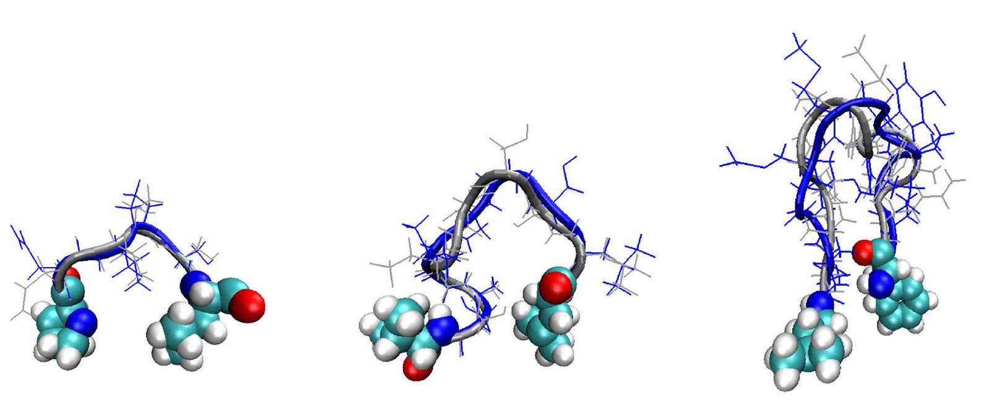
Loop Conformations built by CLOOP
a. 1gpr_123-126 b. 135l_84-91 c. 1pmy_77-88

Slide 33
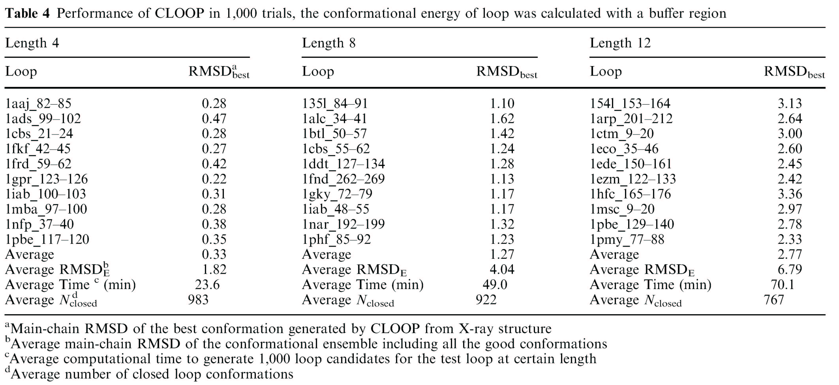
Performance of CLOOP

Slide 34
Conclusion
  CLOOP can be applied to build a good all-atom conformation ensemble of loops with size up to 12 residues.
  Good efficiency, CLOOP is faster than RAPPER
  The contribution of the protein to which a loop is attached (i.e. the ‘buffer region’ ) facilitates the discrimination of near-optimal loop structures.
  The soft core potentials and a DM strategy are effective techniques in building loop conformations.

