Slide 1
PROTEIN PHYSICS
LECTURE 2

Slide 2
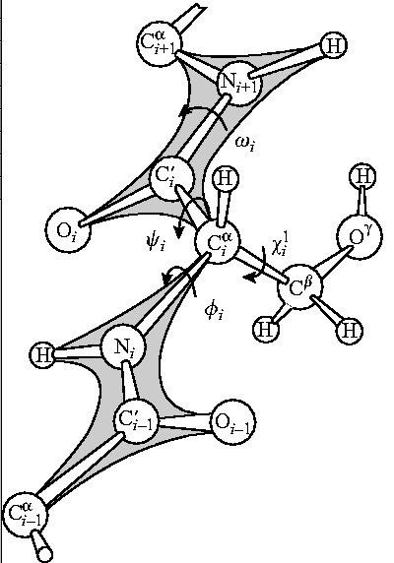
Protein chain:
gene-encoded
sequence of side-chains,
regular main-chain

Slide 3
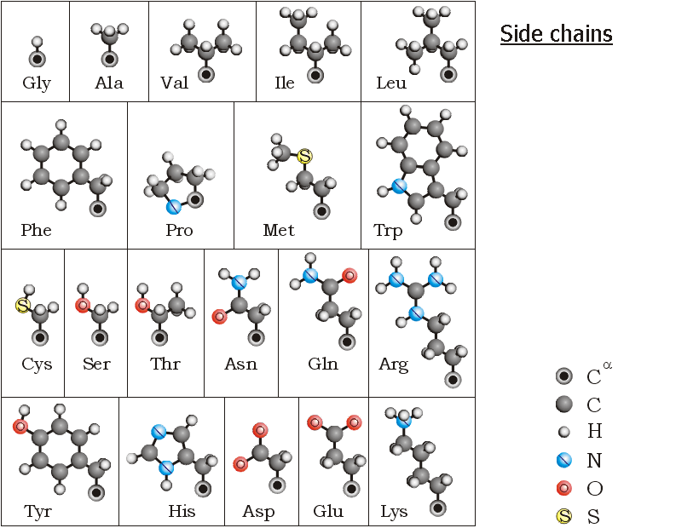

Slide 4
Gly
symmetric
ALL THE OTHER: ASYMMETRIC BACKBONE
Ala _L_
Ala -D-

Slide 5
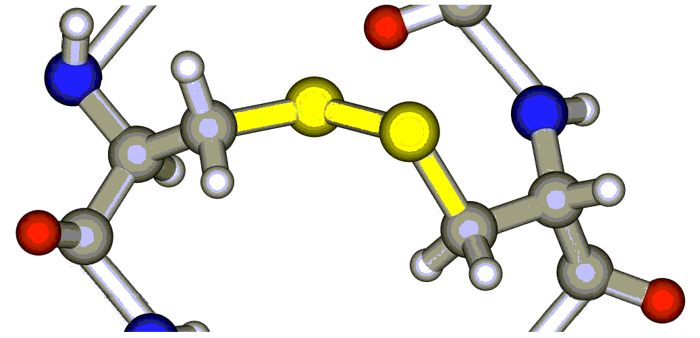
Two amino acids have asymmetric side chains:
THR
ILE
Chemical S-S bond
of two CYS side chains:

Slide 6
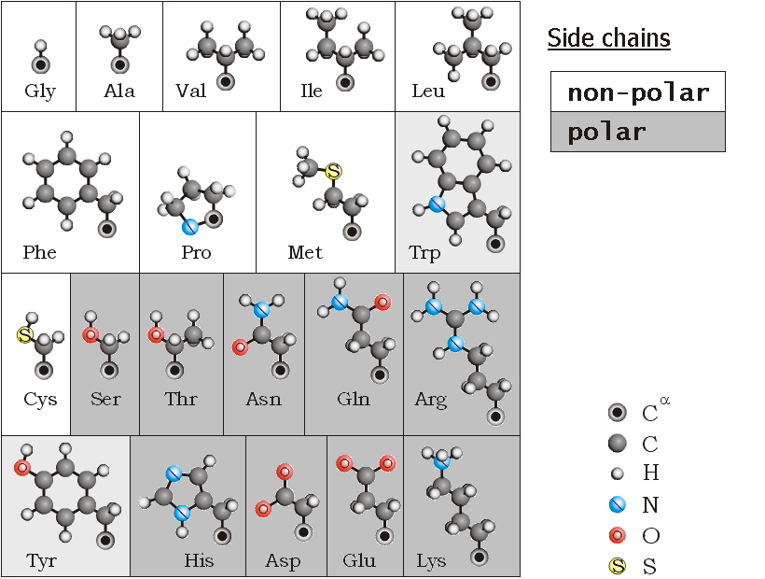
non-polar: core
polar: surface

Slide 7
non_polar: in the core
polar: at the surface

Slide 8
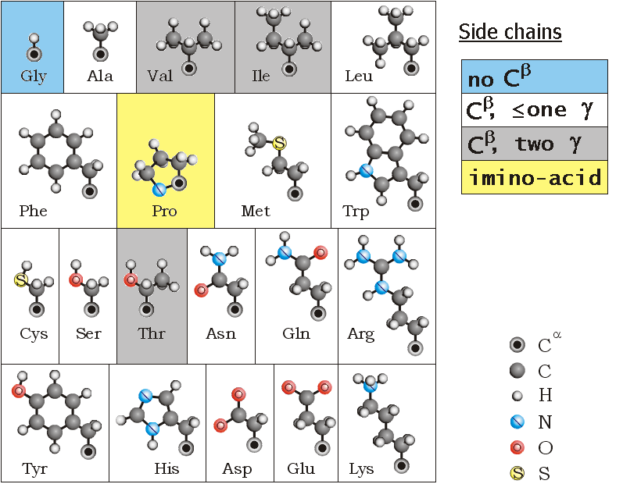
no Cβ: coil
Сβ, ≤1 γ: α, β, coil
Сβ, 2 γ: β
imino: coil, turn

Slide 9
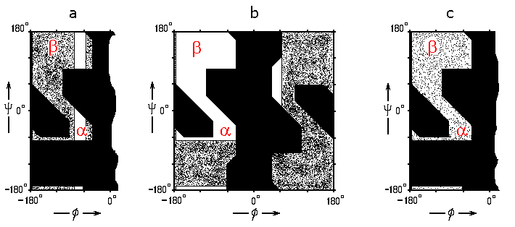
Pro
1,2,3 rot.
no Сβ: coil
Сβ, ≤1 γ: α, β, coil
imino: coil, turn
Сβ, 2 γ: β

Slide 10
charged −: coil,
α_N
charged +: coil,
α_C
Half-charged:
active sites

Slide 11
P_{charged} + P_{uncharged} = 1
P_{charged} / P_{uncharged}
= 10−(pKa – pH)
P_{charged} / P_{uncharged}
= 10+(pKa – pH)
Acids (charge −) Bases (charge +)
pK_{a}
|
|
|
|
pK_{a}
|
|
−
Half-charged: active sites

Slide 12
charged −: coil, α_N
charged +: coil, α_C
−
Half-charged: active sites

Slide 13
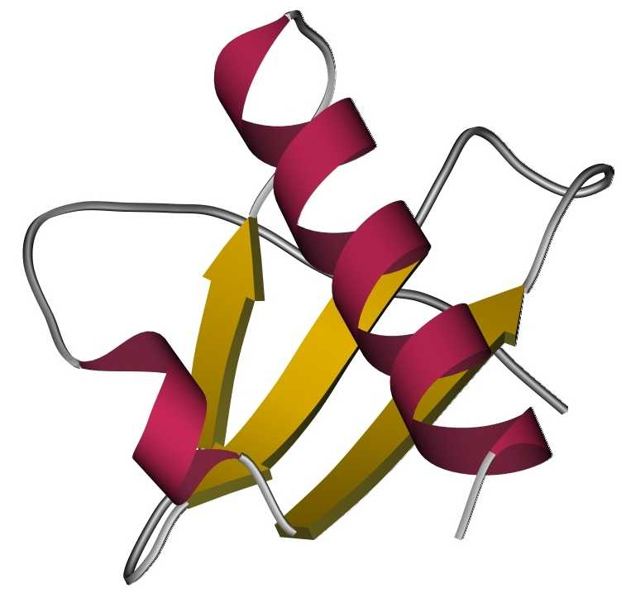
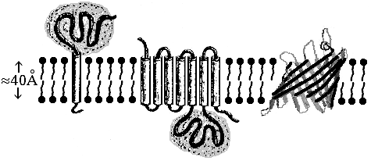
Globular
Membrane
Fibrous
____

Slide 14
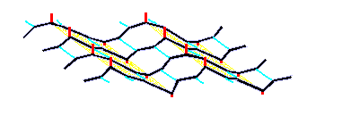
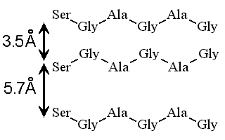
Silk fibroin
×~50

Slide 15
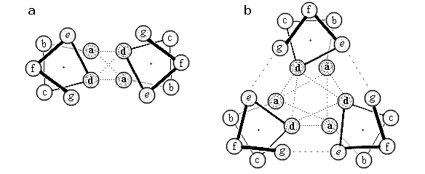
α-helical
coiled-
coil

Slide 16
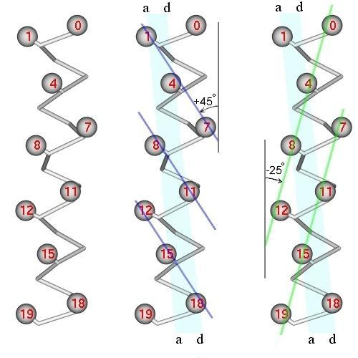
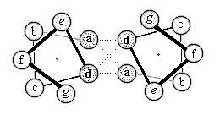

Slide 17
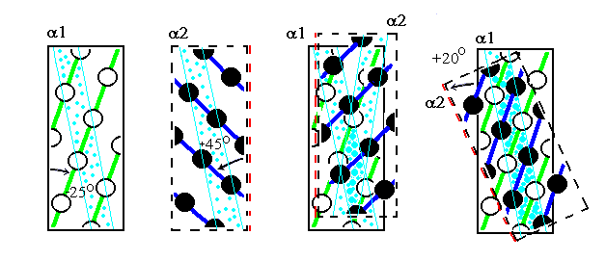

Slide 18
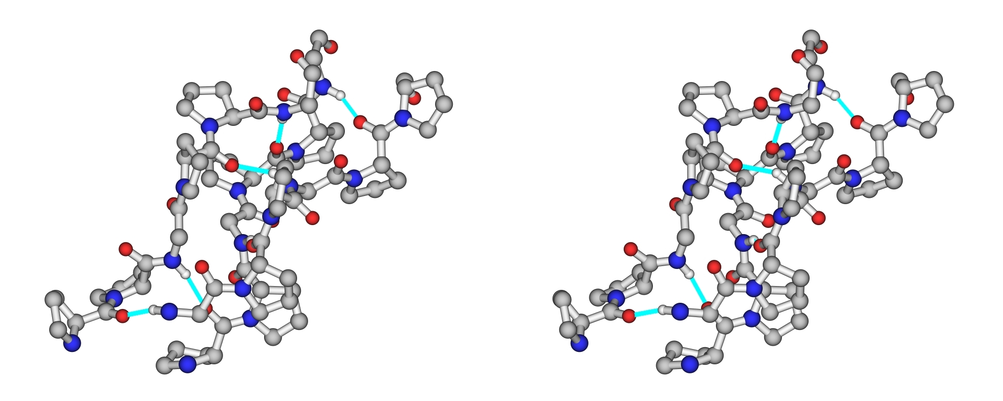
collagen triple helix: 3 chains ≈ [Gly-X-Pro]_{≈500}

Slide 19
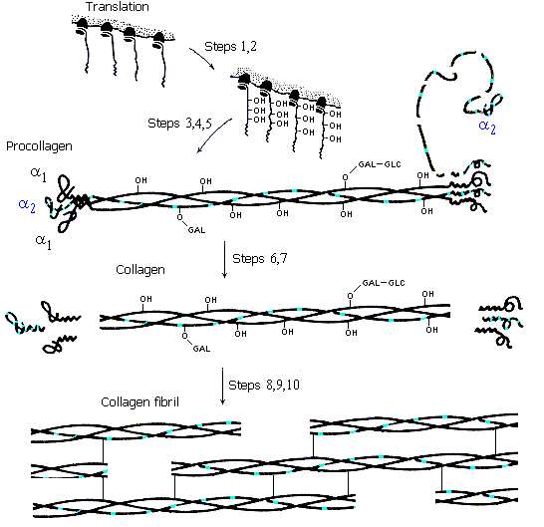

Slide 20
Elastin:
Matrix protein.
Short repeats.
Poor secondary structure.
Chains are linked by chemically modified Lys residues.
Like in rubber.

Slide 21
Globular
Membrane
Fibrous
H-bonds & hydrophobics
____

Slide 22
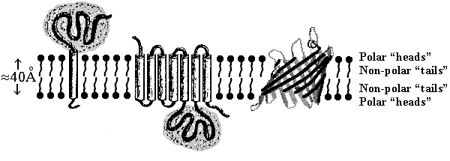
membrane

Slide 23
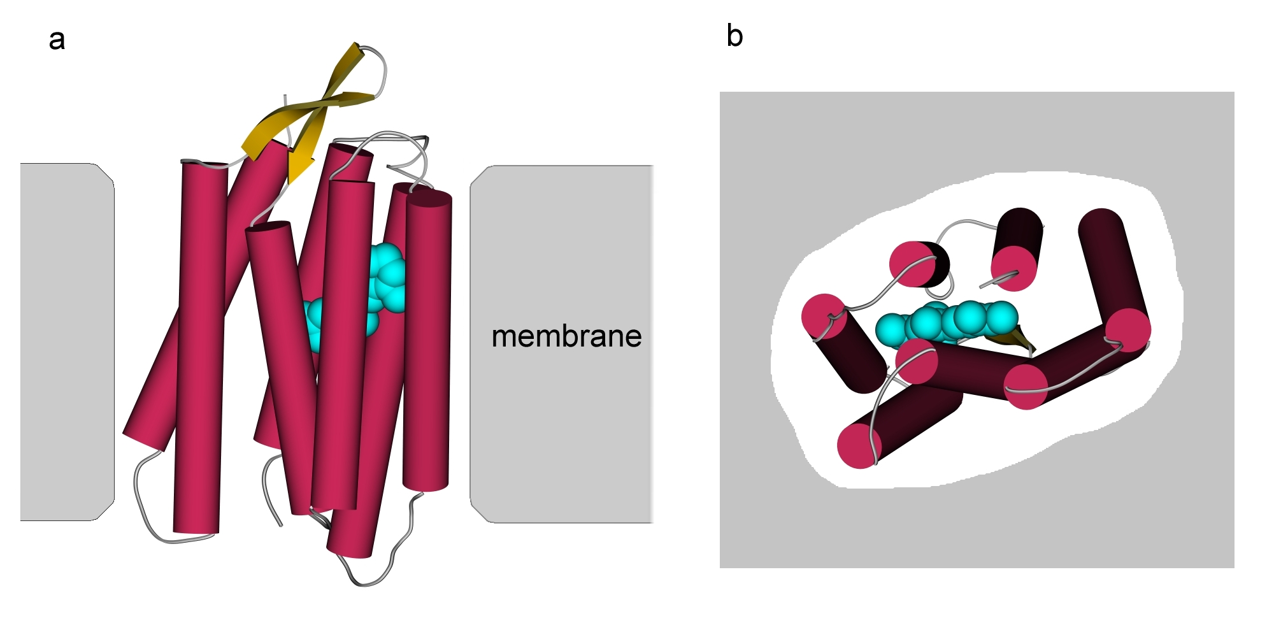
Bacteriorodopsin
with retinal
Transport of protons H⁺

Slide 24
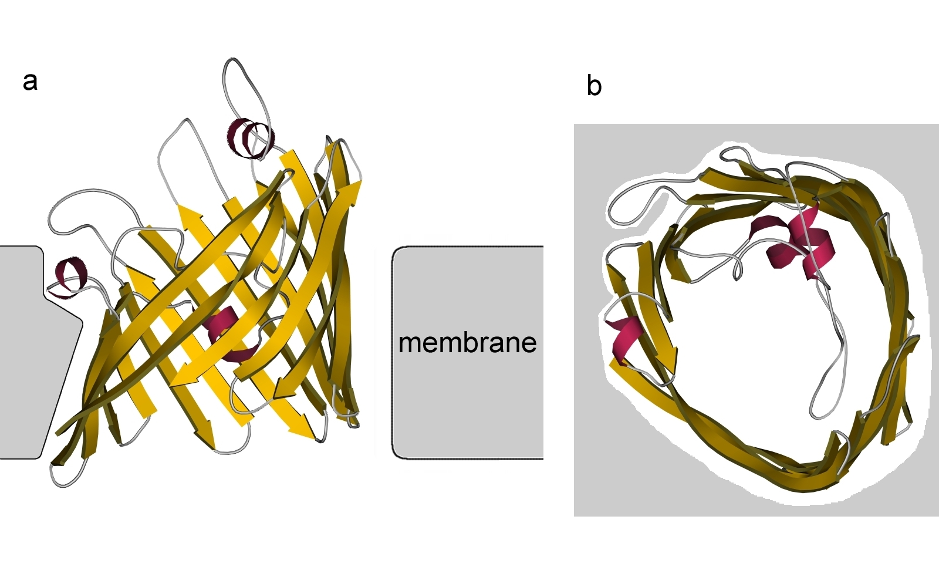
Porin
Transport of polar molecules

Slide 25
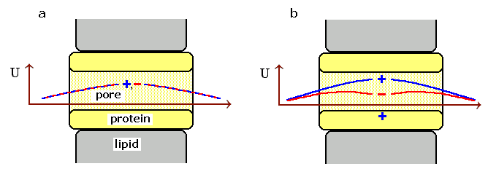
Pore in membrane.
Free energy of charge in the non-polar pore:
~ q² / [(ε_{MEMBR} ε_{WATER} )^{1/2} r_{PORE}] ~
~ 20 kcal/mol / r_{PORE}(Å)

Slide 26
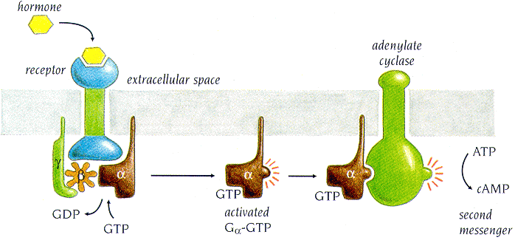
G-protein
Slow decay of GTP = timer of action

Slide 27
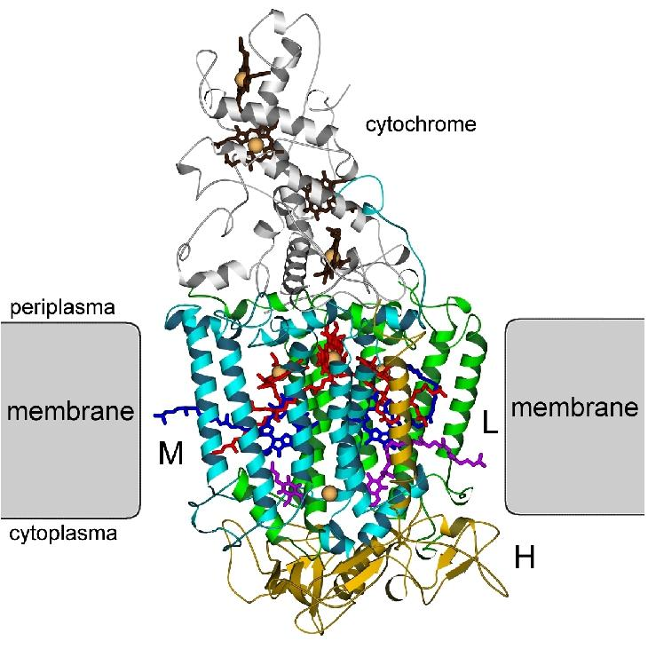
Photo-
synthetic
center

Slide 28
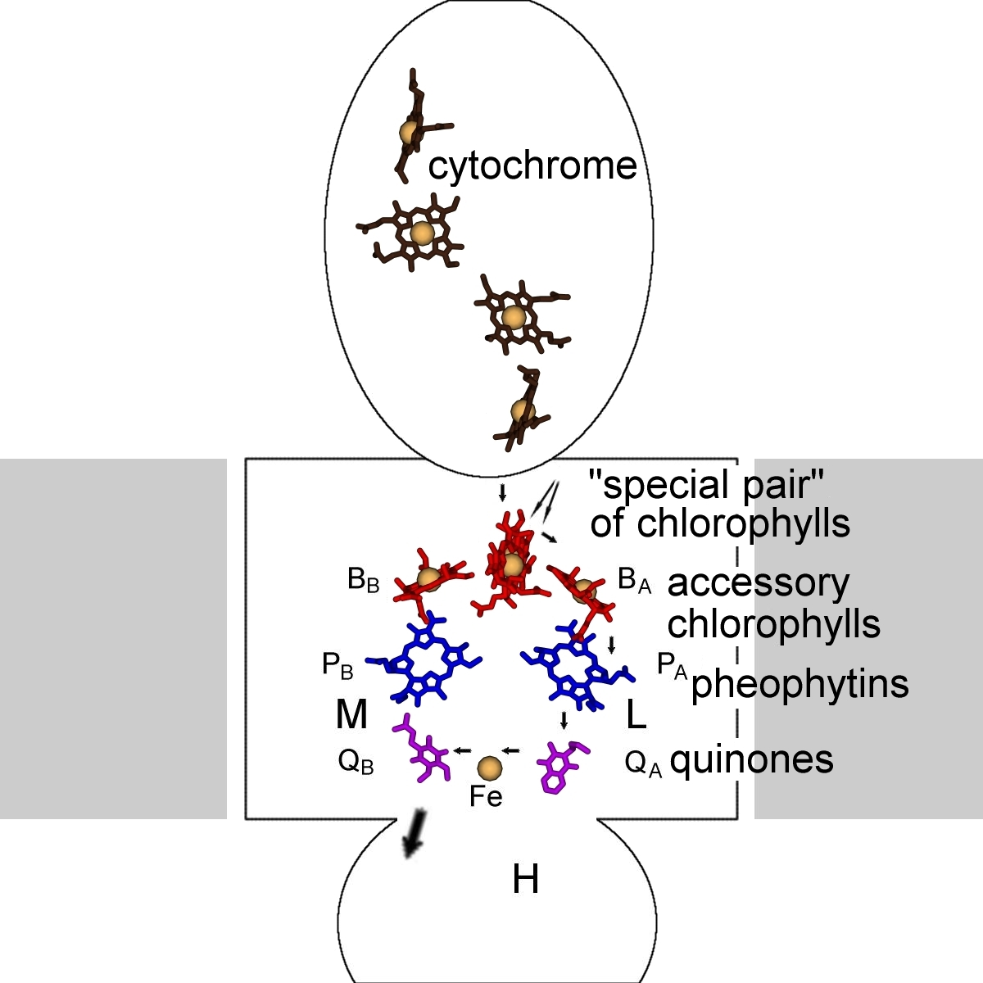
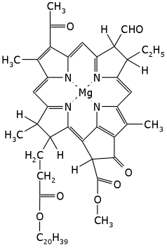
Pigments
in photo-
synthetic
center:
Electron
transfer
chlorophyll

 Light


Slide 29
Tunneling
Atom ≈ 1Å ⇒ Attenuation of
electron density:
P(X) ~ 10^{-X(Å)}
T-independent
Frequency of vibrations (attacks):
f ~ 10¹⁵/sec
Successful attacks:
f_{SUCCS.}(x) ~ P(x)•f, e.g.:
f_{SUCCS.}(5Å) ~ 10⁻⁵⁺¹⁵ ~
~ 10¹⁰/sec

Slide 30
Membrane
Globular
Fibrous
H-bonds & hydrophobics
____

Slide 31
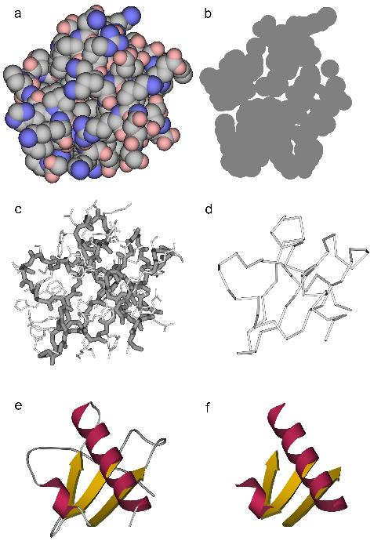
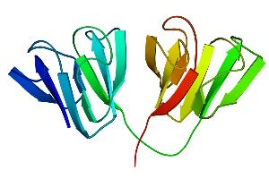
domain 1 domain 2

Slide 32
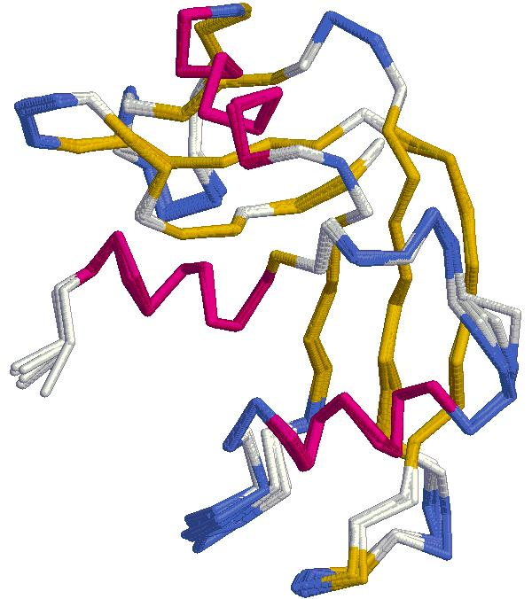
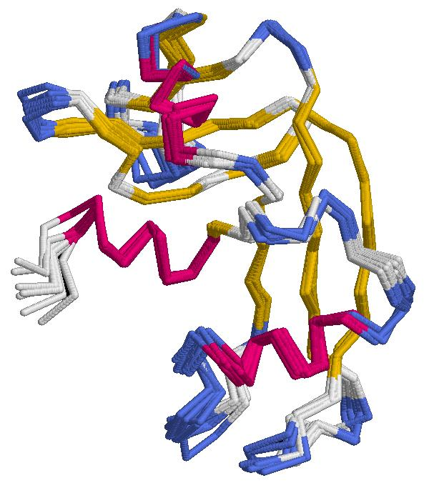
X-RAY.
One protein, various
crystallization
NMR.
Structures, compatible
with one NMR experiment
Secondary structures (α-helices, β-strands) are
the most rigid details of proteins;
they are determined with the smallest errors

Slide 33
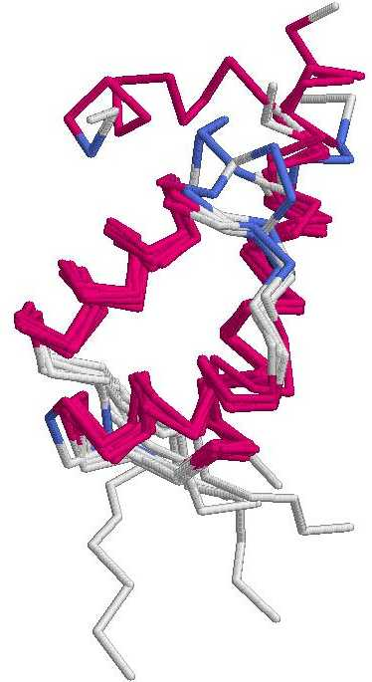
One protein, various
crystallization
Homologous (closely
related) proteins
Secondary structures (α-helices, β-strands)
are most conserved structural elements.
They form a basis of protein classification

Slide 34
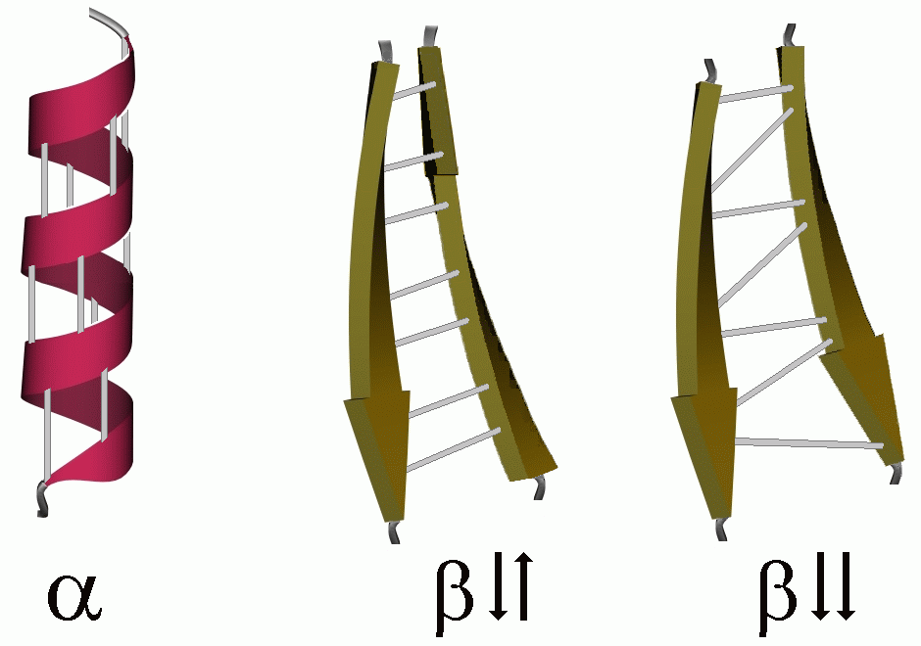
Main secondary structures

Slide 35
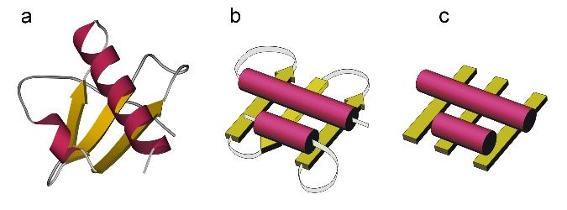
Folding pattern
(stack of secondary
structures
+ chain topology)
Stack of
secondary
structures
Fold
VERBAL PORTRAIT
СЛОВЕСНЫЙ ПОРТРЕТ

Slide 36
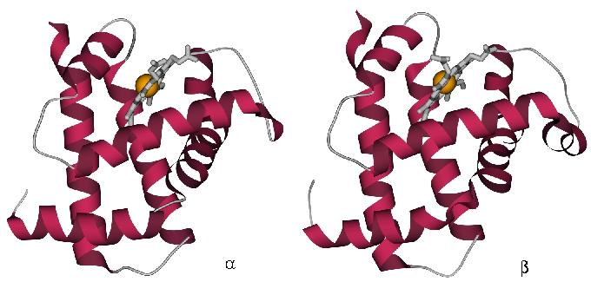
Hemo-
globin
Hemo-
globin
Homologous proteins have similar folds.
True, but trivial.
NON-trivial:
Many NON-homologous proteins have similar folds.

Slide 37
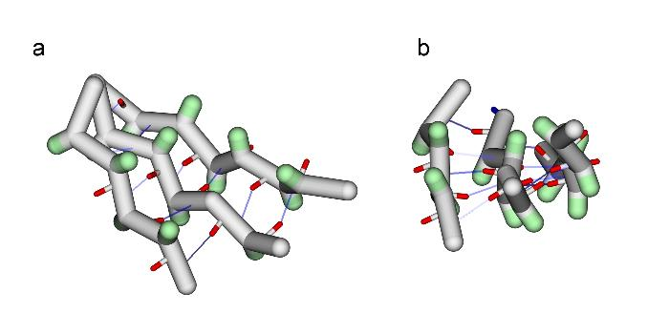
β-sheets: usually, twisted
(usually, right) ↑
β-proteins
____
H-bonds: within sheets
Hydrophobics: between sheets

Slide 38
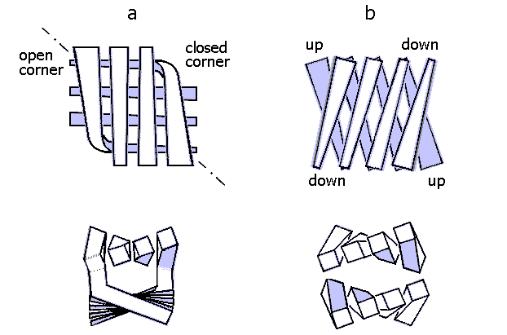
sandwiches
&
cylinders
Orthogonal packing Aligned packing
of β-sheets of β-sheets

Slide 39
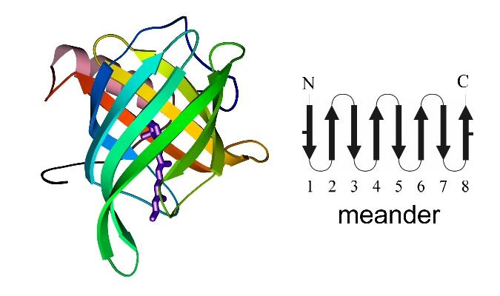
Retinol-binding protein
orthogonal packing
of one rolled β-sheet

Slide 40
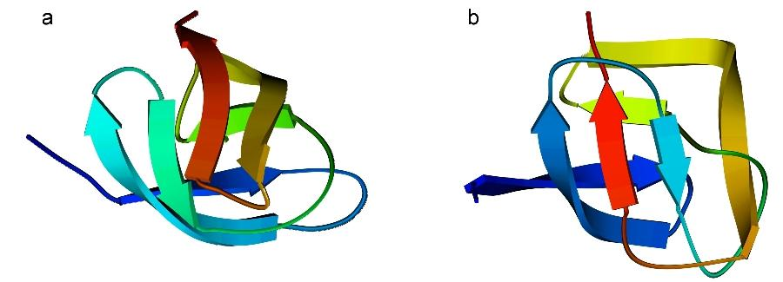
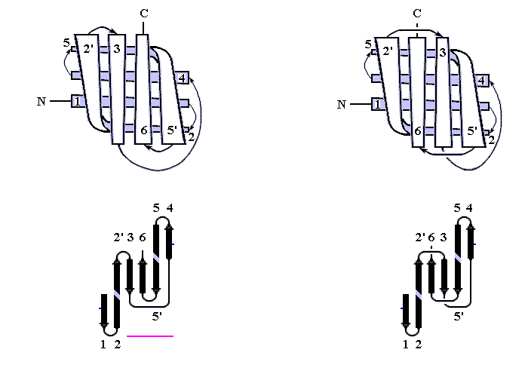
5
5
4
2’
3
4
5’
6
5’
3
2’
6
1
1
2
2
SER-protease Acid-protease
orthogonal packings of β-sheets

Slide 41
Greek key
Ser-protease Acid-protease
orthogonal packings of β-sheets

Slide 42
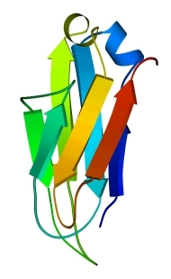
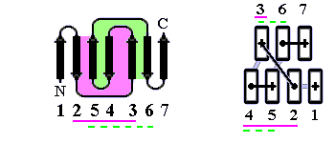
5
2
4
6
7
3
Greek key 2::5
Greek key 3::6
1
non-crossed loops
IG-fold:
aligned packing of β-sheets

Slide 43
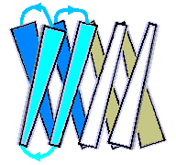
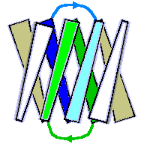
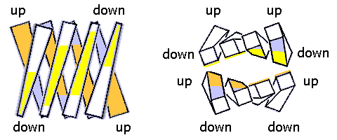
β-sandwich
Greek key:
edge of sandwich
Interlocked pairs:
center of sandwich
Hydrophobic surfaces
of sheets of the sandwich

Slide 44
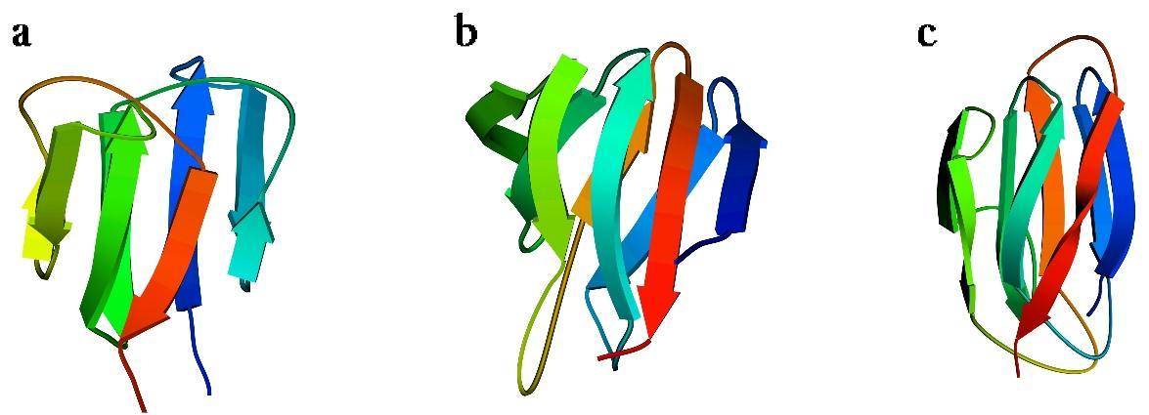
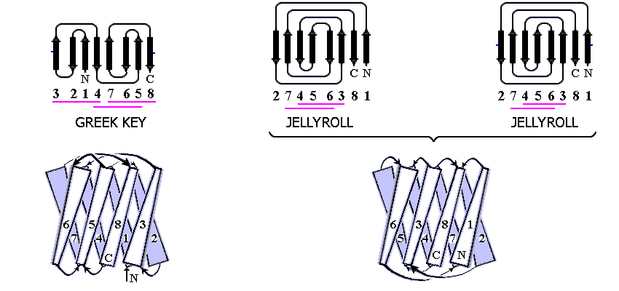
1
2
2
6
6
5
3
8
1
6
8
3
1
3
8
γ-crystallin βCAB cpSTNV
aligned packings
of β-sheets
a) different: only topologies
b) equal: even topology

Slide 45
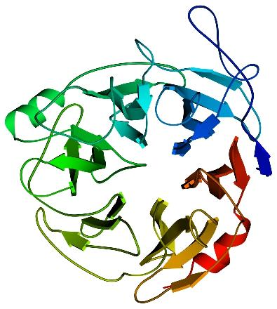
aligned packing
of β-sheets
6-bladed propeller
neuraminidase

Slide 46
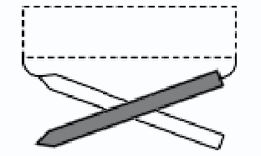
TOPOLOGY
of
chain turns between
parallel β-strands:
Usually,
RIGHT-HANDED
helix
Rare,
LEFT-HANDED
helix
Usually,
RIGHT-HANDED
β-twist

Slide 47
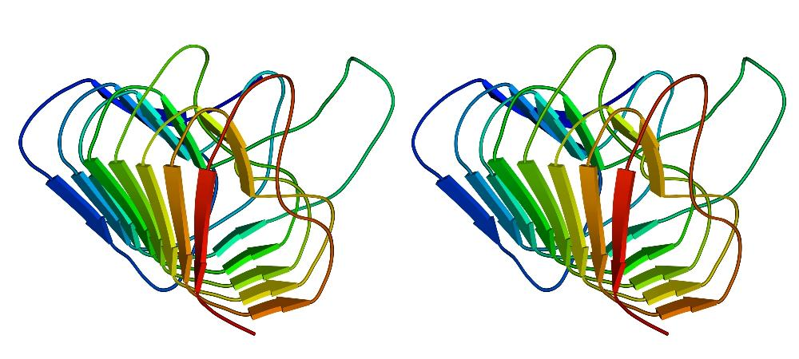
Right-handed β-prism: Pectate lyase
Usual RIGHT-HANDED chain turns
(AND RIGHT β-TWIST!)
TOPOLOGY of chain turns between parallel β-strands

Slide 48
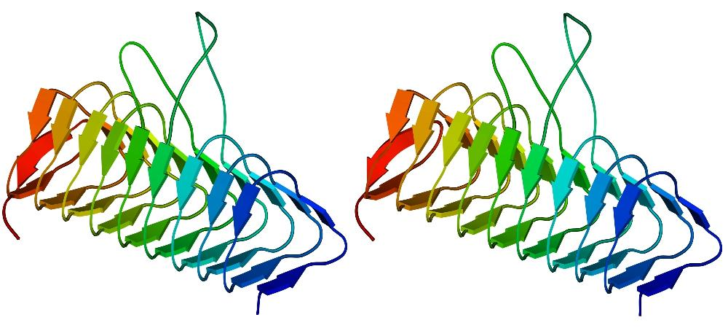
Left-handed β-prism: Acyl trensferase
UNusual LEFT-HANDED chain turns
(AND NO β−TWIST!)

Slide 49
MOST FREQUENT TOPO-ELEMENTS
of all-β folds,
mainly composed of antiparallel β-structure
MEANDER GREEK GREEK
KEY KEY

Slide 50
Membrane
Globular
Fibrous
H-bonds & hydrophobics
____

Slide 51
α-proteins
H-bonds: within helices
&
Hydrophobics: between helices

Slide 52
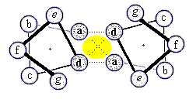
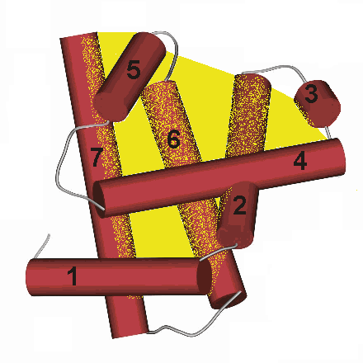
Quasi-cylindrical core
Quasi-flat core
Quasi-spherical core
MOST COMMON

Slide 53
Orthogonal packing Similar to orthogonal
of LONG α-helices packing of β-sheets

Slide 54
Aligned packing Similar to aligned
of LONG α-helices packing of β-sheets

Slide 55
Quasi-spherical core:
MOST COMMON:
Quasi-spherical
polyhedra

Slide 56
no 360-degree turn
no loop crossing

Slide 57
CLOSE PACKING
Packing of ridges
“0-4” & “0-4”: -50⁰
“0-4” & “0-3”
ridges
Packing of ridges
“0-4” & “0-3”: +20⁰

Slide 58
Packing of ridges:
“0-4” & “0-4”: -50⁰
“0-4” & “0-3”: +20⁰
-60⁰ ≈ -50⁰ +60⁰ ≠ +20⁰
IDEAL POLYHEDRA
* *

Slide 59
α/β proteins
H-bonds: within helices & sheets
Hydrophobics: between helices & sheets

Slide 60
TIM barrel Rossmann fold

Slide 61
Regular secondary structure sequence:
β − α − β − α − β − α − β − α − β − ...
α and β layers right-handed
superhelices

Slide 62
Classification of
β-barrels:
“share number” S
and
strand number N.
Here: S=8, N=8
Standard
active site
position is
given by
the archi-
tecture
N
N
N
N

Slide 63
α+β proteins
H-bonds: within helices & sheets
Hydrophobics: between helices & sheets

Slide 64
α+β:
a) A kind of regularity in the secondary
structure sequence:
β − α − β − β − α − β ...
Ferridoxin
fold

Slide 65
α+β:
b) Secondary structure sequence:
composed of irregular blocks, e.g.:
β − β − β − β − β − α − β − β − α − α ...
1
5
4
OB-fold
of the β-subdomain of nuclease
3
2
1’
Nuclease fold (“Russian doll effect”)

Slide 66
EMPIRICAL RULES
separate α and β layers right-handed
superhelices
no 360-degree turn
no loop crossing

Slide 68
Ideal
quasi-spherical polyhedra Each includes 2 to 10
(only 1 for each [3, 4, 5, 6] different packings
number of helices).

