Slide 1
PROTEIN PHYSICS
LECTURE 5

Slide 2
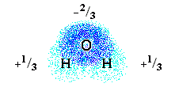
HYDROGEN BONDS
WATER molecule:
H-bond energy: 5 kcal/mol
ICE sublimation: (12 kcal/mol - 2 kcal/mol[vdW])/2
10 kcal/mol[CH₃-CH₂-OH] - 5 kcal/mol[CH₃-O-CH₃]
(HO)^{-1/3}-H^{+1/3} ::::: O^{-2/3}-H₂^{+2/3}: ε•¹/₃ •²/₃ • (-¹/₂-¹/₄+2•¹/₃)
~ 6 kcal/mol

Slide 4
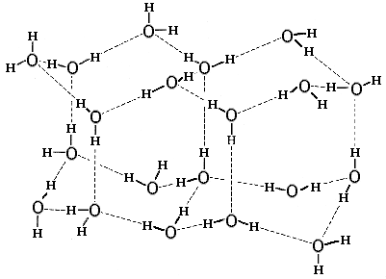
ICE

Slide 5
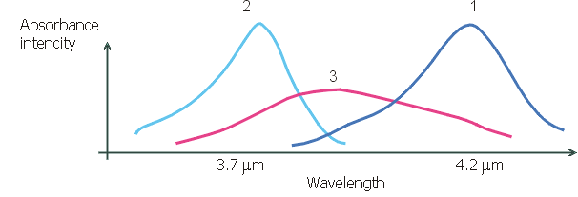
MODEL OF “FORMED” and “BROKEN”
H-BONDS IN WATER IS VERY ROUGH
H--O in CCl4
H--O in ICE
H--O in
WATER
O--H O--H ::: O

Slide 6
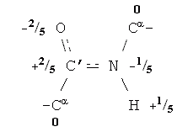
PEPTIDE GROUP
ALSO FORMS
H-BONDS
ACCEPTOR
DONOR

Slide 7
EXCHANGE OF
H-BONDS

Slide 8
ENERGY: E (E → min)
BUT: THEMAL KICKS!
Barometric eq.: density (N/ V)|_{E=mgh} ~ exp(-E/k_{B}T)
Boltzmann:
Probability_{1_STATE}(E) ~ exp(-E/kBT)
Probability_{V_STATES}(E) ~ V•exp(-E/kBT)
= exp(ln(V) - E/kBT)
= exp(-(E – T•kB•ln(V))/kBT)
= exp(-(E – T•S)/kBT)

Slide 9
Probability_{V_STATES}(E) ~ V•exp(-E/k_{B}T)
= exp(-(E – T•S)/k_{B}T)
ENTROPY: S = k_{B}•ln(V)
=> k_{B}•ln(#STATES)
FREE ENEGRY: F = E – TS
Probability ~ exp(-F/k_{B}T) → max
F → min
(under T=const)

Slide 10
H-bonds are formed, when E_{H}< -TS_{H}
Just because H-bonds have large energy,
only their ENTROPIC part
plays a role in water surrounding

