Slide 1
PROTEIN PHYSICS
LECTURE 3

Slide 4
//////////// //////////

Slide 5
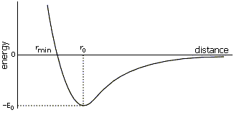

Slide 6
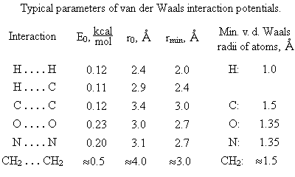
In vacuum

Slide 7
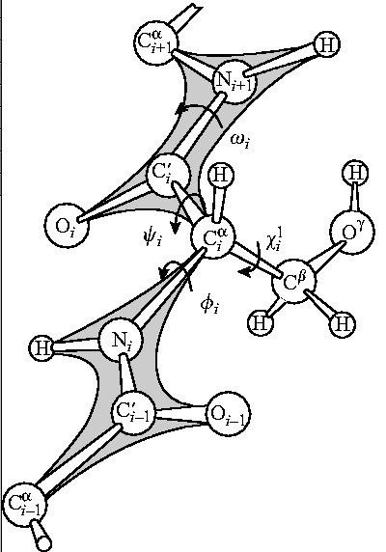
Main-chain:
φ (N-Cα) ,
ψ (Cα-C’)

Slide 8
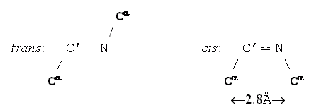
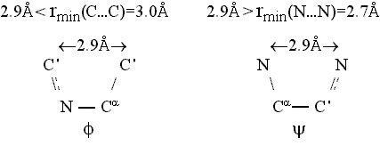
ω = 180^{ο} ω = 0^{ο}

Slide 9
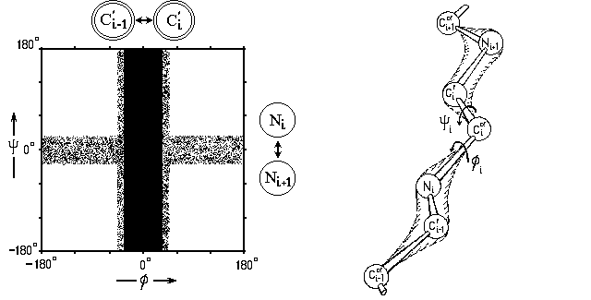

Slide 10
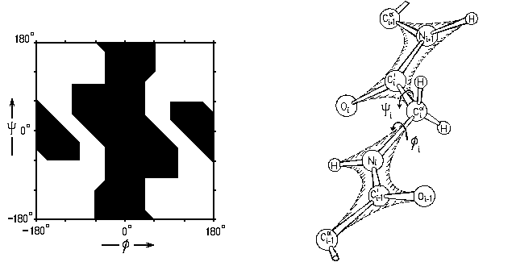
GLY

Slide 11
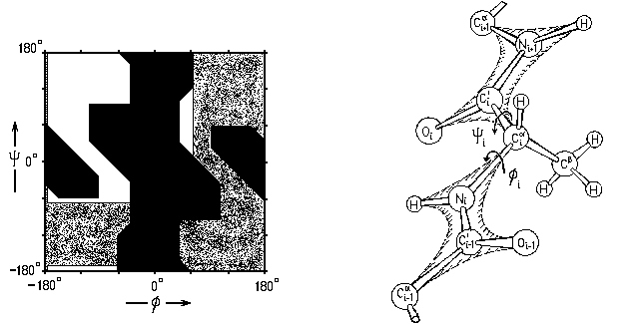
ALA

Slide 12
>ALA:
γ-atoms

Slide 13
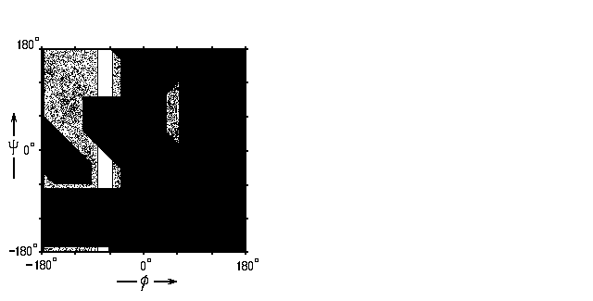
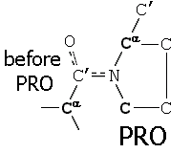
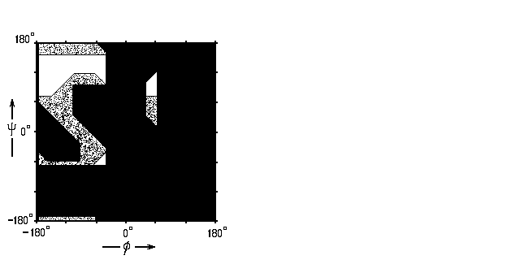
PRO (φ = -70º)
Before PRO

Slide 14
ALA, etc. GLY only

Slide 15
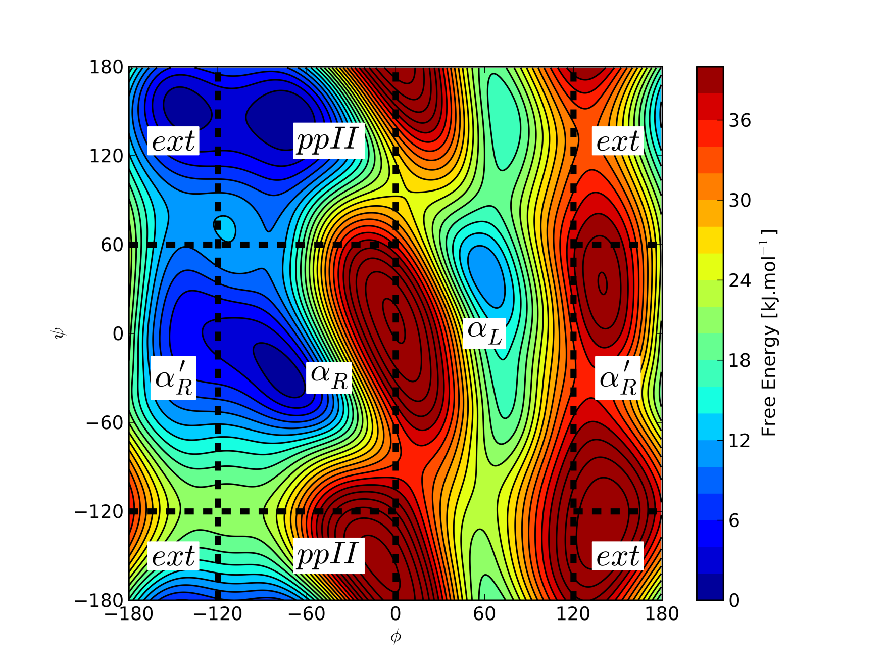

Slide 16
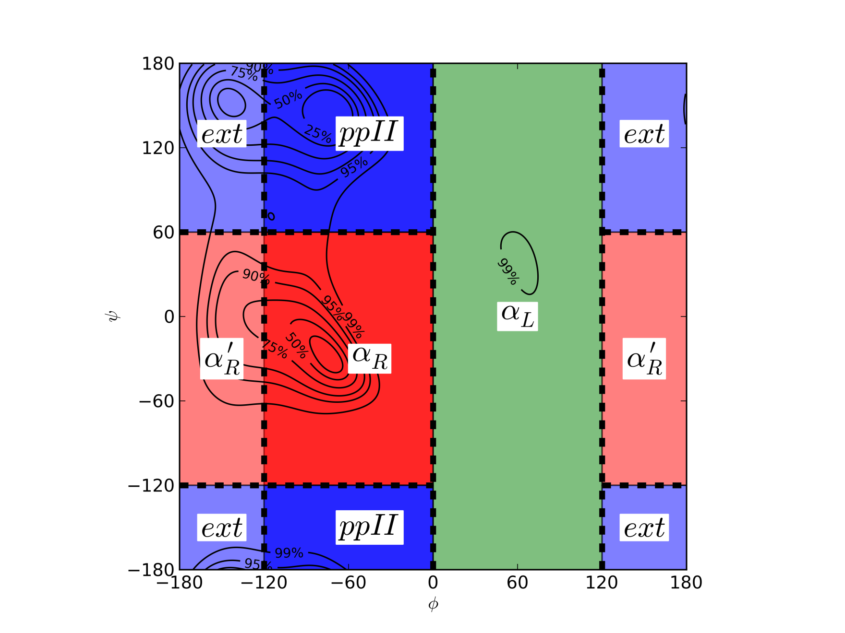

Slide 17
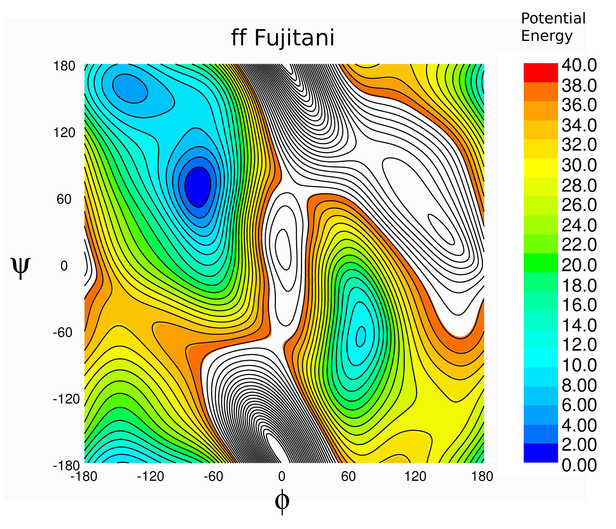

Slide 18
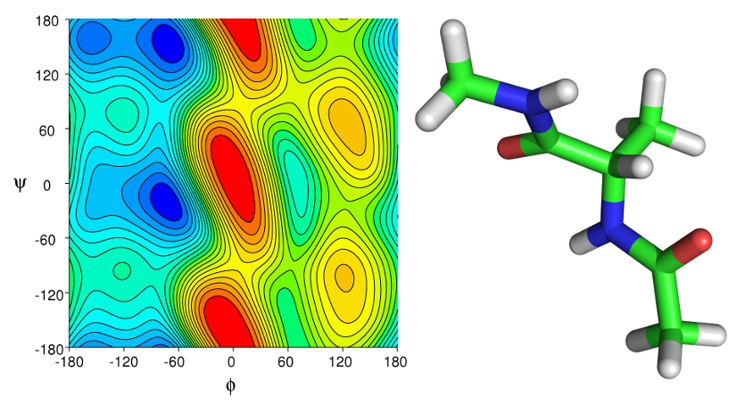

Slide 20
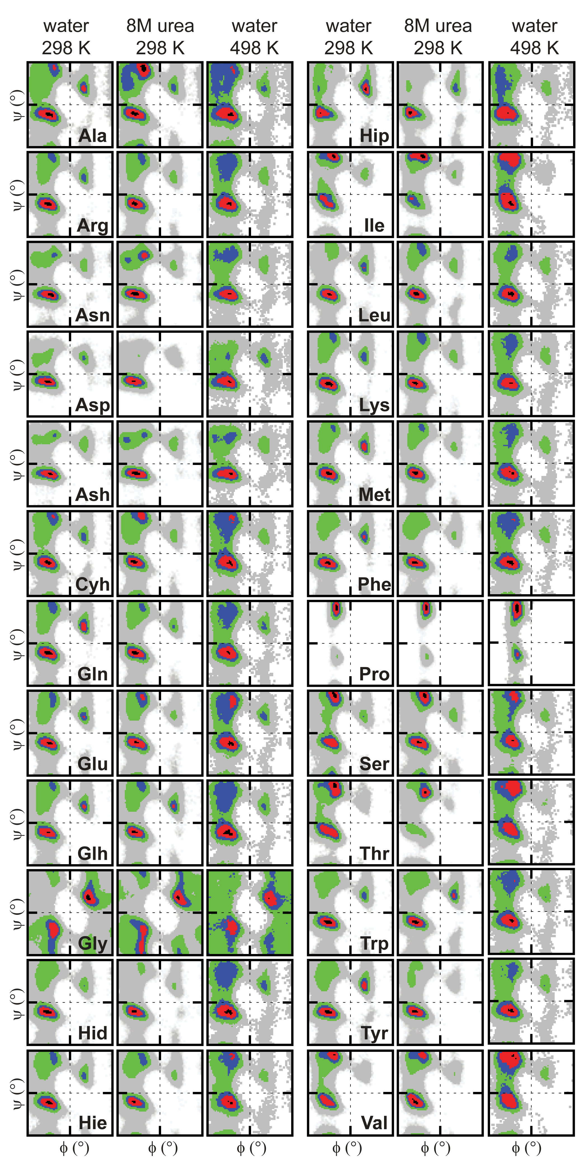
AA preferences in different environment

Slide 23
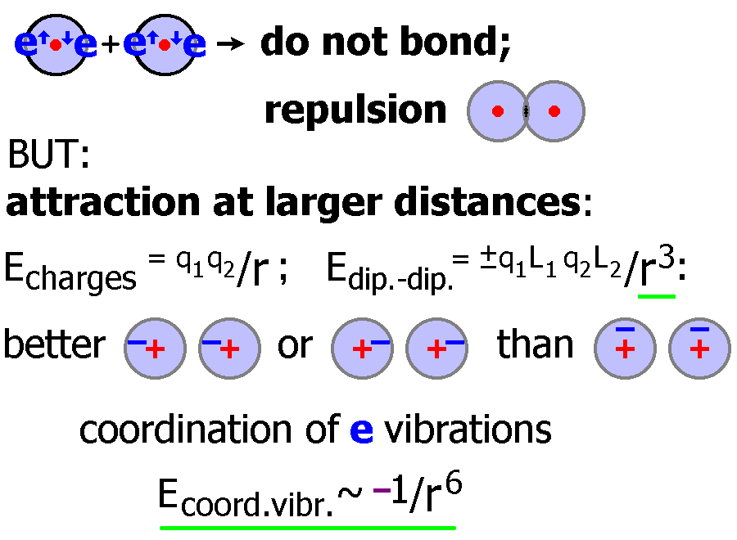
L3, 4
<= r =>
=> L

