Slide 1
PROTEIN PHYSICS
LECTURE 2

Slide 2
Starting Point
Some properties or “propensities” can be directly calculated from individual amino acids
These properties are useful in themselves and may also be used in place of the original sequence for some prediction methods (or in addition to sequence)

Slide 3
Use of amino acid properties in prediction schemes
Sequence
Propensity function
Other inputs
Sequence
Vector of propensities
Prediction function
Prediction
Other inputs

Slide 4
Hydro-pathy/phobicity/philicity
One of the most commonly used properties is the suitability of an amino acid for an aqueous environment
Hydropathy & Hydrophobicity
degree to which something is “water hating” or “water fearing”
Hydrophilicity
degree to which something is “water loving”

Slide 5
Hydro-pathy/phobicity/philicity Analysis
Goal: Obtain quantitative descriptions of the degree to which regions of a protein are likely to be exposed to aqueous solvents
Starting point: Tables of propensities of each amino acid

Slide 6
Hydrophobicity/Hydrophilicity Tables
Describe the likelihood that each amino acid will be found in an aqueous environment - one value for each amino acid
Commonly used tables
Kyte-Doolittle hydropathy
Hopp-Woods hydrophilicity
Eisenberg et al. normalized consensus hydrophobicity

Slide 7
Kyte-Doolittle hydropathy

Slide 8
Basic Hydropathy/Hydrophilicity Plot
Calculate average hydropathy over a window (e.g., 7 amino acids) and slide window until entire sequence has been analyzed
Plot average for each window versus position of window in sequence

Slide 9
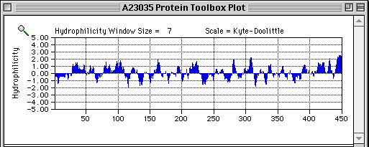
Example Hydrophilicity Plot
This plot is for a tubulin, a soluble cytoplasmic protein. Regions with high hydrophilicity are likely to be exposed to the solvent (cytoplasm), while those with low hydrophilicity are likely to be internal or interacting with other proteins.

Slide 10
Amphiphilicity/Amphipathicity
A structural domain of a protein (e.g., an α-helix) can be present at an interface between polar and non-polar environments
Example: Domain of a membrane-associated protein that anchors it to membrane
Such a domain will ideally be hydrophilic on one side and hydrophobic on the other
This is termed an amphiphilic or amphipathic sequence or domain

Slide 11
Amphiphilicity/Amphipathicity
To find such sequences, we look for regions where short stretches of charged residues alternate with short stretches of hydrophobic residues with a repeat distance corresponding to the period of the structure
A helical wheel plot can aid finding such repeats

Slide 12
Protein chain:
regular backbone
&
gene-encoded sequence
of side chains

Slide 13
O
peptide bond is relatively rigid and planar
(significant barrier to rotation, ~20 kcal/mol)
trans peptide bond is favored over cis by 10³ (steric clash)
Except PRO: trans favored by only 80:20
C
N
H
phi
φ
psi
ψ
H
O
R
C
N
N
C
R
O
R
H
The planar peptide bonds can rotate about the Cα carbon
Ф and Ψ are 180º in the conformation shown and increase
in the clockwise direction when view from the Cα carbon

Slide 14
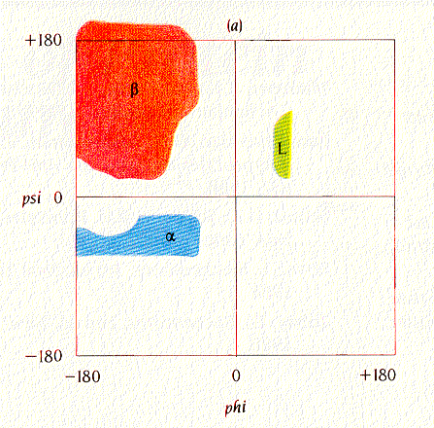
phi
φ
psi
ψ
H
O
R
Core
C
N
N
C
R
O
R
H
Ramachandran plot:
Shows sterically allowed conformational angles phi and psi
Steric interactions eliminate a large fraction of possible comformations.
Brandon & Tooze
Introduction to Protein Structure, Figure 1.7a

Slide 15
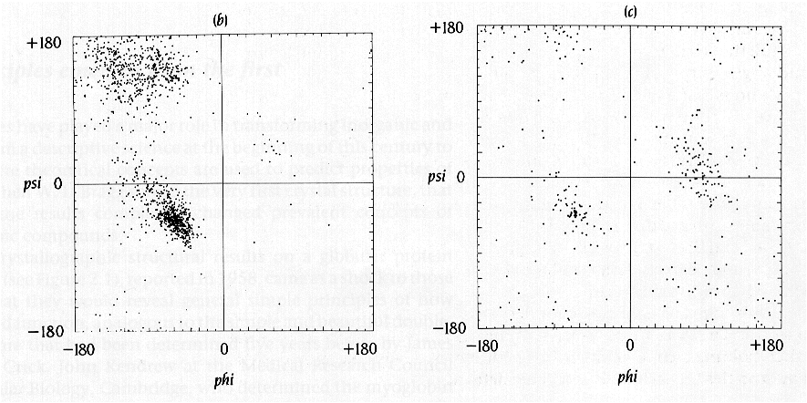
phi
φ
psi
ψ
H
O
R
Brandon & Tooze
Introduction to Protein Structure, Figure 1.7b.c
From J. Richardson, Adv. Prot. Chem. 34, 174-174 (1981)
C
N
N
C
R
O
R
H
All amino acids (except glycine) from high resolution crystals
GLY: much more freedom

Slide 16
amino acids/proteins:
ala, gly, leu, ile, val, glu, asp, gln, asn, pro,
lys, arg, ser, thr, tyr, trp, phe, his, cys, met
Core
Secondary structure
α-helix
β-sheet
loop or turn
random coil
From: Brandon & Tooze, “Introduction to Protein Structure”

Slide 17
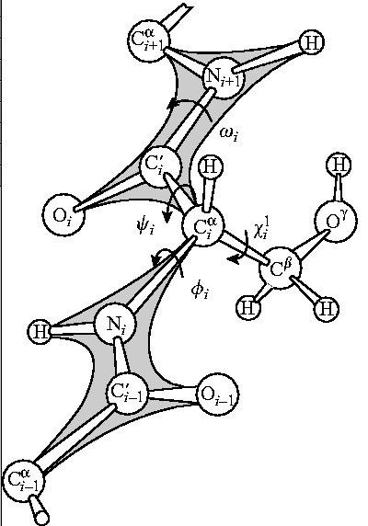
Protein chain
Covalent bond lengths:
0.9 – 1.8 Å
Covalent bond angles:
109º – 120º
Atom radii:
1 – 2 Å

Slide 18
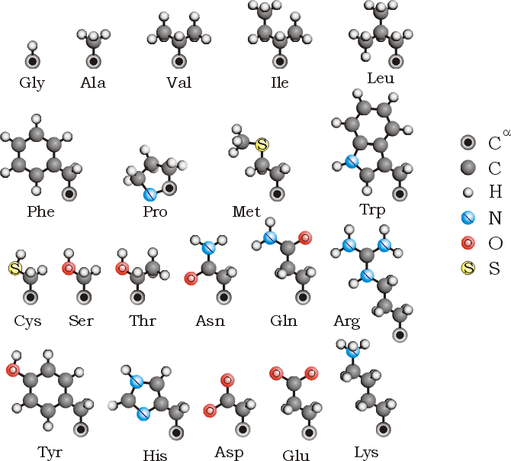
Side chains

Slide 19
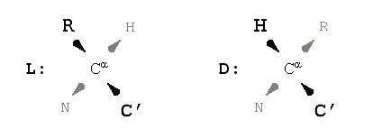
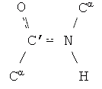
Protein chain
Side chains: L-amino acids
___
______
______
Main-chain
peptide group:
flat & rigid

Slide 20
Gly
Ala _L_
Ala -D-

Slide 21
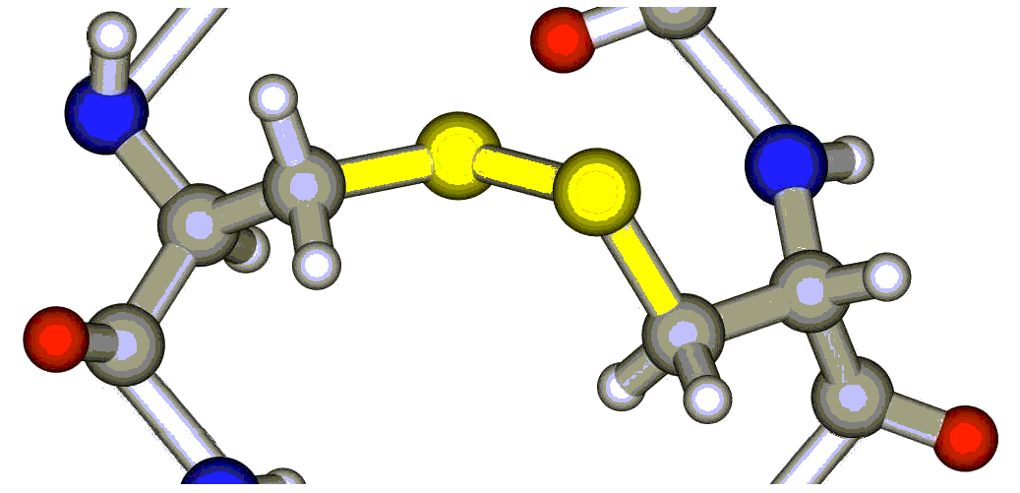
Two amino acids have asymmetric side chains:
THR
ILE
Chemical S-S bond
of two CYS side chains:

Slide 23
Peptide group:
flat & rigid
sp2 + p sp2 + p
Covalent bonding

Slide 24
Main-chain:
φ (N-Cα) ,
ψ (Cα-C’),
ω (C’=N)
Side-chain:
χ¹, χ², ...

Slide 25
Counting
angles:
120º
180º
0º
_____________________________________________

Slide 26
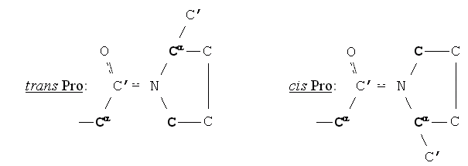
sp2 - sp2 (ω)
ω = 180º ω = 0º

Slide 27
Potentials: from IR spectra of vibrations
_____________________________________________
¼ eV

Slide 28
Potentials: from IR spectra of vibrations
_____________________________________________
QUANTUM
EFFECTS:
No thermal
vibrations
of bonds
at T~300ºK
Thermal
vibrations
of angles
just begin
at T~300ºK
Covalent bond lengths:
l₀ = 0.9 – 1.8 Å
Covalent bond angles:
109º – 120º
quantum
semiclassical

Slide 29
Potentials: from IR spectra of vibrations
_____________________________________________
classical
Pro
sp2 - sp2 (ω)
All,
but Pro
sp3 – sp3 (χ)
CH3-CH3
C-CH₂-CH₂-C
sp2 – sp3 (φ, ψ)

Slide 30
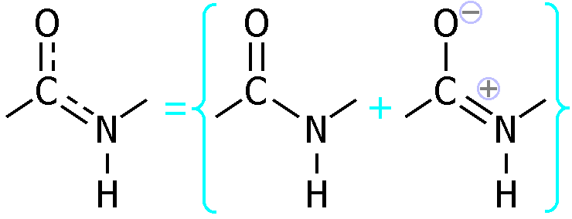
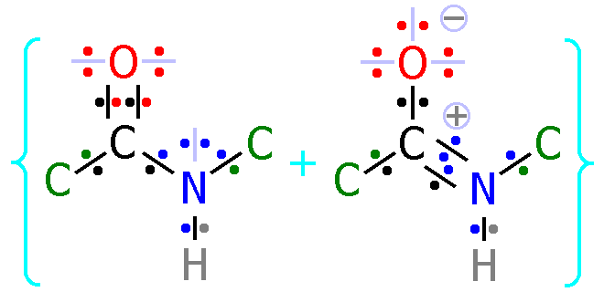
“Partial” double bond:
sp2 + p sp2 + p
“Resonance” of bonds:

