Slide 1
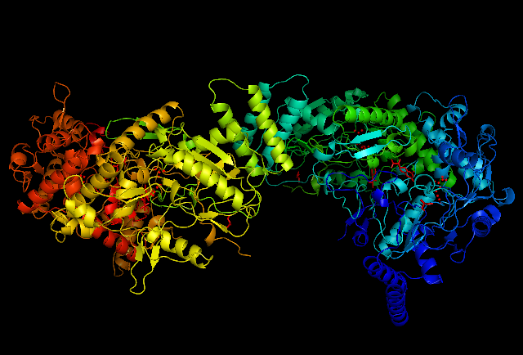
Lecture 2: Proteins In Detail
The ‘Native State’ structures look like this:
But how did they get there (Kinetics) and why do they stay that way (Thermodynamics)?
We’ll start at the very beginning: Primary structure

Slide 2
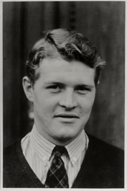
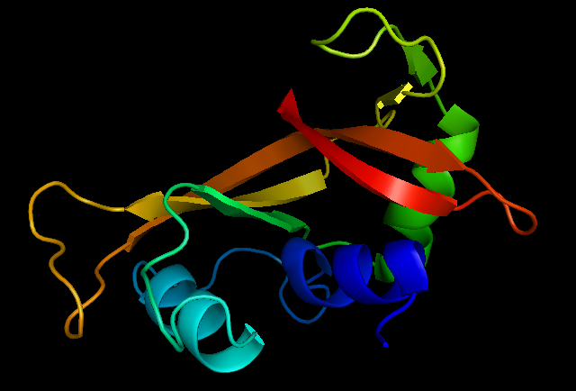
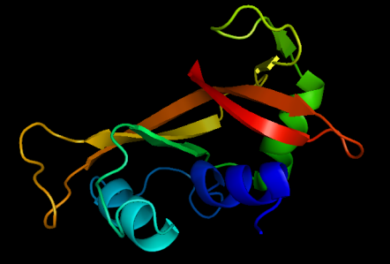
Protein Folding: The Early Years…
In 1954, Anfinsen et al. noted that the activity of Ribonuclease A can be restored after exposure to 85% Formic Acid
Christian Anfinsen(1916 - )
Ribonuclease A
BUT!!!

Slide 3
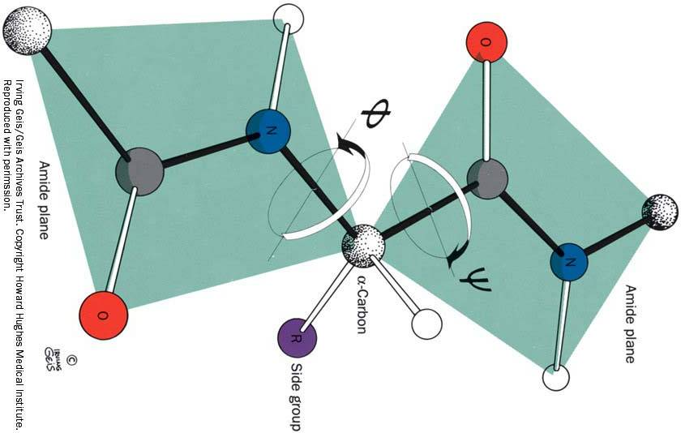
Levinthal’s Paradox…
Levinthall’s Paradox
Protein conformation is essentially a specific set of φ/ψ angles
If protein folding is a ‘random search’, even of only 3 possible φ/ψ angles…
For a 50 a.a. protein there are 3⁹⁸ (or 5.74*10⁴⁶) possible conformations
If rotations around φ/ψ take 1 ns, a random search would take on average…
7.5*10²² Years!!! (For your reference, the age of the universe is 1.37*10¹⁰ Years old).

Slide 4
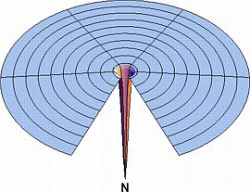

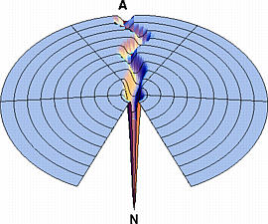
Folding Funnels…
Protein Folding Can be visualized by ‘folding funnels’, Ken Dill style.
The funnel that best describes the Levinthal Paradox is the ‘golf hole’ funel…
The simplest ‘way out’ is the biased search ‘grand canyon’ funnel…
Ken Dill, UCSF

Slide 5
Kinetic Studies…
In Kinetic Studies, reactions are monitored as a function of time:
The purpose is to uncover mechanisms, that is, how do we get to C from A
For protein folding kinetics, we can ‘borrow’ the theoretical framework from small molecule chemistry

Slide 6
The Rate Law…
Let’s take the simples protein folding case:
P_{u} P_{f}
From our small molecule rate law:
rate = -k[P_{u}]
Solve by Separation of Variables:

Slide 7
The Rate Law…
What happens where there’s an equilibrium?
k₁
P_{u} P_{f}
k₂
From our small molecule rate law:
rate_{Pu} = -k₁[P_{u}]+ k₂[P_{f}]
rate_{Pf} = k₁[P_{u}]- k₂[P_{f}]
We now have a system of differential equations. Time to bone up on our linear algebra…
We know that the final answer is going to be in the form of a ‘sum of exponentials’, so we can use the Jacobian Method

Slide 8
Solving Systems of Differential Equations…
First, we need to construct a matrix that is composed of the derivatives of the equations with respect to the variables:
Take the Jacobian and subtract the ‘identity matrix’ * λ:

Slide 9
Solving Systems of Differential Equations…
To solve the system, we have to find the solutions to ‘the determinant of the modified jacobian = 0’
Has two solutions:
and
These are the ‘eigenvalues’ for the system

Slide 10
Solving Systems of Differential Equations…
Now we need to find the ‘eigenvectors’

Slide 11
Solving Systems of Differential Equations…
The Jacobian mthod assumes that the answer is in the form of a sum of exponentials, so…

Slide 12
Kinetic Protein Folding Experiments…
Simple Unfold/Fold
rapid dilute
In Denaturant
Folded
Refold or Double Jump Experiment
denaturant
rapid dilute

Slide 13
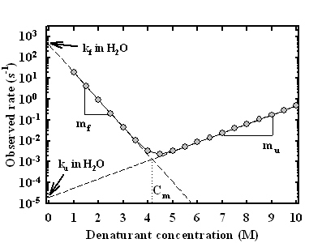
One-state vs. Multistate Folding…
The most common type of kinetic (un)folding experiment is the ‘chevron’ type in which the protein is (un)folded in varying concentrations of denaturant…
The ‘m’ values (slopes) indicate the extent of cooperativity in the (un)folding process
If the absolute sum of the kinetic ‘m’ values matches the equlibrium ‘m’ value, folding is two-state

Slide 14
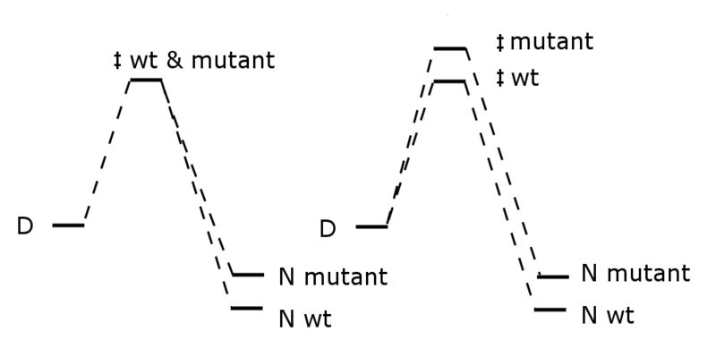

Phi Value Analysis…
Compare the (un)folding kinetics of the native state and selected mutants
The mutated region is unstructured in the TS
The mutated region is structured in the TS
Φ is not 1
Φ is close to 1

Slide 15
Phi Values to Intermediate Structures…
Vendruscolo et al. have used Φ values to determine the structure of the AcP folding transition state…
Φ values are used in the computer model to indicate the number of native contacts in the TS ensemble generated by the Monte Carlo approach
This creates an energy function that is minimized at the TS and can thus be ‘converged to’.

Slide 16
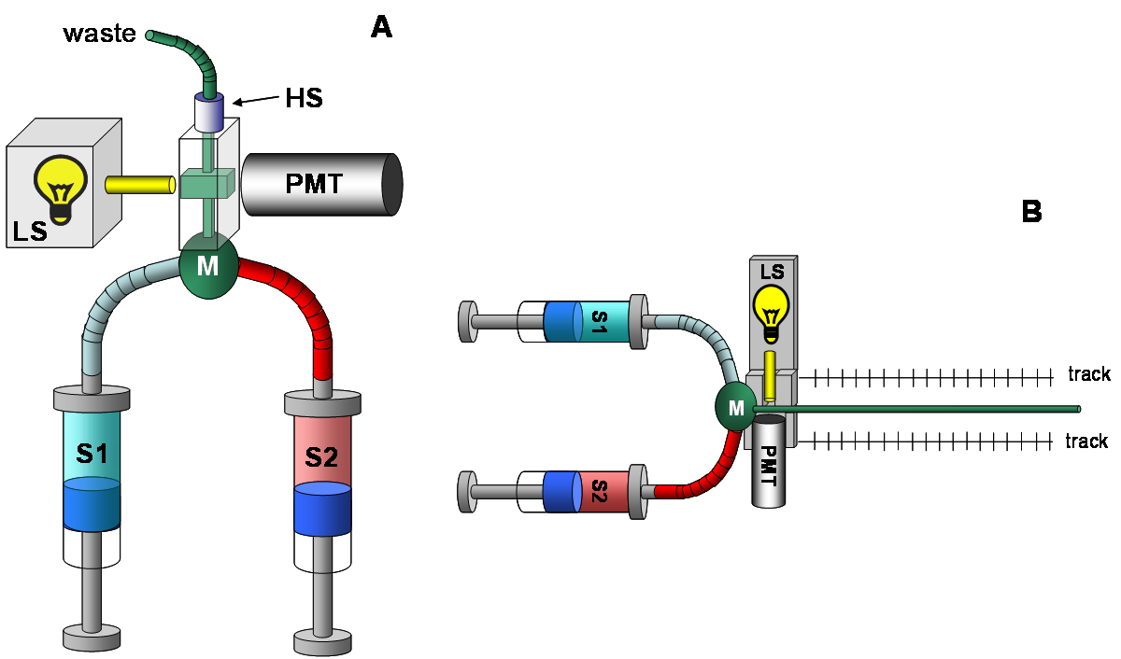
Methods for Studying Kinetics…
Rapid Mixing…
Continuous Flow
Stopped Flow

Slide 17

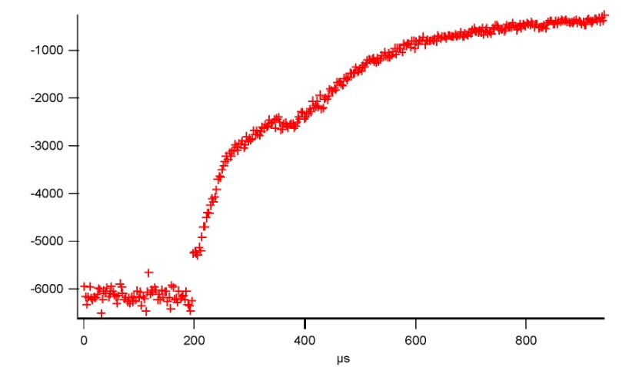
Methods for Studying Kinetics:T-Jump…
Temperature Jump…
Can do very rapid kinetics, +10 °C / 10 ns
G. Dimitriadis et al.
http://www.mnp.leeds.ac.uk/dasmith/Tjump.html

Slide 18
The Native State: Thermodynamics…
Again, to describe the stability of the native state of proteins, we can borrow from small molecule chemistry
TS
E_{a A→B}
E_{a B→A}
G⁰
A
ΔG⁰
B
RC

Slide 19
Enthalpy…
If ΔH_{u→f} is known at one temperature…
What contributes to protein folding Enthalpy?
Ionic Interactions – salt bridges (E=1/D*r)
Randomly oriented dipoles / induced dipoles (E=1/D*r⁶)
Permanent dipole / induced dipoles (E=1/D*r⁴)
D = dielectric constant = 80 (water), 2-4 (protein)
van der Waals (dispersion forces)

Slide 20
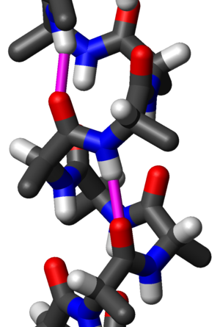
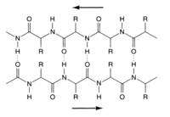
The H-bond…
“Because of its small bond energy and the small activation energy involved in its formation and rupture, the hydrogen bond is especially suited to play a part in reactions occurring at normal temperatures. It has been recognized that hydrogen bonds restrain protein molecules to their native configurations, and I believe that as the methods of structural chemistry are further applied to physiological problems it will be found that the significance of the hydrogen bond for physiology is greater than that of any other single structural feature.” – Linus Pauling 1947
Donor
Acceptor
R-N-H
:O=R
1.85-2.00 Å
2.85-3.00 Å
12 <= E <= 38 kJ/mol

Slide 21
Enthalpy
The enthalpy of protein unfolding can be measured by Differential Scanning Calorimetry…
ΔH is the area under the excess heat capacity curve
Also, since at T_{m} ΔG = 0, ΔH_{u→f} = T_{m} ΔS_{u→f} . T_{m} does not reflect stability

Slide 22
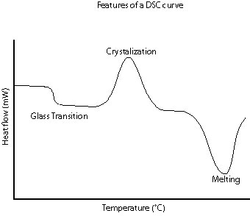
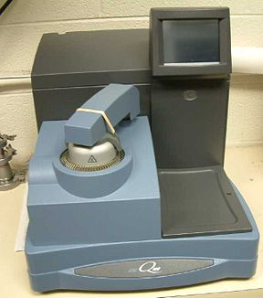
Differential Scanning Calorimetry…
DSC instruments measure the total current required to raise the temperature of the sample solution by each °K
It is easy to convert current to energy (J/sec=V*A) and energy to heat capacity (J/mol/K) of the system

Slide 23
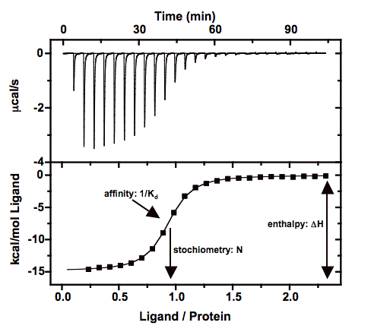
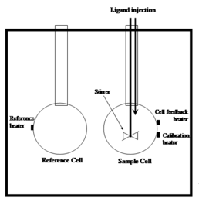
Isothermal Titration Calorimetry…
ITC instruments measure the heat of association upon ligand binding by measuring the amount of energy required to keep the temperature the same.

Slide 24
Entropy
For protein folding, there are two entropy contributions to consider:
Conformational: The denatured state is much more disordered than the native state
Systemic: The folding state of the protein affects the disordered-ness of the solvent
If ΔS is known at one temperature (probably T_{m}) …

Slide 25
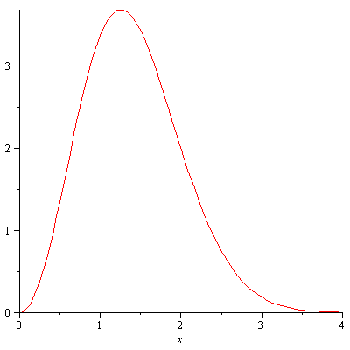
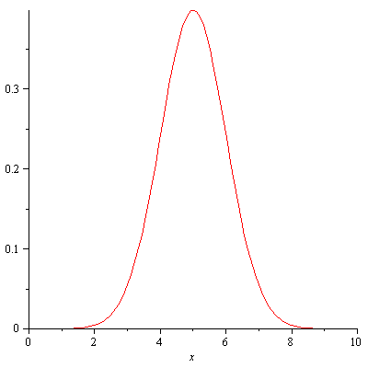
Conformational Entropy…
Conformational entropy arises from the fact that the unfolded state takes up the vast majority of microstates in the distribution of conformations

Slide 26
Entropy of the System…
In protein folding, the entropy of the system arises from the availability of microstates to the surrounding water
‘Iceburg’ water
F
F
F
F
F

Slide 27
Stability of the Native State: ΔG…
Here are our expressions for ΔG…
We can now express ΔG as a function of temperature…
Or as a function of K_{eq}…

Slide 28
Equilibrium Unfolding Experiments…
Temperature studies are useful because we can tease apart ΔH and ΔS, but proteins tend to aggregate at increased temperature. We can also unfold proteins with chemicals, usualy GdnHCl or Urea.
For these denaturants, the free energy of transfer of polypeptides from water to denaturant is roughly linear, thus…
Where [D] is the concentration of denaturant and m is the dependence of ΔG on [D], called the m-value

Slide 29
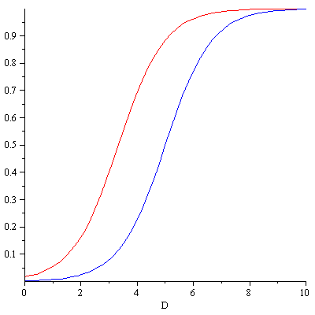
Equilibrium Unfolding Experiments…
GdmHCl experiments…
T_{m}
T_{m}
m has units J/mol/M
m can be seen sum of the solvent transfer energies of exposed groups
it is thus proportional to the size of the protein
It is also proportional to the cooperativity of the transition

Slide 30
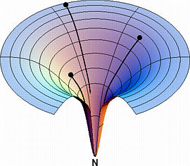
Back to Folding Funnels…
We can now understand folding funnels in terms of Enthalpy and Entropy
A big huge entropic barrier
Enthalpy/Entropy Barrier
No Barrier (???)

Slide 31
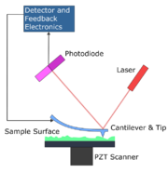
Atomic Force Microscopy
AFM protein ‘pulling’ experiments…
http://www.proteinscience.org/cgi/reprint/11/12/2759

Slide 32
Catalysis…
Catalysis is lowering the activation energy for the reaction. This will make it go faster, but not farther.
TS
E_{a A→B}
E_{a B→A}
E_{a B→A(cat)}
G⁰
A
ΔG⁰
B
RC

Slide 33
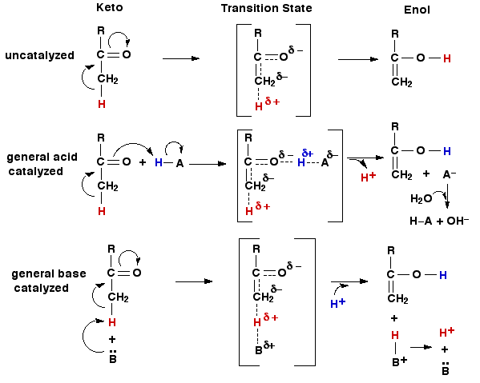
General Acid/Base Catalysis…
In order to do their thing, catalysts must lower the energy of the transition state. This is most often done by providing a complimentary charge.
http://www.biochem.arizona.edu/classes/bioc462/462a/NOTES/ENZYMES/enzyme_mechanism.html

Slide 34
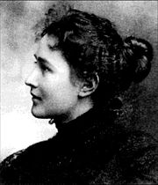





Enzyme Catalysis: The Steady State
The ‘steady state assumption’: Michaelis/Menten Kinetics
All enzyme reactions fall under the general mechanism…
If you assume that the E+S/ES equilibrium is established…
1879-1960
Canadian!
=
rearranges to:
where
so

Slide 35
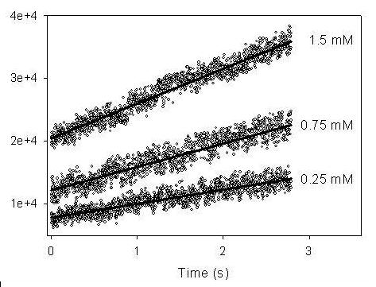
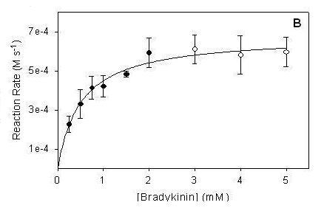
Michaelis-Menten Kinetics
So what happens if you monitor d[P]/dt at different [S]…
K_{m}
V_{max}
K_{m} = the [S] at V_{max}/2. It also =[E]+[S]/∑[ES].
k₂ = number of turnovers/sec. It cannot be greater than any forward microscopic rate.

Slide 36
Michaelis-Menten and Inhibition
All biochem undergrads are taught how to distinguish the different types of enzyme inhibition by how they affect Michaleis-Menten plots…
Competitive
Allosteric
A percentage of the enzyme is unavailable: Affects K_{m} and not V_{max}
There is a conformational change at the active site that affects enzymatic efficiency: V_{max} is affected and not K_{m}

Slide 37
Pre-steady state Kinetics
In the Michaelis-Menten model, k₂ is actually an amalgamation of all of the ‘microscopic’ rates after the formation of ES
To detect microscopic rates, we need to study the enzyme reaction before the internal equilibria are established
k_{2(MM)}
In this case, we need to monitor the formation of EP₁ ad the ES/EP₁ equilibrium is established
For most enzymes the internal equilibria are established on the millisecond time-scale

Slide 38

Pre-steady state example: Chymotrypsin
The classic example: The α-chymotrypsin catalyzed hydrolysis of esters
H₂O
K_{d}
k_{ac}
k₃
+
Chym
p-NPA
p-NP
410nm
Acetate

Slide 39
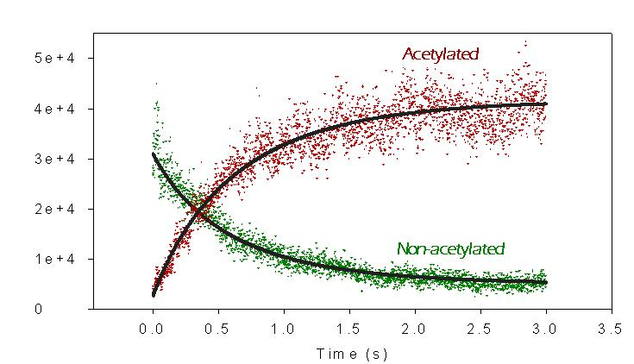
Pre-steady state example: Chymotrypsin
Here we can see the establishment of an equilibrium between E•pNPA and E_{ac}.
Fortunately, the equilibrium strongly favours E_{ac}, so fitting the data to e^{-kt} gives us k_{ac} and not k_{ac}+k_{-ac}

