Slide 1
Protein Stability Protein Folding Chapter 6

Slide 2
Protein Stability
Protein stability is the net balance of forces, which determine whether a protein will be in its native folded conformation or a denatured state.
Protein stability normally refers to the physical (thermodynamic) stability, not the chemical stability.

Slide 3
Chemical Stability
Chemical stability involves loss of integrity due to bond cleavage.
deamination of asparagine and/or glutamine residues,
hydrolysis of the peptide bond of Asp residues at low pH,
oxidation of Met at high temperature,
elimination of disulfide bonds
disulfide interchange at neutral pH
Other processes include thiol-catalyzed disulfide interchange and oxidation of cysteine residues.

Slide 4
Protein Stability
The net stability of a protein is defined as the difference in free energy between the native and denatured state:
Both G_{N} and G_{U} contribute to G
The free energy may be readily calculated from the following relationships:
K = [N]/[U] = F_{N}/(1- F_{N}),
F_{N} = fraction folded
ΔG = G_{N} - G_{U} = -RTlnK
Decreasing the energy of the folded state or increasing the energy of the unfolded state have the same effect on ΔG.

Slide 5
Protein Stability
Protein stability is important for many reasons:
Providing an understanding of the basic thermodynamics of the process of folding,
increased protein stability may be a multi-billion dollar value the in food and drug processing, and in biotechnology and protein drugs.
Two relatively recent innovations, which have had major impact in the study of the thermodynamics of proteins were the development of very sensitive techniques, differential scanning calorimetry (especially by Privalov and Brandts) and site-directed mutagenesis.

Slide 6
Stability of the Folded State
Measuring protein stability is measuring the energy difference between the U (unfolded) and F (folded) states.
The average stability of a monomeric small protein is about 5 - 10 kcal/mol, which is very small!
ΔG = G_{N} - G_{U} = -RTlnK
K=e^{-ΔG/RT} = e^{-10x1000/(2x298)} =2x 10 ⁷
i.e. in aqueous solution, at room temperature, the ratio of folded : unfolded protein is 2x 10 ⁷ : 1!

Slide 7
Stability of the Folded State
K as the equilibrium constant, is the ratio of the forward (f) and the reverse (u) rate constant. K=k_{f}/k_{u}
If a typical protein refolds spontaneously with a rate constant of k_{f} = 1 s⁻¹, its rate of spontaneously unfolding under the same condition will be 10⁻⁷ s⁻¹. The half life is 0.693/10⁻⁷ s = 80 days.
This suggests that the unfolding of proteins will only be transient.
We have to perturb the equilibrium to enable us to measure the unfolding of proteins using urea, pH, etc.

Slide 8
Techniques for Measuring Stability
Any methods that can distinguish between U and F
Absorbance (e.g. Trp, Tyr)
Fluorescence (Trp)-difference in emission max & intensity.
CD (far or near UV) - (2º or 3º)
NMR
DSC (calorimetry)
Urea gradient gels - difference in the migrating rates between F and U.
Catalytic activity
Chromophoric or fluorophoric probes

Slide 9
Denaturing Proteins at Extreme pHs
High pH and low pH denature many, but not all proteins (many are quite stable at pH 1!).
The basic idea is that the net charge on the protein due to the titration of all the ionizing groups leads to intramolecular charge-charge repulsion, which is sufficient to overcome the attractive forces (mostly hydrophobic and dispersive) resulting in at least partial unfolding of the protein.
The presence of specific counterion binding leads to formation of compact intermediate states such as the molten globule (substantial secondary structure, little or no tertiary structure, relatively compact size compared to the native state).

Slide 10
Denaturants
The effects of denaturants such as urea (usually 8 M) or Guanidinium Hydrochloride (usually 6 M GuHCl) are complex, and currently are best thought of as involving preferential solvation of the denatured (unfolded) state, involving predominantly hydrophobic related properties, and to a lesser extent H-bonding (both side-chains and backbone appear to be more soluble in the presence of the denaturants).
There is no a very good solvent because solvents that are good for the hydrophobic components are bad for the hydrophilic ones and vice versa.
As in the case of pH-induced denaturation, not all proteins are unfolded by these denaturants.
Protein stability: SCN⁻ < Cl⁻ < Urea < SO₄ ²⁻
e. g. midpoints of unfolding transition for RNase: GuSCN = 0.3M, GuHCl = 0.8 M, and urea nearly 3 M.

Slide 11
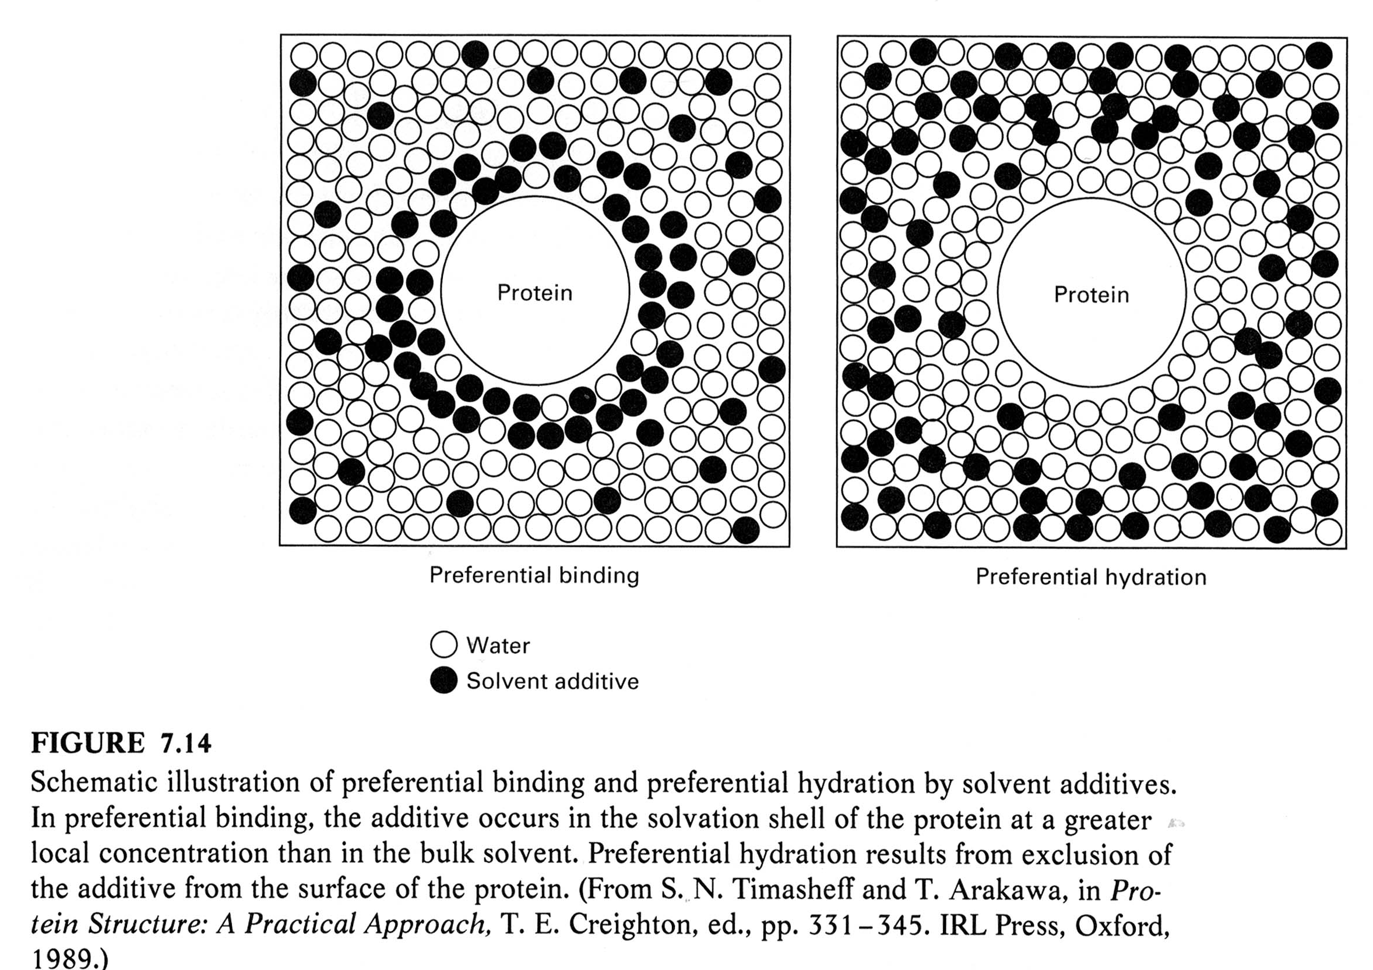
Denaturants

Slide 12
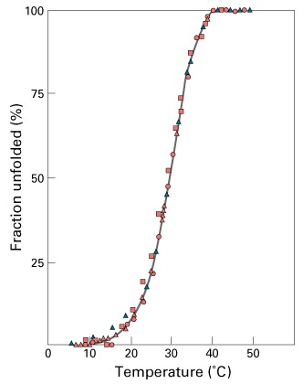
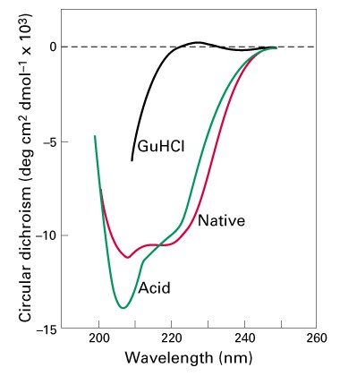
Two-state Unfolding of Protein
Keq=[N]/[U]= ( [θ]_{obs}- [θ]_{D})/( [θ]_{N}- [θ]_{D}) = F_{N}/(1- F_{N})
F_{N} = fraction folded

Slide 13
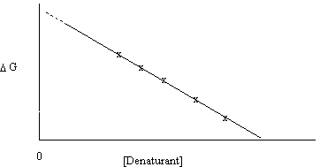
Denaturants
It is common to extrapolate the data for the unfolding transition as a function of denaturant to 0 M to give the value in water (e.g. G(H₂O)).
ΔG _{D-N} = ΔG ^{H20}_{D-N} - m _{D-N} [denaturant]
ΔG ^{H20}_{D-N} is about –5 to –10 kcal/mol
The extrapolation can have large errors.

Slide 14
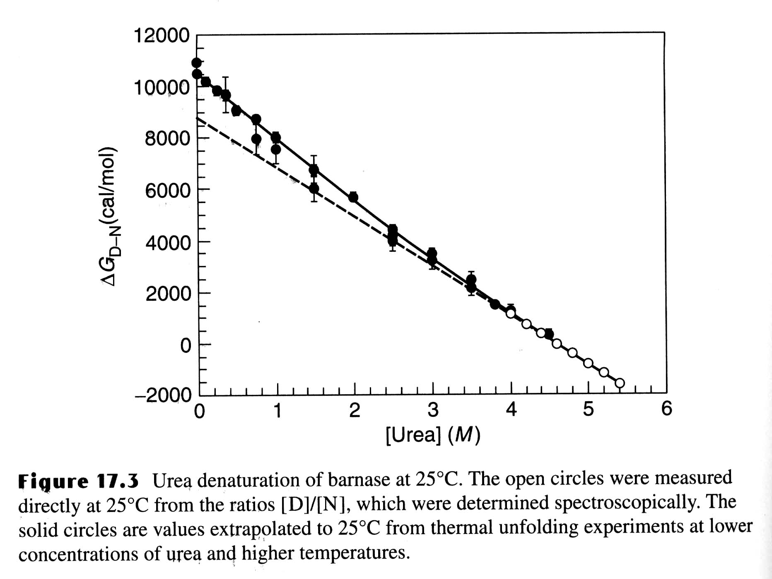
Urea Unfolding of Barnase

Slide 15
m - value
m-value reflects the dependence of the free energy on denaturant concentration
Typically for urea m ~ 1 kcal/mol
For GuHCl m ~ 3 kcal/mol
The variation in slope (m) is believed to be due to change in the solvent accessible area of hydrophobic residues. The m-value is related to how cooperative the transition is, how much structure remains in the denatured state, perhaps how much denaturant binds to the unfolded state, etc.
It’s important to note that because of different values of m, two proteins that have Cm is such that one may appear more stable, but, in fact, the opposite is true in the stability (based on ΔG ^{H20}_{D-N}).

Slide 16
Thermal Denaturation
The effects of temperature on protein structure have been, and are, controversial, since most proteins can show the phenomenon of cold denaturation, under appropriate conditions!
Disruption of hydrogen bonding and increasing hydrophobicity occurs with thermal denaturation.

Slide 17
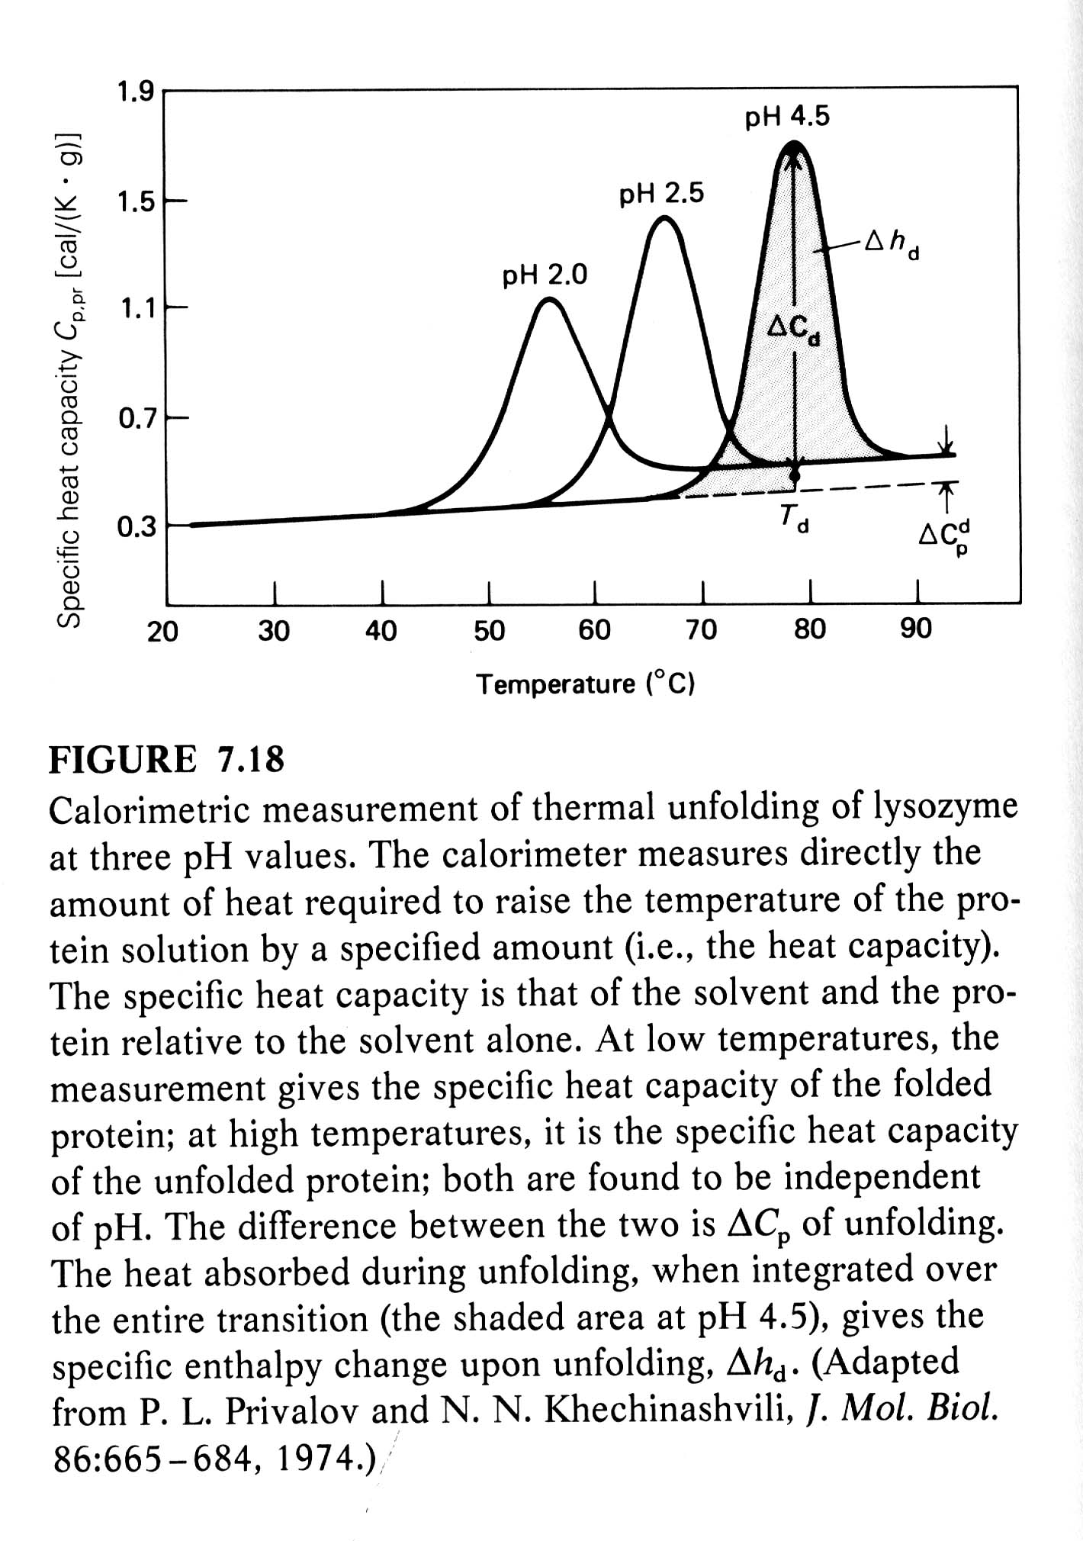
Differential Scanning Calorimetry (DSC)
DSC measures the heat required to raise the temperature of the solution of macromolecules relative to that required to the buffer alone (heat obtained by substracting two large numbers).
DSC can be used to directly measure the enthalpy and melting temperature of a thermally induced transition.
At Tm (50% unfolded),
ΔG = 0, ΔH = TΔS

Slide 18
Thermal Denaturation
It is generally assumed that Cp is constant with respect to temperature. However, Privalov observed that that Cp was positive for denaturation, i.e. the heat capacity Cp was greater for the unfolded state than the folded state.
Cp = H/T = TS/T
It is probably the change in ordered water structure between the native and denatured states which accounts, at least in part, for the change in Cp.

Slide 19
Thermal Denaturation
The Van't Hoff eq: dlnK/d(1/T) = -H/R
Van't Hoff plots (lnK vs. 1/T) of the thermal denaturation of proteins are non-linear, indicating that H varies with temperature.
This implies that the heat capacity for the folded and unfolded proteins are different!
ΔH/ΔT = Cp = (Cp_{U} - Cp_{N})
Since H = Ho + Cp(T-T_{o}), S = So + Cp ln(T/T_{o})
and G(T) = Ho - T S_{o} + Cp [(T - T_{o}) - Tln(T/T_{o} )]
where T₀ is any reference temperature (usually set = Tm).
The Gibbs Helmholz equation.
G(T) = Hm(1-T/Tm) - Cp[(Tm - T) + Tln(T/Tm)]
The temperature where S = 0, Ts = Tm exp(-Hm/[TmCp])

Slide 20
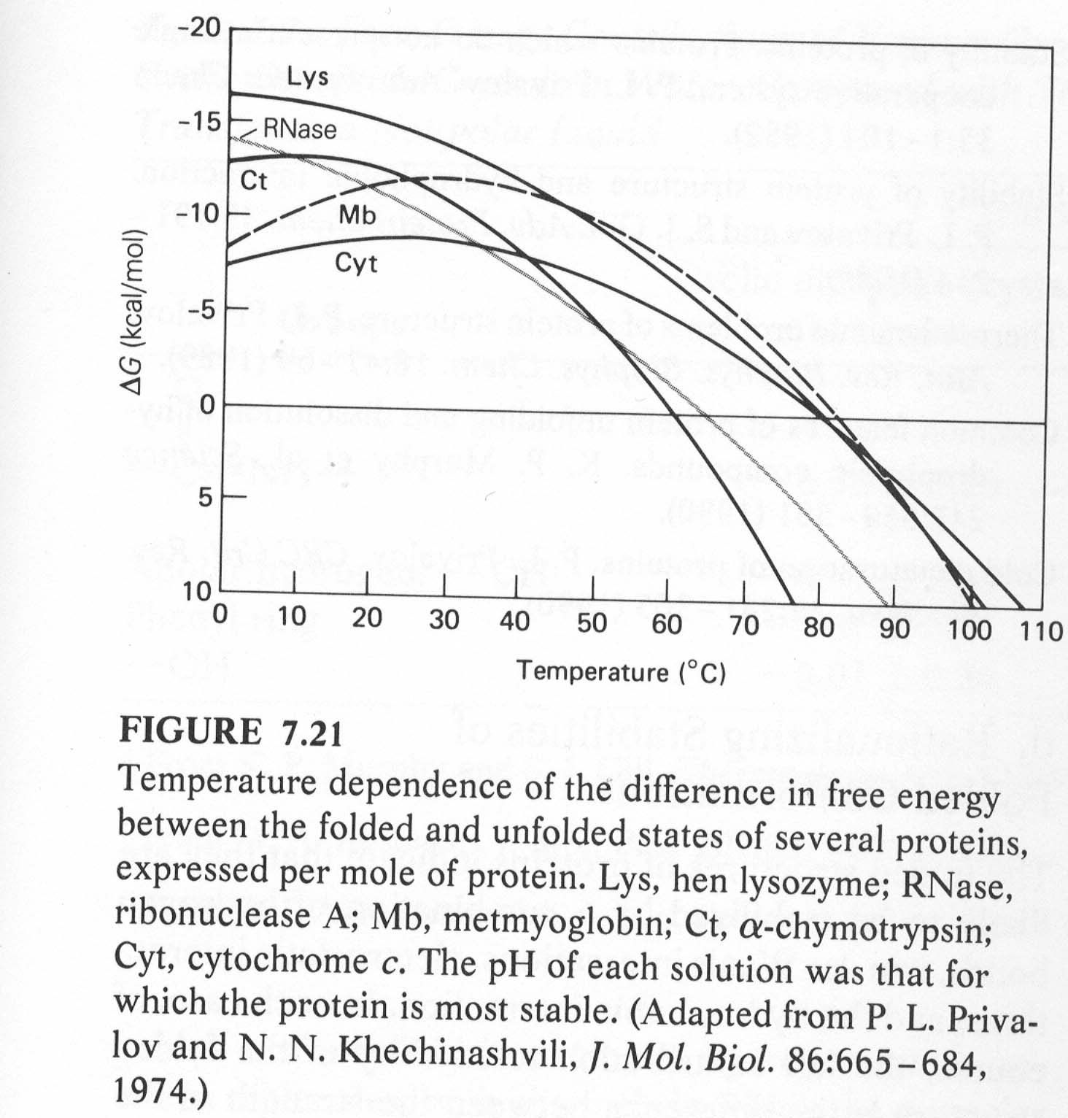

Slide 21
Thermal Denaturation
There are two important forms of enthalpy as far as protein unfolding is concerned,
the Van't Hoff enthalpy, from the temperature dependence of the equilibrium constant, ΔH_{VH},
and the enthalpy measured calorimetrically (the area under the peak), ΔH_{cal}.
If these are equal, it means there are no populated intermediates present at the Tm, i. e. the system is a two-state one.
For most proteins ΔH_{VH}/Δh_{cal} = 1.05 ± 0.03 for two-state.

Slide 22
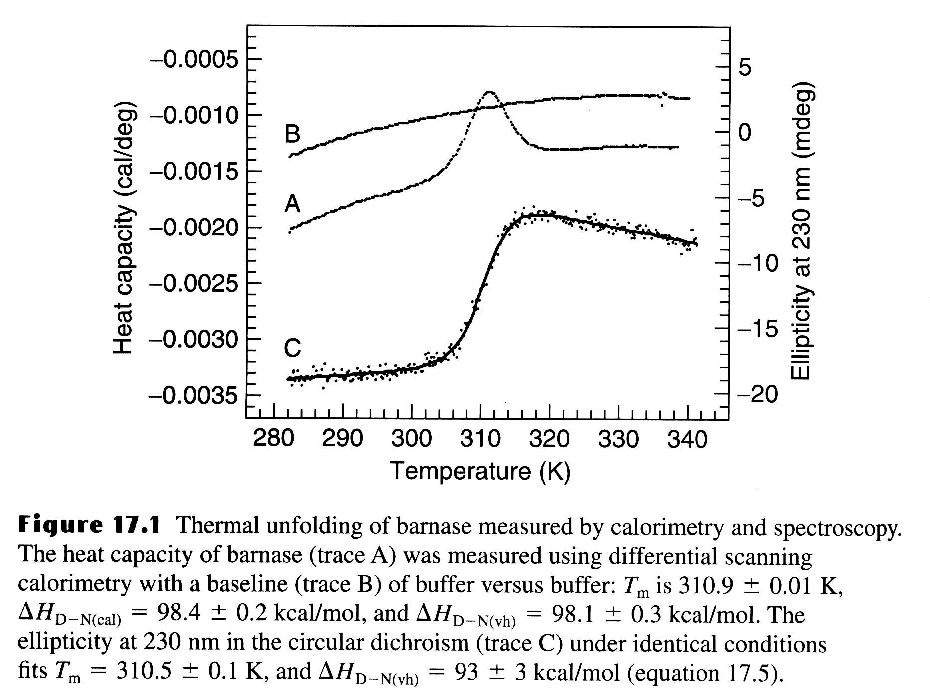
Thermal Unfolding of Barnase

Slide 23
Thermophilic Proteins
Living organisms can be found in the most unexpected places, including deep sea vents at > 100 ºC and several hundred bars pressure, in hot springs, and most recently, deep in the bowels of the earth, living off H₂ formed by chemical decomposition of rocks!
The proteins found in thermophilic species are much more stable than their mesophilic counterparts (although this corresponds to only 3 - 8 kcal/mol of free energy).
However, the overall three-dimensional structures will be essentially the same for both thermophilic and mesophilic proteins.
It only takes stability of a couple of H-bonds, you can understand why there are no gross differences in structure between thermophilic and mesophilic proteins.
The upper limit of temperature growth for bacteria is about 110 º C.
Many of the species found in these extreme environments
(T > 100C, pH 2) belong to the Archeae kingdom.

Slide 24
Thermophilic vs Mesophilic Proteins
Thermophilic proteins have increased amounts of Arg, increased occurrence of Ala in helices, and Gly/Ala substitutions (which affect the entropy of the denatured state, and thus its free energy) and increased number of salt bridges.
Each of these alone makes only a small effect, but several such changes are enough. In general, it appears that there is no single determinant of increased thermal stability; each protein is a unique case, typically involving variations in hydrophobic interactions, H-bonds, electrostatic interactions, metal-ligand (e. g. Ca²⁺) binding, and disulfide bonds. There is some suggestion that better packing may also play a role.

Slide 25
Stability-activity Trade-off?
Some enzymes from thermophiles that are very stable at normal temperatures have low activities at the lower temperatures.
There are is a compromise between the stability and activity in the structure of the active site of a protein.
There are several positions in the active site can be mutated to give more stable but less active protein.
Activity can then be increased further at an unacceptable expense to stability.
Active site of enzymes and binding sites of proteins are a general source of instability, because they contain groups that are exposed to solvent in order to bind substrates and ligands, and so are not paired with their normal types of partners.

Slide 26
Aldehyde Ferredoxin Oxidoreductase
The crystal structure of an unusual hyperthermophilic enzyme, aldehyde ferredoxin oxidoreductase, a tungsten-containing enzyme, has been solved.
The optimum temperature for this enzyme is > 95° C!! The amino acid composition is close to the average for all prokaryotic proteins except glutamine. It is 45 % helical, 14 % β sheet. There are no disulfide bonds.
As observed with many other thermophilic proteins there may be an increased number of salt bridges.
What may be significant is that the solvent accessible area is reduced, although the fraction of polar/hydrophobic is similar to other proteins.

Slide 27
Cold Denaturation
The free energy curve starts to drop at lower temperatures as predicted by the thermodynamics of protein folding.
In the past few years, several proteins have been shown to exhibit cold denaturation under destabilizing conditions, in usually either low pH or moderate denaturant concentration.
Fink, A. L. observed a cold Denaturation for a Staphylococcal Nuclease Mutant under neutral pH and no-denaturant conditions.

Slide 28
Factors Affecting Protein Stability
1) pH: proteins are most stable in the vicinity of their isoelectric point, pI. In general, electrostatic interactions are believed to contribute to a small amount of the stability of the native state; however, there may be exceptions.
2) Ligand binding: It has been known for a long time that binding ligands, e.g. inhibitors to enzymes, increases the stability of the protein. This also applies to ion binding --- many proteins bind anions in their functional sites.

Slide 29
Factors Affecting Protein Stability
3) Disulfide bonds: It was observed that many extracellular proteins contained disulfide bonds; whereas intracellular proteins usually did not exhibit disulfide bonds.
In addition, for many proteins, if their disulfides are broken (i.e. reduced) and then carboxymethylated with iodoacetate, the resulting protein is denatured, i.e. unfolded, or mostly unfolded.
Disulfide bonds are believed to increase the stability of the native state by decreasing the conformational entropy of the unfolded state due to the conformational constraints imposed by cross-linking (i. e. decreasing the free energy of the unfolded state). Most protein have "loops" introduced by disulfides of about 15 residues, but rarely more than 25.

Slide 30
Factors Affecting Protein Stability
4) Not all residues make equal contributions to protein stability. In fact, it makes sense that interior ones, inaccessible to the solvent in the native state, should make a much greater contribution than those on the surface, which will also be solvent accessible in the unfolded state.
Proteins are very malleable, i.e. a mutation at a particular residue tends to be accommodated by changes in the position of adjacent residues, with little further propagation.

Slide 31
Denatured States
If the denatured state involves most residues in a fully extended peptide chain conformation, i. e. maximal solvent exposure, then substitutions involving solvent-exposed residues in the native state will have limited effect.
If, on the other hand, the denatured state have considerable residual structure, then it is also possible that mutations may affect the conformation and free energy of the unfolded state; in extreme cases, perhaps only the denatured state and not the native state!

Slide 32
m-value
wt
m+
m-
The m-value changes can be used to understand the nature of denatured state.
The effect of mutations to the protein stability can be estimated using the change of ΔG ^{H20}_{D-N}
For some of the mutation, the m-value is changed. The different m-values related to the difference between the number of molecules of solvent bound in the native vs. denatured state. Since for the folded stated we have similar structure, the number of solvent molecules bound to the folded state is about the same, and the m-value difference reflects the different distribution of denatured state.
=> more or less exposure of hydrophobic residues.

Slide 33
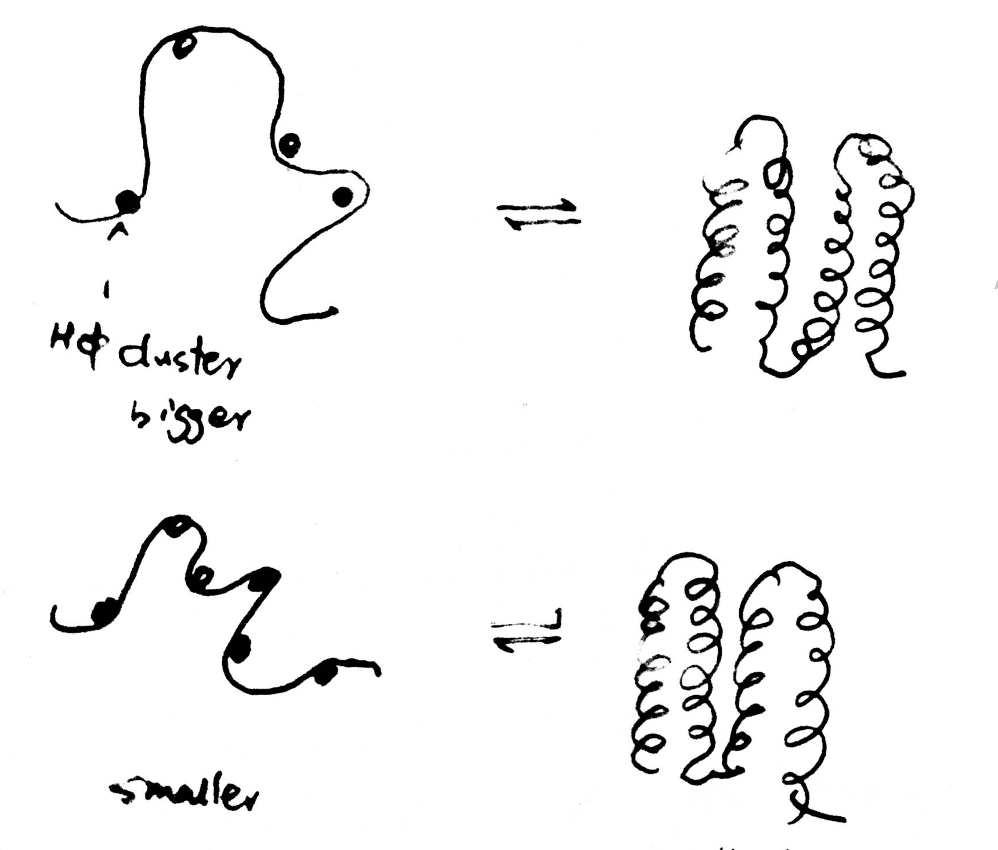
Different Unfolded States
m+ mutant has a more exposed unfolded state than that of m- mutant.
m+ mutant
M- mutant
smallest

Slide 34
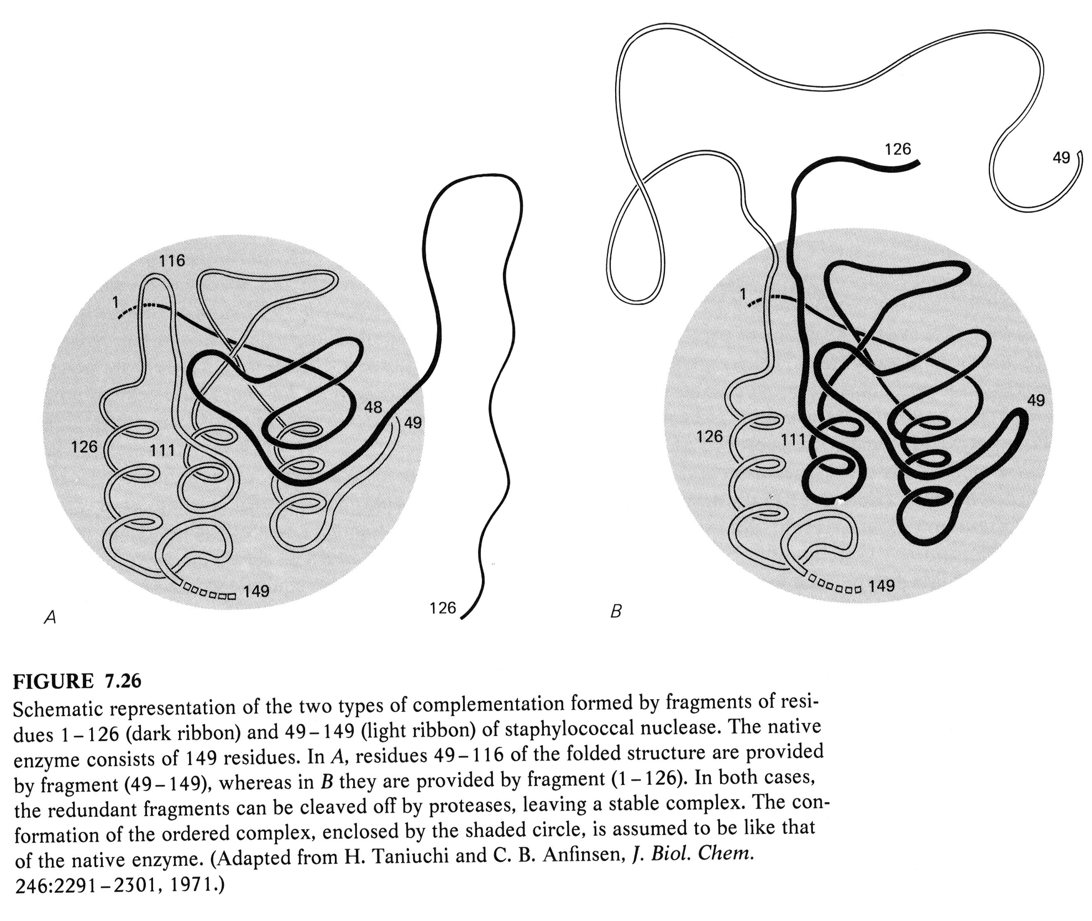

Slide 35
Protein Folding
Protein folding considers the question of how the process of protein folding occurs, i. e. how the unfolded protein adopts the native state.
This has proved to be a very challenging problem. It has aptly been described as the second half of the genetic code, and as the three-dimensional code, as opposed to the one-dimensional code involved in nucleotide/amino acid sequence.
Predict 3D structure from primary sequence
Avoid misfolding related to human diseases
Design proteins with novel functions

Slide 36
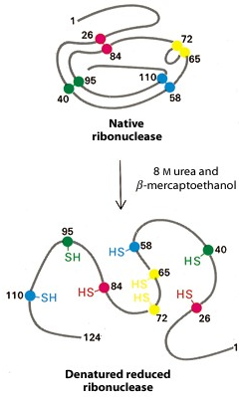
Anfinsen Experiment
Denaturation of ribunuclease A ( 4 disulfide bonds) with 8 M Urea containing β-mercaptoethanol to random coil, no activity

Slide 37
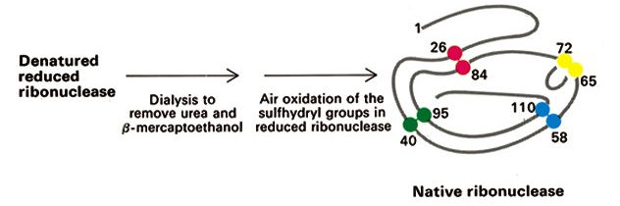
Anfinsen Experiment
After renaturation, the refolded protein has native activity despite the fact that there are 105 ways to renature the protein.
Conclusion: All the information necessary for folding the peptide chain into its native structure is contained in the primary amino acid sequence of the peptide.

Slide 38
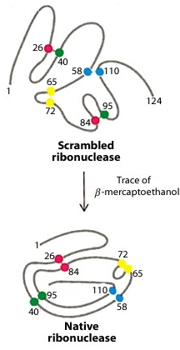
Anfinsen Experiment
Remove β-mercaptoethanol only, oxidation of the sulfhydryl group, then remove urea → scrambled protein, no activity
Further addition of trace amounts of β-mercaptoethanol converts the scrambled form into native form.
Conclusion: The native form of a protein has the thermodynamically most stable structure.

Slide 39
The Levinthal Paradox
There are vastly too many different possible conformations for a protein to fold by a random search.
Consider just for the peptide backbone, there are 3 conformations per amino acid in the unfolded state, For a 100 a.a. protein we have 3¹⁰⁰ conformations.
If the chain can sample 10¹² conformations/sec, it takes 5 x 10³⁵ sec (2 x 10²⁸ year)
Conclusion: Protein folding is not random, must have pathways.

Slide 40
Equilibrium Unfolding
switch off part of the interactions in the native protein under different denaturing conditions such as chemical denaturants, low pH, high salt and high temperature
understand which types of native structure can be preserved by the remaining interactions

Slide 41
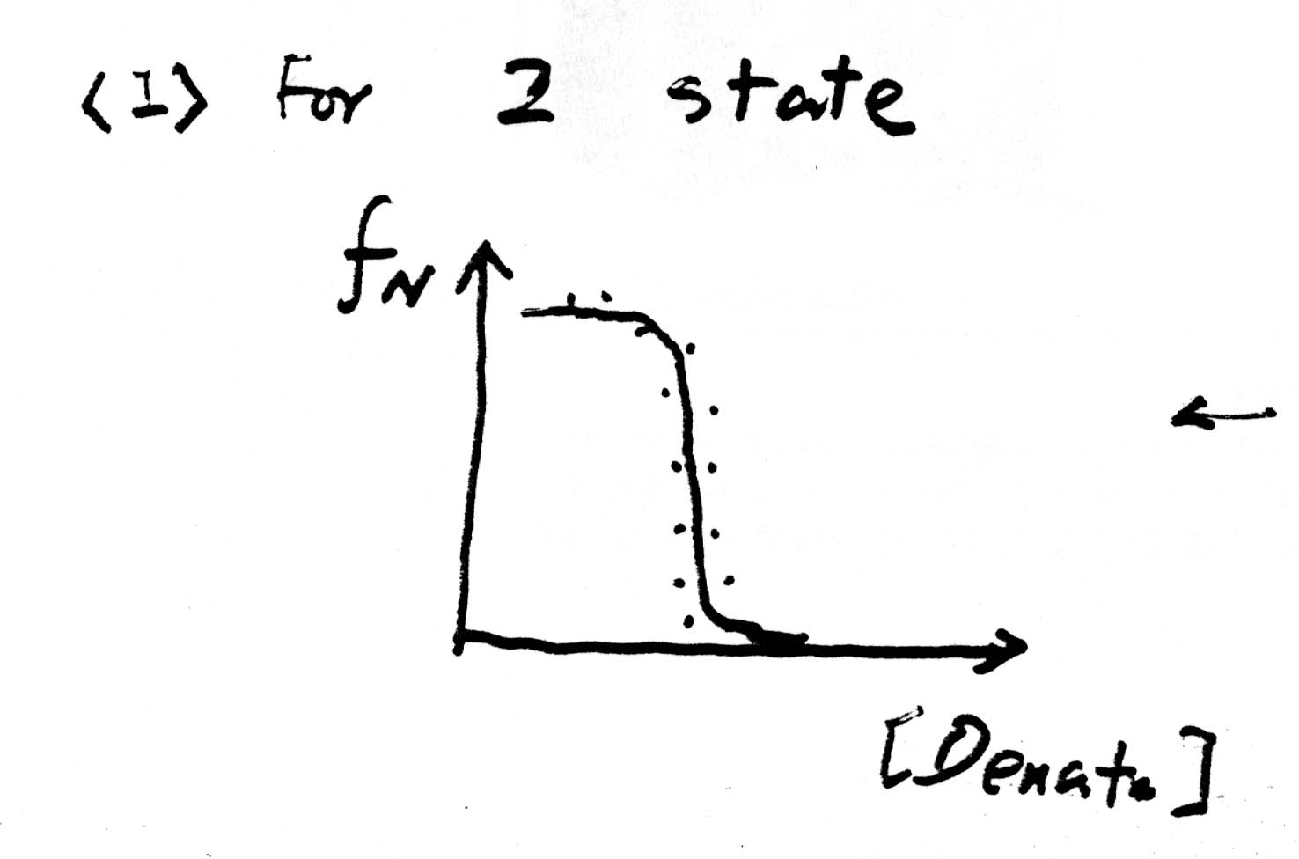
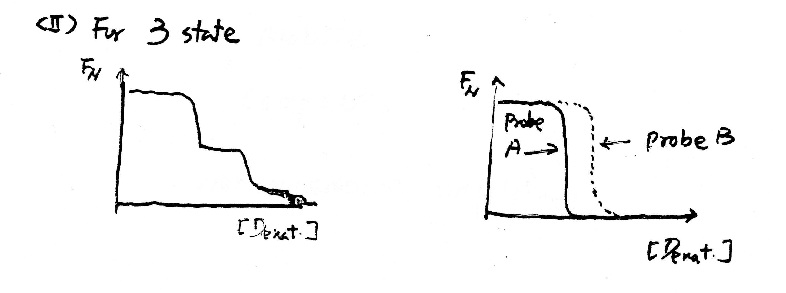
Equilibrium Unfolding
Using many probes to investigate the number of transitions during unfolding and folding
For 2-state unfolding, all probes give the same transition curves. Single domains or small proteins usually have two-state folding behavior.
For 3-state unfolding, there are more than one transitions or different probes have different transition curves

Slide 42
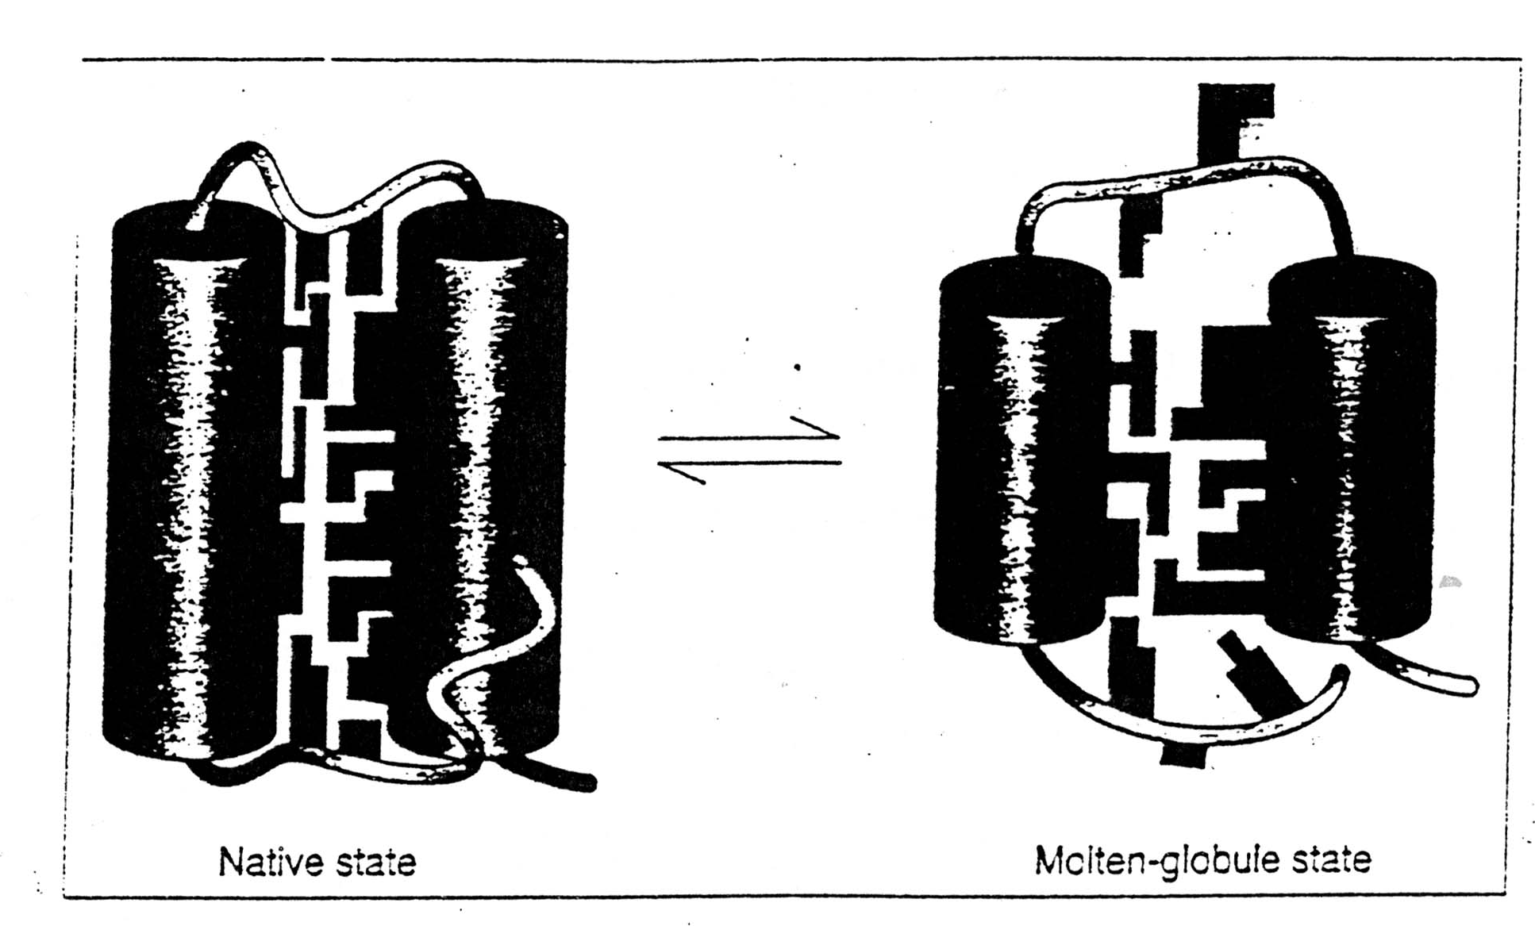
Molten Globule State (MG)
It is an intermediate of the folding transition U→MG→F
It is a compact globule, yet expanded over a native radius
Native-like secondary structure, can be measured by CD and NMR proton exchange rate
It has a slowly fluctuating tertiary structure which gives no detectable near UV CD signal and gives quenched fluorescence signal with broadened NMR chemical peaks
Non-specific assembly of secondary structure and hydrophobic interactions, which allows ANS to bind and gives an enhanced ANS fluorescence
MG is about a 10 % increase in size than the native state

Slide 43
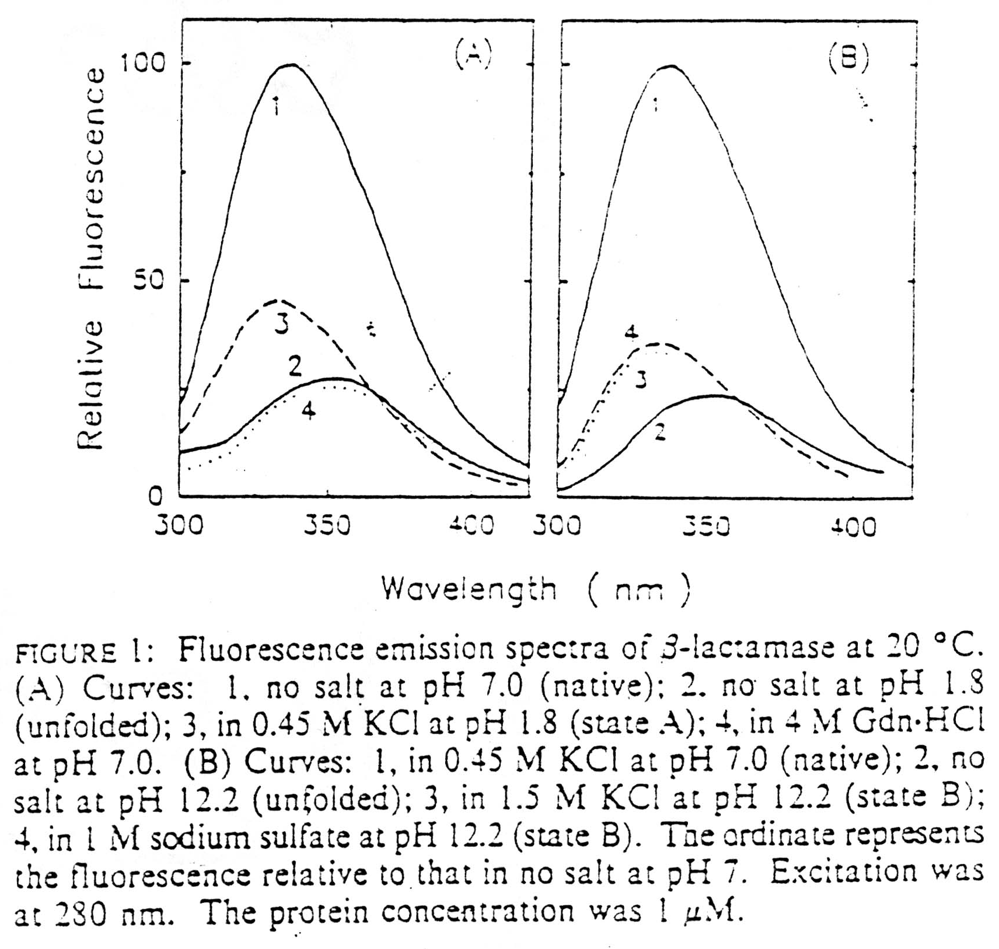
Fluorescence
A.
1 - native
3 - MG
2,4 - unfolded
B.
1 - native
3,4 - MG
2 - unfolded

Slide 44
ANS has a Strong Affinity to the Hydrophobic Surface

Slide 45
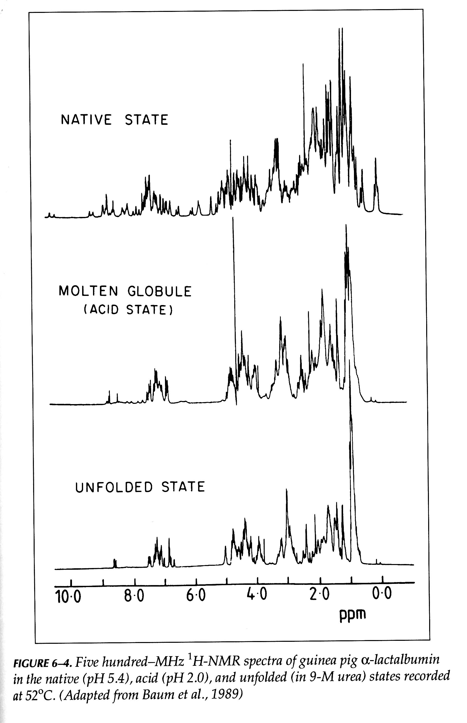
NMR of MG

Slide 46
Kinetic Folding Pathways
U→ I →II → N
Not all steps have the same rate constants.
Intermediates accumulate to relatively low concentrations, and always present as a mixture
Identify kinetic intermediates
Measuring the rate constants
Figure out the pathways
Slow folding
Formation of disulfile bond
Pro isomerization

Slide 47
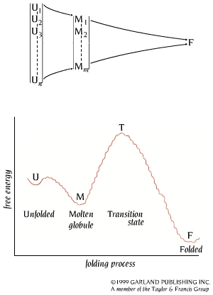
Unfolded State
The unfolded state is an ensemble of a large number of molecules with different conformations.

Slide 48
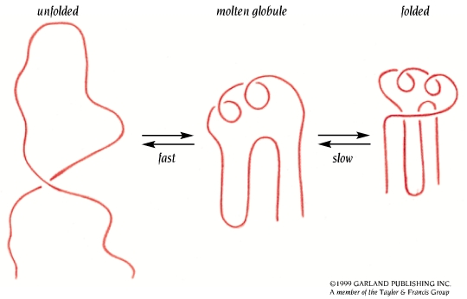
MG is a Key Kinetic Intermediate

Slide 49
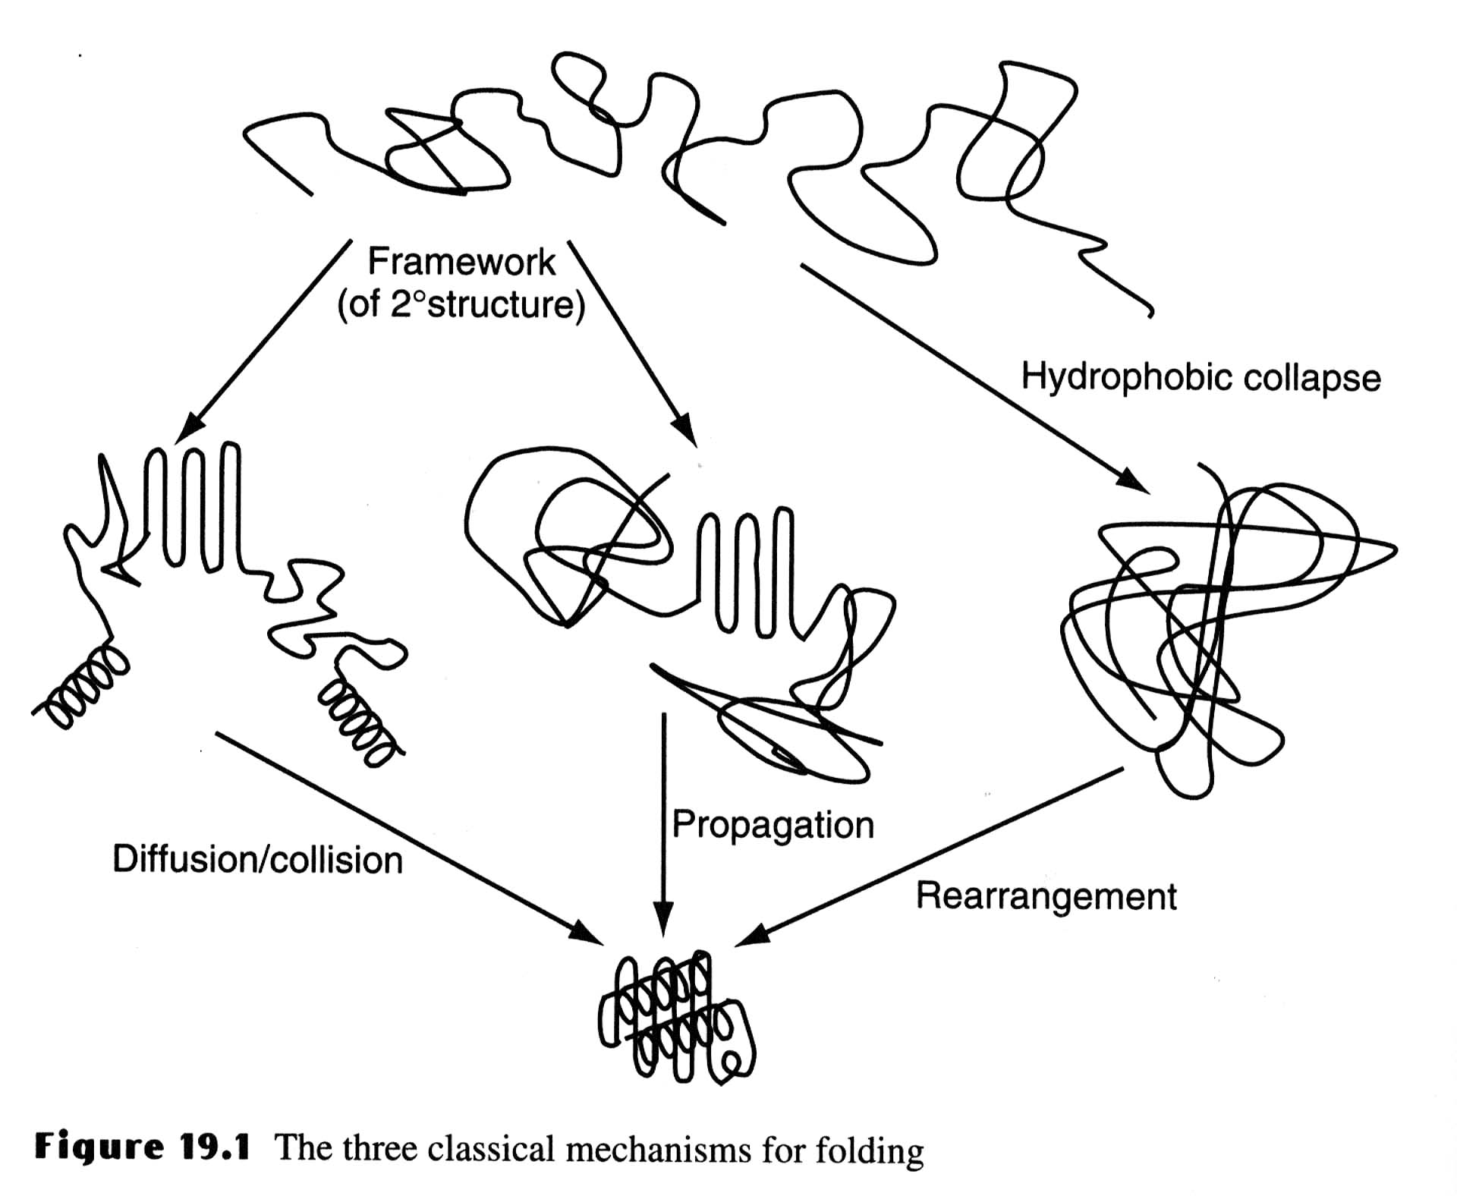
Three Classic Models of Protein Folding
The Framework model proposed that local elements of native local secondary structure could form independently of tertiary structure (Kim and Baldwin). These elements would diffuse until they collided, successfully adhering and coalescing to give the tertiary structure (diffusion-collision model)(Karplus & Weaver).

Slide 50
The classic Nucleation Model
The classic nucleation model postulated that some neighboring residues in the sequence would form native secondary structure that would act as a nucleus from which the native structure would propagate, in a stepwise manner. Thus, the tertiary structure would form as a necessary consequence of the secondary structure (Wetlaufer).

Slide 51
The hydrophobic-collapse Model
The hydrophobic-collapse
model hypothesized that a
protein would collapse
rapidly around its
hydrophobic sidechains
and then rearrange from
restricted conformational
space occupied by the
intermediate. Here the
secondary structure would
be directed by native-like
tertiary structure (Ptitsyn
& Kuwajima).

Slide 52
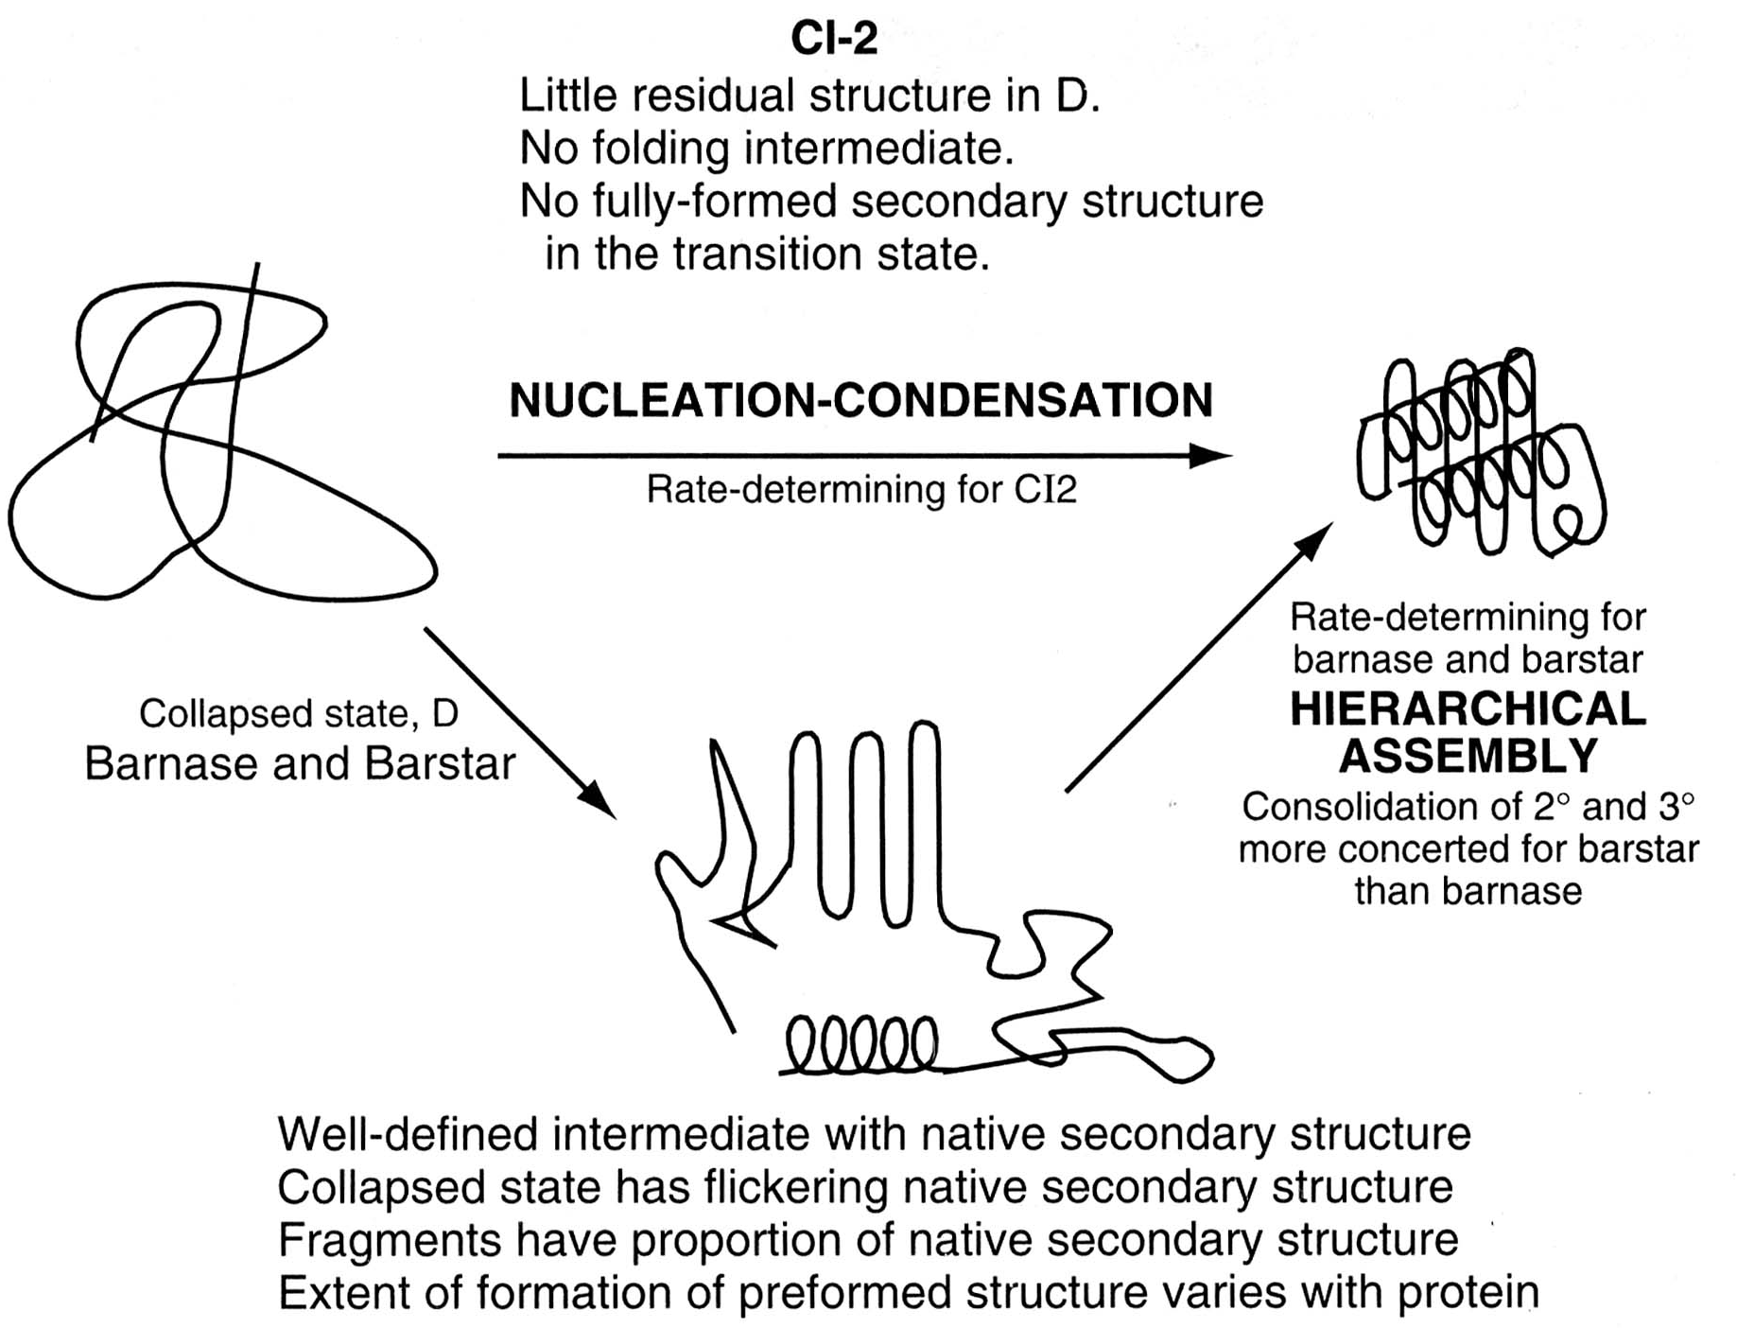
Unified Nucleation-condensation Scheme
It is unlikely that there is a single mechanism for protein folding.

Slide 53
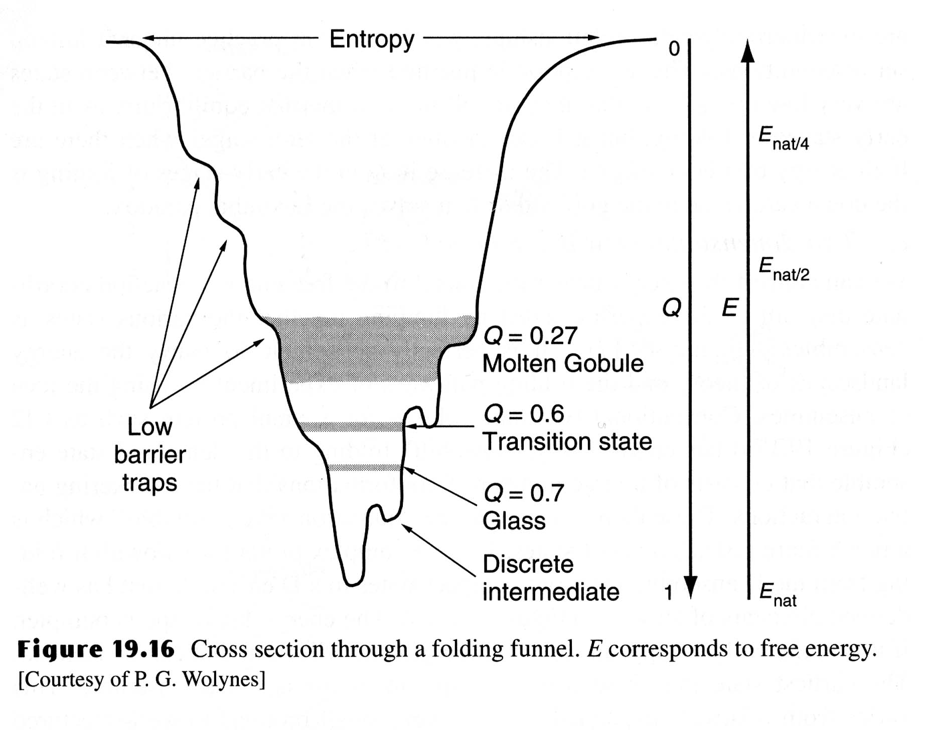
The Folding Funnel
A new view of protein folding suggested that there is no single route, but a large ensemble of structures follow a many dimensional funnel to its native structure.
Progress from the top to the bottom of the funnel is accompanied by an increase in the native-like structure as folding proceeds.

Slide 54
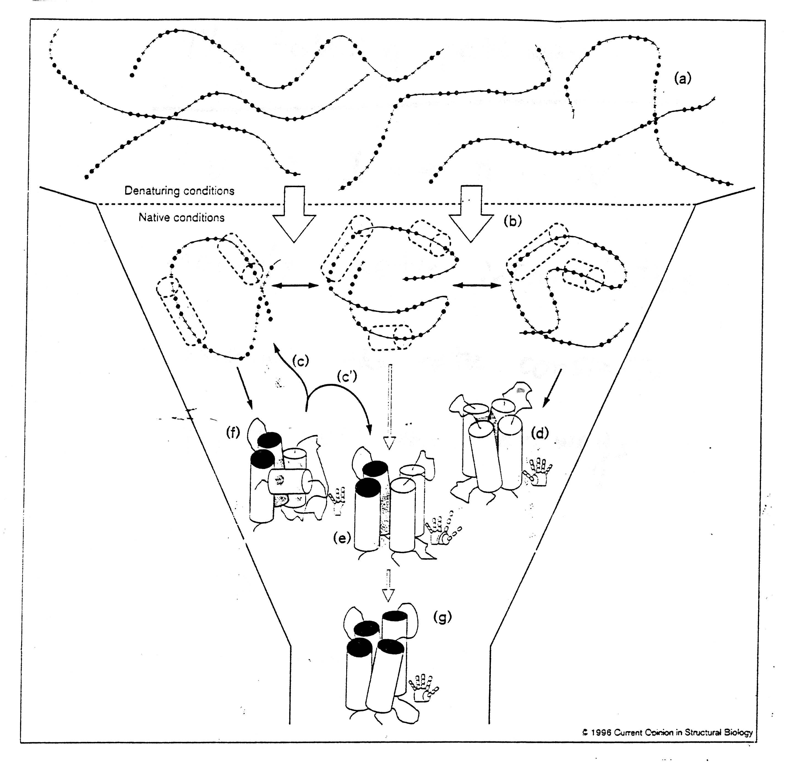

Slide 55
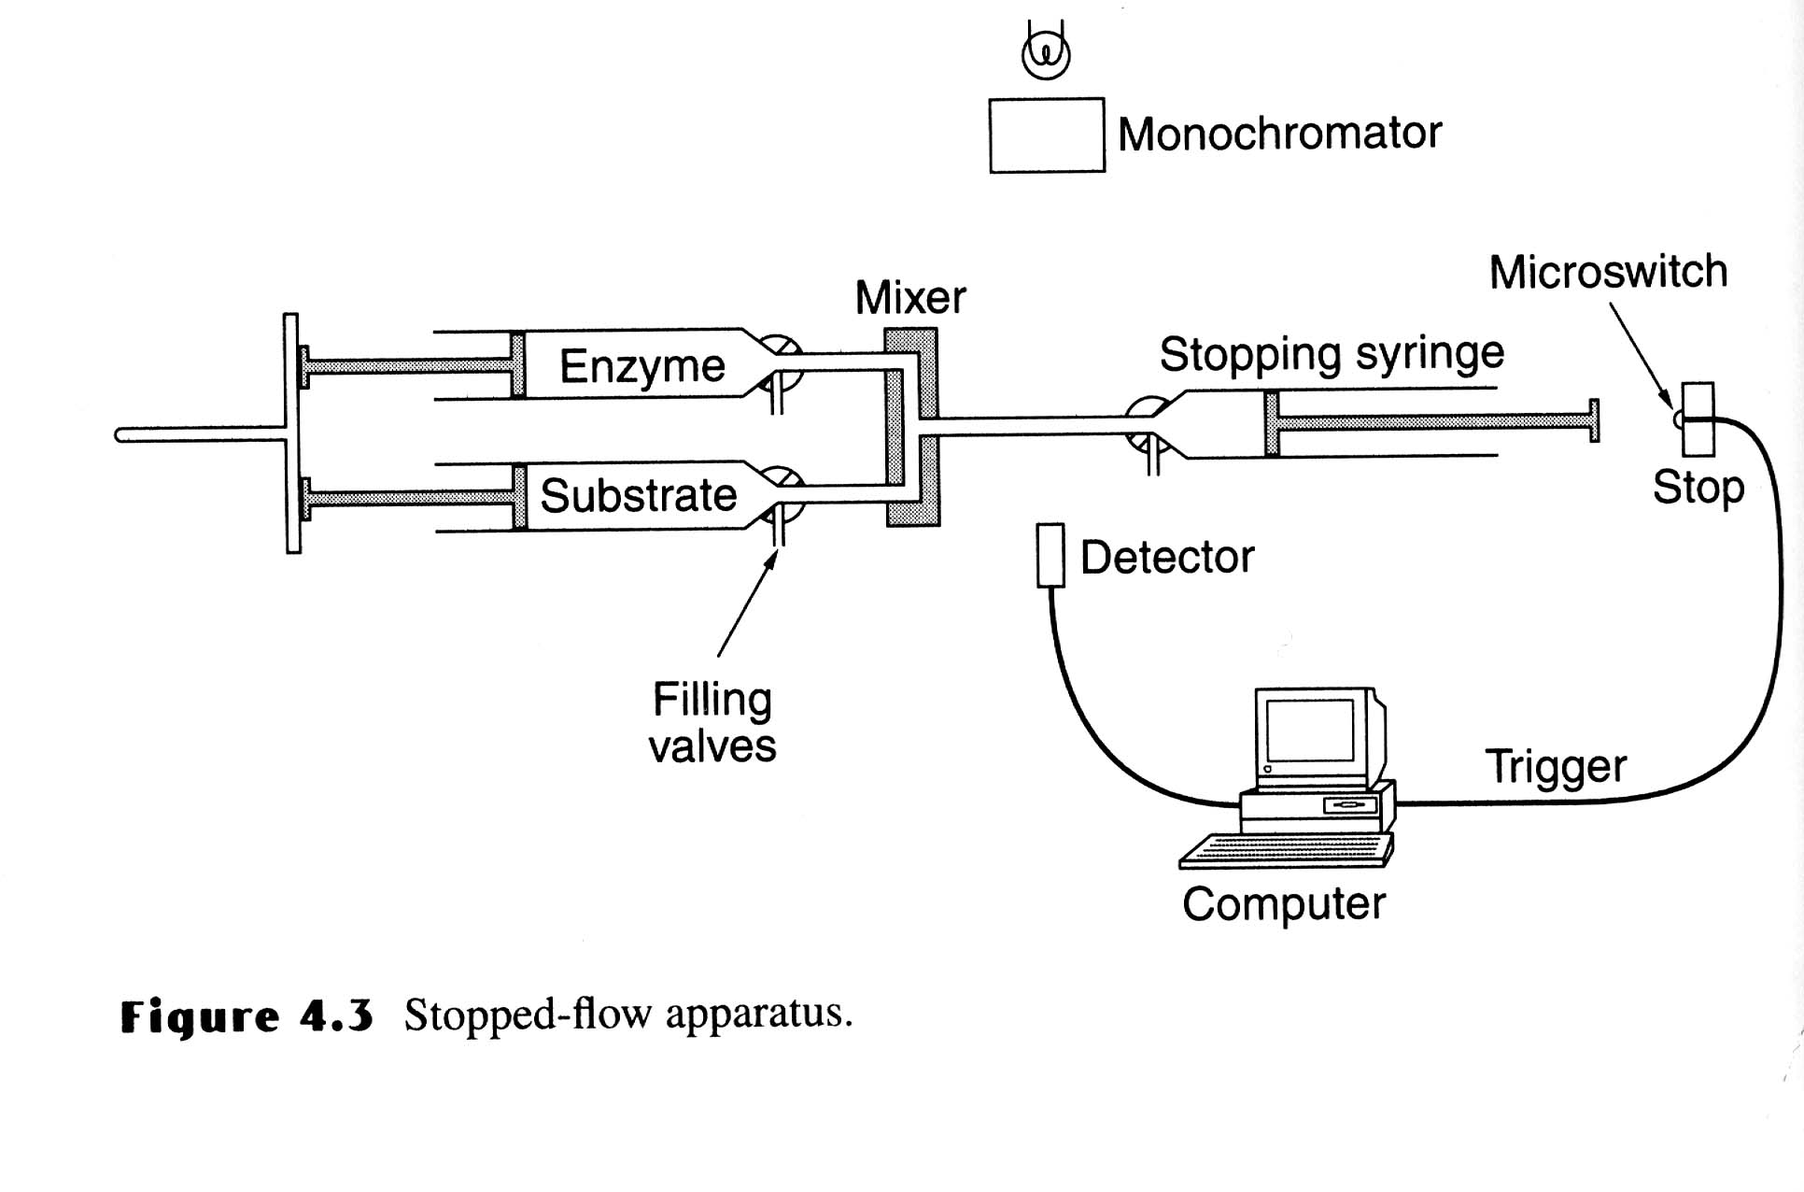
Stopped-Flow Technique
Unfolded proteins in denaturant and buffer are placed in two syringes and mixed to allow protein folding at lower concentration of denaturants and mechanically stopped. The recording of the optical signal changes during the folding and is initiated by the macro-switch attached to the stop button.

Slide 56
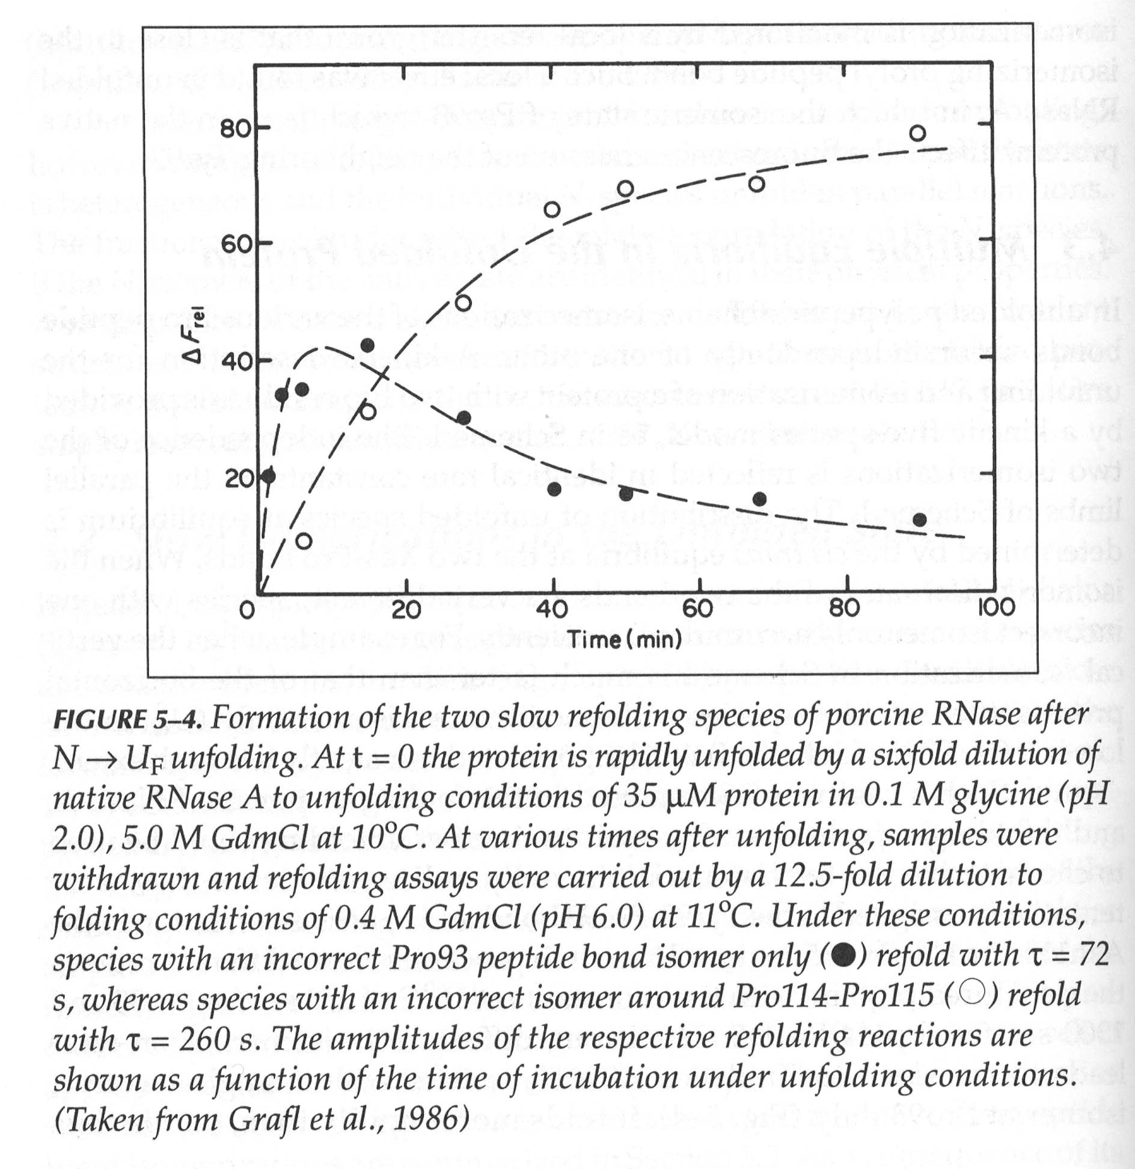
Cis-trans pro

Slide 57
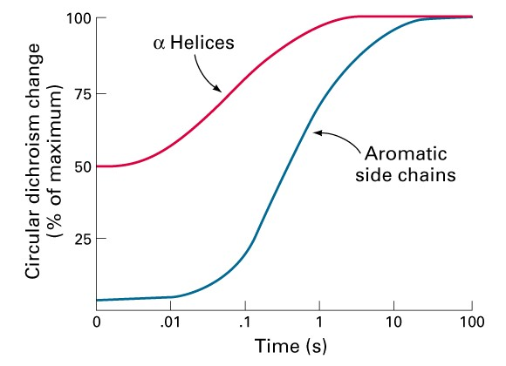
Folding of Cytochrome c
α−helix formation is more rapid than tertiary structure rearrangements of aromatic sidechains in the folding of cytochrome c.
The kinetics of these changes were determined by CD at 222 and 289 nm

Slide 58
Trapping of Disulfide-bound Intermediate
The sequence of formation of disulfide bonds in proteins can be determined by trapping free cysteine residues with iodoacetate (alkylating agent).
The S-carboxymethyl derivative of cysteine is stable, which be determined using chromatographic separation.

Slide 59
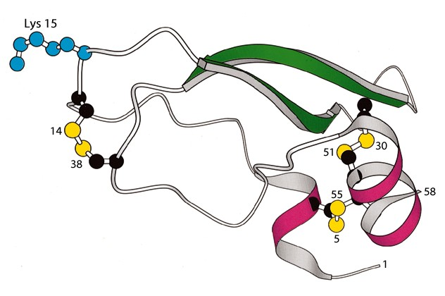
Structure of BPTI
Bovine pancreatic typsin inhibitor (BPTI) has three disulfide bonds.
BPTI inhibits trypsin by inserting Lys-15 into the specificity pocket of the enzyme.

Slide 60
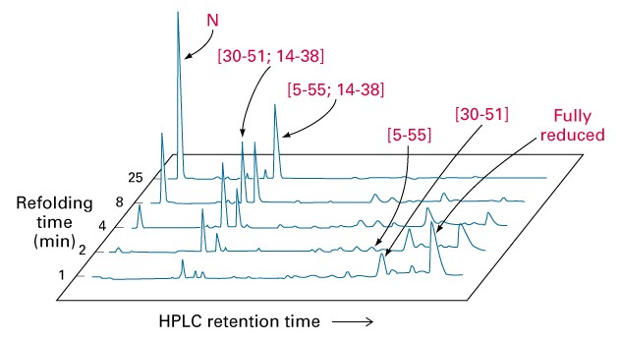
Folding of BPTI
Disulfide bond formation was quenched at the indicated times by addition of an acid. The identities of the HPLC peaks were determined after free sulfhydryls were reacted with iodoacetate to prevent rearrangements.
Only native disulfide bonds are present in the major peaks.

Slide 61
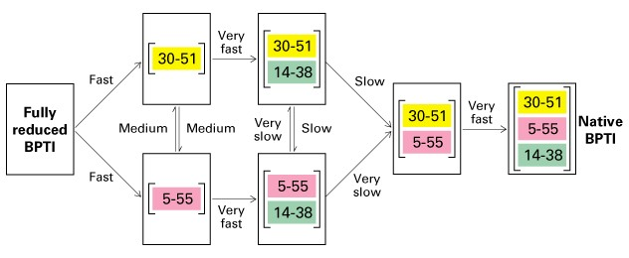
Folding of BPTI
The very fast reactions occur in milliseconds, whereas the very slow ones occur in months. The species contain 5 - 55, 14 - 38 disulfide bonds are kinetically trapped in the absence of enzymes.

Slide 62
Pulsed-labeled NMR
A protein is unfolded in a D₂O-denaturant solution to change amide NH groups to ND groups. Refolding is then initiated by diluting the sample in D₂O to lower the concentration of denaturant. Then diluted into H₂O at pH 9.0 for 10 ms and then pH 4.0. The formation of secondary and tertiary structures protects the ND group from exchange to NH. NMR is used to detect the exchanged NH groups.

Slide 63
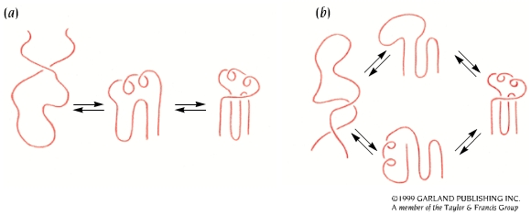
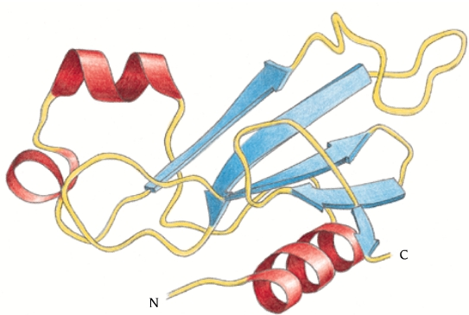
Folding of Barnase
Barnase folds through a major pathway

Slide 64
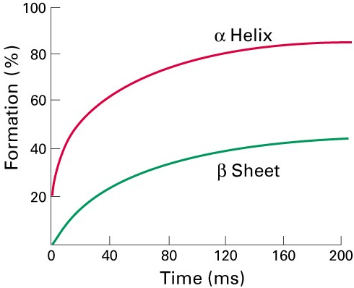
Folding of Lysozyme
In the refolding of lysozyme, the helix domain is formed before the β-sheet.
Proton exchangeability was measured at different times after the initiation of folding.

Slide 65
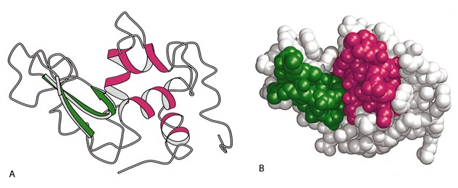
Folding of Lysozyme
The alpha helix domain is folded faster than the beta domain.

Slide 66
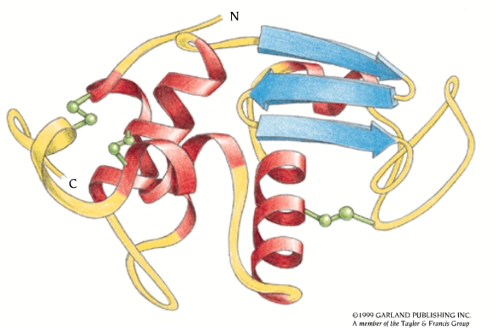
Parallel Pathways for the Folding of Lysozyme

Slide 67
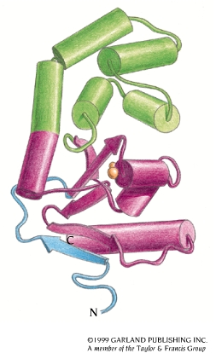
Protein Disulfide Isomerase (PDI)
The formation of correct disulfide pairings in nascent proteins is catalyzed by PDI.
PDI preferentially binds with peptides that containing Cys residues. It has a broad substrate specificity for the folding of diverse disulfide-containing proteins
By shuffling disulfide bonds, PDI enables proteins to quickly find the thermodynamically most stable pairing those that are accessible.

Slide 68
Protein Disulfide Isomerase
PDI contains two Cys-Gly-His-Cys sequences. The thiols of these Cys are highly active because of their lower pKa (7.3) than most thiols in proteins (8.5), and are very active at physiological pH.
PDI is especially important in accelerating disulfide inter-change in kinetically trapped folding intermediate.

Slide 69
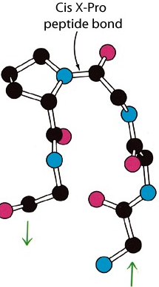
Peptidyl Prolyl Isomerase (PPI)
Peptide bonds in proteins are nearly always in the trans configuration, but X-pro peptide bonds are 6% cis.
Prolyl isomerization is the rate-limiting in the folding of many proteins in vitro.
PPI accelerates cis-trans isomerization more than 300 fold by twisting the peptide bond so that the C,O, and N atoms are no longer planar.

Slide 70
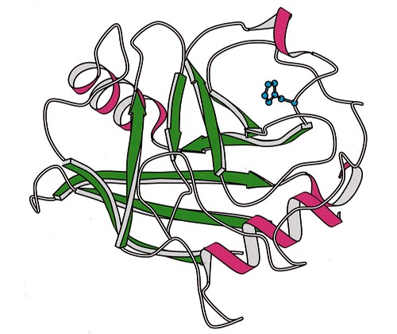
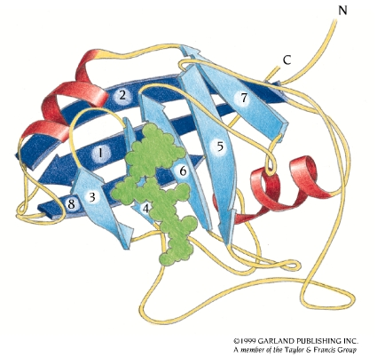
Peptidyl Prolyl Isomerase (PPI)

Slide 71
Molecular Chaperones
Nascent polypeptides come off the ribosome and fold spontaneously, molecular chaperones are involved in their folding in vivo, and are related to heat shock proteins (hsp).
The main hsp families are:
"Small hsp's" - Diverse "family" 10,000 - 30,000 MW (hsp26/27 - crystallins (eye lens))
hsp40
hsp60 (e.g. GroEL in E. coli)
hsp70 (DnaK in E. coli)
hsp90
hsp100

Slide 72
Function of Heat Shock Proteins
Minimize heat and stress damage to proteins (renaturation/degradation)
Facilitate correct folding of proteins by minimizing aggregation and other misfolding
Bind to nascent polypeptides to prevent premature folding
Facilitate membrane translocation/import by preventing folding prior to membrane translocation
Facilitate assembly/disassembly of multiprotein complexes

Slide 73
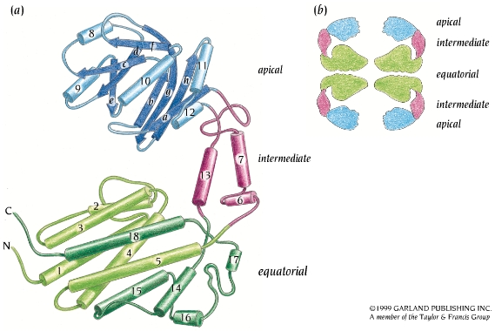
One Subunit of GroEL

Slide 74
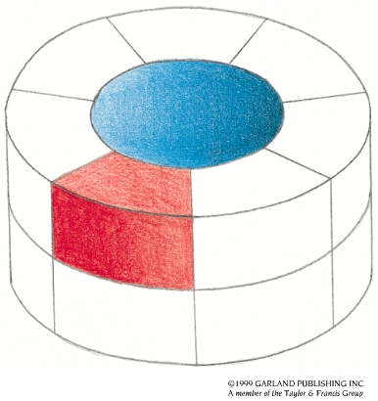
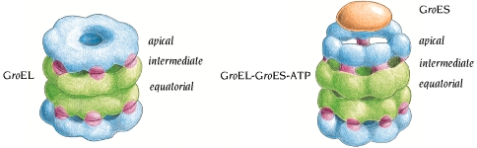
Proteins can Fold/unfold Inside Chaperonins
A large conformational change of GroEL occurs when GroES and ATP are bound. The GroES molecule binds to one of the GroEL rings and closes off the central cavity. The GroEL ring becomes larger and the cavity inside that part of the cylinder becomes wider.

Slide 75
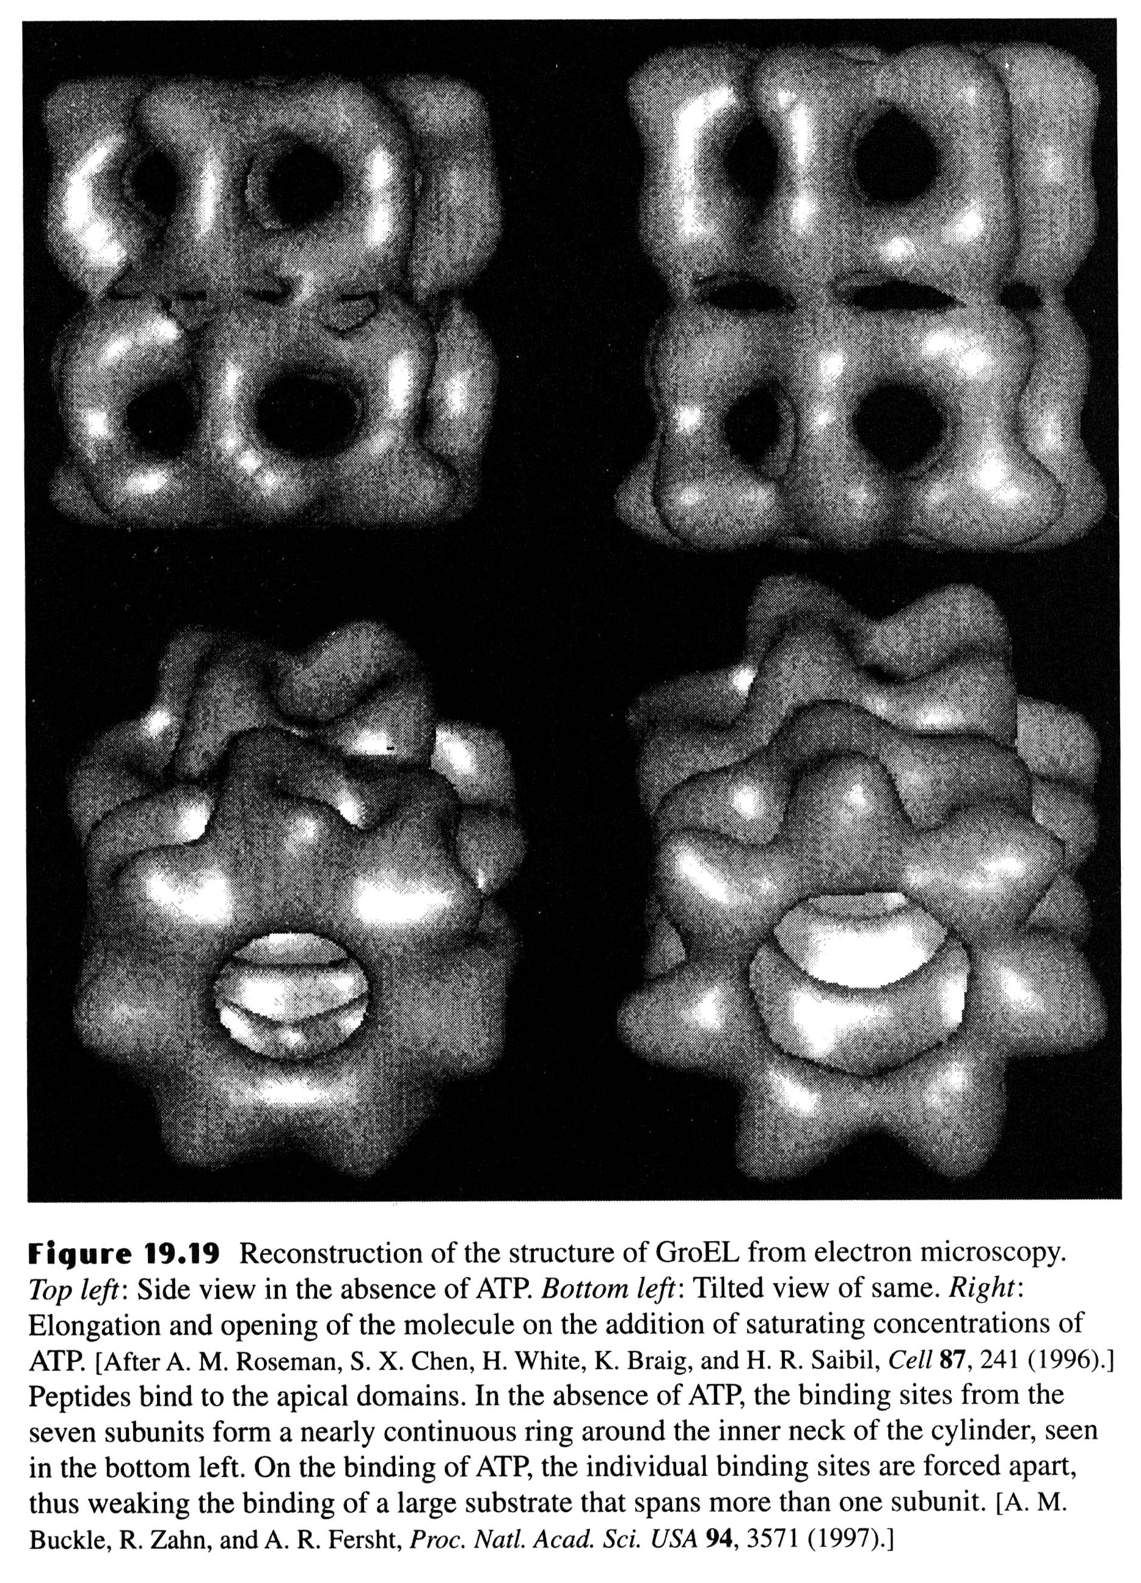

Slide 76
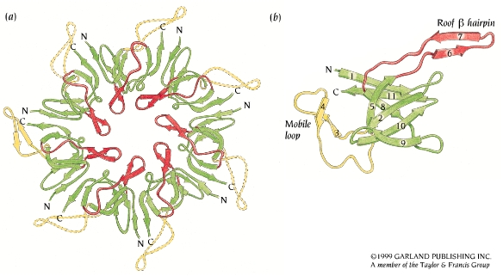
GroES Closes Off One End of the GroEL Cylinder

Slide 77
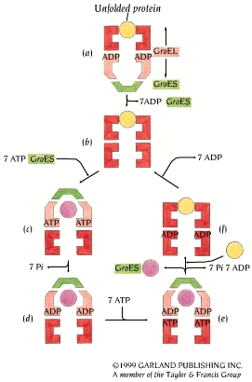
Functional Cycle of GroEL-GroES
As shown in (a), an unfolded protein
molecule (yellow) binds to one end
of the GroEL-ADP complex (red)
with bound GroES (green) at the
other end. In (b) and (c), GroES is
released from the trans-position and
rebound together with ATP at the
cis-position (light red) of GroEL. In
(d), ATP hydrolysis occurs as the
protein is folding or unfolding inside
the central cavity. In (e), ATP
binding and hydrolysis in the trans-
position is required for release of
GroES and the protein molecule.
Finally, in (f), a new unfolded
protein molecule can now bind to
GroEL.

Slide 78
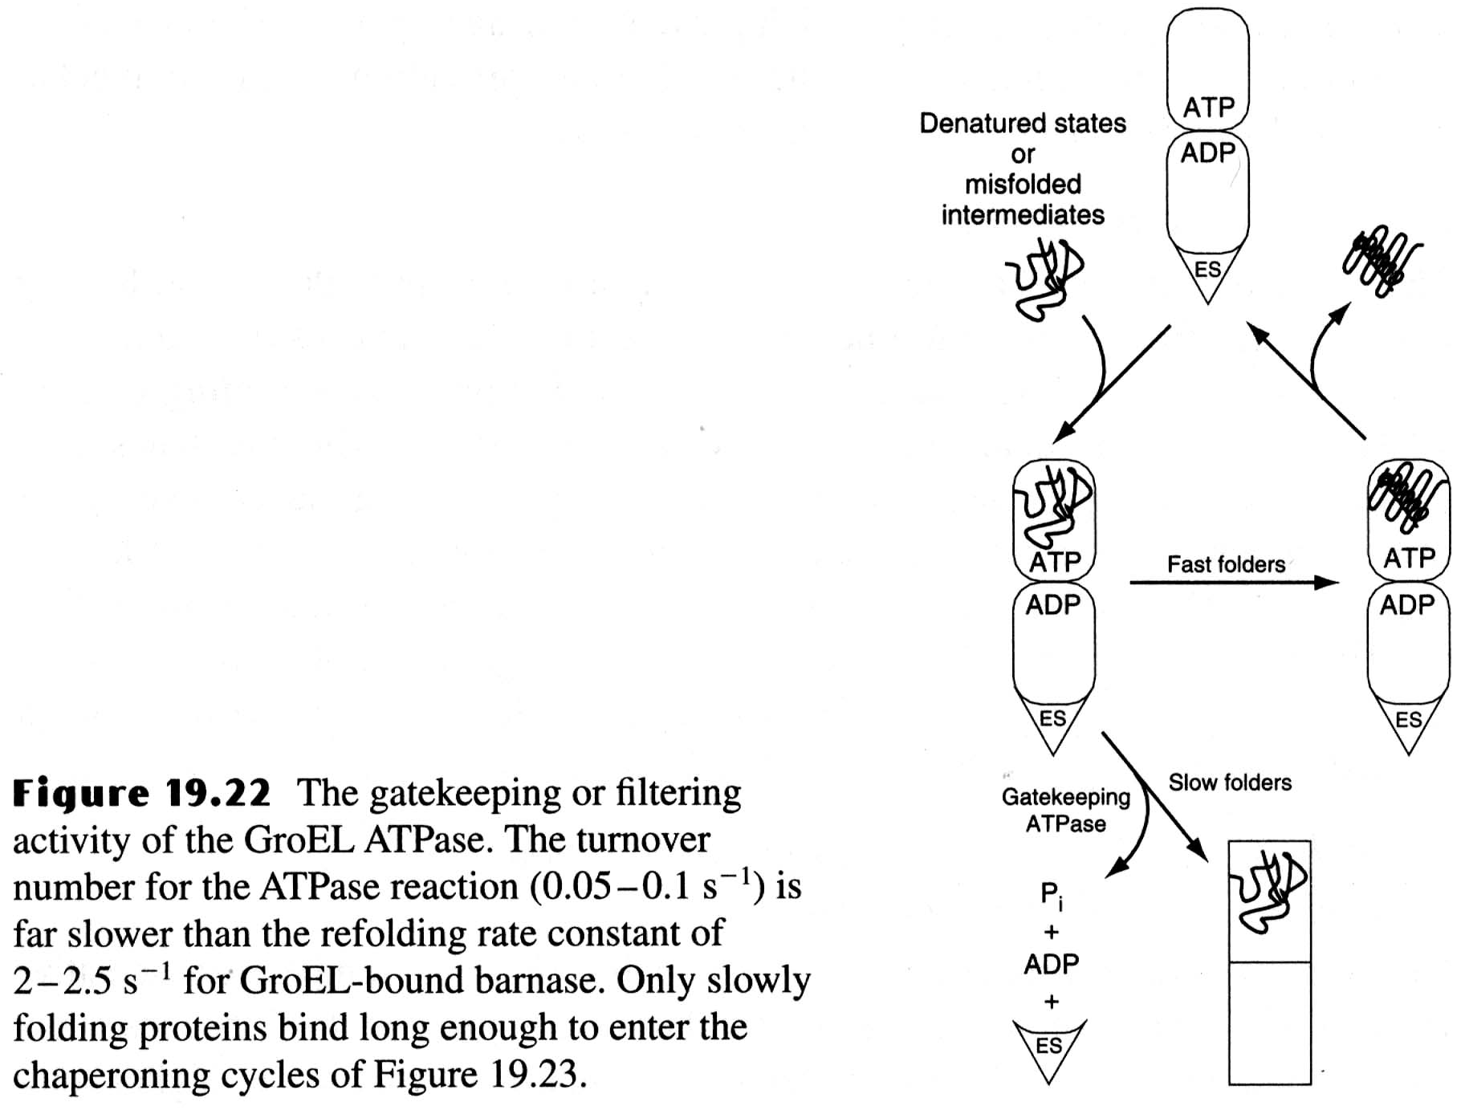

Slide 79
