Slide 1
Prediction of Protein Structures
State of the art: ~50% of the soluble proteins in a microbial genome could have correct fold prediction and might be 50% of these proteins have good backbone structure prediction
Functional inference could be made based on
  accurately predicted structures:
  correctly identified structural folds:

Slide 2
Prediction of Protein Structures
All-atom structures could be predicted through prediction of
  prediction of backbone structure
  prediction of sidechain packing
    Backbone-dependent rotamers
    Ab initio prediction of sidechains
State of the art – accurate prediction of side chains remains a challenging problem

Slide 3
Structure prediction using additional information
Some structural information may be available before whole structure is solved
  disulfide bonds
  active sites
  residues identified buried/exposed
  (partial) secondary structure
  partial NMR data
  inter-residual distances by cross-linking and mass spec
  overall shape derived from cryo-EM
  …….
These data can provide highly useful constraints on threading prediction

Slide 4
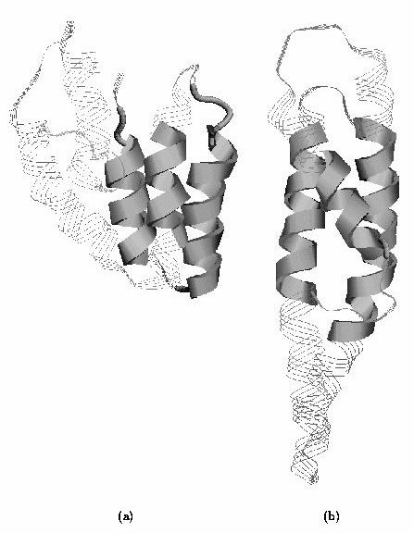
Structure prediction using additional information
The basic idea
MTYKLILNGKTKGETTTEAVDAATAEKVFQYANDNGVDGEWTYTE
Distance or other types of constraints could be derived before the structure is solved, which could help to the structure prediction more accurate

Slide 5
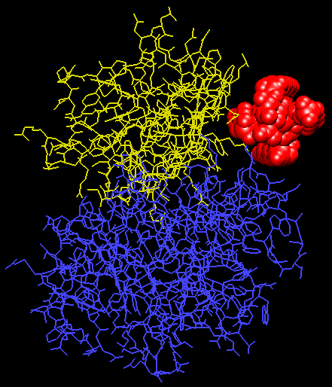
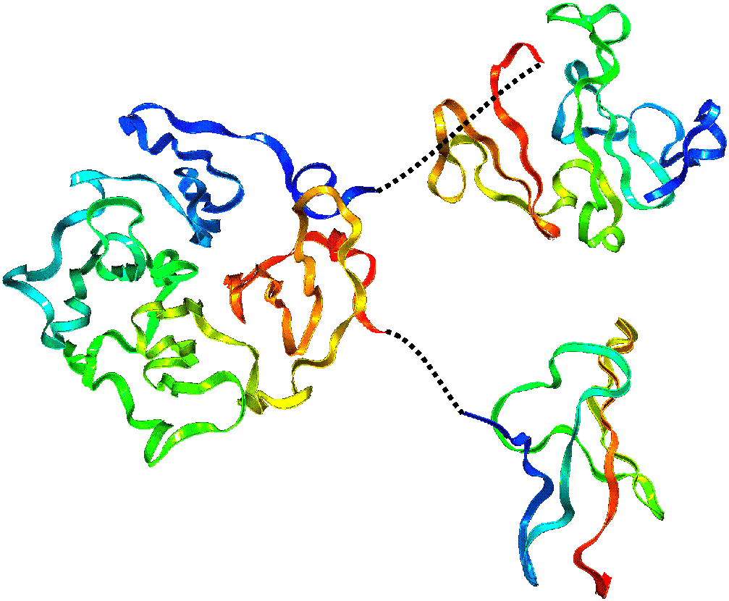
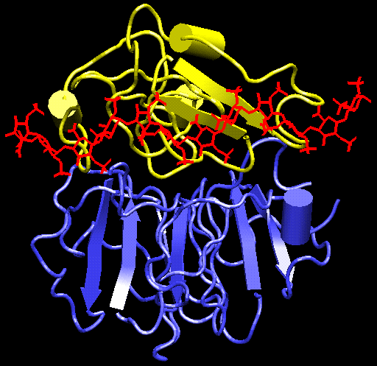
Structure prediction using additional information
Victronectin: a three-domain protein
  various structural data have been derived through experiments, including disulfide bonds, active sites, heparin binding sites, cleavage sites, ....
  data-constrained threading/docking to its structure prediction

Slide 6
Computational Methods for Protein Structure Prediction
An energy function to describe the protein
  bond energy
  bond angle energy
  dihedral angle energy
  van der Waals energy
  electrostatic energy
Calculating the structure through minimizing the energy function
Not practical in general
  Computationally very expensive
  Accuracy is poor
providing both folding pathway and folded structure

Slide 7
Computational Methods for Protein Structure Prediction
Comparative modeling
  Protein threading – make structure prediction through identification of “good” sequence-structure fit
  Homology modeling – identification of homologous proteins through sequence alignment; structure prediction through placing residues into “corresponding” positions of homologous structure models
providing folded structure only

Slide 8
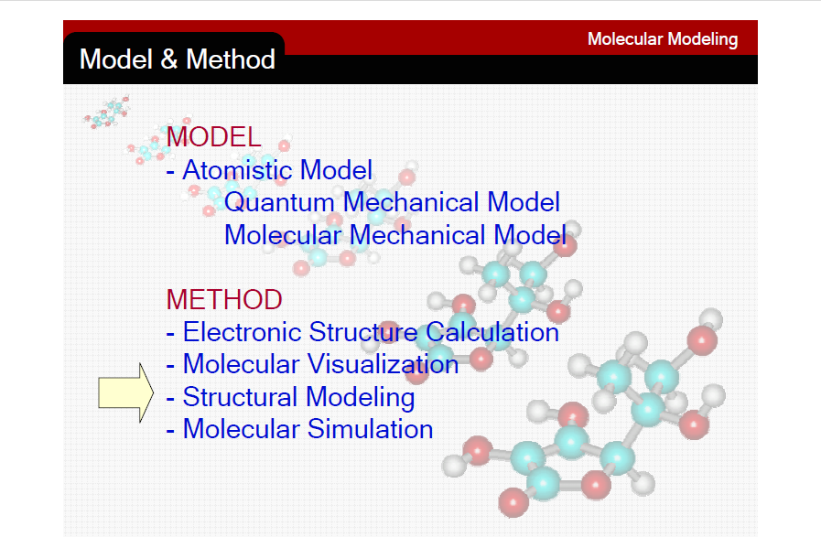

Slide 9
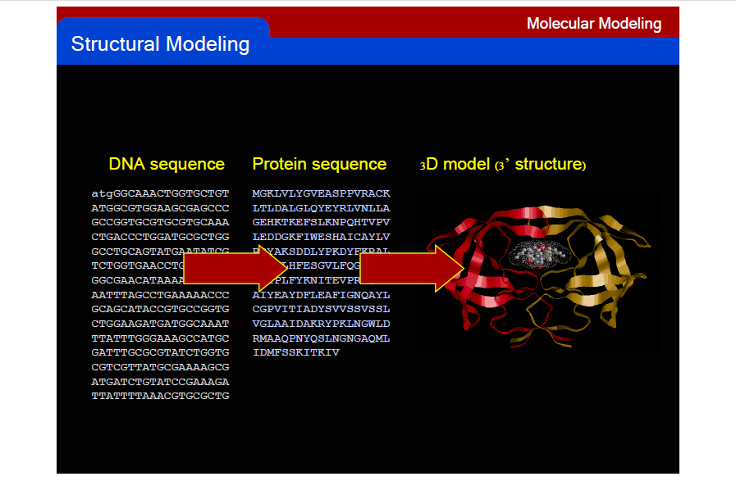

Slide 10
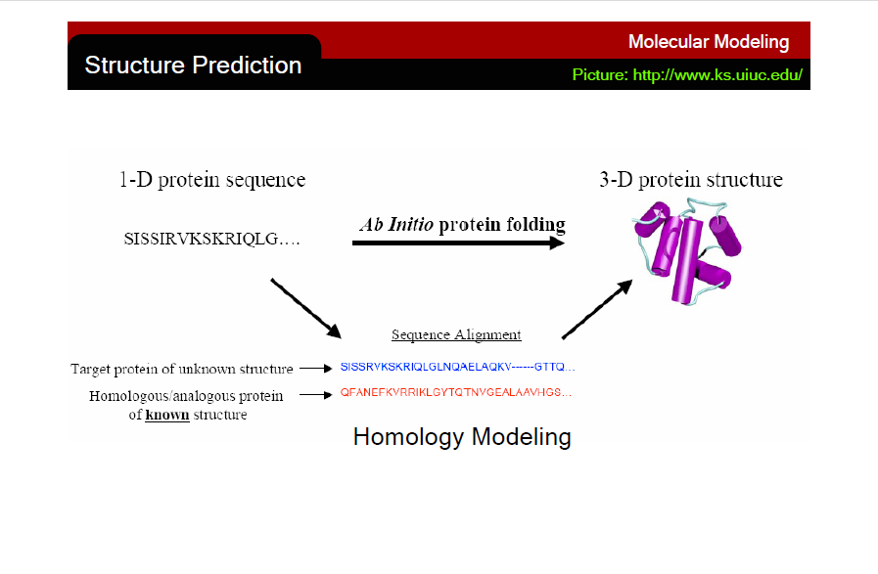

Slide 11
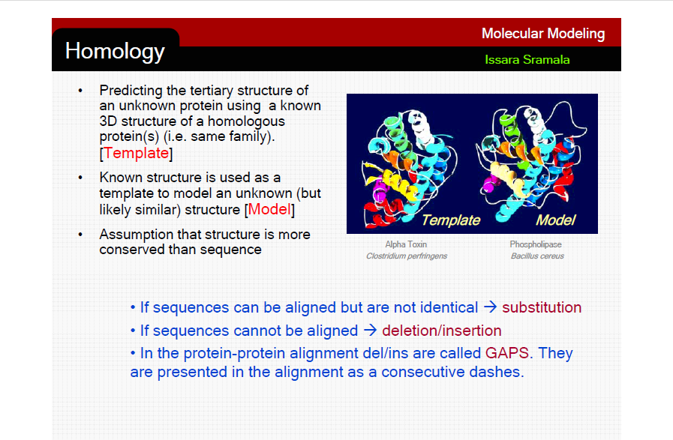

Slide 12
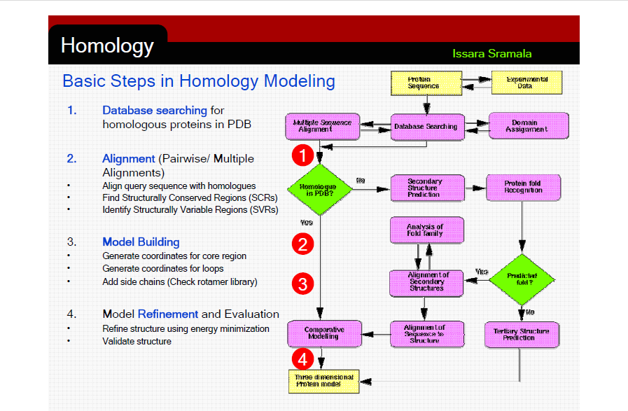

Slide 13
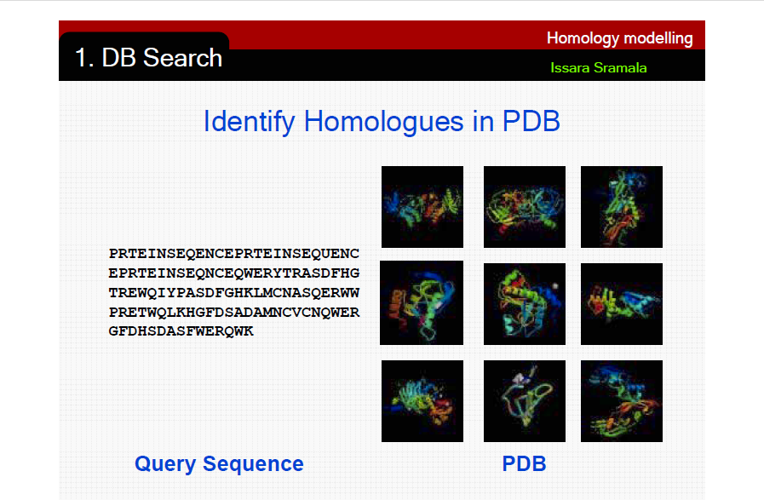

Slide 14
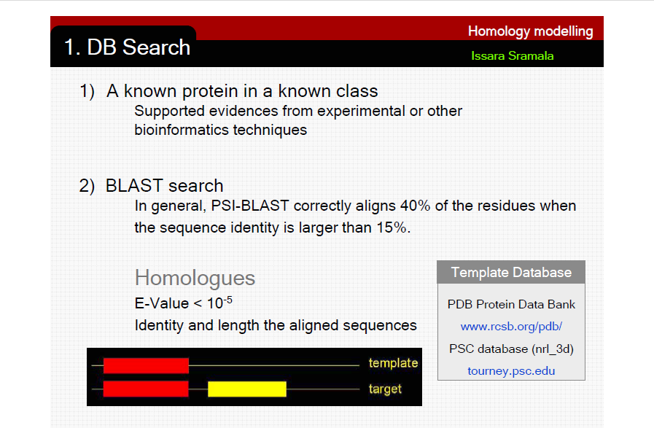

Slide 15
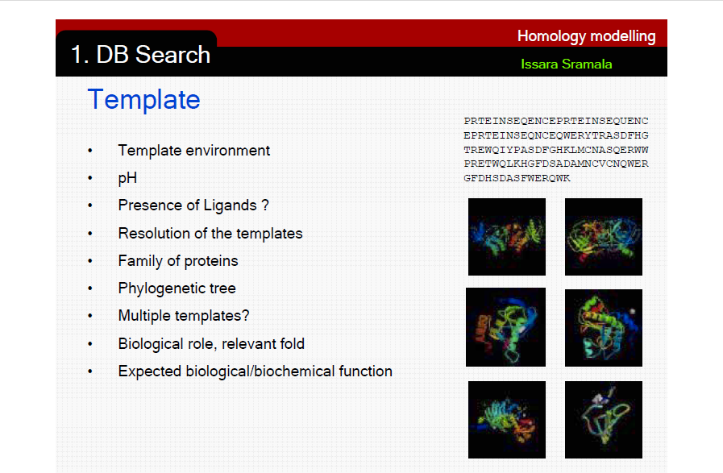

Slide 16
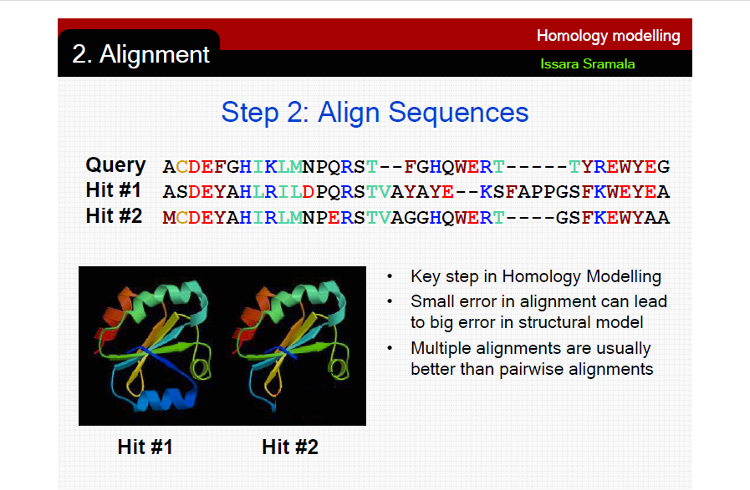

Slide 17
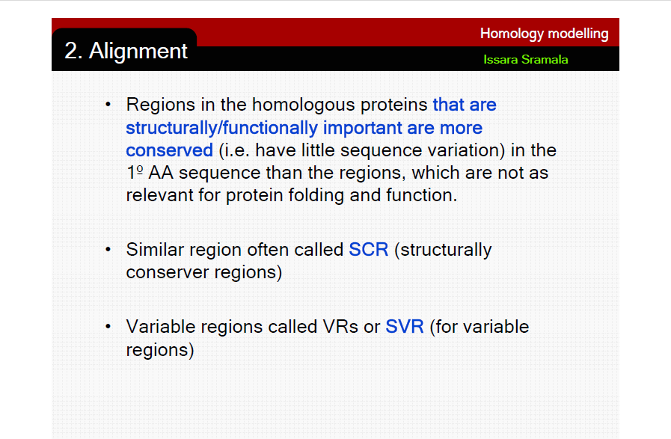

Slide 18
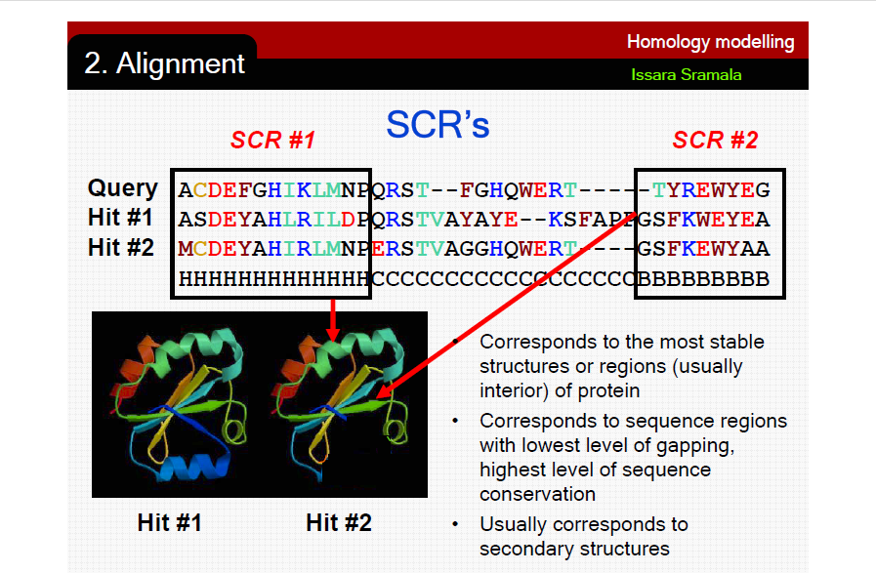

Slide 19
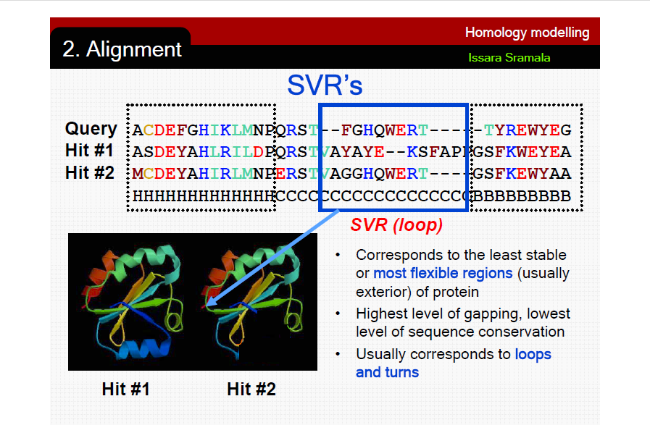

Slide 20
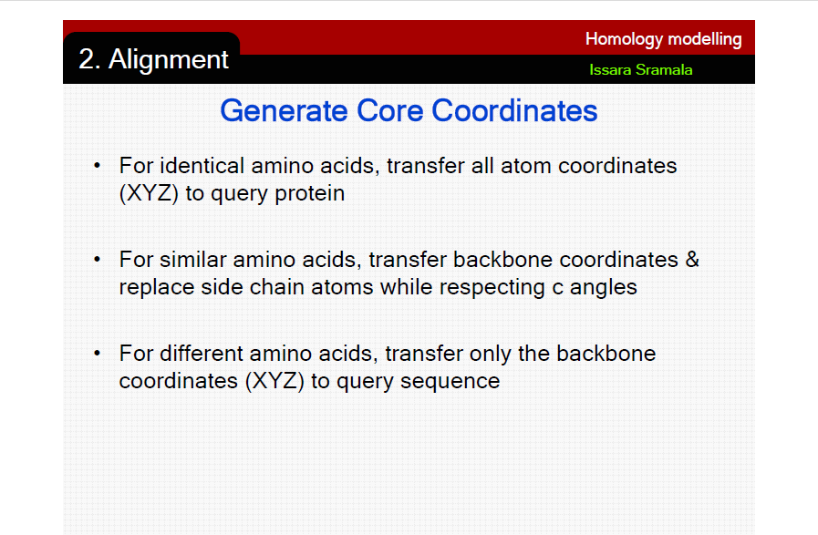

Slide 21
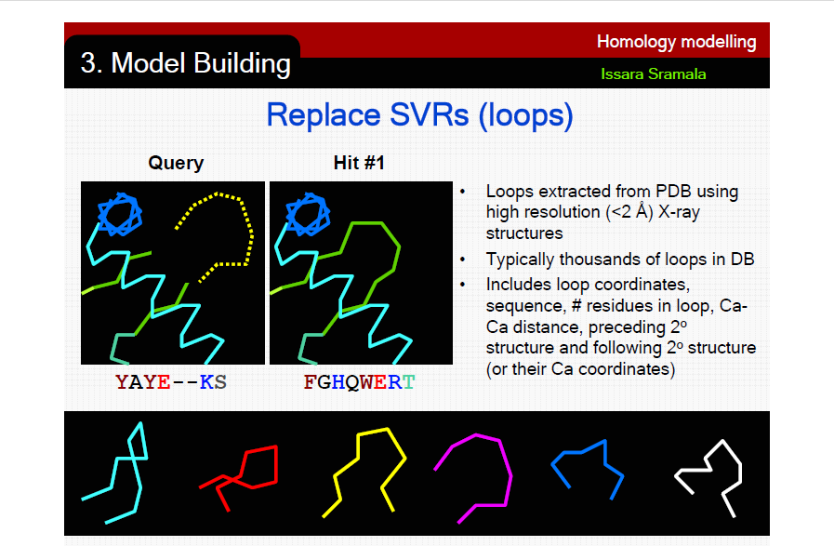

Slide 22
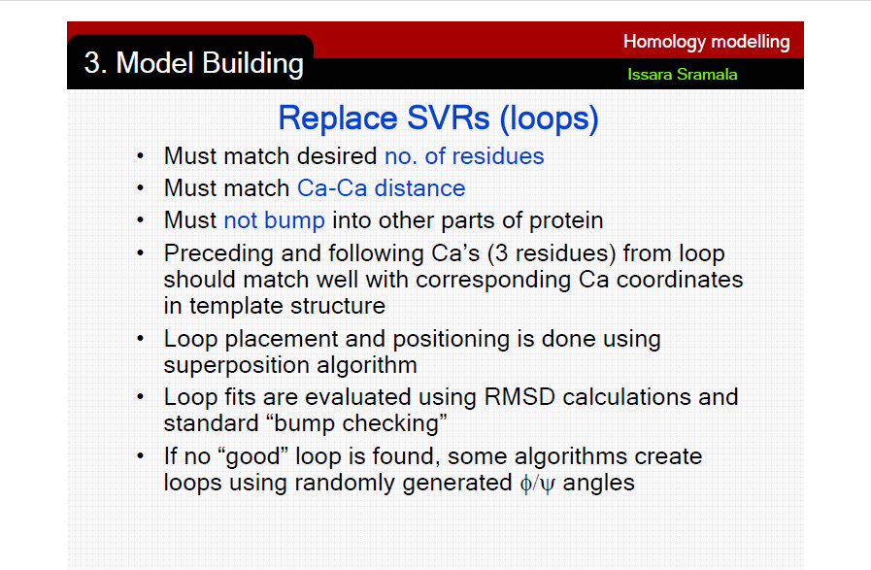

Slide 23
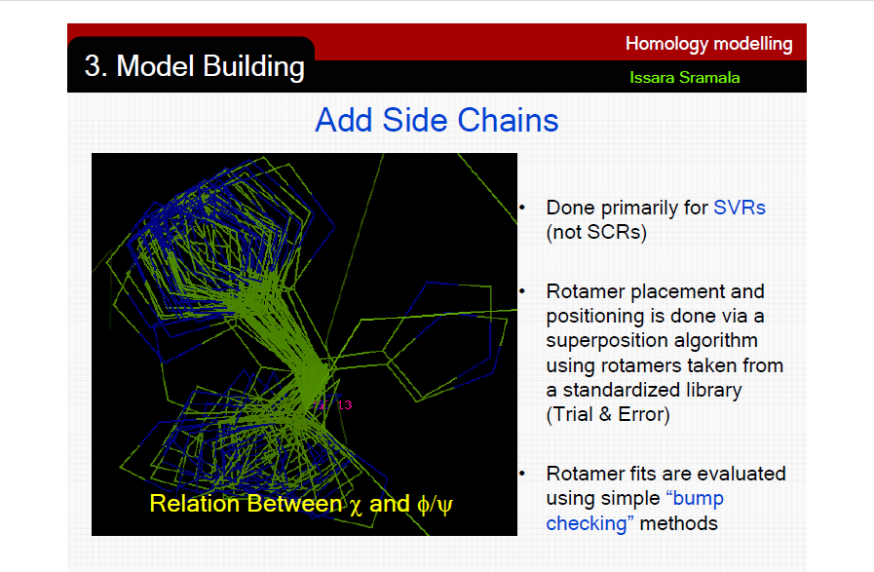

Slide 24
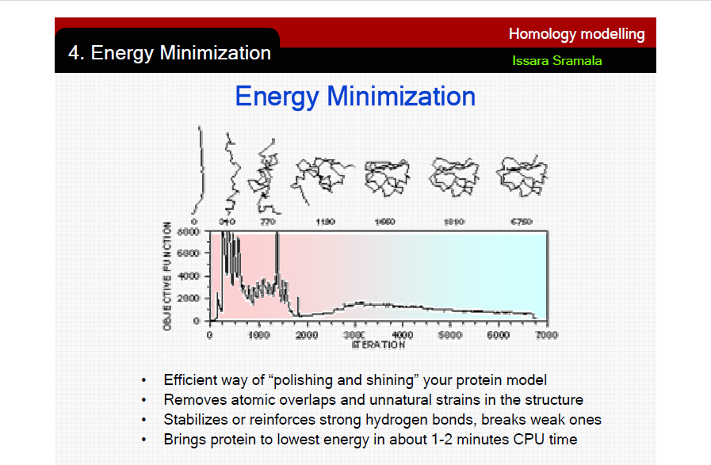

Slide 25
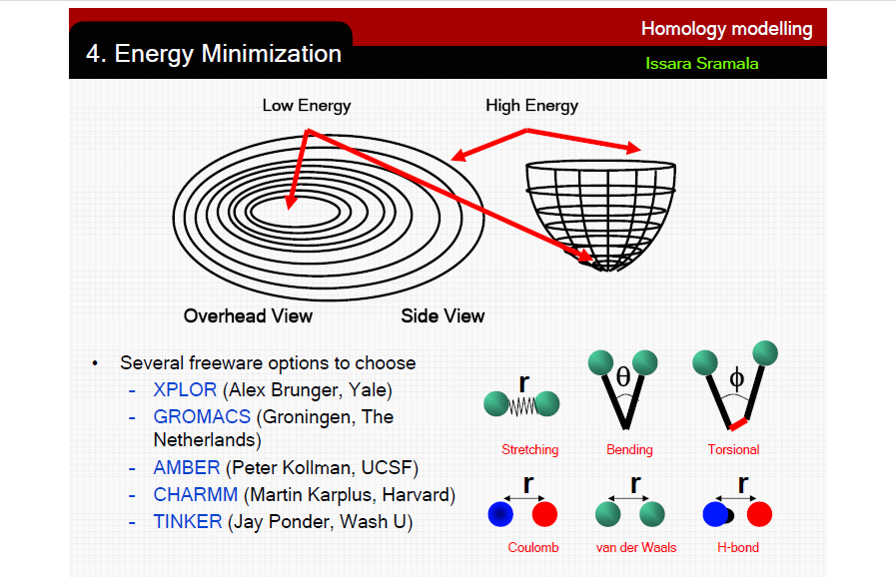

Slide 26
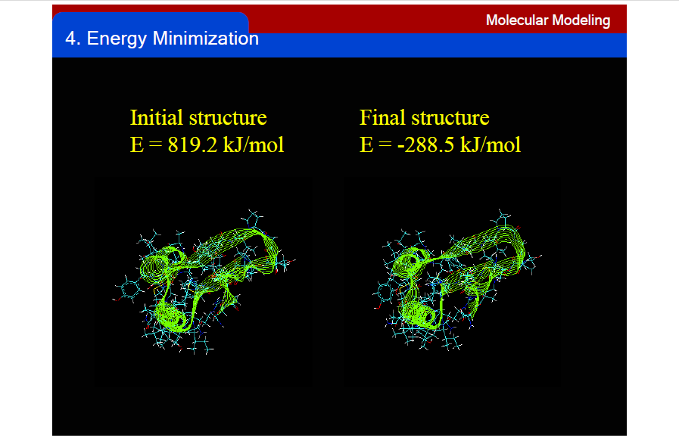

Slide 27
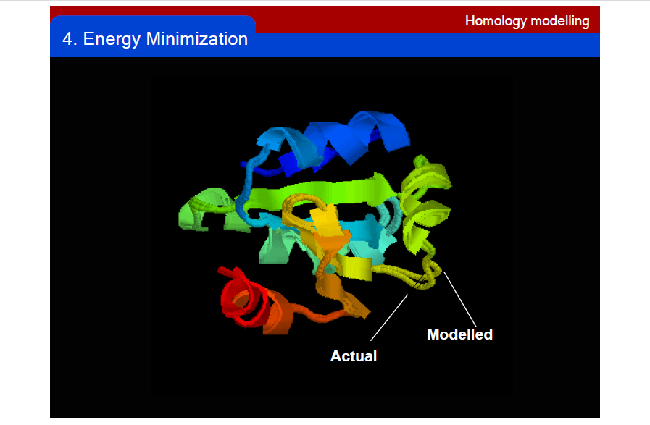

Slide 28
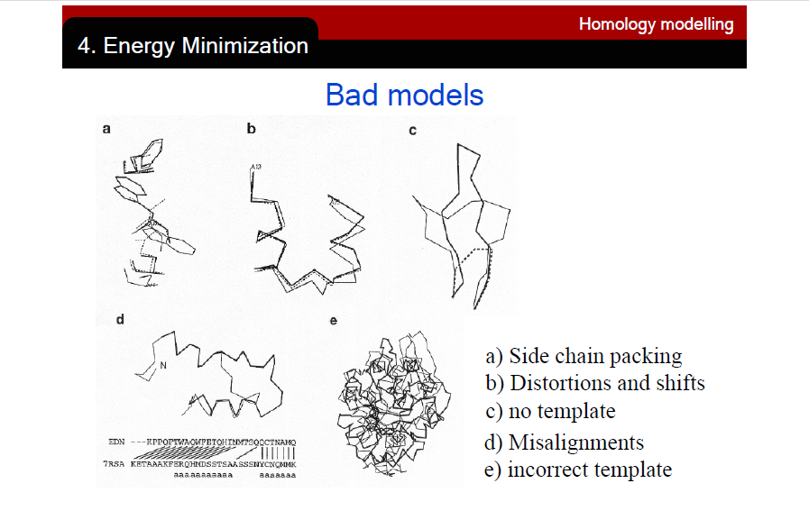

Slide 29
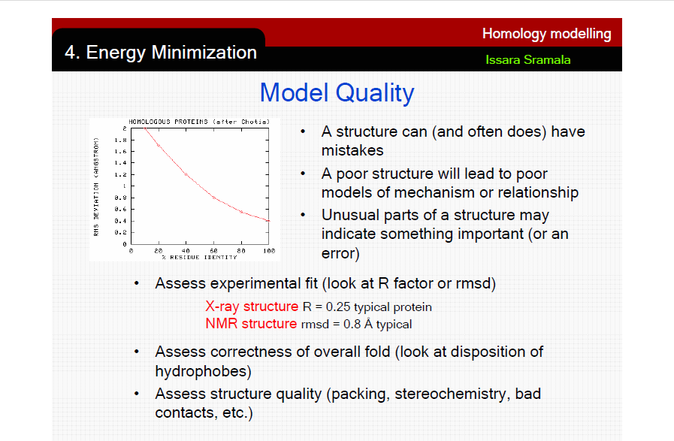

Slide 30
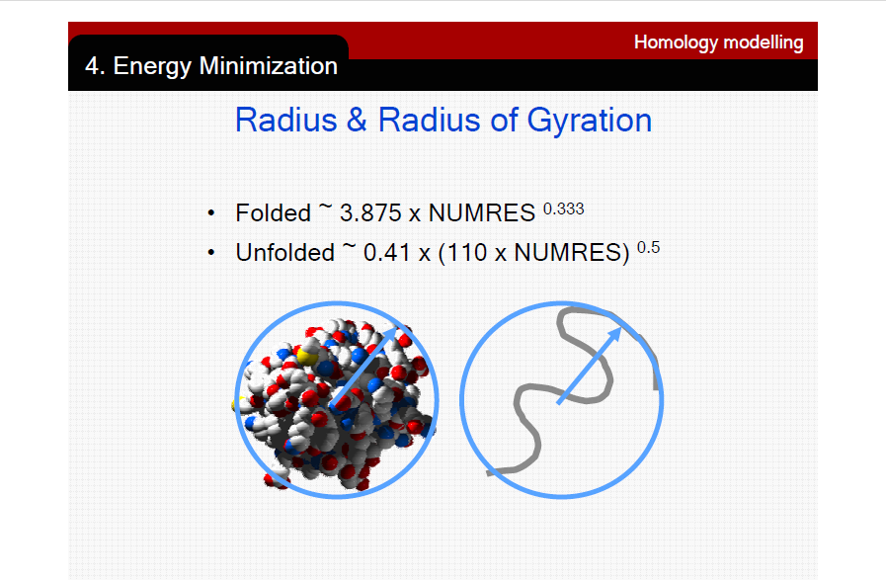

Slide 31
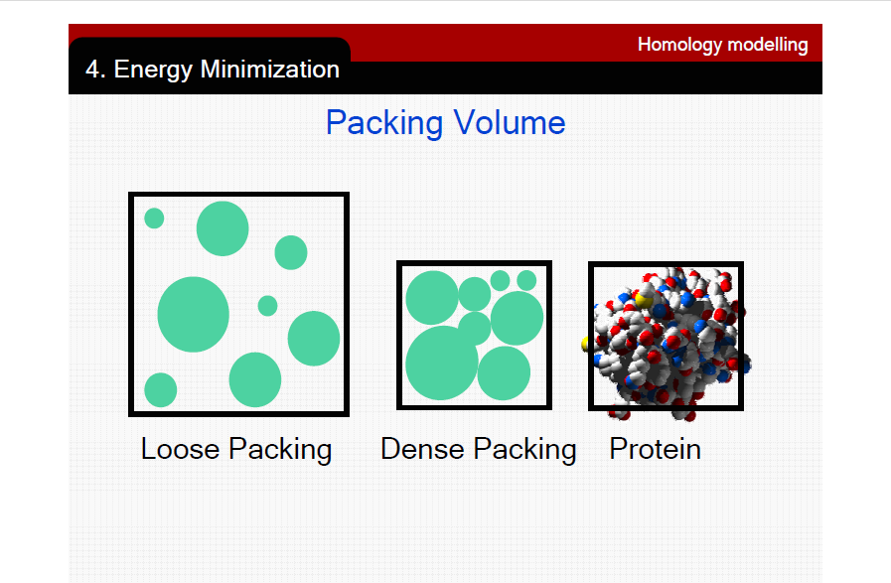

Slide 32
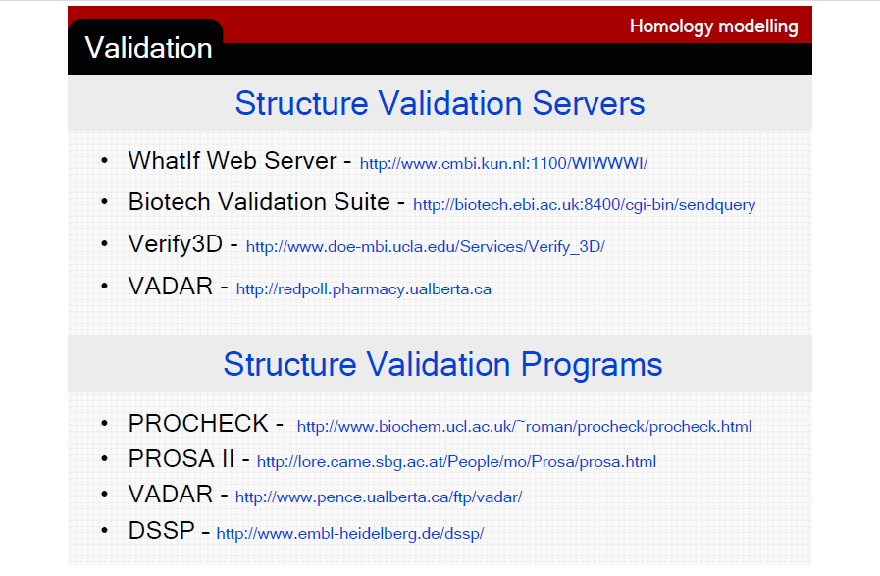

Slide 33
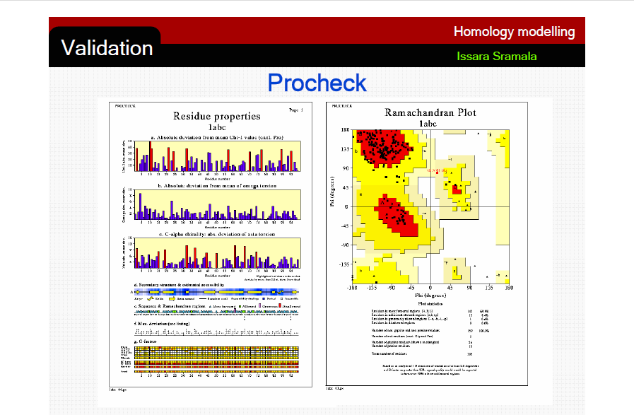

Slide 34
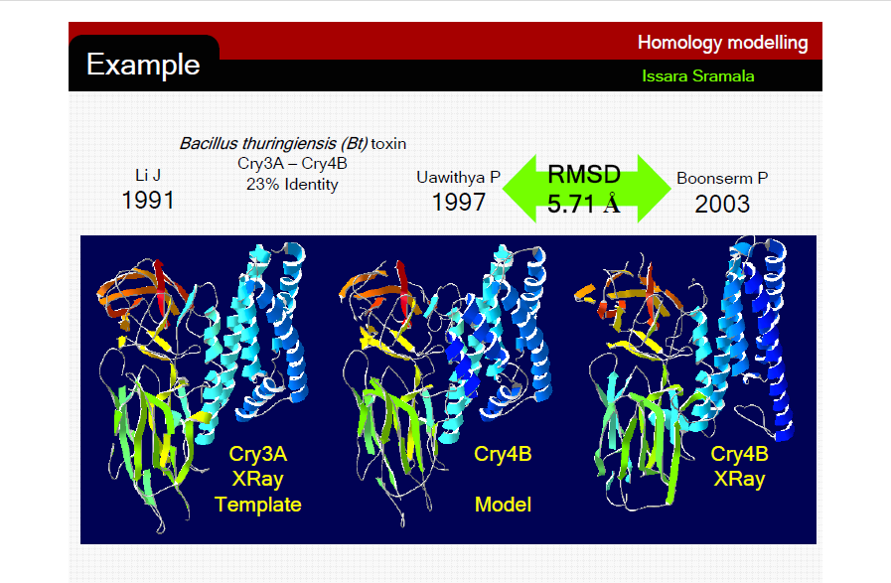

Slide 35
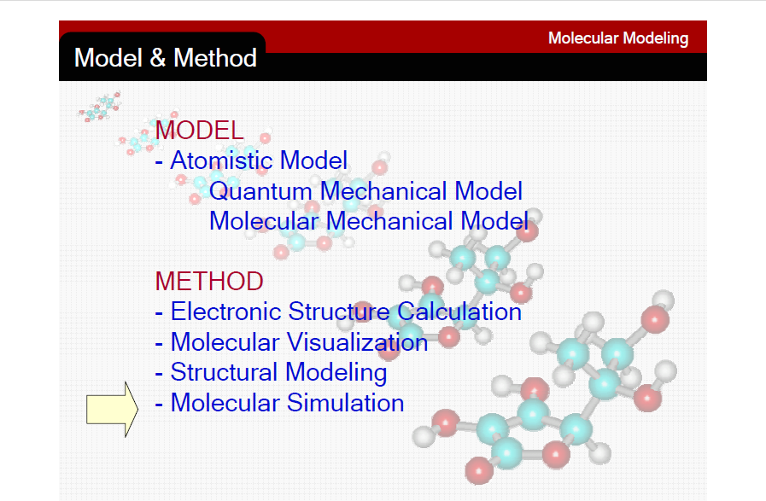

Slide 36
Homology Modeling Software?
Freely available packages perform as good as commercial ones at CASP (Critical Assessment of Structure Prediction)
Swiss Model (tutorial)
Modeller (http://guitar.rockefeller.edu)

Slide 37
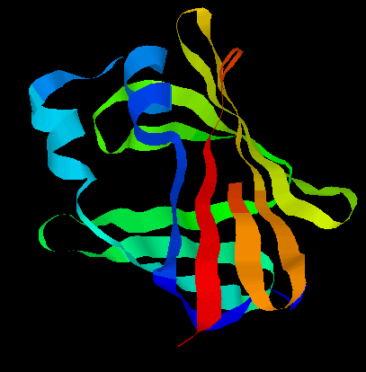
Protein Threading
The goal: find the “correct” sequence-structure alignment between a target sequence and its native-like fold in PDB
Energy function – knowledge (or statistics) based rather than physics based
  Should be able to distinguish correct structural folds from incorrect structural folds
  Should be able to distinguish correct sequence-fold alignment from incorrect sequence-fold alignments
MTYKLILN …. NGVDGEWTYTE

Slide 38
Protein Threading
Basic premise
Statistics from Protein Data Bank (~54,000 structures)
Chances for a protein to have a native-like structural fold in PDB are quite good (estimated to be 60-70%)
  Proteins with similar structural folds could be homologues or analogues
The number of unique structural (domain) folds in nature
is fairly small (possibly a few thousand)
90% of new structures submitted to PDB in the past
three years have similar structural folds in PDB

Slide 39
Protein Threading – four basic components
Structure database
Energy function
Sequence-structure alignment algorithm
Prediction reliability assessment

Slide 40
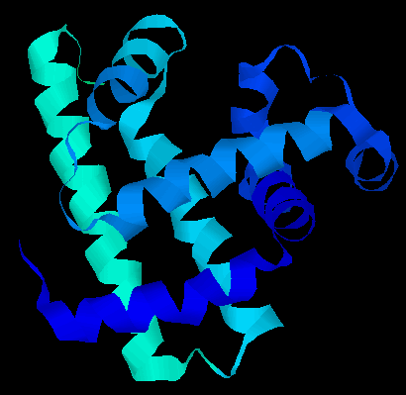
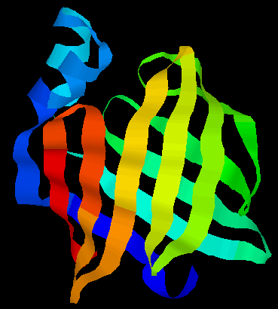
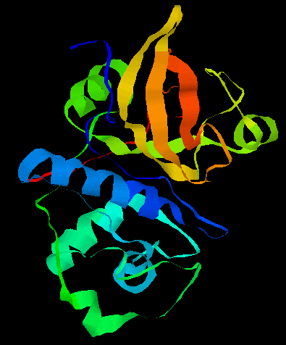
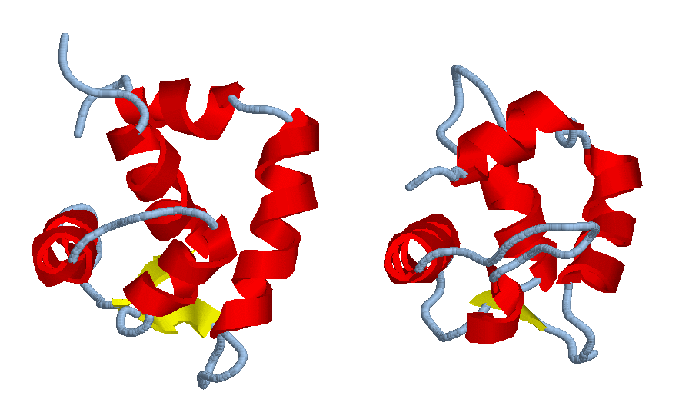
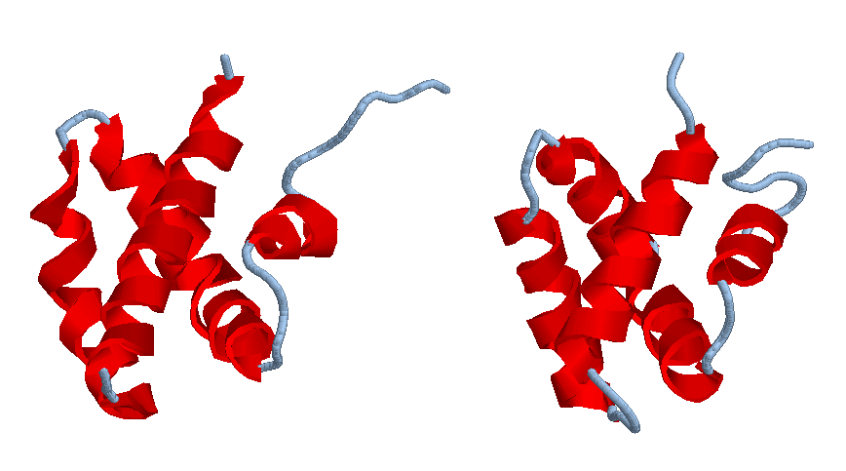
Protein Threading – structure database
Build a template database

Slide 41
Protein Threading – energy function
MTYKLILNGKTKGETTTEAVDAATAEKVFQYANDNGVDGEWTYTE
how preferable to put two particular residues nearby: E_p
how well a residue fits a structural environment: E_s
alignment gap penalty: E_g
total energy: E_p + E_s + E_g
find a sequence-structure alignment to minimize the energy function

Slide 42
Protein Threading – energy function
Calculating energy terms
  E_p for each pair of amino acids, e.g. (C, V)
  E_p(C, V) = log (E (C, V)/F (C, V))
    E(): expected frequency and F(): observed frequency
  E_s for each type of amino acid, e.g., A
  E_s(A) = log (E (A)/F(A))
    E(): expected frequency and F(): observed frequency
  E_g: alignment gap penalty

Slide 43
Protein Threading – energy function
Unlike sequence-sequence alignment where amino acids are aligned, a sequence-structure alignment aligns amino acids with structural environments
A simple definition of structural environment
  secondary structure: alpha-helix, beta-strand, loop
  solvent accessibility: 0, 10, 20, …, 100% of accessibility
  each combination of secondary structure and solvent accessibility level defines a structural environment
    E.g., (alpha-helix, 30%), (loop, 80%), …

Slide 44
Protein Threading – energy function
BLOSUM matrix
A
R
N
D
C
Q
E
G
H
I
L
K
M
F
P
S
T
W
Y
V
4
-1 5
-2 0 6
-2 -2 1 6
0 -3 -3 -3 9
-1 1 0 0 -3 5
-1 0 0 2 -4 2 5
0 -2 0 -1 -3 -2 -2 6
-2 0 1 -1 -3 0 0 -2 8
-1 -3 -3 -3 -1 -3 -3 -4 -3 4
-1 -2 -3 -4 -1 -2 -3 -4 -3 2 4
-1 2 0 -1 -3 1 1 -2 -1 -3 -2 5
-1 -1 -2 -3 -1 0 -2 -3 -2 1 2 -1 5
-2 -3 -3 -3 -2 -3 -3 -3 -1 0 0 -3 0 6
-1 -2 -2 -1 -3 -1 -1 -2 -2 -3 -3 -1 -2 -4 7
1 -1 1 0 -1 0 0 0 -1 -2 -2 0 -1 -2 -1 4
0 -1 0 -1 -1 -1 -1 -2 -2 -1 -1 -1 -1 -2 -1 1 5
-3 -3 -4 -4 -2 -2 -3 -2 -2 -3 -2 -3 -1 1 -4 -3 -2 11
-2 -2 -2 -3 -2 -1 -2 -3 2 -1 -1 -2 -1 3 -3 -2 -2 2 7
0 -3 -3 -3 -1 -2 -2 -3 -3 3 1 -2 1 -1 -2 -2 0 -3 -1 4
A R N D C Q E G H I L K M F P S T W Y V

Slide 45
Protein Threading – energy function
E_s: a scoring matrix of 30 structural environments by 20 amino acids
  E.g., E_s ((loop, 30%), A)
E_p: a scoring matrix of 20 amino acids by 20 amino acids
  Unlike BLOSUM matrix, this matrix measures how two amino acids prefer to be next to each other

Slide 46
Protein Threading -- algorithm
Threading algorithm – to find a sequence-structure alignment with the minimum energy
  considering only singleton energy and gap penalty
  considering all three energy terms
sequence
fold
links

Slide 47
Protein Threading -- algorithm
Considering only singleton energy + gap penalty
Represent a structure a sequence of “structural environments”
  (helix, 100%), (helix, 90%), ….. (strand, 0%)
Align a sequence MACKLPV …. with a structural sequence (helix, 100%), (helix, 90%), ….. (strand, 0%)

Slide 48
Protein Threading -- algorithm
 | (helix, 100%) | (helix, 90%) | (helix, 80%) | (loop, 80%)
M
L
V
A
Rule:
1: initialization– fill the first row and column with matching scores
2: fill an empty cell based on scores of its left, upper and upper-left neighbors + the matching of the current cell
3: if the score comes from left or up, deduct a gap penalty
4: chose the one giving the highest score

Slide 49
Protein Threading -- algorithm
Considering all three energy terms
Considering the pair-wise interaction energy makes the problem much more difficult to solve – dynamic programming algorithm does not work any more!
There are other techniques that can be used to solve the problem – integer programming, divide-and-conquer, etc

Slide 50
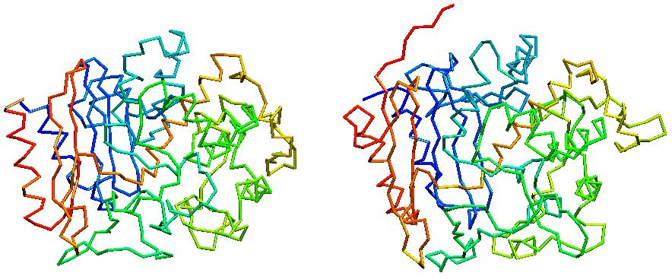
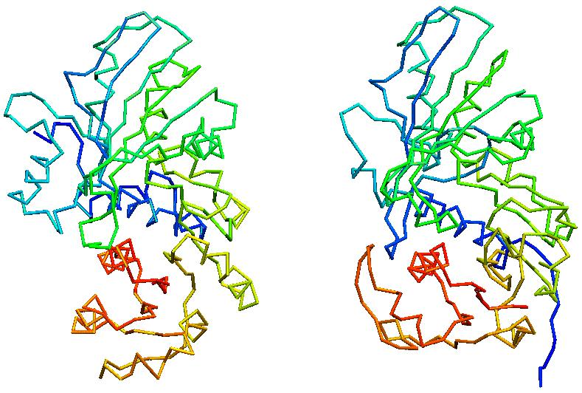
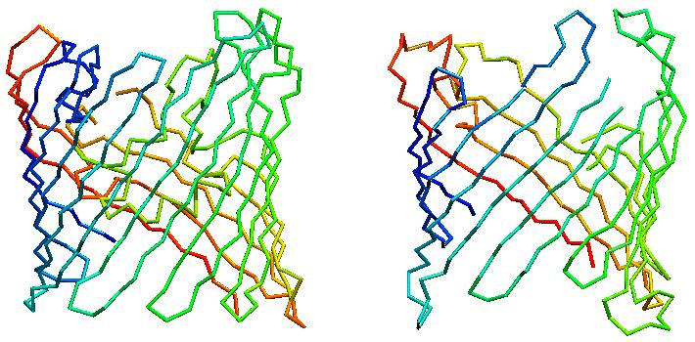
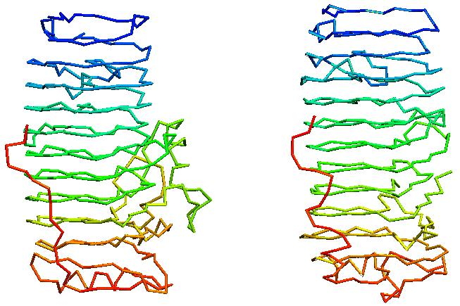
Prediction of Protein Structures
Examples – a few good examples
actual
predicted
actual
predicted
actual
predicted
actual
predicted

Slide 51
Prediction of Protein Structures
Not so good example

Slide 52
Applications
Many protein structures have been successfully predicted prior to the solution of their experimental structures (and later were verified by experimental structures)
There are numerous computer programs for protein structure predictions on the Internet

Slide 53
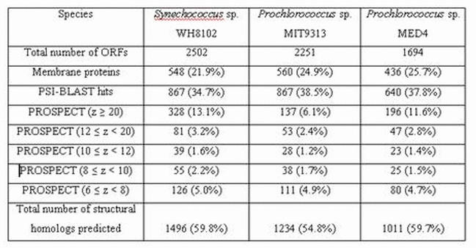
Applications
Structure predictions of all predicted genes in three microbial genomes, Synechococcus, Procholorococcus MIT/MED
~60% of predicted genes have structural fold assignments

Slide 54
Existing Prediction Programs
PROSPECT
  https://csbl.bmb.uga.edu/protein_pipeline
FUGU
  http://www-cryst.bioc.cam.ac.uk/~fugue/prfsearch.html
THREADER
  http://bioinf.cs.ucl.ac.uk/threader/

Slide 55

PROSPECT

Slide 56
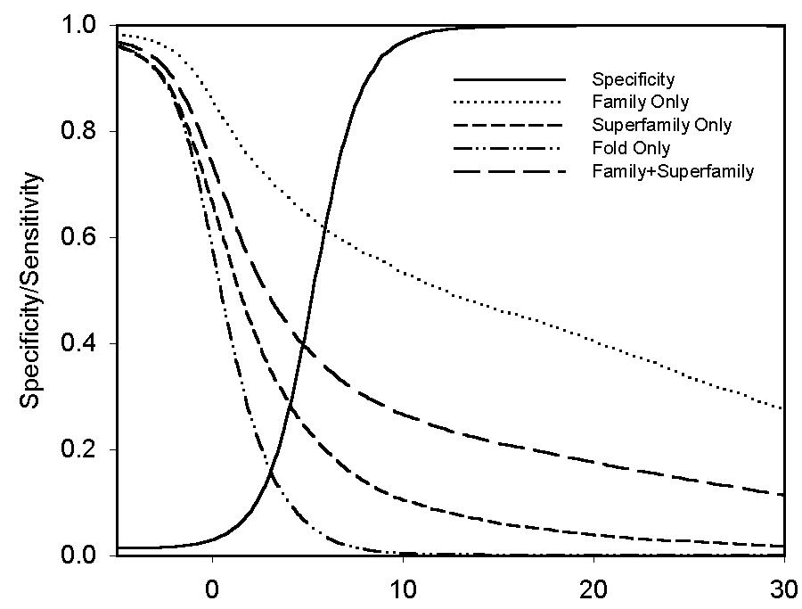
PROSPECT
PROSPECT uses z-score to assess its prediction reliability
Z-score is > 8 is considered “reliable”
z-score

Slide 57

FUGU (http://www-cryst.bioc.cam.ac.uk/~fugue/prfsearch.html)

Slide 58
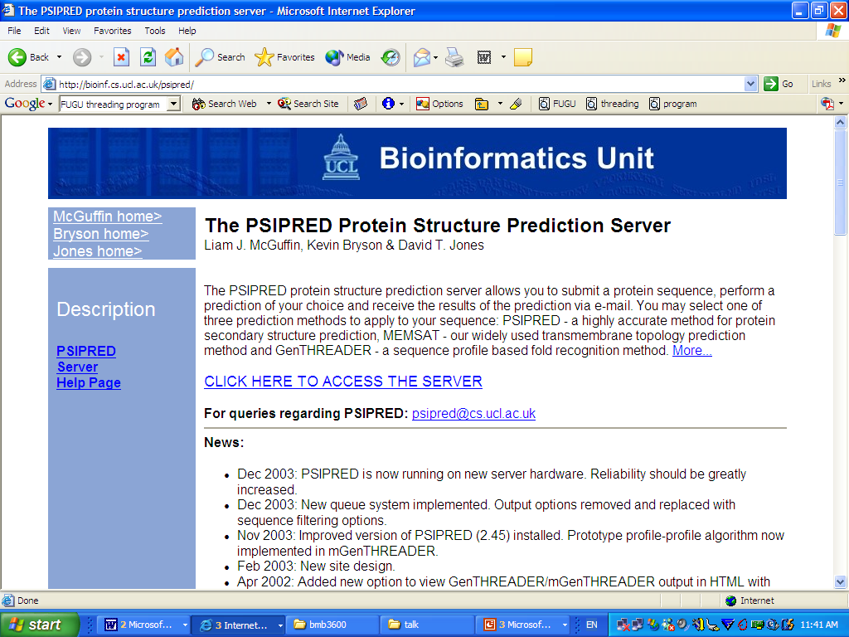
THREADER

Slide 59
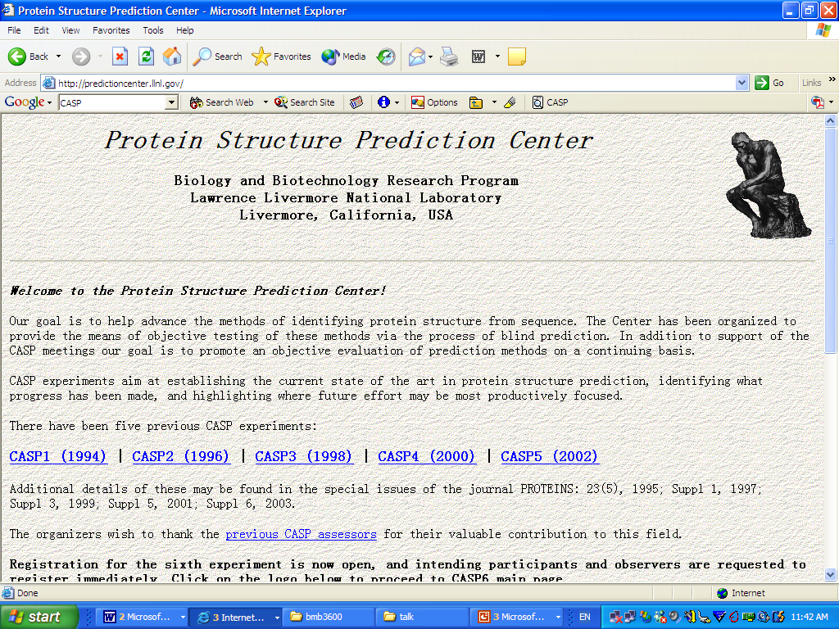
CASP (http://predictioncenter.llnl.gov/)

Slide 60
Review
Computational methods for gene finding
  Prediction of coding potential based on biased di-codon frequency
  Prediction of translation starts, splice junction sites using position specific matrices
  Combining multiple pieces of information through discriminant analysis

Slide 61
Review
Identification of functional motifs in DNA and protein sequences
  Identification of conserved sequences
  Information content
  Popular prediction tools: prosite, prints, blocks
Microarray gene expression data analysis
  Data normalization
  Identification of differentially expressed genes
  Identification of co-expressed genes

Slide 62
Review
Sequence alignment
  Scoring matrix
  Dynamic programming
  Multiple sequence alignment
Functional prediction of proteins
  Functional classification
    Pfam, ENZYME databases
  Orthologs versus paralogs
  Sequence-based approach
  Motif-based approach
  Structure-based approach
  Phylogenetic profile-based approach
  Popular server

Slide 63
Review
Protein structure prediction
  Ab initio versus comparative modeling methods
  Energy functions
  Sequence-structure alignment
  Assessment of prediction reliability
  applications
The basic ideas of computational methods for solving biological problems
The popular computational tools
How to use them for solving simple problems

