Slide 1
Extremophiles
Hina Husain
Ryan Peters
Nichole Wiemann
January 25th, 2012
BIOL 475

Slide 2
Extremophiles - What are they?
  Organisms that thrive under "extreme conditions".
    Alkaline
    Acidic
    Extremely cold
    Extremely hot
    Theory: liquid water is necessary for life
  Most known extremophiles are microbes, mostly Archaea, but can also include bacteria.
  Not all are unicellular; can also include protostome animals.

Slide 3
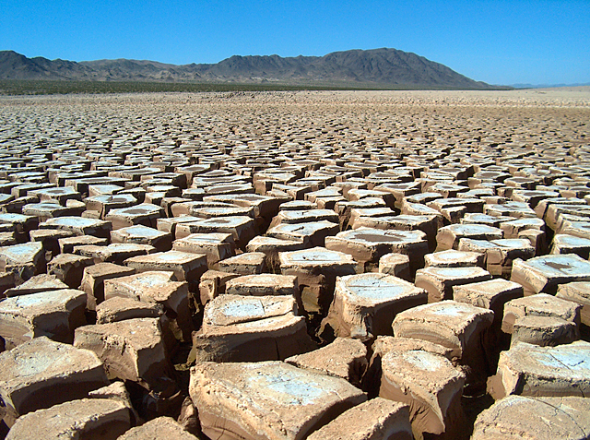
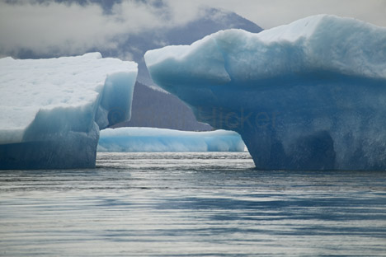
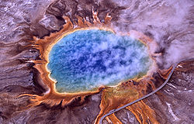
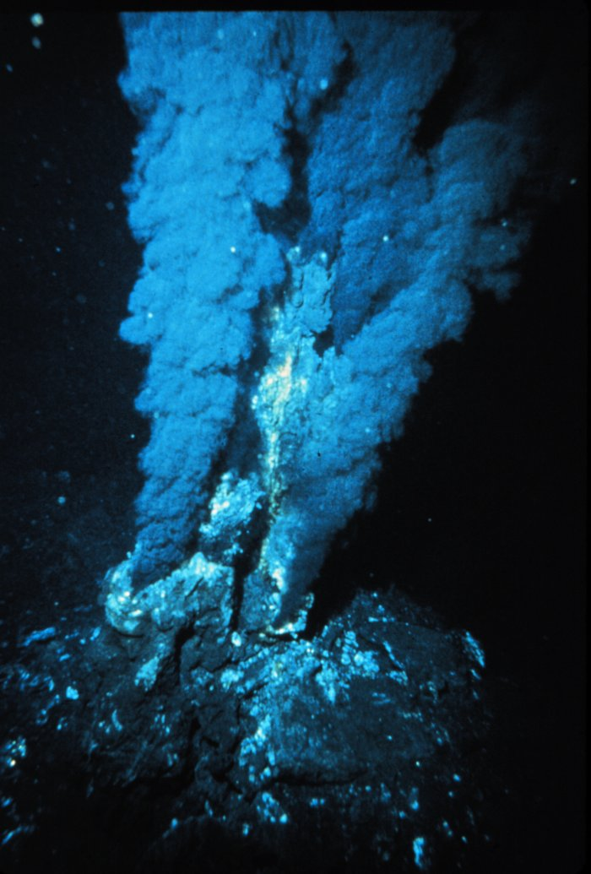
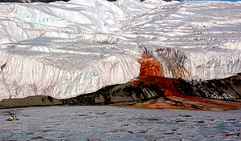
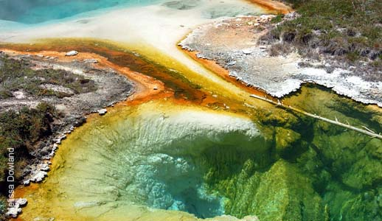
Extreme Environments

Slide 4
Astrobiology and Extremophiles
  Astrobiology is the field of study that deals with forming theories about the nature of life in the universe.
  Extremophiles are of interest because they are capable of surviving in habitats where life would seem improbable.
  Research carried out on Paracoccus denitrificans by subjecting it to extreme gravity showed robust cellular growth under conditions of hyperacceleration.

Slide 5
Types of Extremophiles
Acidophile | low pH; optimally 3 or below
Alkaliphile | high pH; optimally 9 or above
Anaerobe | little to no oxygen needed for growth
Halophile | high salt, at least 0.2M, needed for growth
Hyperthermophile | high heat, 80-122 C
Hypolith | lives under rocks in cold deserts
Metallotolerant | tolerating high levels of metal concentrations
Oligotroph | can grow in nutritionally limited environments
Osmophile | can grow in high sugar concentrations
Psychrophile | very low heat, temperatures of less than -15 C
Radioresistant | extreme radioactivity
Xerophile | grow in very dry conditions

Slide 6
Halophiles: overview and applications

Slide 7
Overview
  Halophiles are microorganisms that are salt-lovers and require NaCl for growth.
  Their tolerance for salinity ranges from slight, moderate, to extreme.
  Can be found in places with salt concentration as much as 5 times greater than that of the ocean (e.g. Great Salt Lakes, Mono Lake, Dead Sea, etc).
  Mesophiles (that live in moderate environments) would perish in such environments, where halophiles thrive.

Slide 8
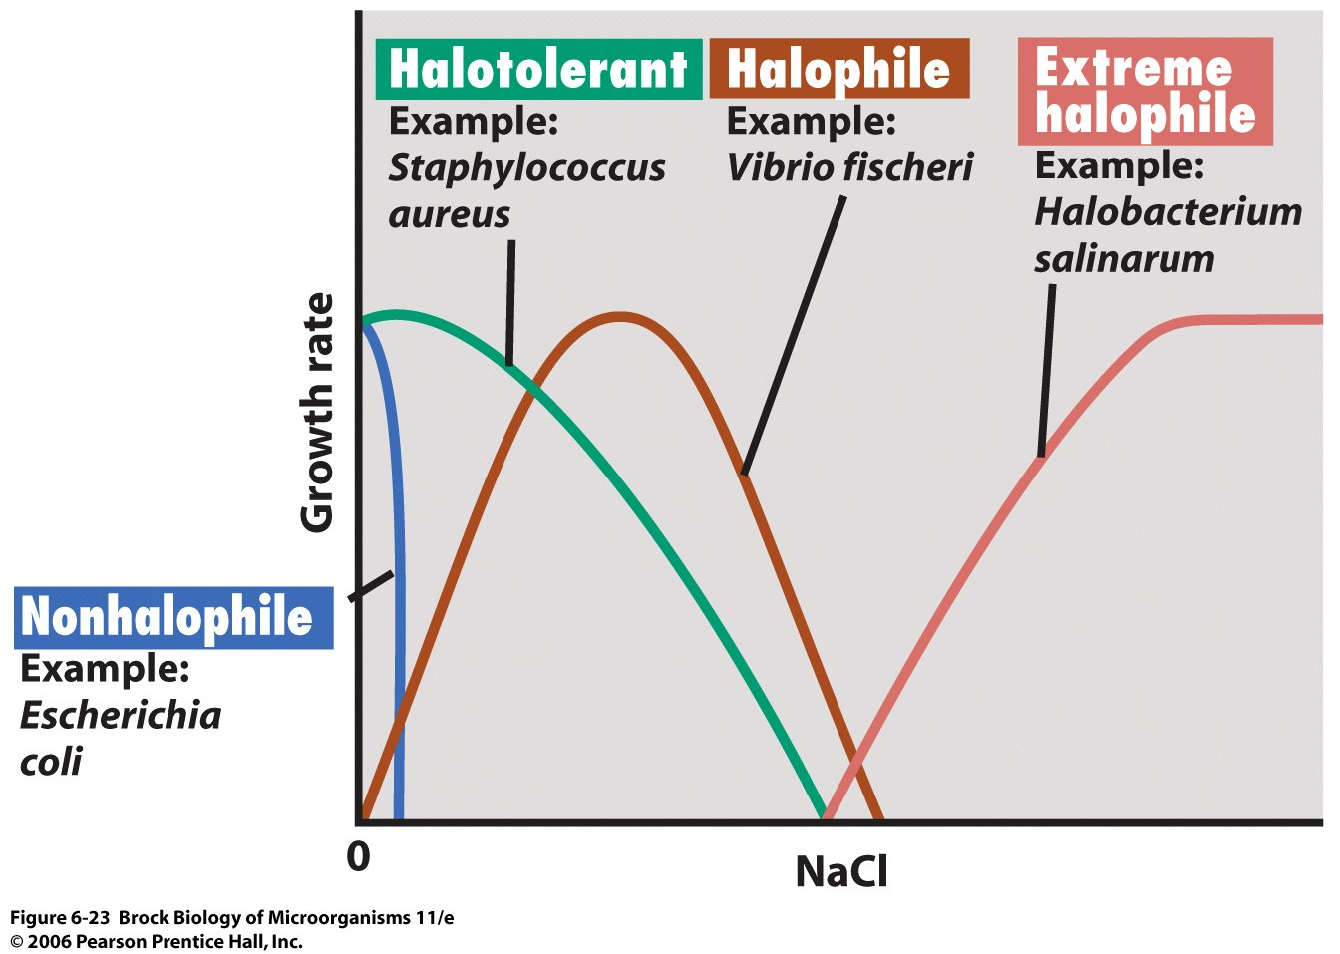

Slide 9
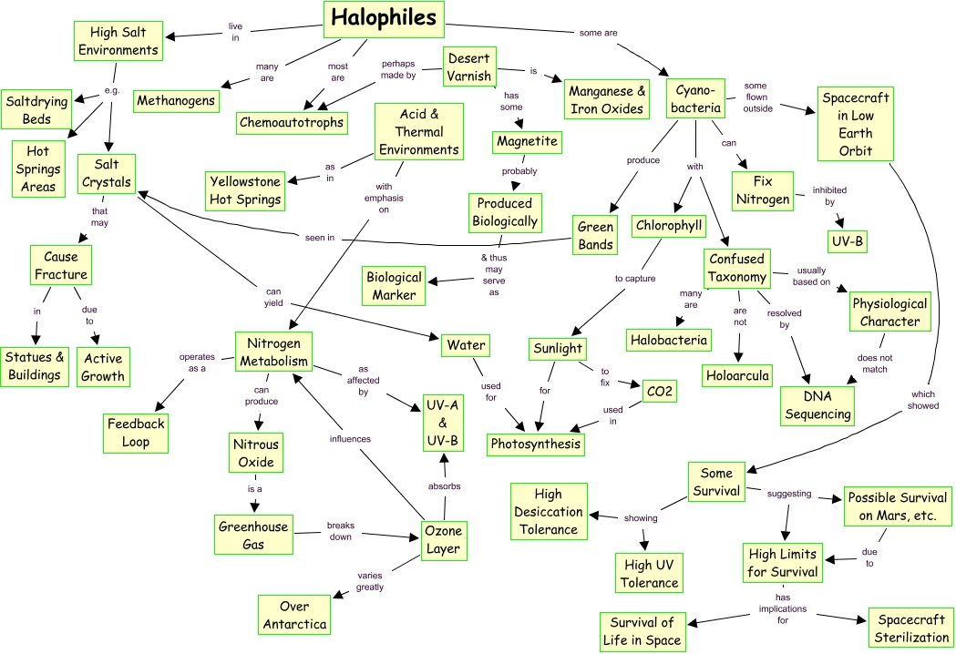

Slide 10
How do they do it?
Osmoregulation
  Need to have mechanisms to avoid water loss by osmosis.
  Halobacteria accumulate up to 5M KCl in their cells, excluding Na+.
  Other halophiles produce/accumulate low molecular weight compounds that have osmotic potential.

Slide 11
Applications - Food
  Halophilic cyanobacteria Spirulina spp. Can be conveniently grown in open ponds/troughs and is used as health food and astronaut diet supplement.
  Dunaliella salina is extremely halophilic and is the best natural source of carotenoids in the world.
  It is also good animal feedstock in dry form as it lacks any substantial cell wall.
  Proteolytic Halobacterium is associated with the brine fermentation of one type of traditional fish sauce.

Slide 12
Hyperthermophiles: background, mechanisms, applications

Slide 13
Background/History
  Thermophiles: reproduce at temperatures greater than 45 °C
  Hyperthermophiles: reproduce at over 80 °C
  Strain 121
    Hardiest thermophile known so far, doubles pop. after 24 h at 121°C (Autoclave temperature!)
  Thomas Brock and colleagues (late 1960s)
    Discovered first extremophile capable of growing over 70°C in Yellowstone’s volcanic hot springs
    Thermus aquaticus, the natural source of taq polymerase

Slide 14
Background/History
  Brock also realized: organisms growing in the boiling water of some hot springs (over 100 °C)
  "life is present wherever liquid water exists.”
  Carl Woese and colleagues (late 1970s)
    Defined the archaea domain
    theory that archaea and bacteria were the first organisms to evolve on earth.

Slide 15
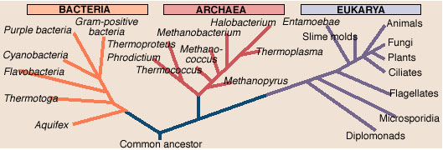

Background/History
  Hyperthermophilic oxygen sensitive organisms thought to branch off very early in the evolutionary tree of life.(e.g. Aquifex, Methanopyrus)

Slide 16
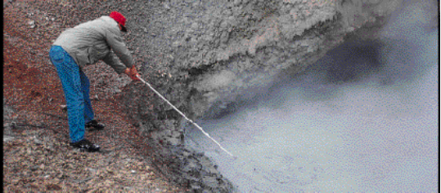
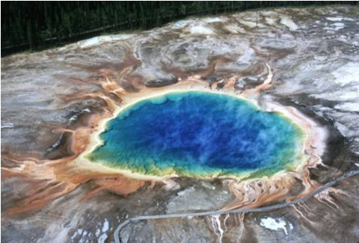
Habitats
Volcanic Hot Springs
Thermophile prospecting from boiling water

Slide 17
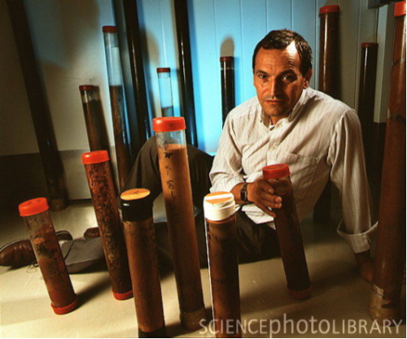
Extreme Subsurface

Slide 18
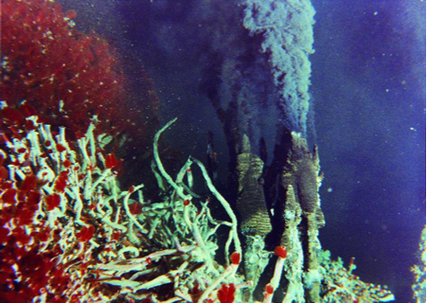
Hydrothermal Vents

Slide 19
How to Survive Being Boiled Alive
  Be a prokaryote
  Add/remove amino acids in proteins
  Positive supercoiling of DNA
  High levels of salt and ions like K⁺ in their cytoplasm
  Lipid monolayer (prevents separation of bilayer)
  Proteins that refold heat denatured proteins

Slide 20
Applications
  Biofuel made from cellulosic biomass (tough stuff)
  Non-toxic Biocatalysts from thermostable enzymes
  DNA polymerases used in the polymerase chain reaction technique or PCR (DNA sequencing, forensics, genetic engineering, disease detection)

Slide 21
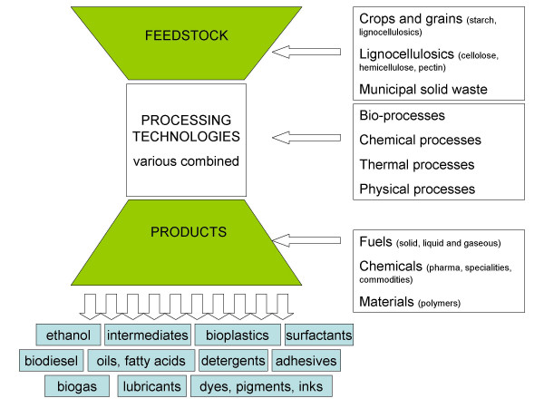


(easy)
hard

Slide 22
In Depth: Biofuel
2 steps
  Hydrolysis
    Break down cellulose to monosaccharides (e.g. glucose)
  Fermentation
    Convert monosaccharides to alcohols (e.g. ethanol)
    End goal : 200 proof (pure alcohol)

Slide 23
Biofuel
Problem 1: Cellulose has evolved to resist degradation. Starch from corn: much less so
Solution 1: Thermostable cellulases obtained from thermophiles
  Catalyze hydrolysis reaction that occurs best at temperatures of over 100 °C
Arrhenius equation: k = Ae^{-Ea/RT}
therefore: Reaction rate ∝ T

Slide 24
Biofuel
Problem 2: Single step process is needed for production to become economical.
Solution 2: Thermo-active bacteria can ferment sugars to alcohol at high temperatures.
  Cool down step not required.

Slide 25
Psychrophiles:
Adaptations to Cold Environments

Slide 26
Where do they Live?
  Psychrophiles live anywhere on Earth from the deepest parts of the oceans to the peaks of the tallest mountains and all the way from the North Pole to the South Pole
  Sea ice, glaciers, polar caps, deep seas, rocks of Antarctica’s dry deserts, alpine caves, and more

Slide 27
What exactly is a Psychrophile?
  Psychrophile – organisms that have optimum growth rates at a temperature of 15°C or lower
    Ex. Polaromonas sp. living in sea ice
  Psychrotolerant – organisms that are capable of growth at low temperatures but have an optima between 20-40°C

Slide 28
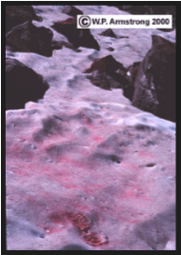
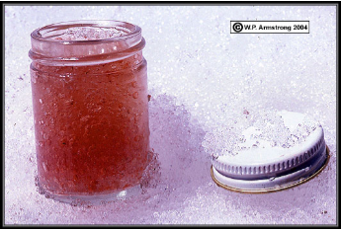
A Little Note About Water…
  Liquid water is necessary for growth
  Freezing temperature of seawater is lower than that of freshwater
  Some psychrophiles have developed methods to obtain water when there otherwise would be none

Slide 29
Challenges of Surviving the Cold
  Reduced enzyme activity
  Decreased membrane fluidity
  Altered transport of nutrients and waste products
  Decreased rates of transcription, translation, and cell division
  Inappropriate protein folding
  Protein cold-denaturation
  Intracellular ice formation

Slide 30
Cold Adapted Proteins
  Three main types of cold adapted proteins:
    Cold-shock proteins (CSPs) that appear in meosphiles and psychrophiles
    Cold-acclimation proteins (CAPs) in psychrophiles
    Antifreeze proteins to prevent cell freezing

Slide 31
Applications of Enzymes: Detergents
  Laundry detergents and household cleaners are beginning to use cold-active enzymes as their cleaning agents
  This can result in many benefits
    Energy savings
    Time saving
    Reduced environmental impact
  Most common enzymes used are proteases, amylases, lipases, and cellulases

Slide 32
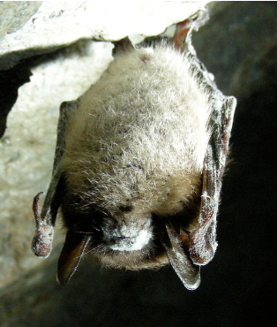
White Nose Syndrome
  Millions of little brown bats in eastern North America have been dying since 2006
  Cause is the fungal psychrophile Geomyces destructans
  Transmissable through bat-to-bat
  contact and capable of living in
  winter soils so it may be lethal to
  bat populations
  Hot topic for research right now

Slide 34
References
Brenchley, J.E. Psychrophilic microorganisms and their cold-active enzymes. Journal of Industrial Microbiology. (1996)17:432-437.
Cavicchioli, R., Charlton, T., Ertan, H., Mohd Omar, S., Siddiqui, K.S., & Williams, T.J. Biotechnological uses of enzymes from psychrophiles. Microbial Biotechnology. (2011) 4(4), pp.449-460.
Cavicchioli, R., Siddiqui, K.S., Andrews, D., & Sowers, K.R. Low-temperature extremophiles and their applications. Current Opinion in Biotechnology 2002(13), pp. 253-261.
D’Amico, S., Collins, T., Marx, J-C., Feller, G., & Gerday, C. Psychrophilic microorganisms: challenges for life. European Molecular Biology Organization. 7(4), pp.385-389.
Duval, B., Duval, E. & Hoham, R.W. Snow algae of the Sierra Nevada, Spain, and High Atlas mountains of Morocco. International Microbiology. (1999)2:39-42.
Feller, G. & Gerday, C. Psychrophilic Enzymes: Hot Topics in Cold Adaptation. Nature. Vol. 1. 2003. pp 200-208. doi:10.1038/nrmicro773
Grosjean, H. & Oshima, T. (2007). How nucleic acids cope with high temperatures. In Gerday, C. & Glansdorff, N., eds. Physiology and Biochemistry of Extremophiles. Washington, D.C.: ASM Press. 39-56.
Horikoshi, K. & Grant, W.D. Extremophiles - Microbial Life in Extreme Environments. New York: Wiley-Liss, 1998.
K. Kashefi and D.R. Lovley. Extending the upper temperature limit for life. Science 301, 934 (August 15, 2003)
Lorch, J.M., Meteyer C. U., Behr, M.J., Boyles, J.G., Cryan, P.M., Hicks, A.C., Ballmann, A.E., Coleman, J.T.H., Redell, D.N., Reeder, D.M., & Blehert, D.S. Experimental infection of bats with Geomyces destructans causes white-nose syndrome. Nature [Internet]. 26 October 2011 [cited 2012 January 17];000:[about 4 p.] Available from: www.nature.com/nature doi:10.1038/nature10590

Slide 35
References
Madigan, M.T. Extremophilic Bacteria and Microbial Diversity: Enhancement Chapter. Raven and Johnson's Biology, 6th Edition
Madigan, M.T. and Marrs B.L., Extremophiles. Scientific American, April 1997
Madigan, M.T., Martinko, J.M., Dunlap, P.V., & Clark, D.P. Brock Biology of Microorganisms, 12ED. Benjamin Cummings. 2008. Pp. 160-2, 690-2.
Margesin, R. Psychrophiles: From Biodiversity to Biotechnology. Springer (2008). p197.
Monastersky, R. (1997). Deep Dwellers: Microbes thrive far below ground. Retrieved January, 2012 from http://www.sciencenews.org/pages/sn_arc97/3_29_97/bob1.htm
M.W.W. Adams and R. M. Kelly: Enzymes Isolated from Microorganisms That Grow in Extreme Environments. Chemical and Engineering News, Vol. 73, No. 51, pages 32–42; December 18, 1995.
Pikuta, E.V., Hoover, R.B., & Tang, J. Microbial Extremophiles at the Limits of Life. Critical Review in Microbiology. 33:183-209, 2007. Doi:10.1080/10408410701451948
Synowiecki J: Some applications of thermophiles and their enzymes for protein processing.African Journal of Biotechnology Vol. 9(42), pp. 7020-7025
Turner P, Mamo G and Karlsson, E: Potential and utilization of thermophiles and thermostable enzymes in biorefining. Microbial Cell Factories 2007, 6:9
Terui, Y., et al. (2005). Stabilization of nucleic acids by unusual polyamines produced by an extreme thermophile, Thermus thermophilus. Biochem. J. 388, 427-433.

