Slide 1
Physical and chemical properties of proteins. Denaturation.

Slide 2
Physical properties
Size
Colloidal solutions
Charge
UV absorption
Solubility

Slide 3
Protein molecular size
Molecular weight:
Vary from 6000 to million Daltons (Da)
Protomeric proteins: 50 000 to 100 000 Da
Oligomeric proteins: > 100 000 Da

Slide 4
Colloidal properties
Solution （< 1 nm）
Colloid （1 – 100 nm）
Suspension (> 100 nm)
Protein
  Particle size of 2~20 nm
  Protein solution has colloidal properties (high viscosity, high absorption capacity, light distraction, do not pass through a semipermeable membrane …

Slide 5
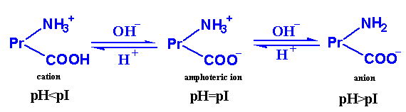
Protein charge
The pH at which the protein has zero net-charge is referred to as isoelectric point (pI).
Amphoteric properties.

Slide 6
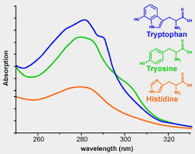
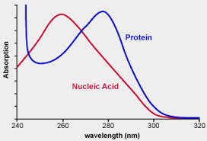
UV absorption
Trp, Tyr, Phe, and His have aromatic groups of resonance double bonds.
Proteins have a strong absorption at 280nm.

Slide 7
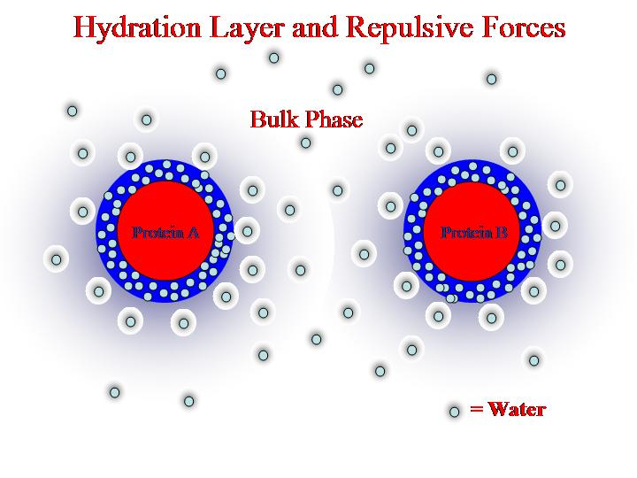
Solubility
Affected by the balance of hydrophobic and hydrophilic amino acids on its surface
Charged amino acids play the most important role in keeping the protein soluble
Solubility determined by repulsion forces among protein molecules and a hydration water layer

Slide 8
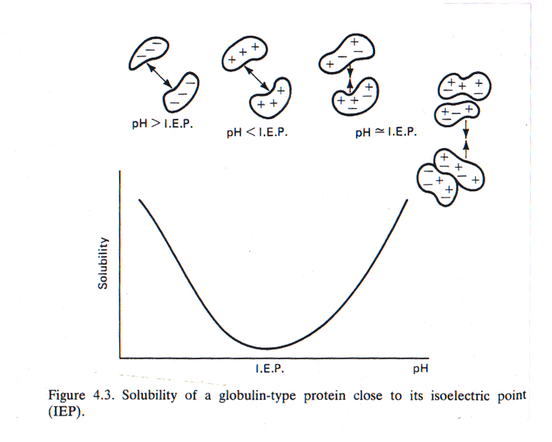
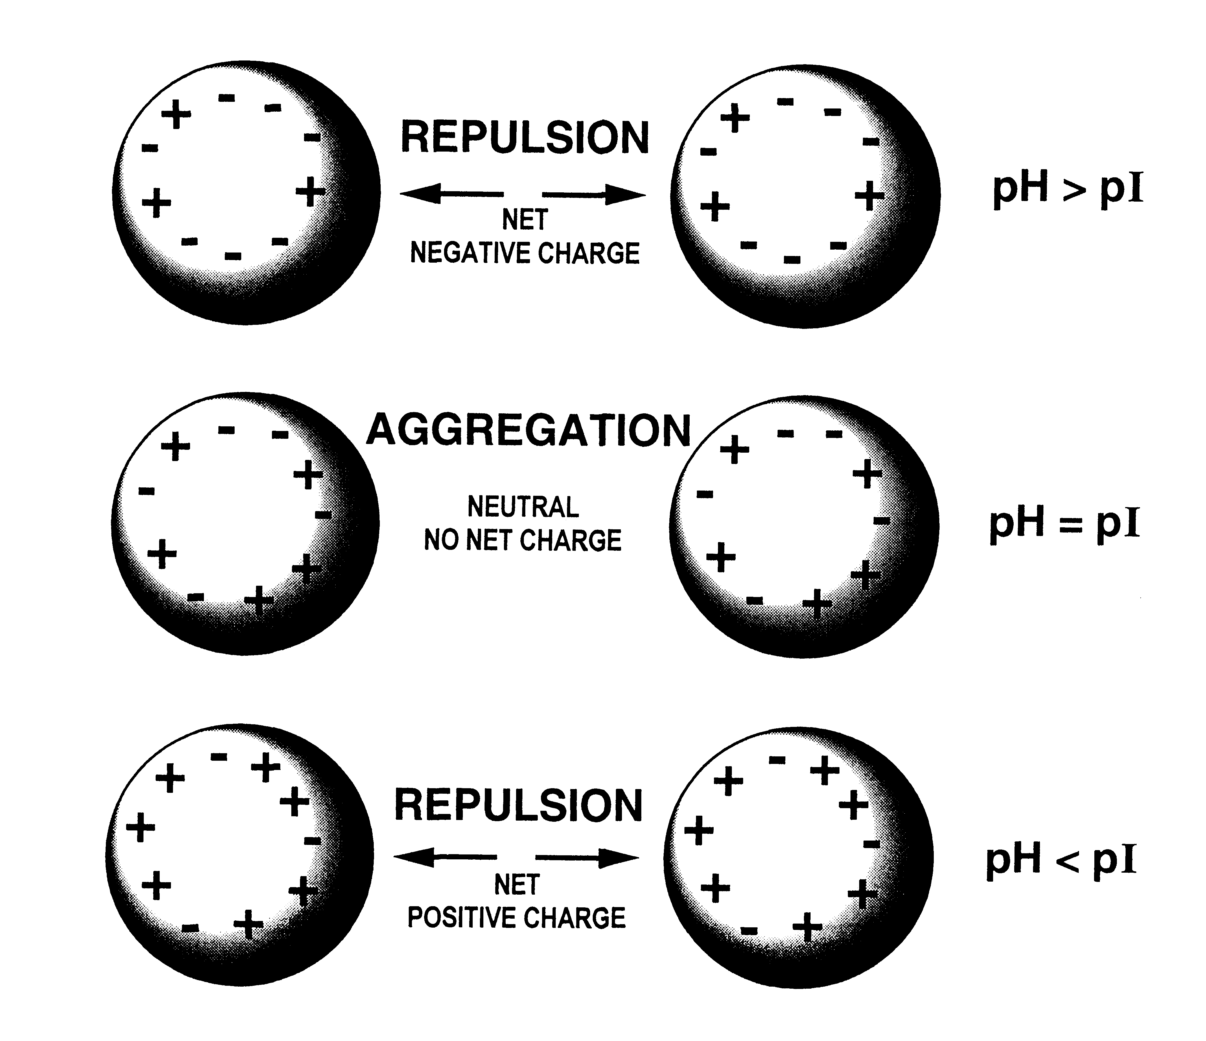
Influence of pH on protein solubility
  The proteins are least soluble at their isoelectric point (no net charge)
  The protein become increasingly soluble as pH is increased or decreased away from the pI

Slide 9
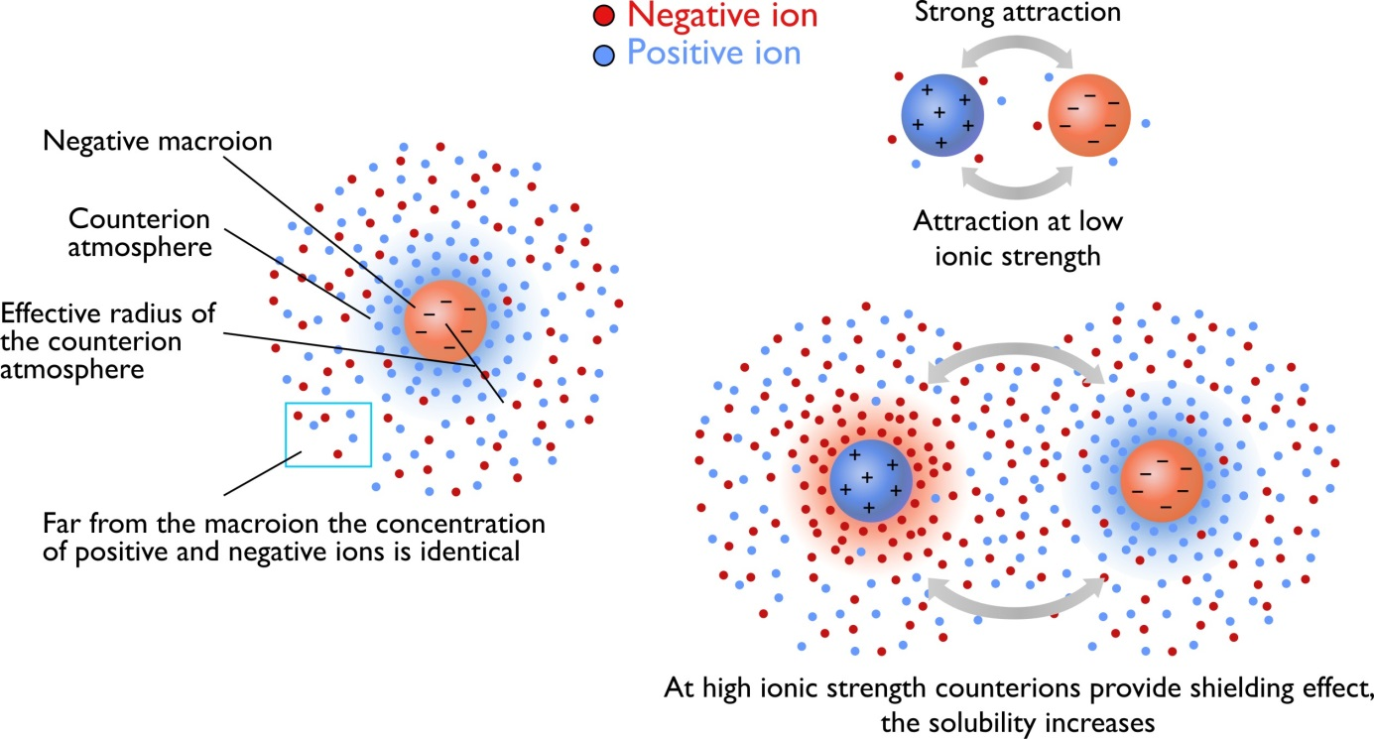
Influence of salt on protein solubility
Positively and negatively charged small ions in solution can cluster around charged side groups
These ions can “screen” interacting side groups from each other
Charged side groups of proteins can collect a cloud of ions called a counterion atmosphere
Extent of the counterion atmosphere depends on the ionic strength of the charged ions in solution

Slide 10
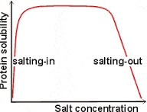
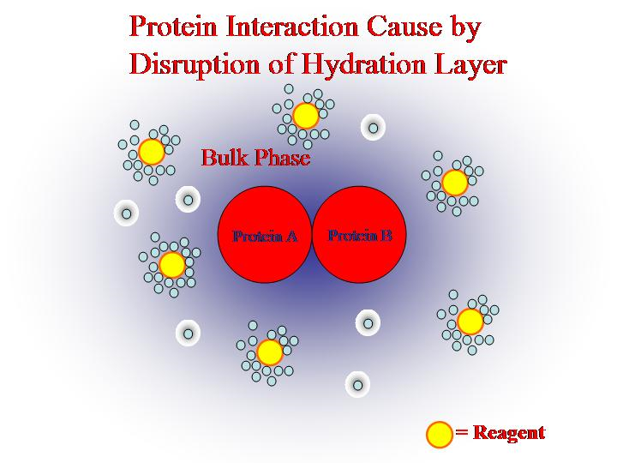
Influence of salt concentration on protein solubility
  At low salt concentrations protein solubility increases (salting-in): interactions between side groups at the pI are screened which prevent aggregation.
  At high salt concentrations protein solubility decreases (salting-out): salt ions bound to water molecules and disrupt hydrolytic layer of proteins.

Slide 11
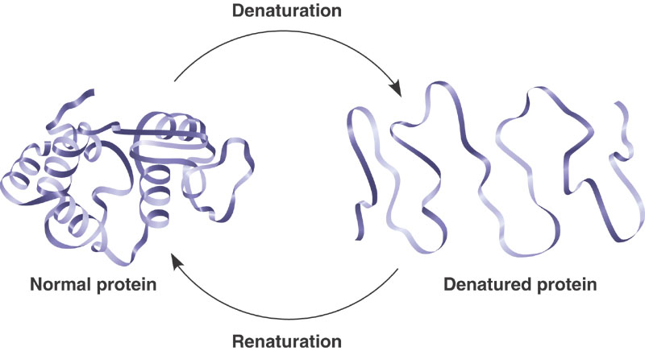
Protein denaturation
Proteins exist in two main states
DENATURED STATE
Loss of native conformation
  Altered secondary, tertiary or quaternary structure
  Disruption of disulfide bonds (covalent) and non-covalent bonds (H-bond, ionic bond, hydrophobic interaction
  Peptide bonds are not affected
NATIVE STATE
Usually most stable
Usually most soluble
Polar groups usually on the outside
Hydrophobic groups on inside
  The proteins can regain their native state when the denaturing influence is removed-Renaturation.

Slide 12
Denaturing agents
100
Physical agents
  Thermal treatment
  High temperature destabilizes the non-covalent interactions holding the protein together causing it to eventually unfold. Increase molecular energy and motion.
  Hydrogen bonds are affected the most.
  Freezing can also denature due to ice crystals and weakening of hydrophobic interactions.
%Denatured
0
0
100
T (C)

Slide 13
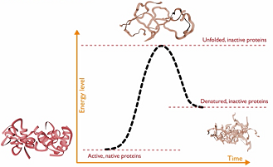
  Thermal treatment
At a slow increasing temperature, protein conformation remains intact in a relatively broad temperature range.
Abrupt loss of structure (and function) occurs in a narrow temperature range

Slide 14
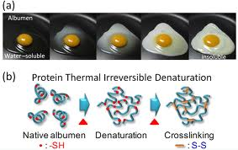
  Thermal treatment: an example

Slide 15
Denaturing agents: Physical agents
  Hydrostatic pressure (5 000 to 10 000 atm): Destabilize hydrophobic interactions; Water molecules can penetrate hydrophobic protein core.
  http://www.researchgate.net/profile/Vadim_Mozhaev/publication/227836660_High_pressure_effects_on_protein_structure_and_function/links/0f31752e01a8a03a30000000.pdf
  UV radiation: similar to high temperature treatment effect: higher kinetic energy increases the vibration of molecules thus disrupting H-bonds.

Slide 16
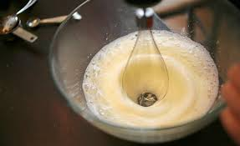
Denaturing agents: Physical agents
  X-rays
  Violent shaking (H-bond disruption).

Slide 17
Denaturing agents: Chemical agents
Acids and alkalis; Altered pH
Organic solvents (ether, alcohol)
Salts of heavy metals (Pb, Hg)
Chaotropic agents
Detergents
Reducing/oxidizing agents

Slide 18
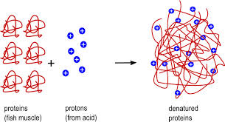
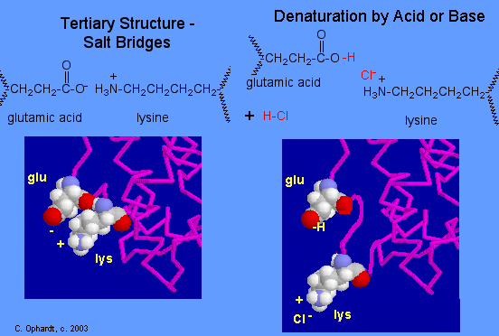
Acids and alkalis
Disrupt ionic bonds
Example: protein denaturation by gastric juices

Slide 19
Denaturing agents: Chemical agents
  pH and denaturation
Proteins are more stable against denaturation at their isoelectric point than at any other pH.
At extreme pH values, strong intramolecular electrostatic repulsion caused by high net charge results in swelling and unfolding of the protein molecule.
100
%Denatured
0
0
pH
12

Slide 20
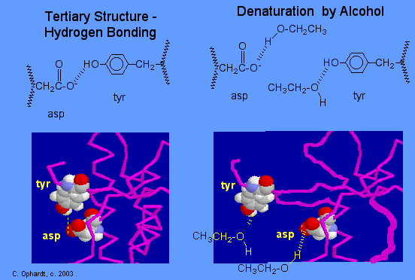
Organic solvents (ether, alcohol)
Organic solvents denature proteins by disrupting the side chain intramolecular hydrogen bonding.
New hydrogen bonds are formed instead between the new organic solvent molecule and the protein side chains.

Slide 21
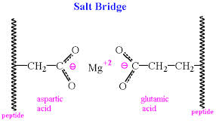
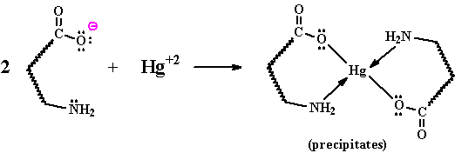
Salts of heavy metals (Pb⁺², Cd⁺² Hg⁺²…)
Disrupt ionic bonds
The reaction of a heavy metal salt with a protein usually leads to an insoluble metal protein salt.

Slide 22


Chaotropic agents
A chaotropic agent is a molecule in water solution that can disrupt the hydrogen bonding network between water molecules. This has an effect on the stability of the native state of other molecules in the solution such as proteins.
Compete for hydrogen bonds
Examples:
urea
guanidinium chloride

Slide 23
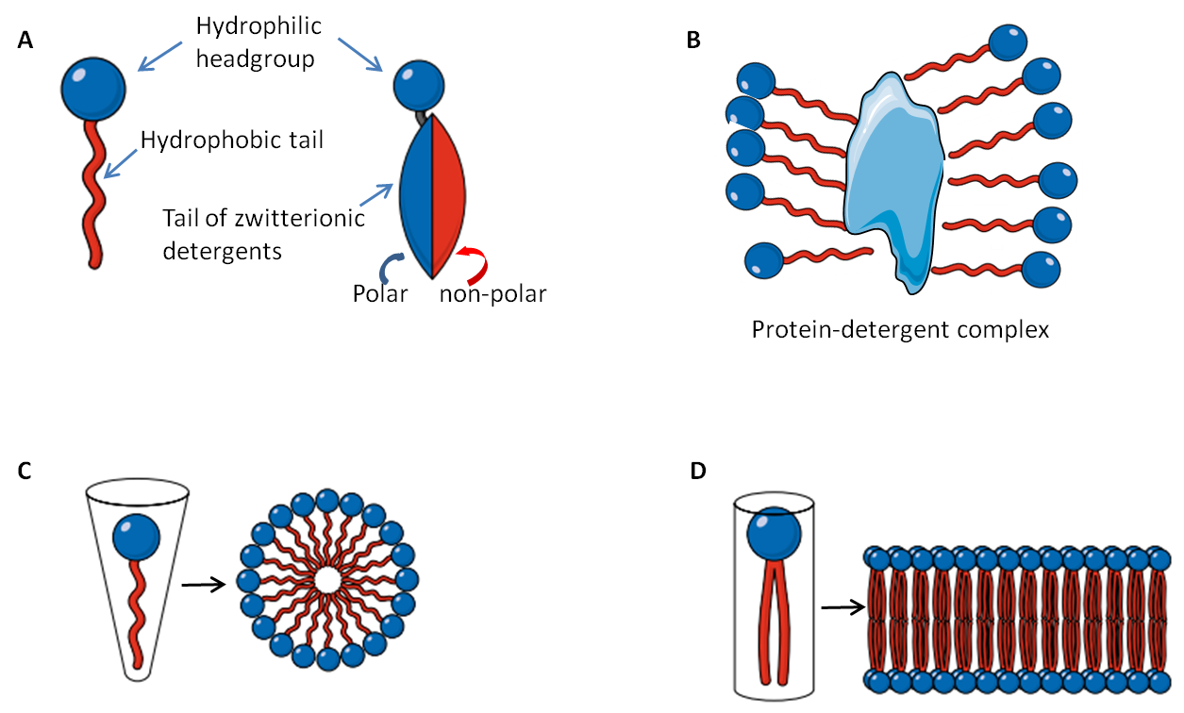
Detergents
Disrupt hydrophobic interactions in protein molecules.
Detergents are amphiphilic molecules which contain both hydrophobic and hydrophilic parts.
Hydrophobic parts of the detergent associates with the hydrophobic parts of the protein.
Hydrophilic parts of the detergent interact with water molecules
Thus, hydrophobic parts of the protein do not need to interact with each other.

Slide 24
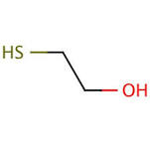
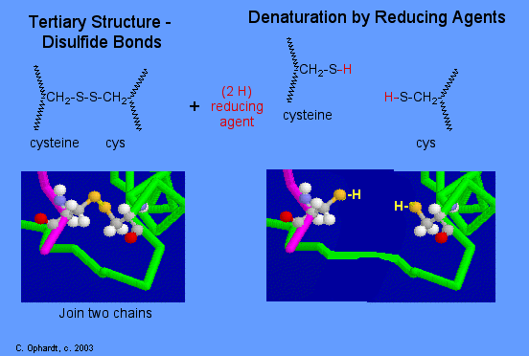
Reducing agents
Mercaptoethanol

Slide 25
Protein denaturation: consequences
Change in physical, chemical and biological properties of proteins.
  Increased viscosity
  Altered functional properties
  Loss of enzymatic activity

Slide 26
  Altered solubility
Denaturation of the protein can both increase or decrease solubility of proteins.
E.g. very high and low pH denature but the protein is soluble since there is much repulsion
Very high or very low temperature on the other hand will lead to loss in solubility since exposed hydrophobic groups of the denatured protein lead to aggregation (may be desirable or undesirable in food products)
+
+
Low pH
+
+
+
+
+
+
+
+
+
+
Insoluble complex

Slide 27
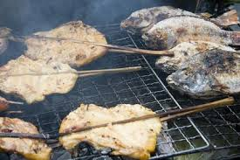
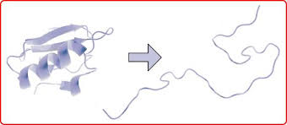
  Increased digestibility
Denatured protein is more easily digested due to enhanced exposure of peptide bonds to enzymes.
Cooking causes protein denaturation and therefore, cooked food is more easily digested.

Slide 28
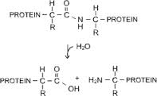
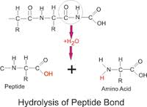
Chemical properties of proteins
Hydrolysis
  Proteins can be hydrolyzed (the peptide bond) by acid or enzymes to give peptides and free amino acids (e.g. soy sauce, fish sauce etc.)

Slide 29
Chemical properties of proteins: consequences
  Modifies protein functional properties
    E.g. increased solubility
  Increases bioavailability of amino acids
    Excessive consumption of free amino acids is not good however

Slide 30
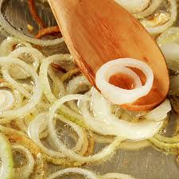
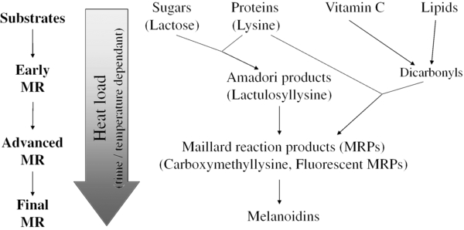
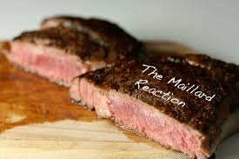
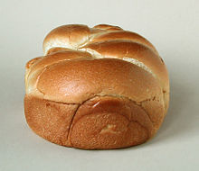
Maillard reaction (carbonyl - amine browning)
  Changes functional properties of proteins
  Changes color
  Changes flavor
  Decreases nutritional quality (amino acids less available)

Slide 31
Alkaline reactions
  Soy processing (textured vegetable protein)
    0.1 M NaOH for 1 hr @ 60°C
    Denatures proteins
    Opens up its structure due to electrostatic repulsion
    The peptide bond may also be hydrolyzed

Slide 32
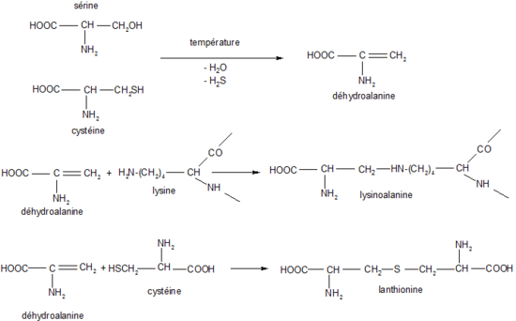
Alkaline reactions (cont.)
    Some amino acids become highly reactive
      NH₃ groups in lysine
      SH groups and S-S bonds become very reactive (e.g. cysteine)
  Lysinoalanine formation (LAL)
    Lysine becomes highly reactive at high pH and reacts with dehydroalanine forming a cross-link
      Lysine, an essential amino acid, becomes unavailable

Slide 33
  Lysinoalanine formation (LAL)
    Problem:
      Lysine is the limiting amino acid in cereal foods.
        Limiting amino acid: Essential amino acid of least quantity.
      Lysinoalanine can lead to kidney toxicity in rats, and possibly humans.

Slide 34
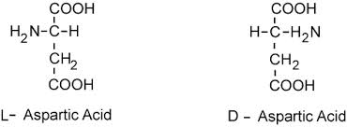
Alkaline reactions (cont.)
  Isomerization (racemization)
    L- to D-amino acids
    We cannot metabolize D-amino acids
    Not a very serious problem in texturized vegetable protein production.

Slide 35
4. Oxidation
  Lipid oxidation
    Aldehyde, ketones react with lysine making it unavailable
    Usually not a major problem
  Methionine oxidation (no major concern)
    Sulfoxide or sulfone
    Met sulfoxide still active as an essential amino acid
    Met sulfone – no or little amino acid activity
http://onlinelibrary.wiley.com/doi/10.1111/1541-4337.12127/epdf

Slide 36
Protein Stability
Protein stability is the net balance of forces, which determine whether a protein will be in its native folded conformation or a denatured state.
Protein stability normally refers to the physical (thermodynamic) stability, not the chemical stability.

Slide 37
Chemical Stability
Chemical stability involves loss of integrity due to bond cleavage.
  deamination of asparagine and/or glutamine residues,
  hydrolysis of the peptide bond of Asp residues at low pH,
  oxidation of Met at high temperature,
  elimination of disulfide bonds
  disulfide interchange at neutral pH
Other processes include thiol-catalyzed disulfide interchange and oxidation of cysteine residues.

Slide 38

Protein Stability
The net stability of a protein is defined as the difference in free energy between the native and denatured state:
Both G_{N} and G_{U} contribute to G
The free energy may be readily calculated from the following relationships:
K = [N]/[U] = F_{N}/(1- F_{N}),
F_{N} = fraction folded
ΔG = G_{N} - G_{U} = -RTlnK
Decreasing the energy of the folded state or increasing the energy of the unfolded state have the same effect on ΔG.

Slide 39
Protein Stability
Protein stability is important for many reasons:
  Providing an understanding of the basic thermodynamics of the process of folding,
  increased protein stability may be a multi-billion dollar value the in food and drug processing, and in biotechnology and protein drugs.
Two relatively recent innovations, which have had major impact in the study of the thermodynamics of proteins were the development of very sensitive techniques, differential scanning calorimetry (especially by Privalov and Brandts) and site-directed mutagenesis.

Slide 40
Stability of the Folded State
Measuring protein stability is measuring the energy difference between the U (unfolded) and F (folded) states.
The average stability of a monomeric small protein is about 5 - 10 kcal/mol, which is very small!
ΔG = G_{N} - G_{U} = -RTlnK
K=e^{-ΔG/RT} = e^{-10x1000/(2x298)} =2x 10 ⁷
  i.e. in aqueous solution, at room temperature, the ratio of folded : unfolded protein is 2x 10 ⁷ : 1!

Slide 41
Stability of the Folded State
K as the equilibrium constant, is the ratio of the forward (f) and the reverse (u) rate constant. K=k_{f}/k_{u}
If a typical protein refolds spontaneously with a rate constant of k_{f} = 1 s⁻¹, its rate of spontaneously unfolding under the same condition will be 10⁻⁷ s⁻¹. The half life is 0.693/10⁻⁷ s = 80 days.
  This suggests that the unfolding of proteins will only be transient.
  We have to perturb the equilibrium to enable us to measure the unfolding of proteins using urea, pH, etc.

Slide 42
Techniques for Measuring Stability
Any methods that can distinguish between U and F
Absorbance (e.g. Trp, Tyr)
Fluorescence (Trp)-difference in emission max & intensity.
CD (far or near UV) - (2º or 3º)
NMR
DSC (calorimetry)
Urea gradient gels - difference in the migrating rates between F and U.
Catalytic activity
Chromophoric or fluorophoric probes

Slide 43
Denaturing Proteins at Extreme pHs
High pH and low pH denature many, but not all proteins (many are quite stable at pH 1!).
The basic idea is that the net charge on the protein due to the titration of all the ionizing groups leads to intramolecular charge-charge repulsion, which is sufficient to overcome the attractive forces (mostly hydrophobic and dispersive) resulting in at least partial unfolding of the protein.
The presence of specific counterion binding leads to formation of compact intermediate states such as the molten globule (substantial secondary structure, little or no tertiary structure, relatively compact size compared to the native state).

Slide 44
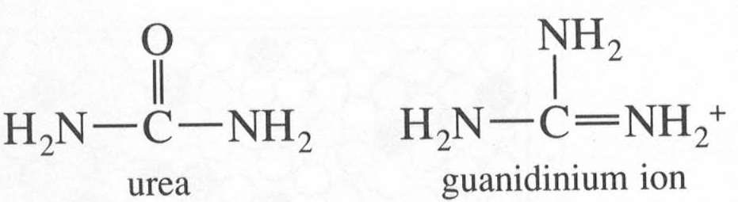
Denaturants
The effects of denaturants such as urea (usually 8 M) or Guanidinium Hydrochloride (usually 6 M GuHCl) are complex, and currently are best thought of as involving preferential solvation of the denatured (unfolded) state, involving predominantly hydrophobic related properties, and to a lesser extent H-bonding (both side-chains and backbone appear to be more soluble in the presence of the denaturants).
There is no a very good solvent because solvents that are good for the hydrophobic components are bad for the hydrophilic ones and vice versa.
As in the case of pH-induced denaturation, not all proteins are unfolded by these denaturants.
Protein stability: SCN⁻ < Cl⁻ < Urea < SO₄ ²⁻
e. g. midpoints of unfolding transition for RNase: GuSCN = 0.3M, GuHCl = 0.8 M, and urea nearly 3 M.

Slide 45
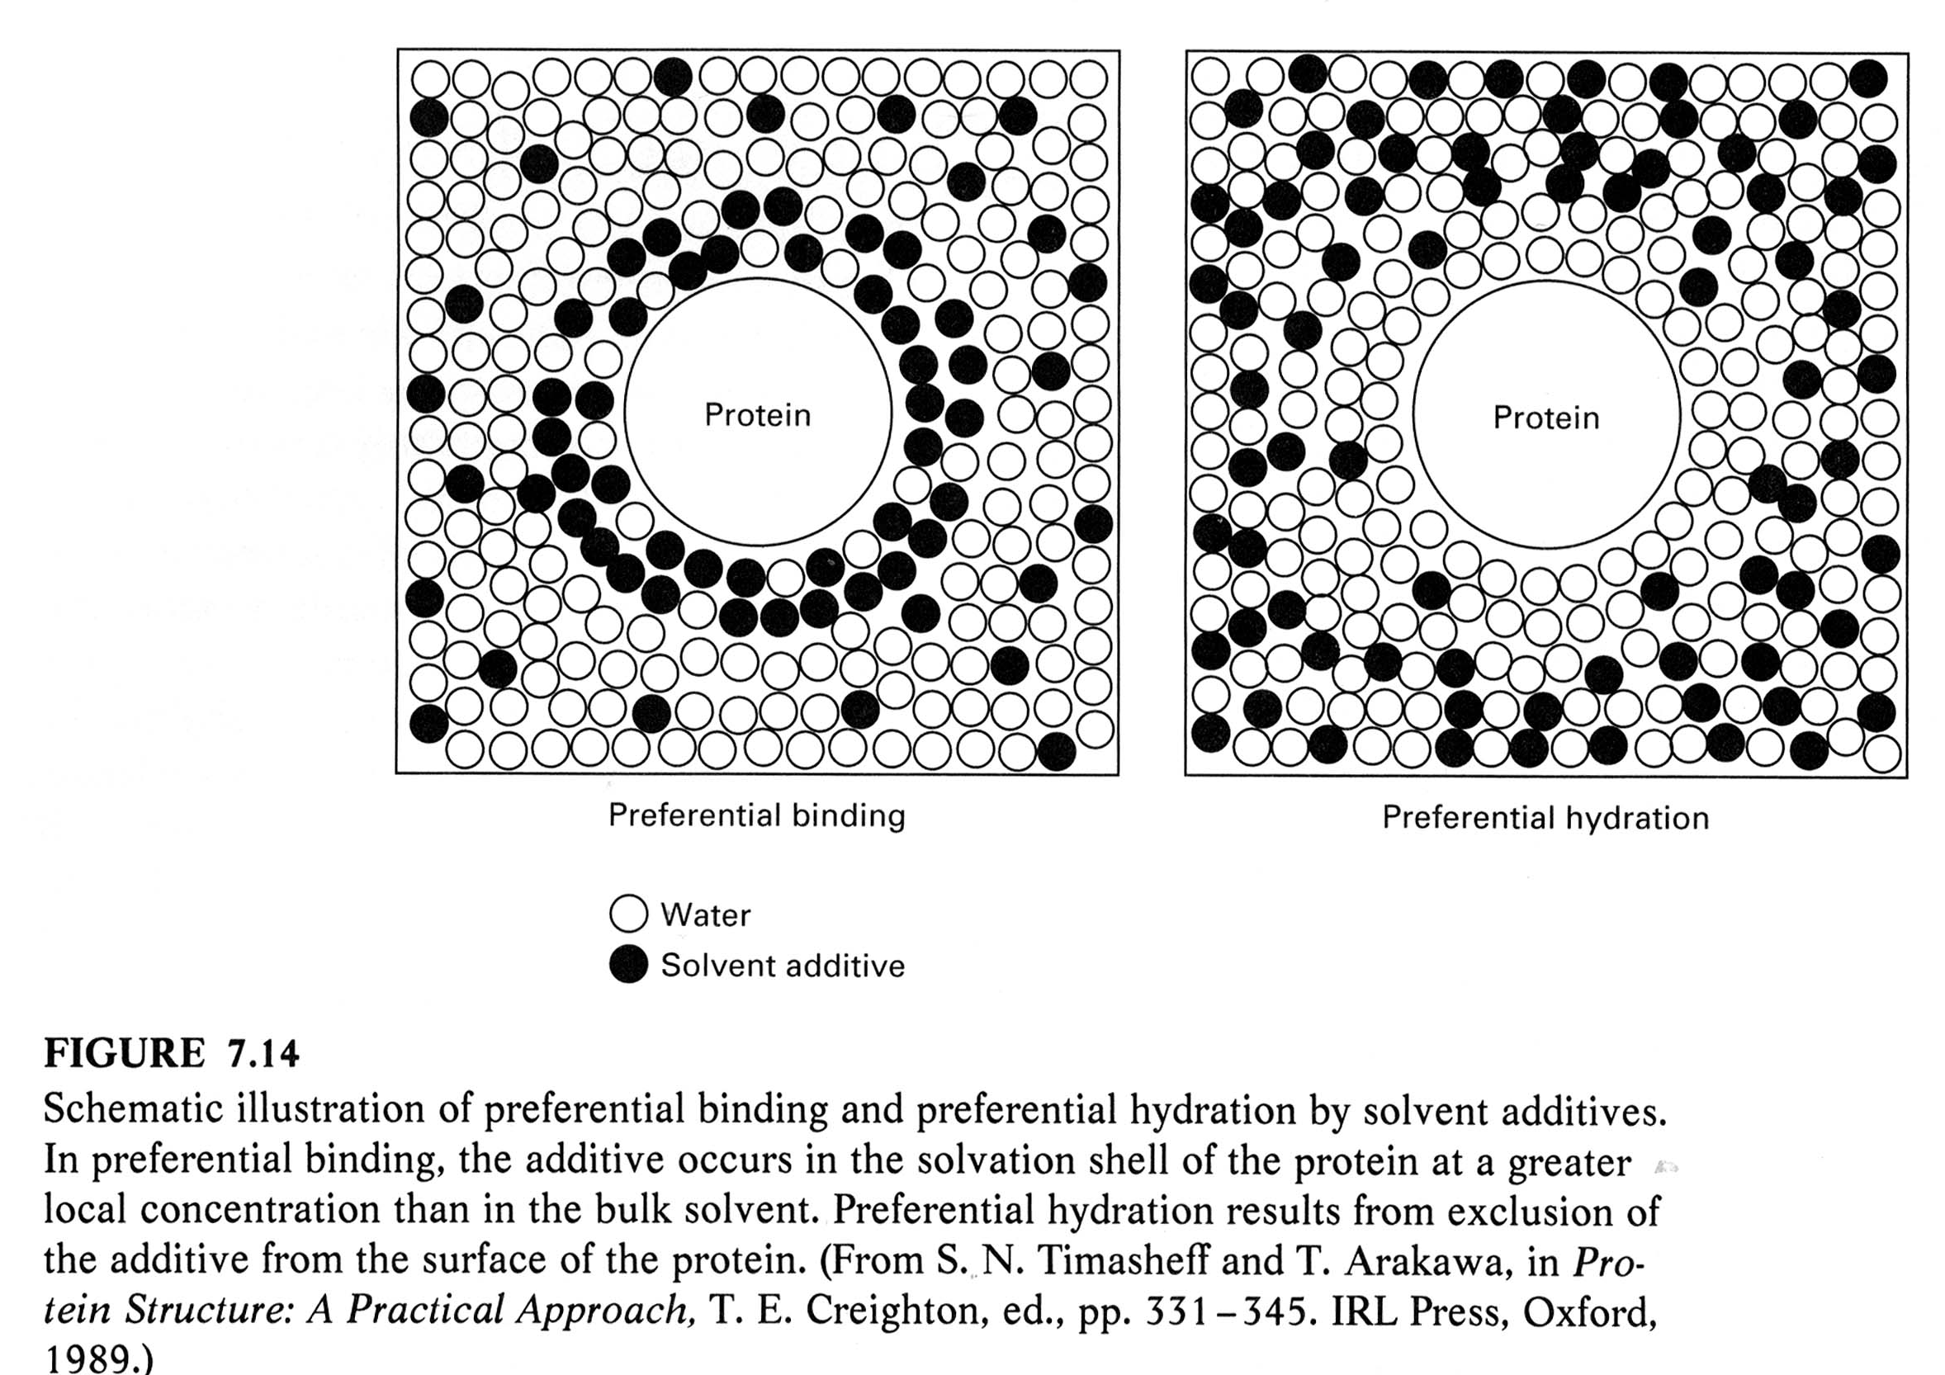
Denaturants

Slide 46
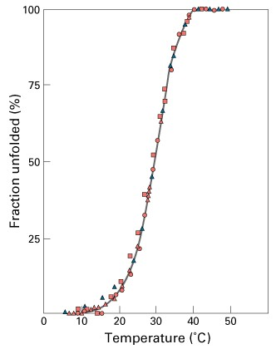
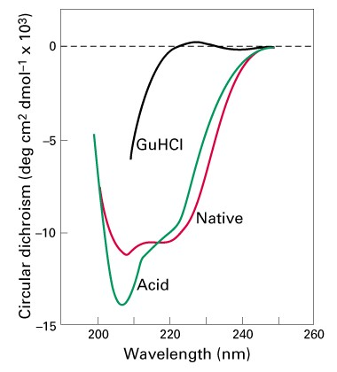
Two-state Unfolding of Protein
Keq=[N]/[U]= ( [θ]_{obs}- [θ]_{D})/( [θ]_{N}- [θ]_{D}) = F_{N}/(1- F_{N})
F_{N} = fraction folded

Slide 47
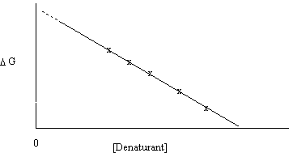
Denaturants
It is common to extrapolate the data for the unfolding transition as a function of denaturant to 0 M to give the value in water (e.g. G(H₂O)).
ΔG _{D-N} = ΔG ^{H20}_{D-N} - m _{D-N} [denaturant]
ΔG ^{H20}_{D-N} is about –5 to –10 kcal/mol
The extrapolation can have large errors.

Slide 48
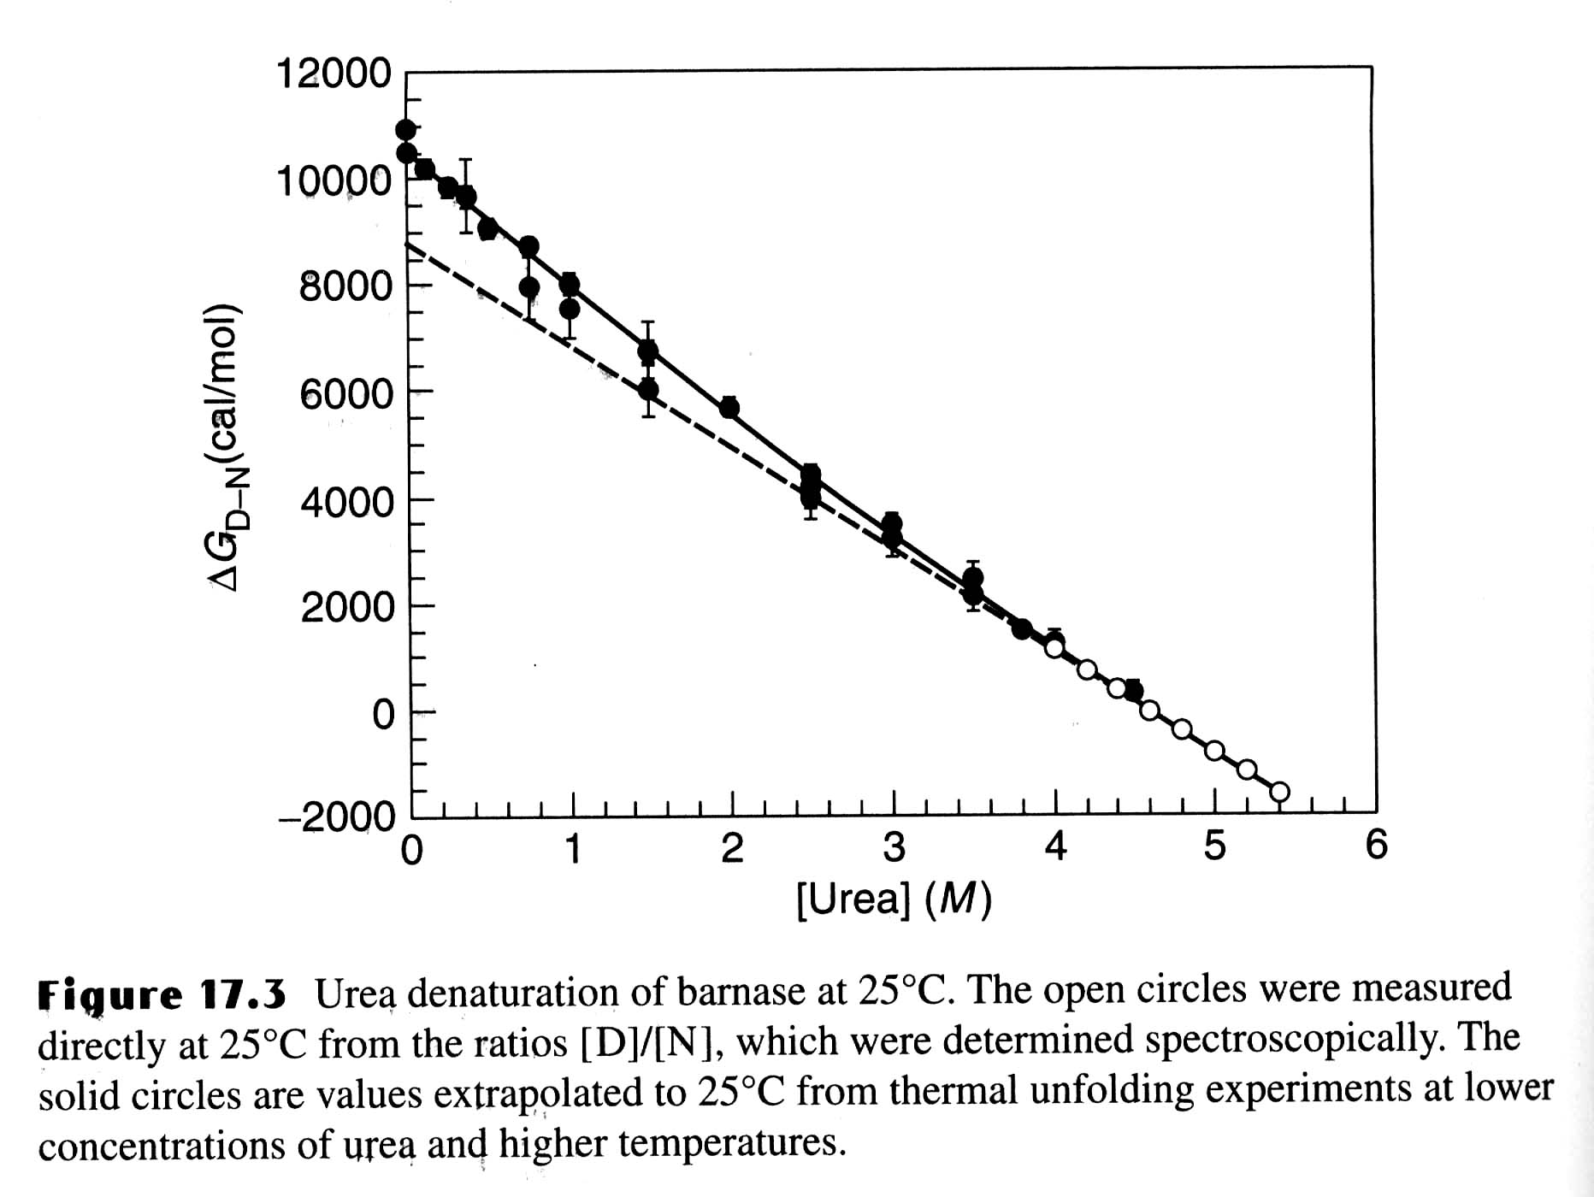
Urea Unfolding of Barnase

Slide 49
m - value
m-value reflects the dependence of the free energy on denaturant concentration
  Typically for urea m ~ 1 kcal/mol
  For GuHCl m ~ 3 kcal/mol
The variation in slope (m) is believed to be due to change in the solvent accessible area of hydrophobic residues. The m-value is related to how cooperative the transition is, how much structure remains in the denatured state, perhaps how much denaturant binds to the unfolded state, etc.
It’s important to note that because of different values of m, two proteins that have Cm is such that one may appear more stable, but, in fact, the opposite is true in the stability (based on ΔG ^{H20}_{D-N}).

Slide 50
Thermal Denaturation
The effects of temperature on protein structure have been, and are, controversial, since most proteins can show the phenomenon of cold denaturation, under appropriate conditions!
Disruption of hydrogen bonding and increasing hydrophobicity occurs with thermal denaturation.

Slide 51
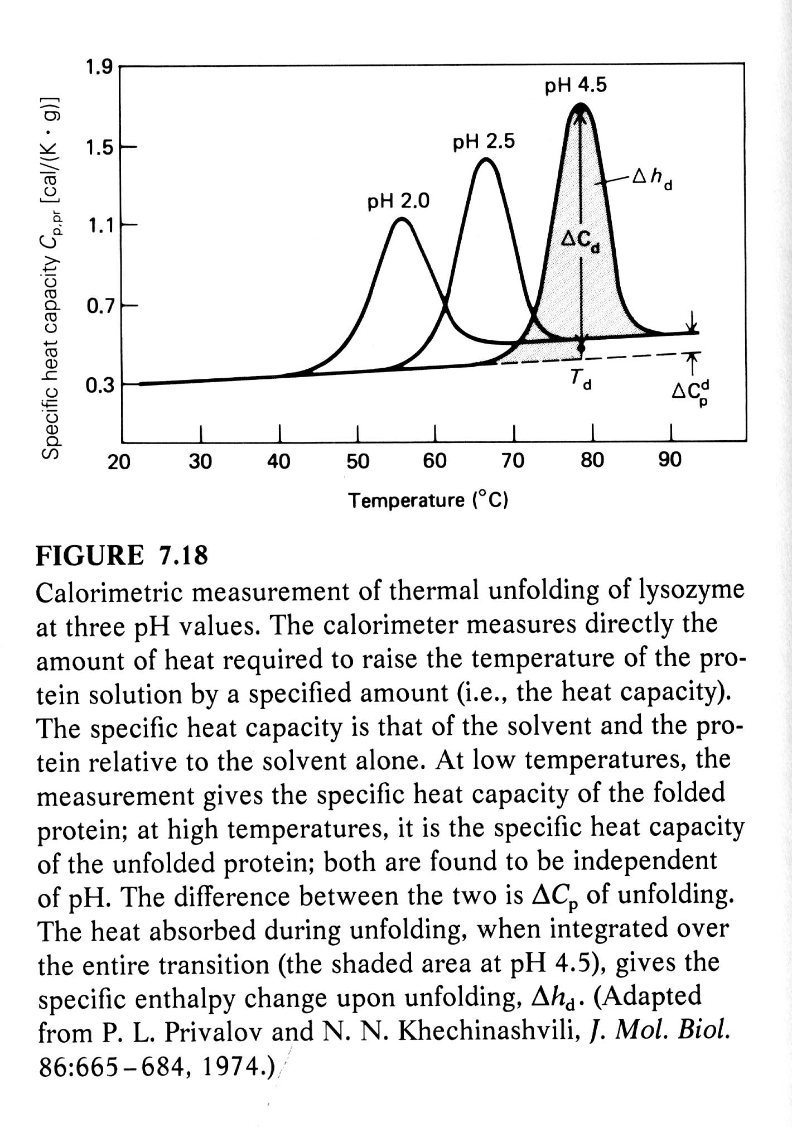
Differential Scanning Calorimetry (DSC)
DSC measures the heat required to raise the temperature of the solution of macromolecules relative to that required to the buffer alone (heat obtained by substracting two large numbers).
DSC can be used to directly measure the enthalpy and melting temperature of a thermally induced transition.
At Tm (50% unfolded),
ΔG = 0, ΔH = TΔS

Slide 52
Thermal Denaturation
It is generally assumed that Cp is constant with respect to temperature. However, Privalov observed that that Cp was positive for denaturation, i.e. the heat capacity Cp was greater for the unfolded state than the folded state.
Cp = H/T = TS/T
It is probably the change in ordered water structure between the native and denatured states which accounts, at least in part, for the change in Cp.

Slide 53
Thermal Denaturation
The Van't Hoff eq: dlnK/d(1/T) = -H/R
Van't Hoff plots (lnK vs. 1/T) of the thermal denaturation of proteins are non-linear, indicating that H varies with temperature.
This implies that the heat capacity for the folded and unfolded proteins are different!
ΔH/ΔT = Cp = (Cp_{U} - Cp_{N})
Since H = Ho + Cp(T-T_{o}), S = So + Cp ln(T/T_{o})
and G(T) = Ho - T S_{o} + Cp [(T - T_{o}) - Tln(T/T_{o} )]
where T₀ is any reference temperature (usually set = Tm).
The Gibbs Helmholz equation.
G(T) = Hm(1-T/Tm) - Cp[(Tm - T) + Tln(T/Tm)]
The temperature where S = 0, Ts = Tm exp(-Hm/[TmCp])

Slide 54
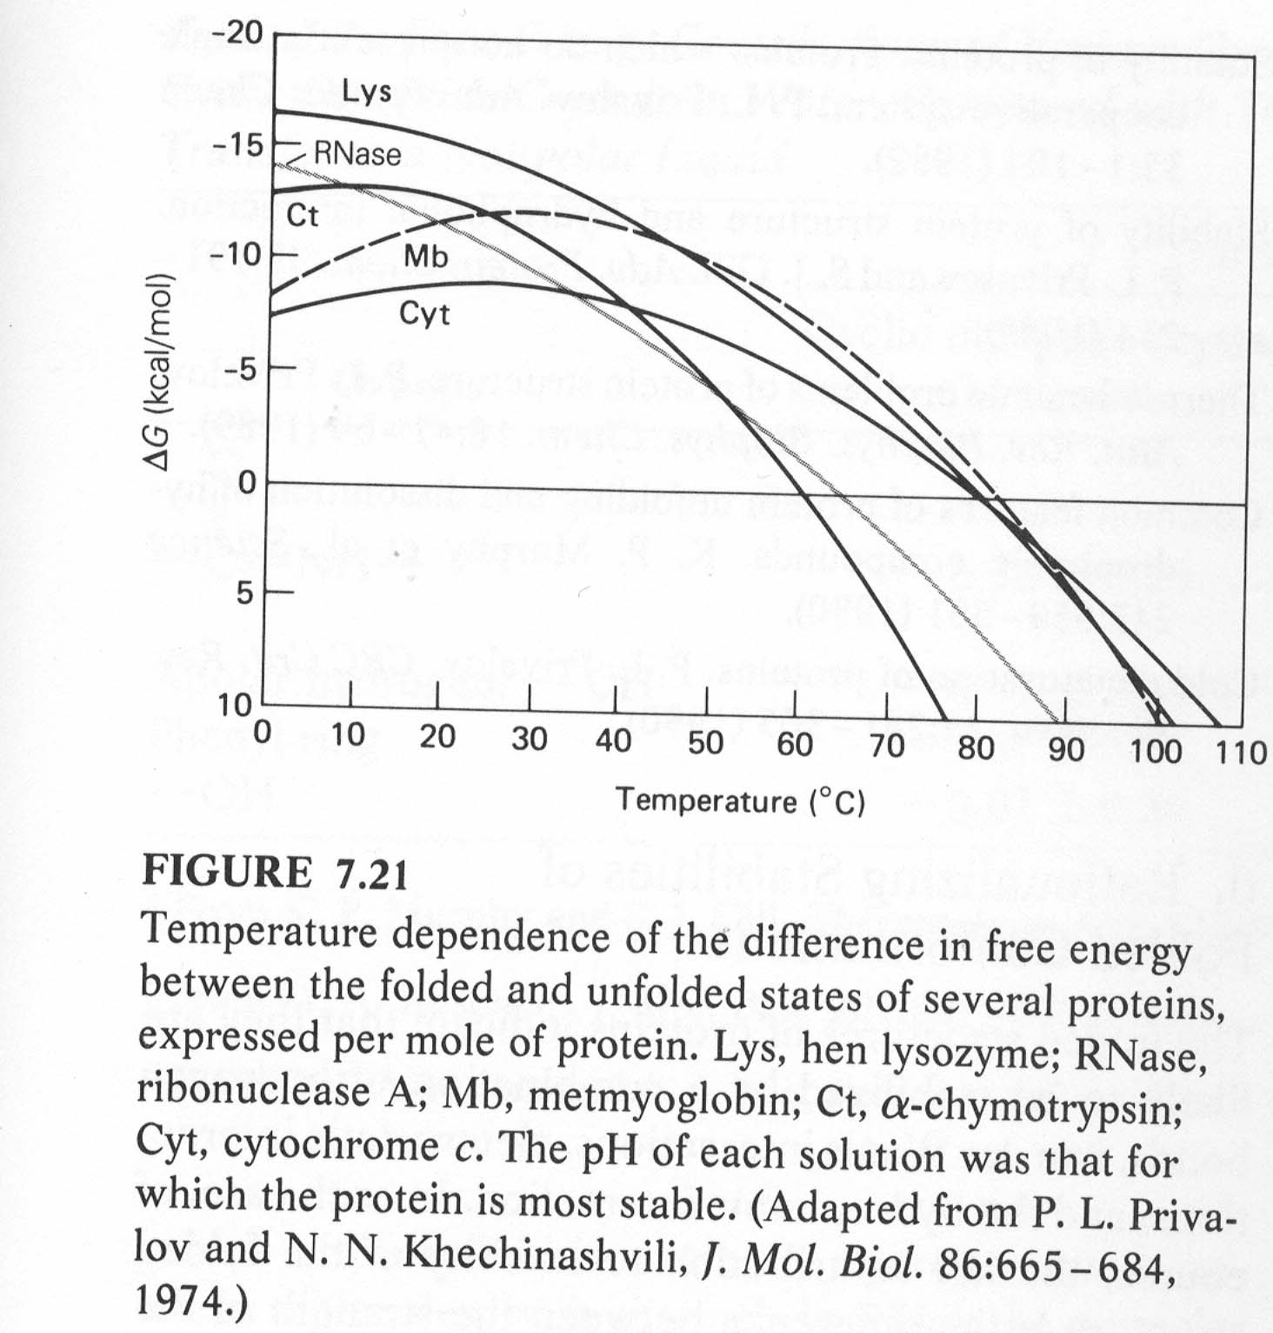

Slide 55
Thermal Denaturation
There are two important forms of enthalpy as far as protein unfolding is concerned,
  the Van't Hoff enthalpy, from the temperature dependence of the equilibrium constant, ΔH_{VH},
  and the enthalpy measured calorimetrically (the area under the peak), ΔH_{cal}.
If these are equal, it means there are no populated intermediates present at the Tm, i. e. the system is a two-state one.
For most proteins ΔH_{VH}/Δh_{cal} = 1.05 ± 0.03 for two-state.

Slide 56
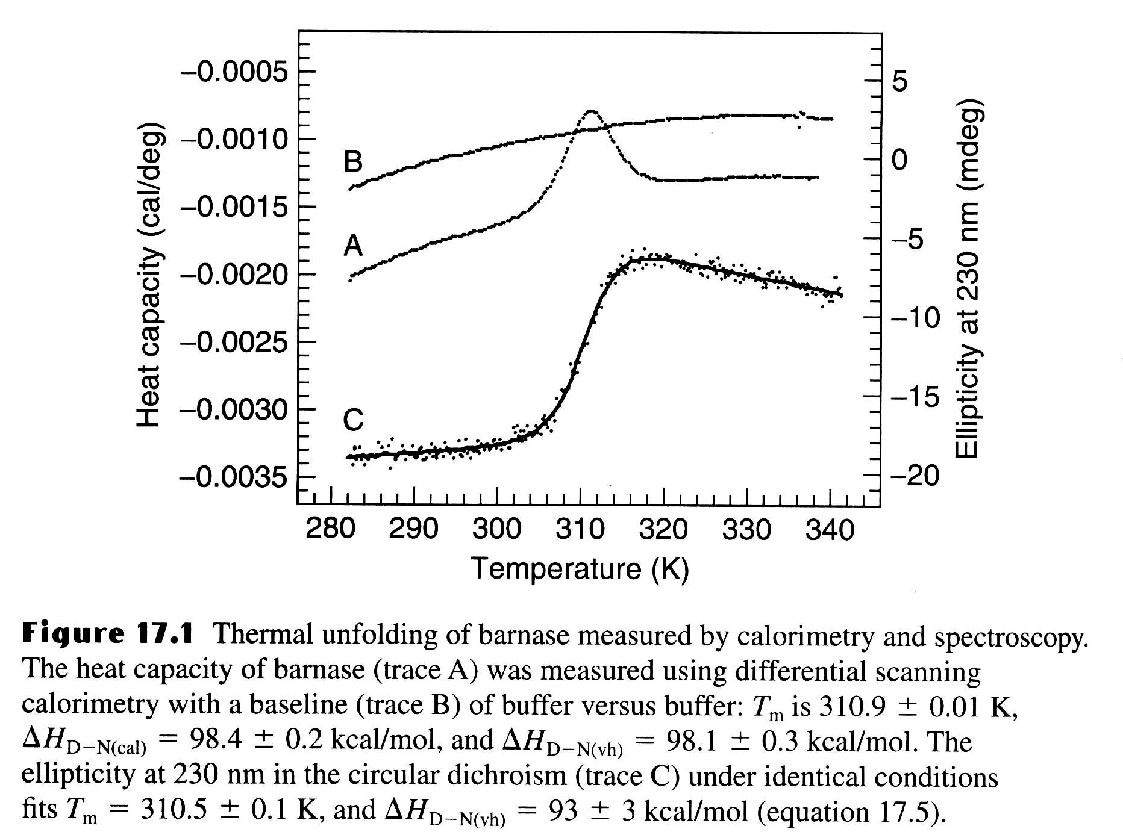
Thermal Unfolding of Barnase

Slide 57
Thermophilic Proteins
Living organisms can be found in the most unexpected places, including deep sea vents at > 100 ºC and several hundred bars pressure, in hot springs, and most recently, deep in the bowels of the earth, living off H₂ formed by chemical decomposition of rocks!
The proteins found in thermophilic species are much more stable than their mesophilic counterparts (although this corresponds to only 3 - 8 kcal/mol of free energy).
However, the overall three-dimensional structures will be essentially the same for both thermophilic and mesophilic proteins.
It only takes stability of a couple of H-bonds, you can understand why there are no gross differences in structure between thermophilic and mesophilic proteins.
The upper limit of temperature growth for bacteria is about 110 º C.
Many of the species found in these extreme environments
(T > 100C, pH 2) belong to the Archeae kingdom.

Slide 58
Thermophilic vs Mesophilic Proteins
Thermophilic proteins have increased amounts of Arg, increased occurrence of Ala in helices, and Gly/Ala substitutions (which affect the entropy of the denatured state, and thus its free energy) and increased number of salt bridges.
Each of these alone makes only a small effect, but several such changes are enough. In general, it appears that there is no single determinant of increased thermal stability; each protein is a unique case, typically involving variations in hydrophobic interactions, H-bonds, electrostatic interactions, metal-ligand (e. g. Ca²⁺) binding, and disulfide bonds. There is some suggestion that better packing may also play a role.

Slide 59
Stability-activity Trade-off?
Some enzymes from thermophiles that are very stable at normal temperatures have low activities at the lower temperatures.
There are is a compromise between the stability and activity in the structure of the active site of a protein.
There are several positions in the active site can be mutated to give more stable but less active protein.
Activity can then be increased further at an unacceptable expense to stability.
Active site of enzymes and binding sites of proteins are a general source of instability, because they contain groups that are exposed to solvent in order to bind substrates and ligands, and so are not paired with their normal types of partners.

Slide 60
Aldehyde Ferredoxin Oxidoreductase
The crystal structure of an unusual hyperthermophilic enzyme, aldehyde ferredoxin oxidoreductase, a tungsten-containing enzyme, has been solved.
The optimum temperature for this enzyme is > 95° C!! The amino acid composition is close to the average for all prokaryotic proteins except glutamine. It is 45 % helical, 14 % β sheet. There are no disulfide bonds.
As observed with many other thermophilic proteins there may be an increased number of salt bridges.
What may be significant is that the solvent accessible area is reduced, although the fraction of polar/hydrophobic is similar to other proteins.

Slide 61
Cold Denaturation
The free energy curve starts to drop at lower temperatures as predicted by the thermodynamics of protein folding.
In the past few years, several proteins have been shown to exhibit cold denaturation under destabilizing conditions, in usually either low pH or moderate denaturant concentration.
Fink, A. L. observed a cold Denaturation for a Staphylococcal Nuclease Mutant under neutral pH and no-denaturant conditions.

Slide 62
Factors Affecting Protein Stability
1) pH: proteins are most stable in the vicinity of their isoelectric point, pI. In general, electrostatic interactions are believed to contribute to a small amount of the stability of the native state; however, there may be exceptions.
2) Ligand binding: It has been known for a long time that binding ligands, e.g. inhibitors to enzymes, increases the stability of the protein. This also applies to ion binding --- many proteins bind anions in their functional sites.

Slide 63
Factors Affecting Protein Stability
3) Disulfide bonds: It was observed that many extracellular proteins contained disulfide bonds; whereas intracellular proteins usually did not exhibit disulfide bonds.
In addition, for many proteins, if their disulfides are broken (i.e. reduced) and then carboxymethylated with iodoacetate, the resulting protein is denatured, i.e. unfolded, or mostly unfolded.
Disulfide bonds are believed to increase the stability of the native state by decreasing the conformational entropy of the unfolded state due to the conformational constraints imposed by cross-linking (i. e. decreasing the free energy of the unfolded state). Most protein have "loops" introduced by disulfides of about 15 residues, but rarely more than 25.

Slide 64
Factors Affecting Protein Stability
4) Not all residues make equal contributions to protein stability. In fact, it makes sense that interior ones, inaccessible to the solvent in the native state, should make a much greater contribution than those on the surface, which will also be solvent accessible in the unfolded state.
Proteins are very malleable, i.e. a mutation at a particular residue tends to be accommodated by changes in the position of adjacent residues, with little further propagation.

Slide 65
Denatured States
If the denatured state involves most residues in a fully extended peptide chain conformation, i. e. maximal solvent exposure, then substitutions involving solvent-exposed residues in the native state will have limited effect.
If, on the other hand, the denatured state have considerable residual structure, then it is also possible that mutations may affect the conformation and free energy of the unfolded state; in extreme cases, perhaps only the denatured state and not the native state!

Slide 66
m-value
wt
m+
m-
The m-value changes can be used to understand the nature of denatured state.
The effect of mutations to the protein stability can be estimated using the change of ΔG ^{H20}_{D-N}
For some of the mutation, the m-value is changed. The different m-values related to the difference between the number of molecules of solvent bound in the native vs. denatured state. Since for the folded stated we have similar structure, the number of solvent molecules bound to the folded state is about the same, and the m-value difference reflects the different distribution of denatured state.
=> more or less exposure of hydrophobic residues.

Slide 67
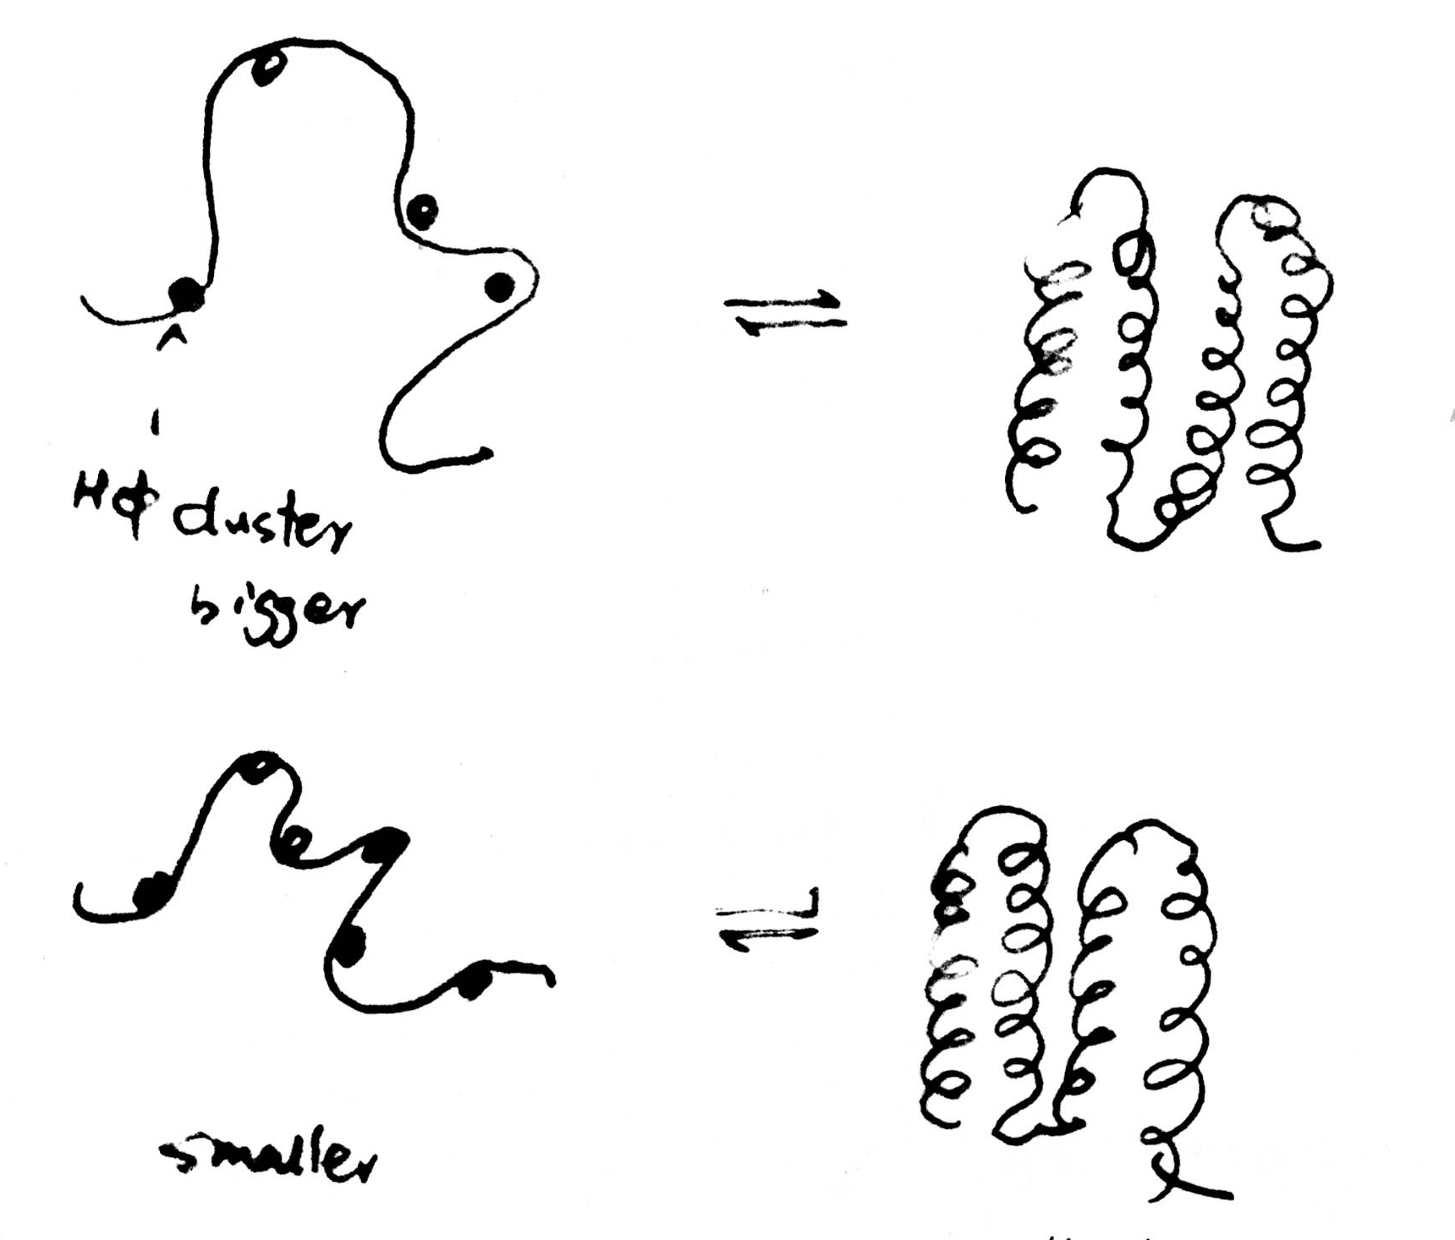
Different Unfolded States
m+ mutant has a more exposed unfolded state than that of m- mutant.
m+ mutant
M- mutant
smallest

Slide 68
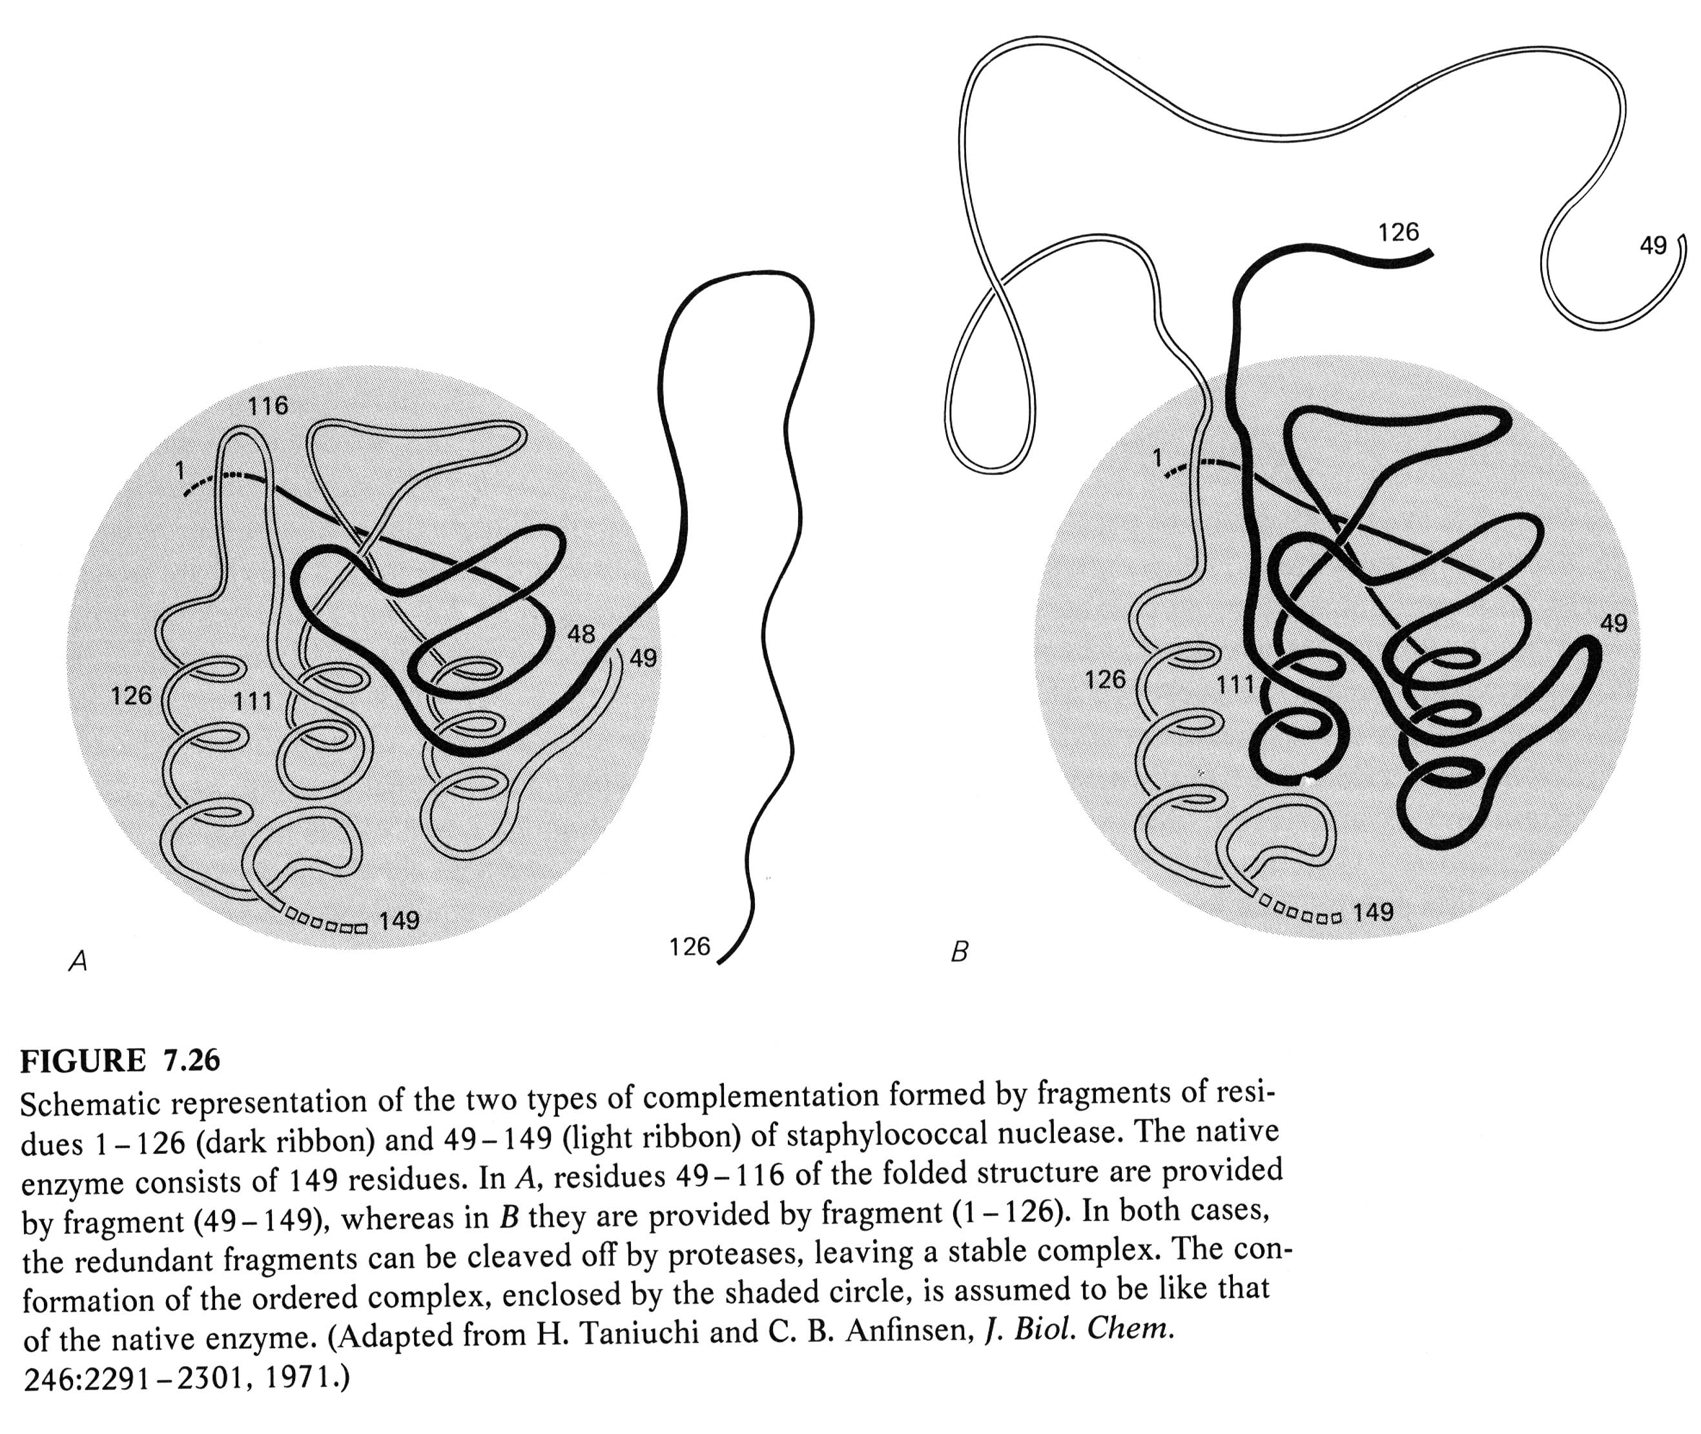

Slide 69
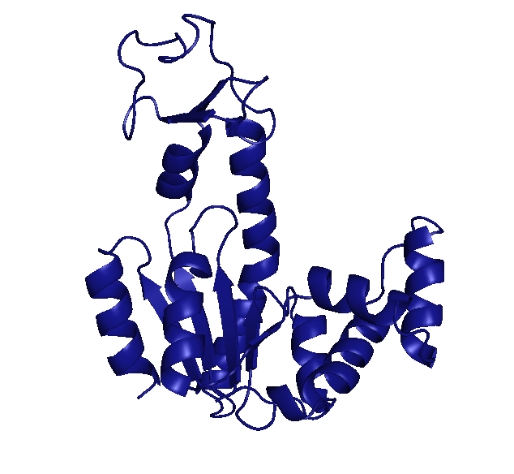
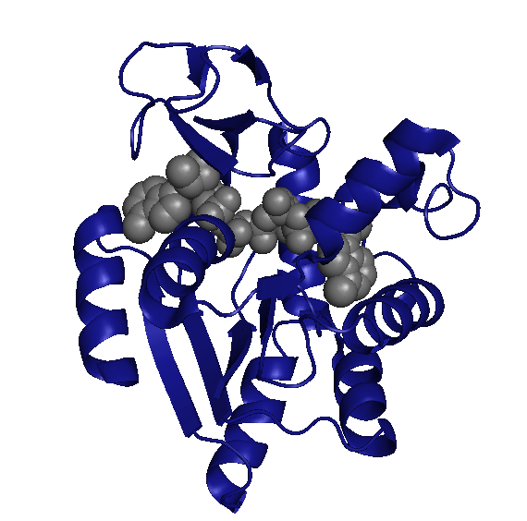
Numbers Matter
10
1
0.1
E
ΔG
ΔG
ΔG
0
0
0
1
2
3
1
2
3
1
2
3
1
2
3
Conformation
Conformation
Conformation
Conformation
1
0.9999
1
1
P
P
P
0.0001
~0
0
0
0
1
2
3
1
2
3
1
2
3
Conformation
Conformation
Conformation
X-ray crystallographically accessible

Slide 70
Numbers Matter
10
1
0.1
ΔG
ΔG
ΔG
0
0
0
1
2
3
1
IDPs
2
3
1
2
3
Conformation
Conformation
Conformation
1
0.9999
1
1
P
P
P
0.0001
~0
0
0
0
1
2
3
1
2
3
1
2
3
Conformation
Conformation
Conformation

Slide 71
Numbers Matter
10
0.9999
1
0.10
P
P
P
0.0001
~0
0
0
0
1
2
3
1
2
3
1
2
3
Conformation
Conformation
Conformation
This is an eye!

