Slide 1
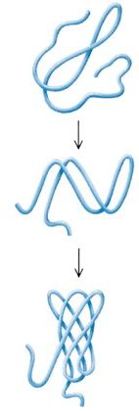
Protein Folding
Protein folding considers the question of how the process of protein folding occurs, i. e. how the unfolded protein adopts the native state.
This has proved to be a very challenging problem. It has aptly been described as the second half of the genetic code, and as the three-dimensional code, as opposed to the one-dimensional code involved in nucleotide/amino acid sequence.
Predict 3D structure from primary sequence
Avoid misfolding related to human diseases
Design proteins with novel functions

Slide 2
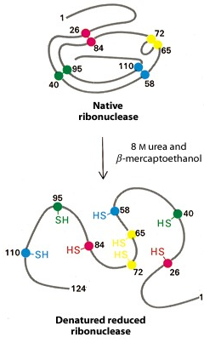
Anfinsen Experiment
Denaturation of ribunuclease A ( 4 disulfide bonds) with 8 M Urea containing β-mercaptoethanol to random coil, no activity

Slide 3
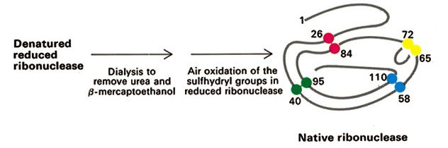
Anfinsen Experiment
After renaturation, the refolded protein has native activity despite the fact that there are 105 ways to renature the protein.
Conclusion: All the information necessary for folding the peptide chain into its native structure is contained in the primary amino acid sequence of the peptide.

Slide 4
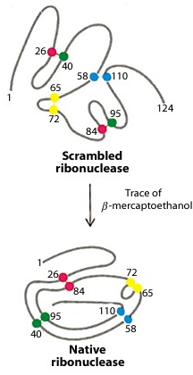
Anfinsen Experiment
Remove β-mercaptoethanol only, oxidation of the sulfhydryl group, then remove urea → scrambled protein, no activity
Further addition of trace amounts of β-mercaptoethanol converts the scrambled form into native form.
Conclusion: The native form of a protein has the thermodynamically most stable structure.

Slide 5
The Levinthal Paradox
There are vastly too many different possible conformations for a protein to fold by a random search.
Consider just for the peptide backbone, there are 3 conformations per amino acid in the unfolded state, For a 100 a.a. protein we have 3¹⁰⁰ conformations.
If the chain can sample 10¹² conformations/sec, it takes 5 x 10³⁵ sec (2 x 10²⁸ year)
Conclusion: Protein folding is not random, must have pathways.

Slide 6
Equilibrium Unfolding
switch off part of the interactions in the native protein under different denaturing conditions such as chemical denaturants, low pH, high salt and high temperature
understand which types of native structure can be preserved by the remaining interactions

Slide 7
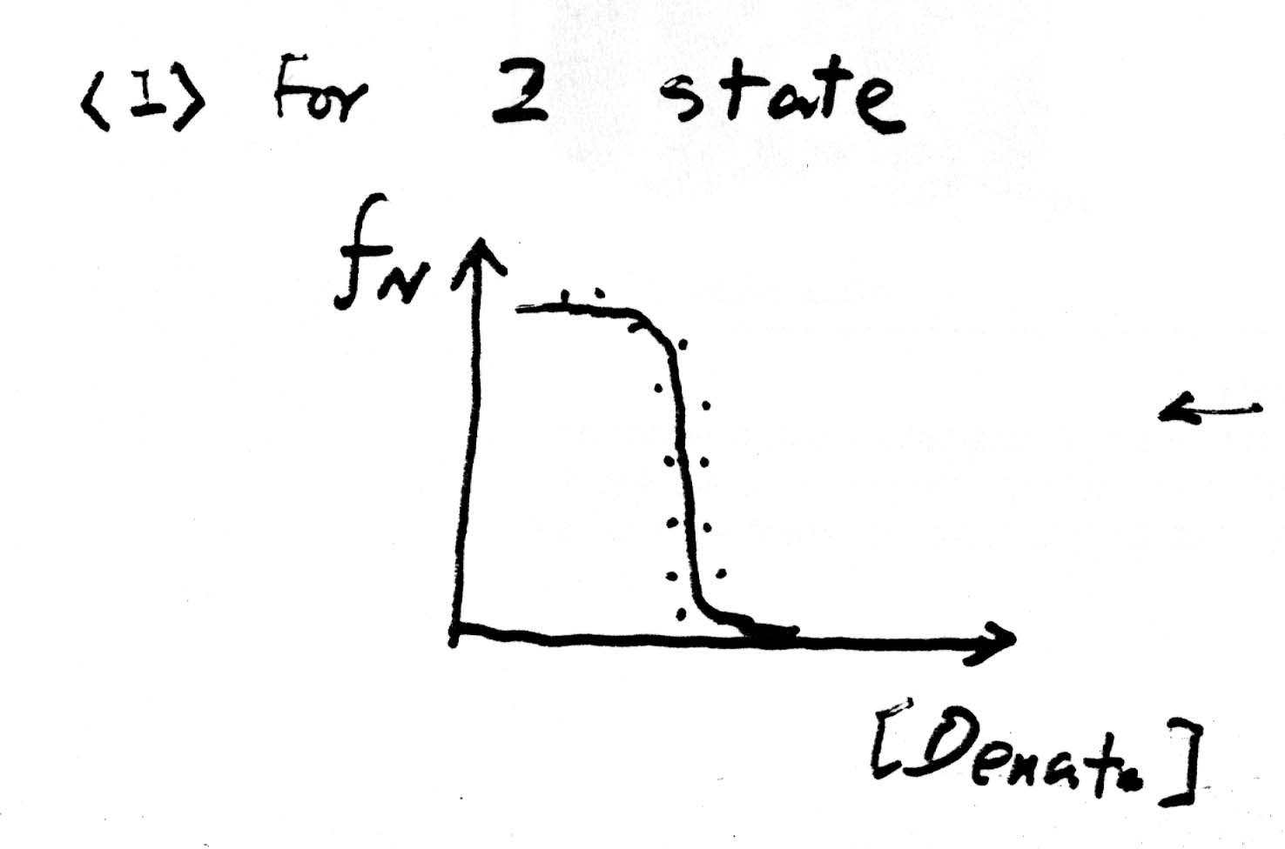
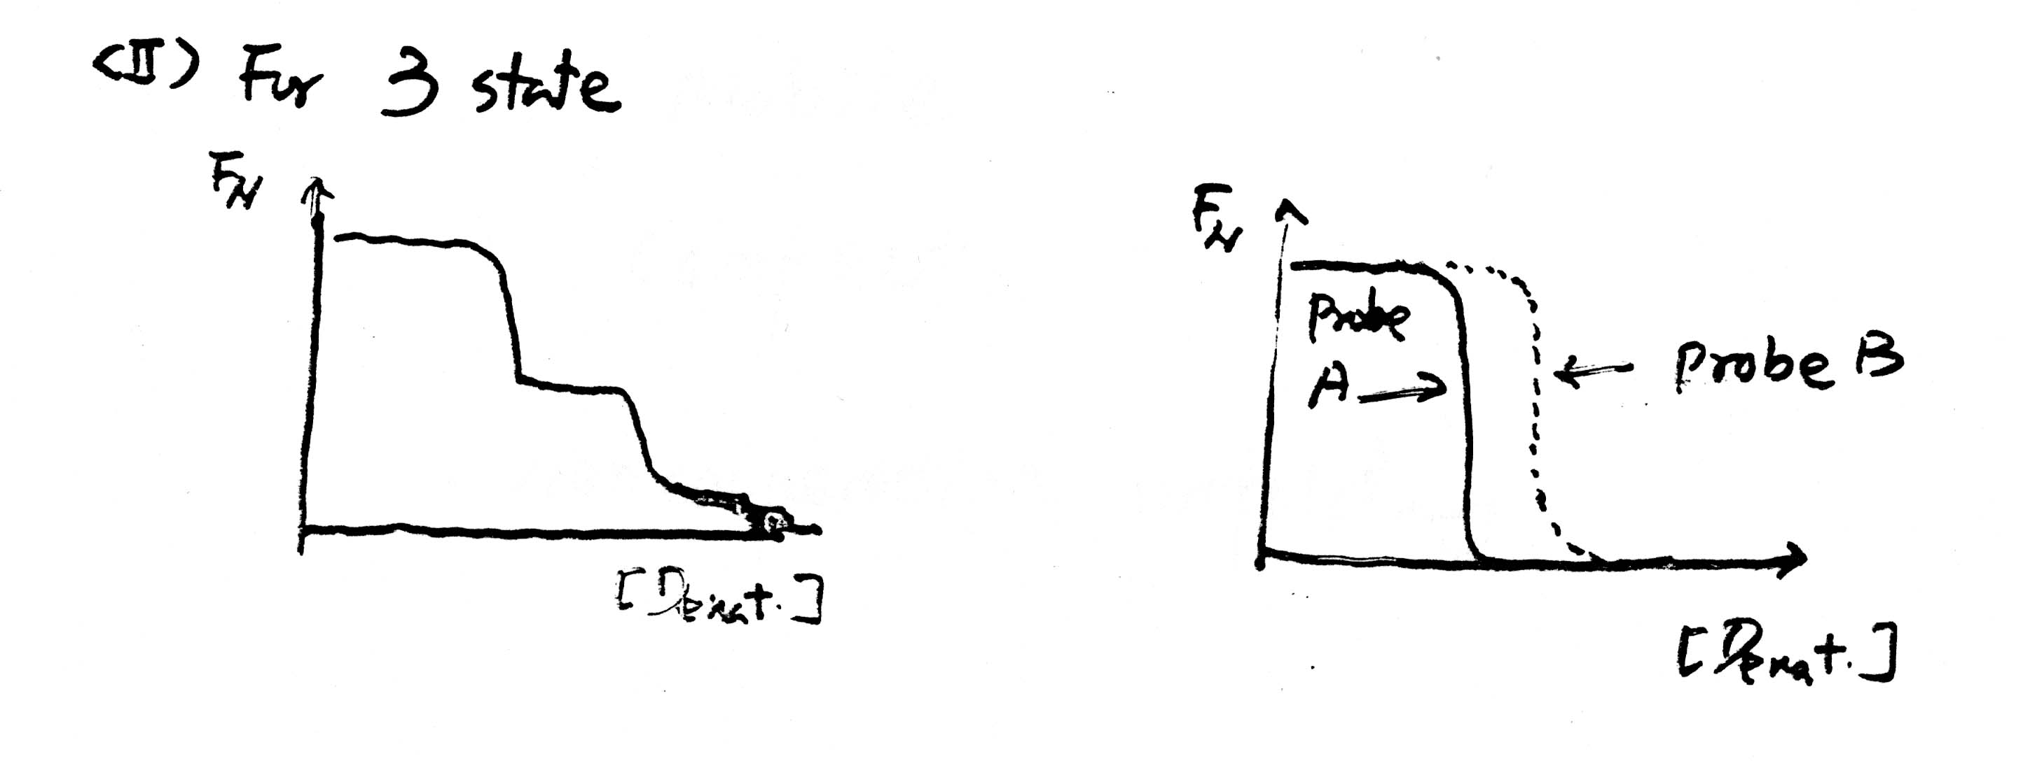
Equilibrium Unfolding
Using many probes to investigate the number of transitions during unfolding and folding
For 2-state unfolding, all probes give the same transition curves. Single domains or small proteins usually have two-state folding behavior.
For 3-state unfolding, there are more than one transitions or different probes have different transition curves

Slide 8
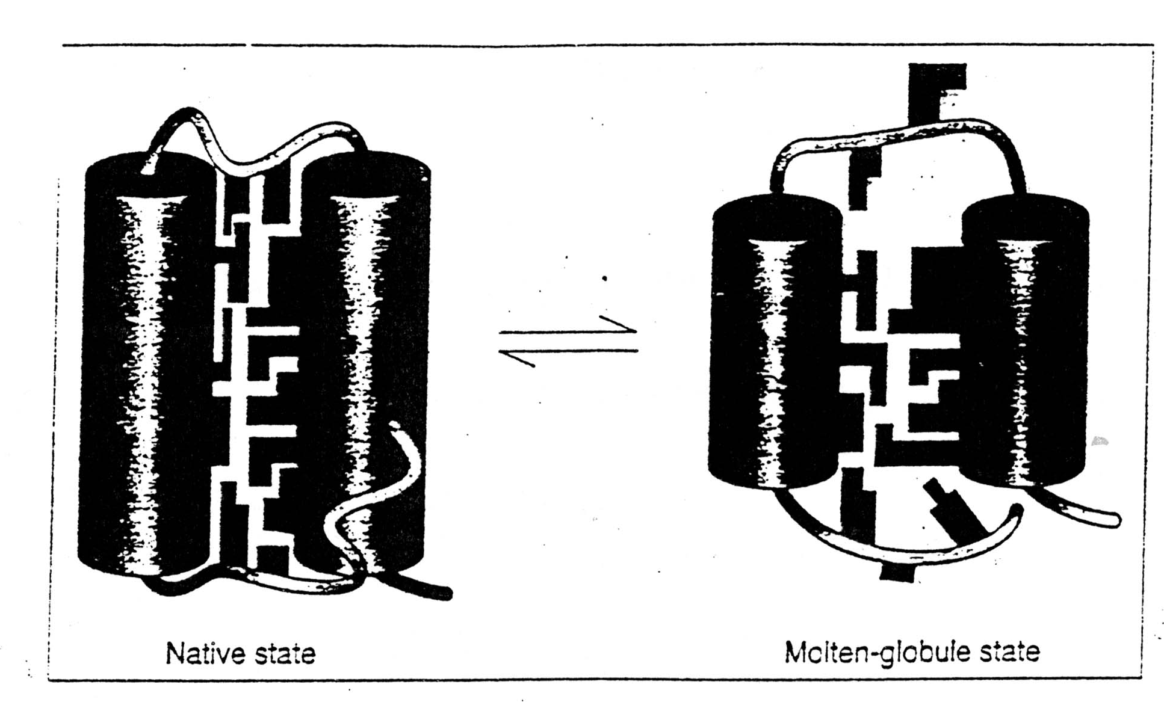
Molten Globule State (MG)
It is an intermediate of the folding transition U→MG→F
It is a compact globule, yet expanded over a native radius
Native-like secondary structure, can be measured by CD and NMR proton exchange rate
It has a slowly fluctuating tertiary structure which gives no detectable near UV CD signal and gives quenched fluorescence signal with broadened NMR chemical peaks
Non-specific assembly of secondary structure and hydrophobic interactions, which allows ANS to bind and gives an enhanced ANS fluorescence
MG is about a 10 % increase in size than the native state
8-Anilinonaphthalene-1-sulfonic acid

Slide 9
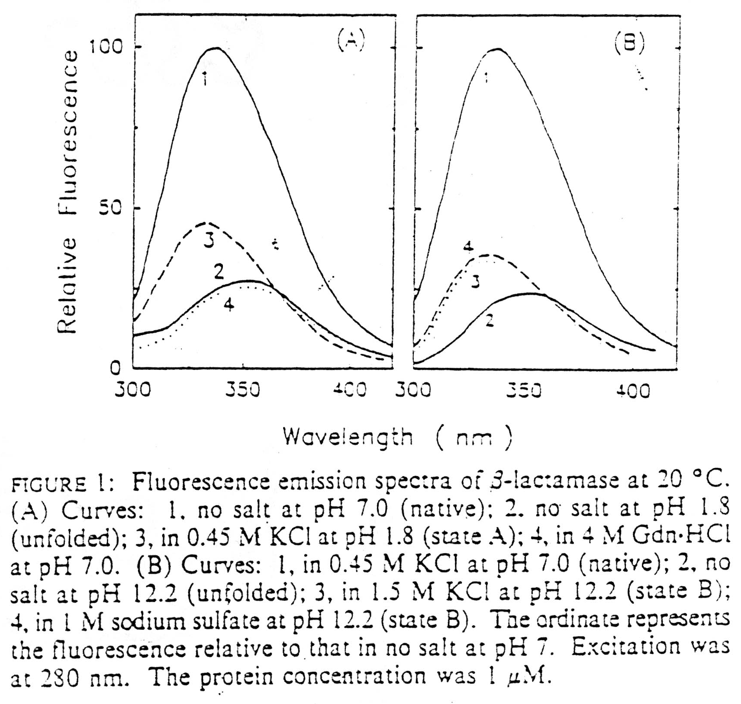
Fluorescence
A.
1 - native
3 - MG
2,4 - unfolded
B.
1 - native
3,4 - MG
2 - unfolded

Slide 10
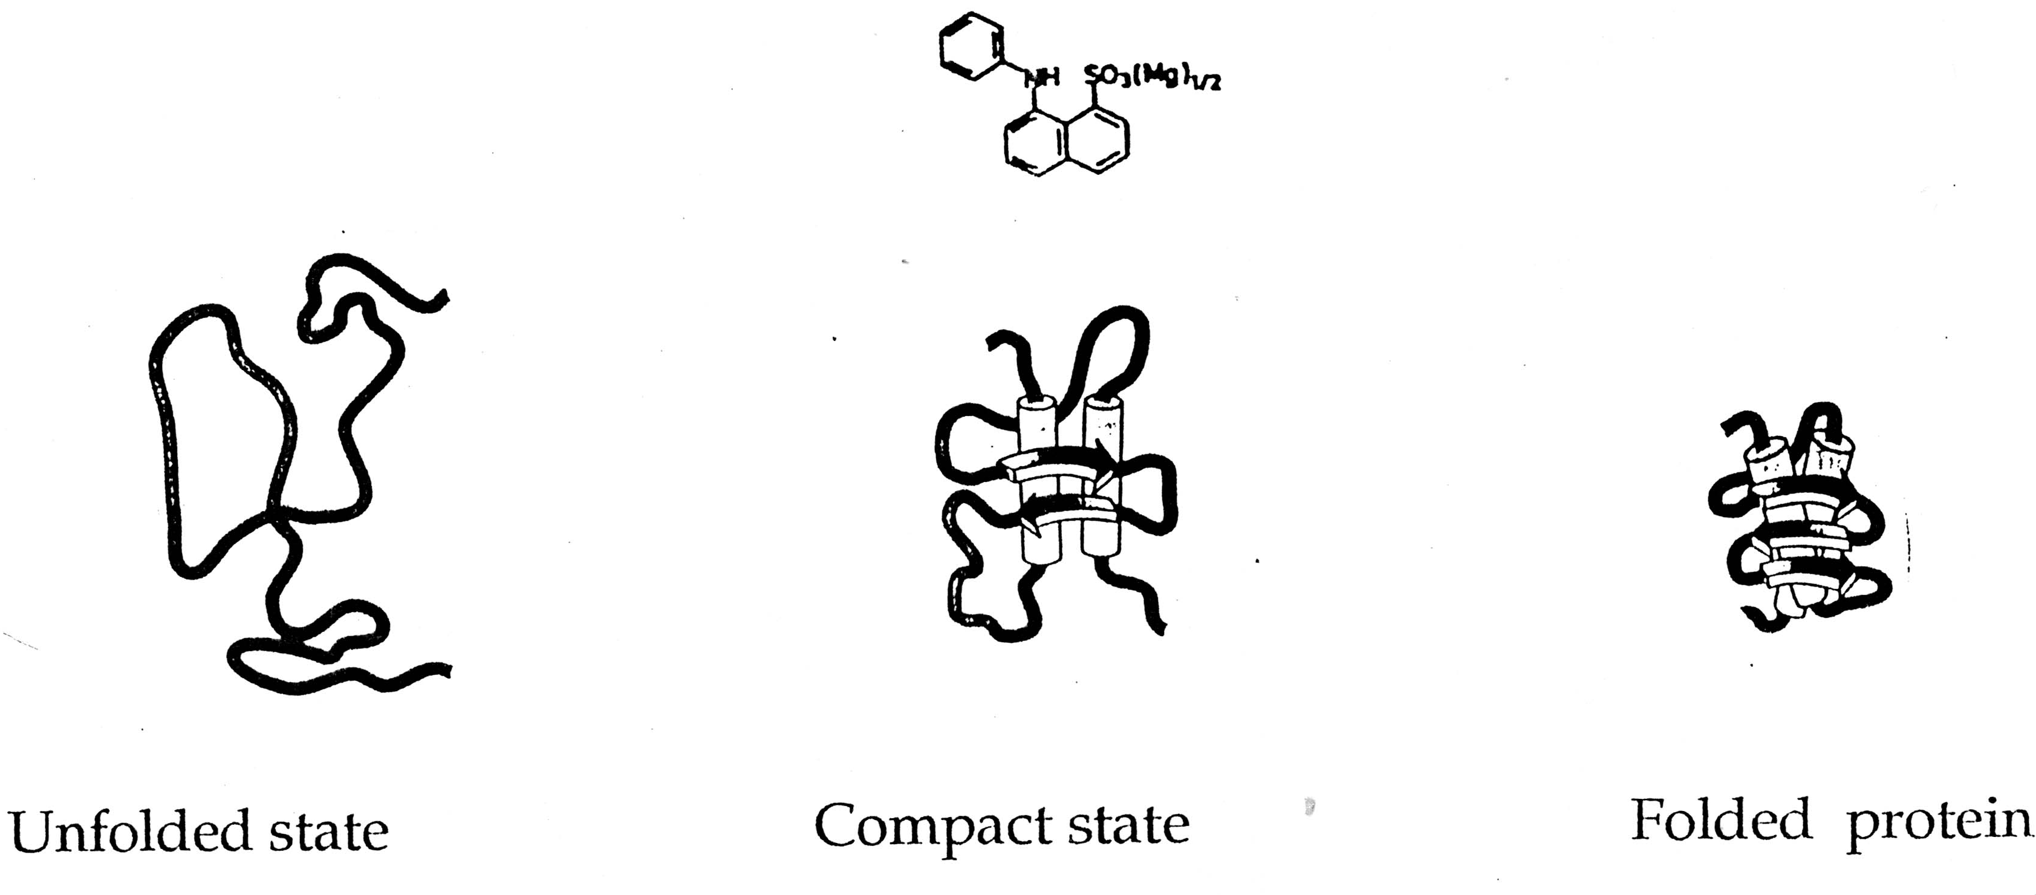
ANS has a Strong Affinity to the Hydrophobic Surface

Slide 11
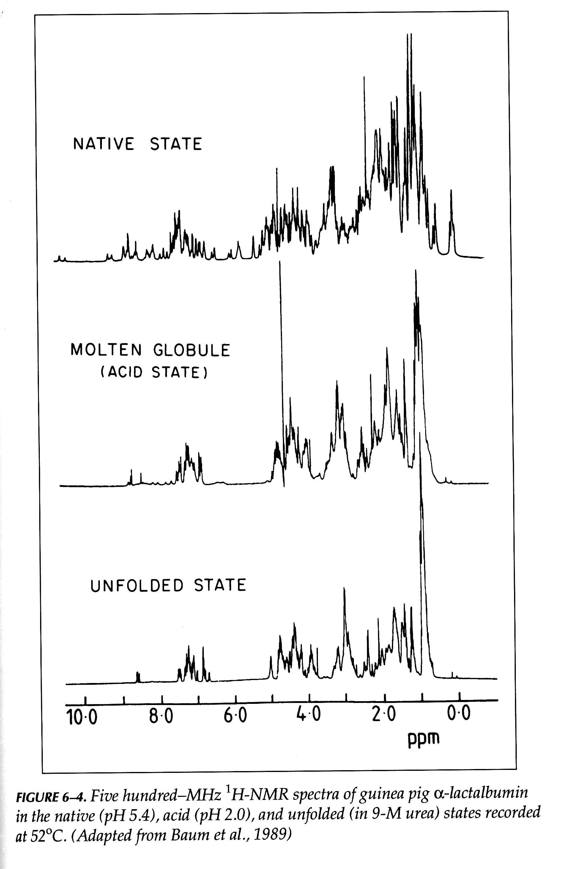
NMR of MG

Slide 12
Kinetic Folding Pathways
U→ I →II → N
Not all steps have the same rate constants.
Intermediates accumulate to relatively low concentrations, and always present as a mixture
Identify kinetic intermediates
Measuring the rate constants
Figure out the pathways
Slow folding
Formation of disulfile bond
Pro isomerization

Slide 13
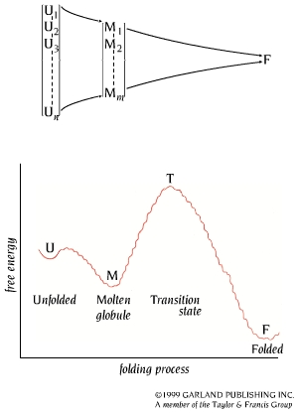
Unfolded State
The unfolded state is an ensemble of a large number of molecules with different conformations.

Slide 14
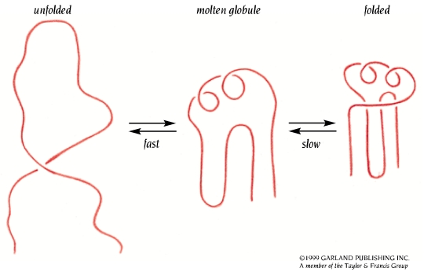
MG is a Key Kinetic Intermediate

Slide 15
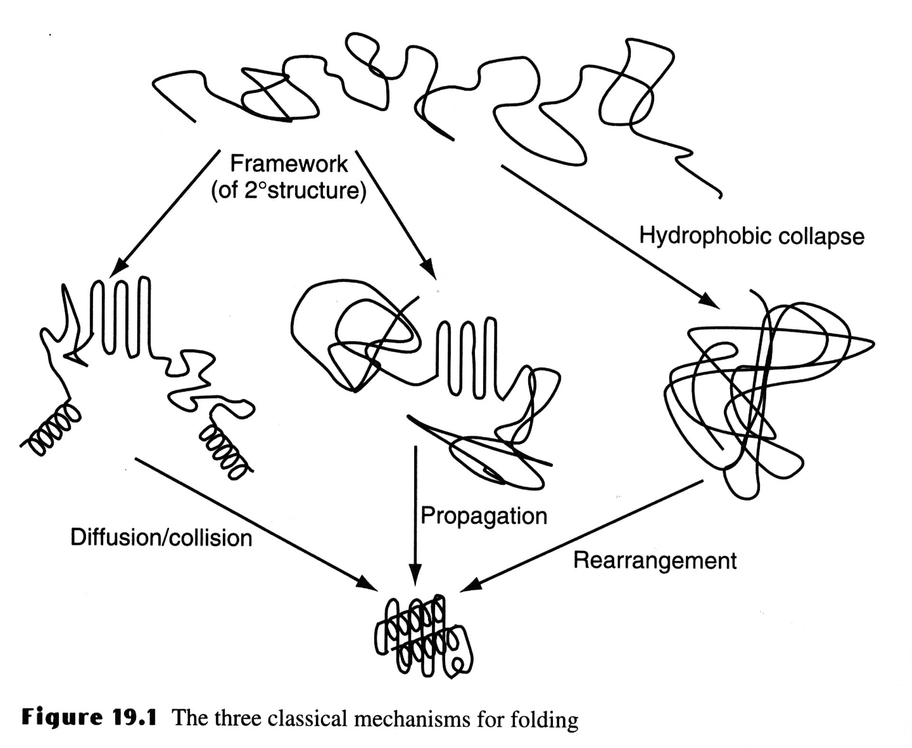
Three Classic Models of Protein Folding
The Framework model proposed that local elements of native local secondary structure could form independently of tertiary structure (Kim and Baldwin). These elements would diffuse until they collided, successfully adhering and coalescing to give the tertiary structure (diffusion-collision model)(Karplus & Weaver).

Slide 16
The classic Nucleation Model
The classic nucleation model postulated that some neighboring residues in the sequence would form native secondary structure that would act as a nucleus from which the native structure would propagate, in a stepwise manner. Thus, the tertiary structure would form as a necessary consequence of the secondary structure (Wetlaufer).

Slide 17
The hydrophobic-collapse Model
The hydrophobic-collapse
model hypothesized that a
protein would collapse
rapidly around its
hydrophobic sidechains
and then rearrange from
restricted conformational
space occupied by the
intermediate. Here the
secondary structure would
be directed by native-like
tertiary structure (Ptitsyn
& Kuwajima).

Slide 18
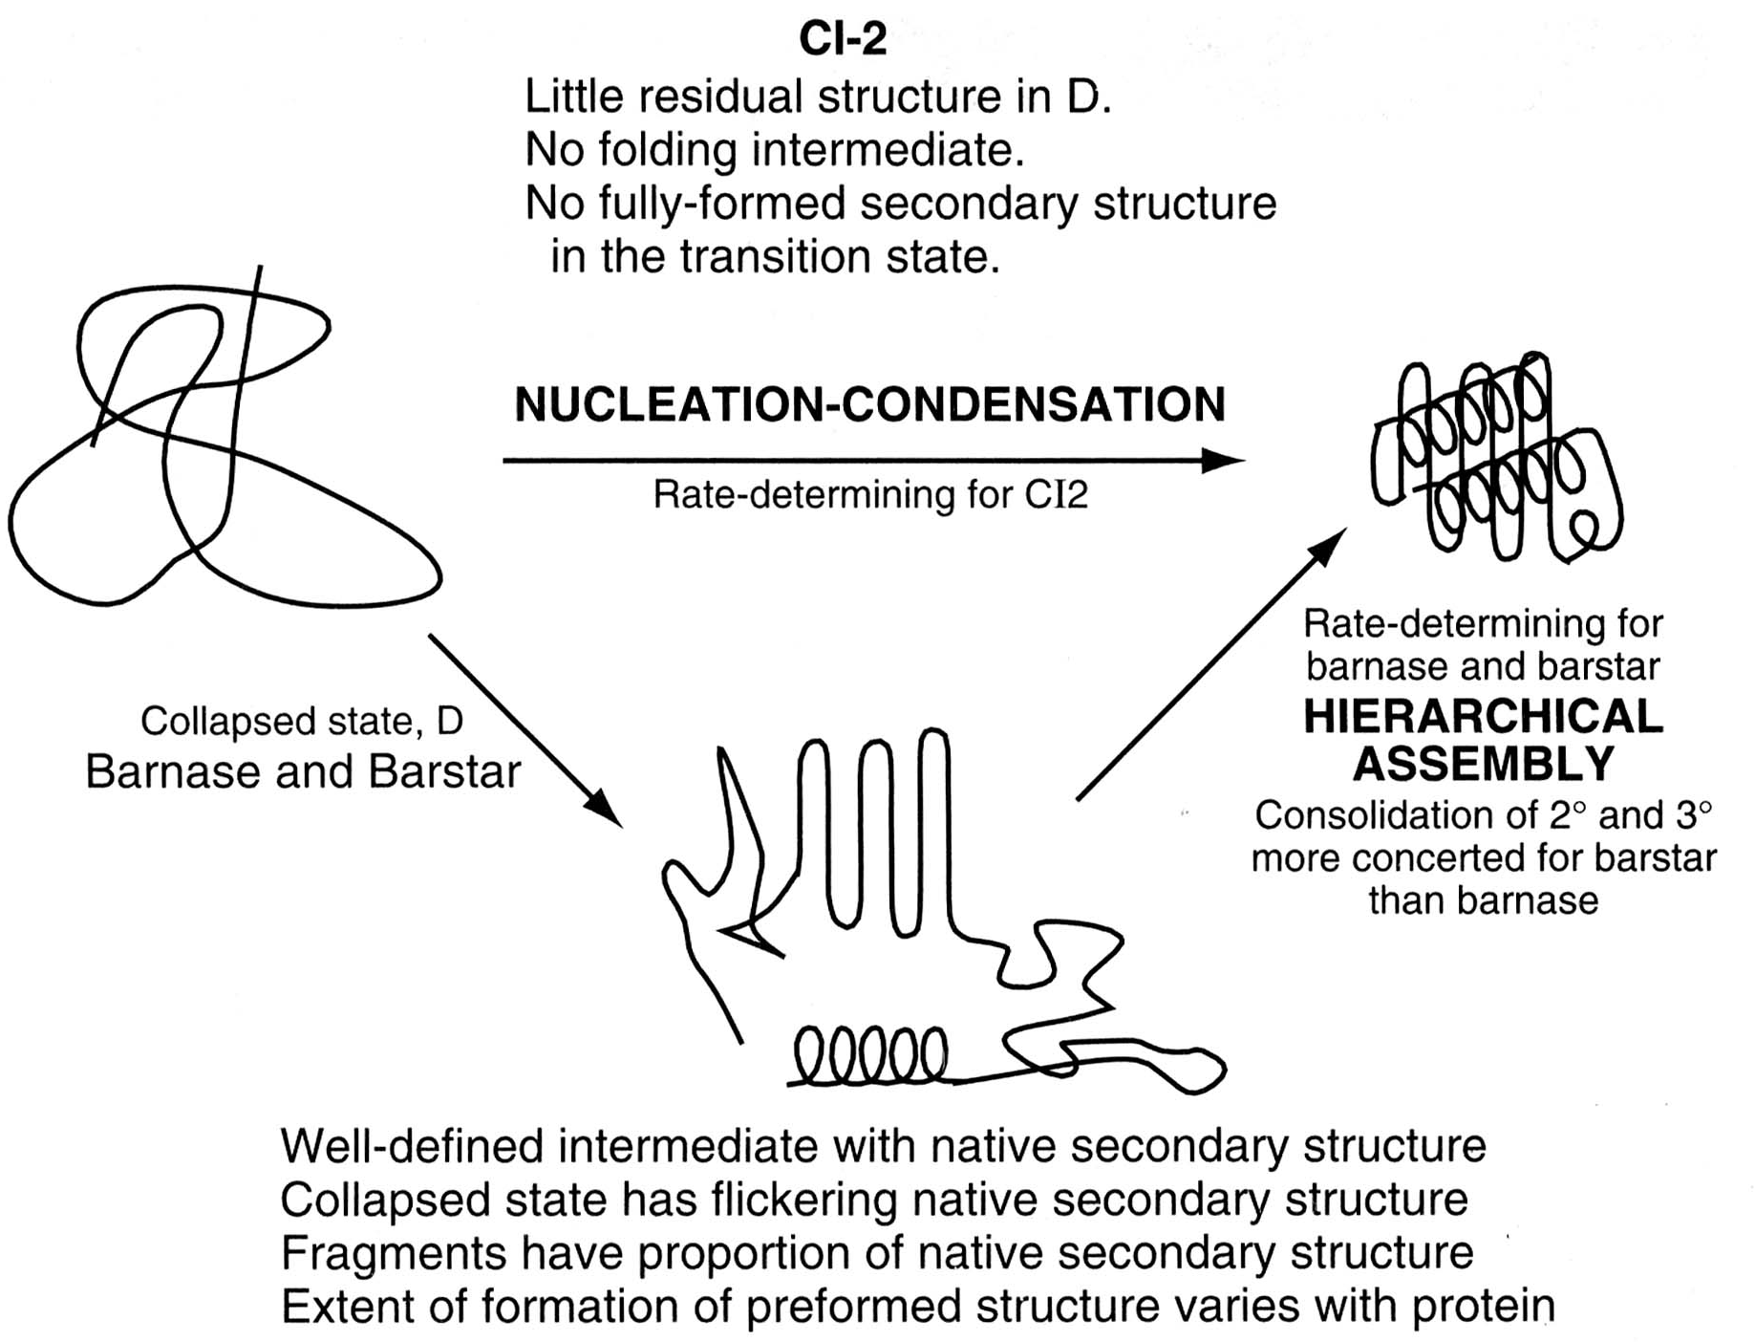
Unified Nucleation-condensation Scheme
It is unlikely that there is a single mechanism for protein folding.

Slide 19
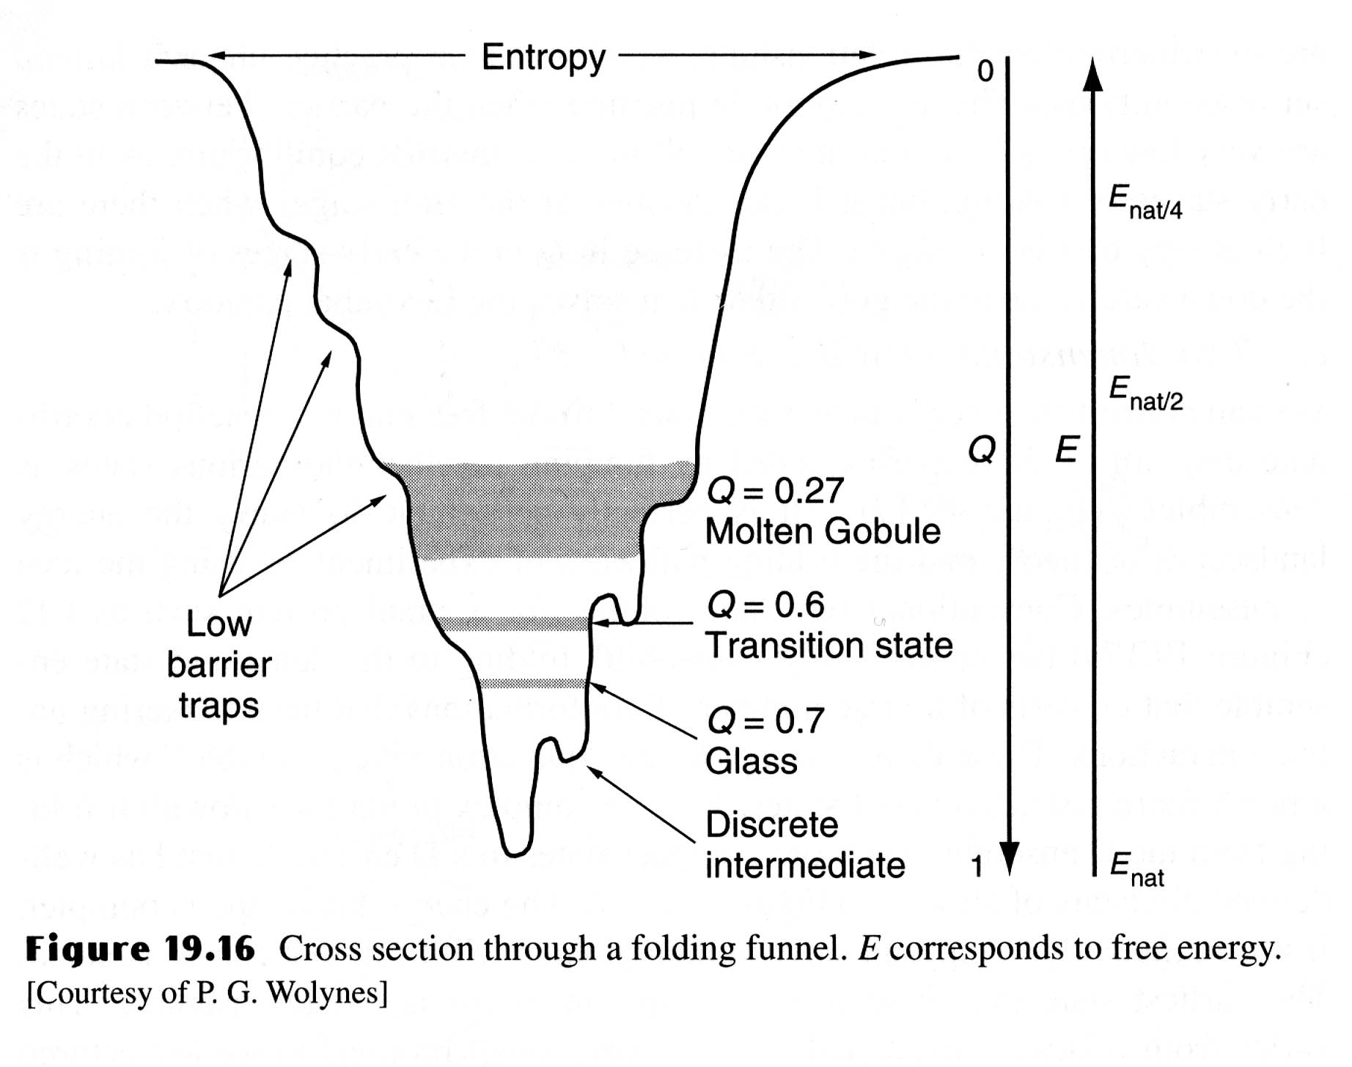
The Folding Funnel
A new view of protein folding suggested that there is no single route, but a large ensemble of structures follow a many dimensional funnel to its native structure.
Progress from the top to the bottom of the funnel is accompanied by an increase in the native-like structure as folding proceeds.

Slide 20
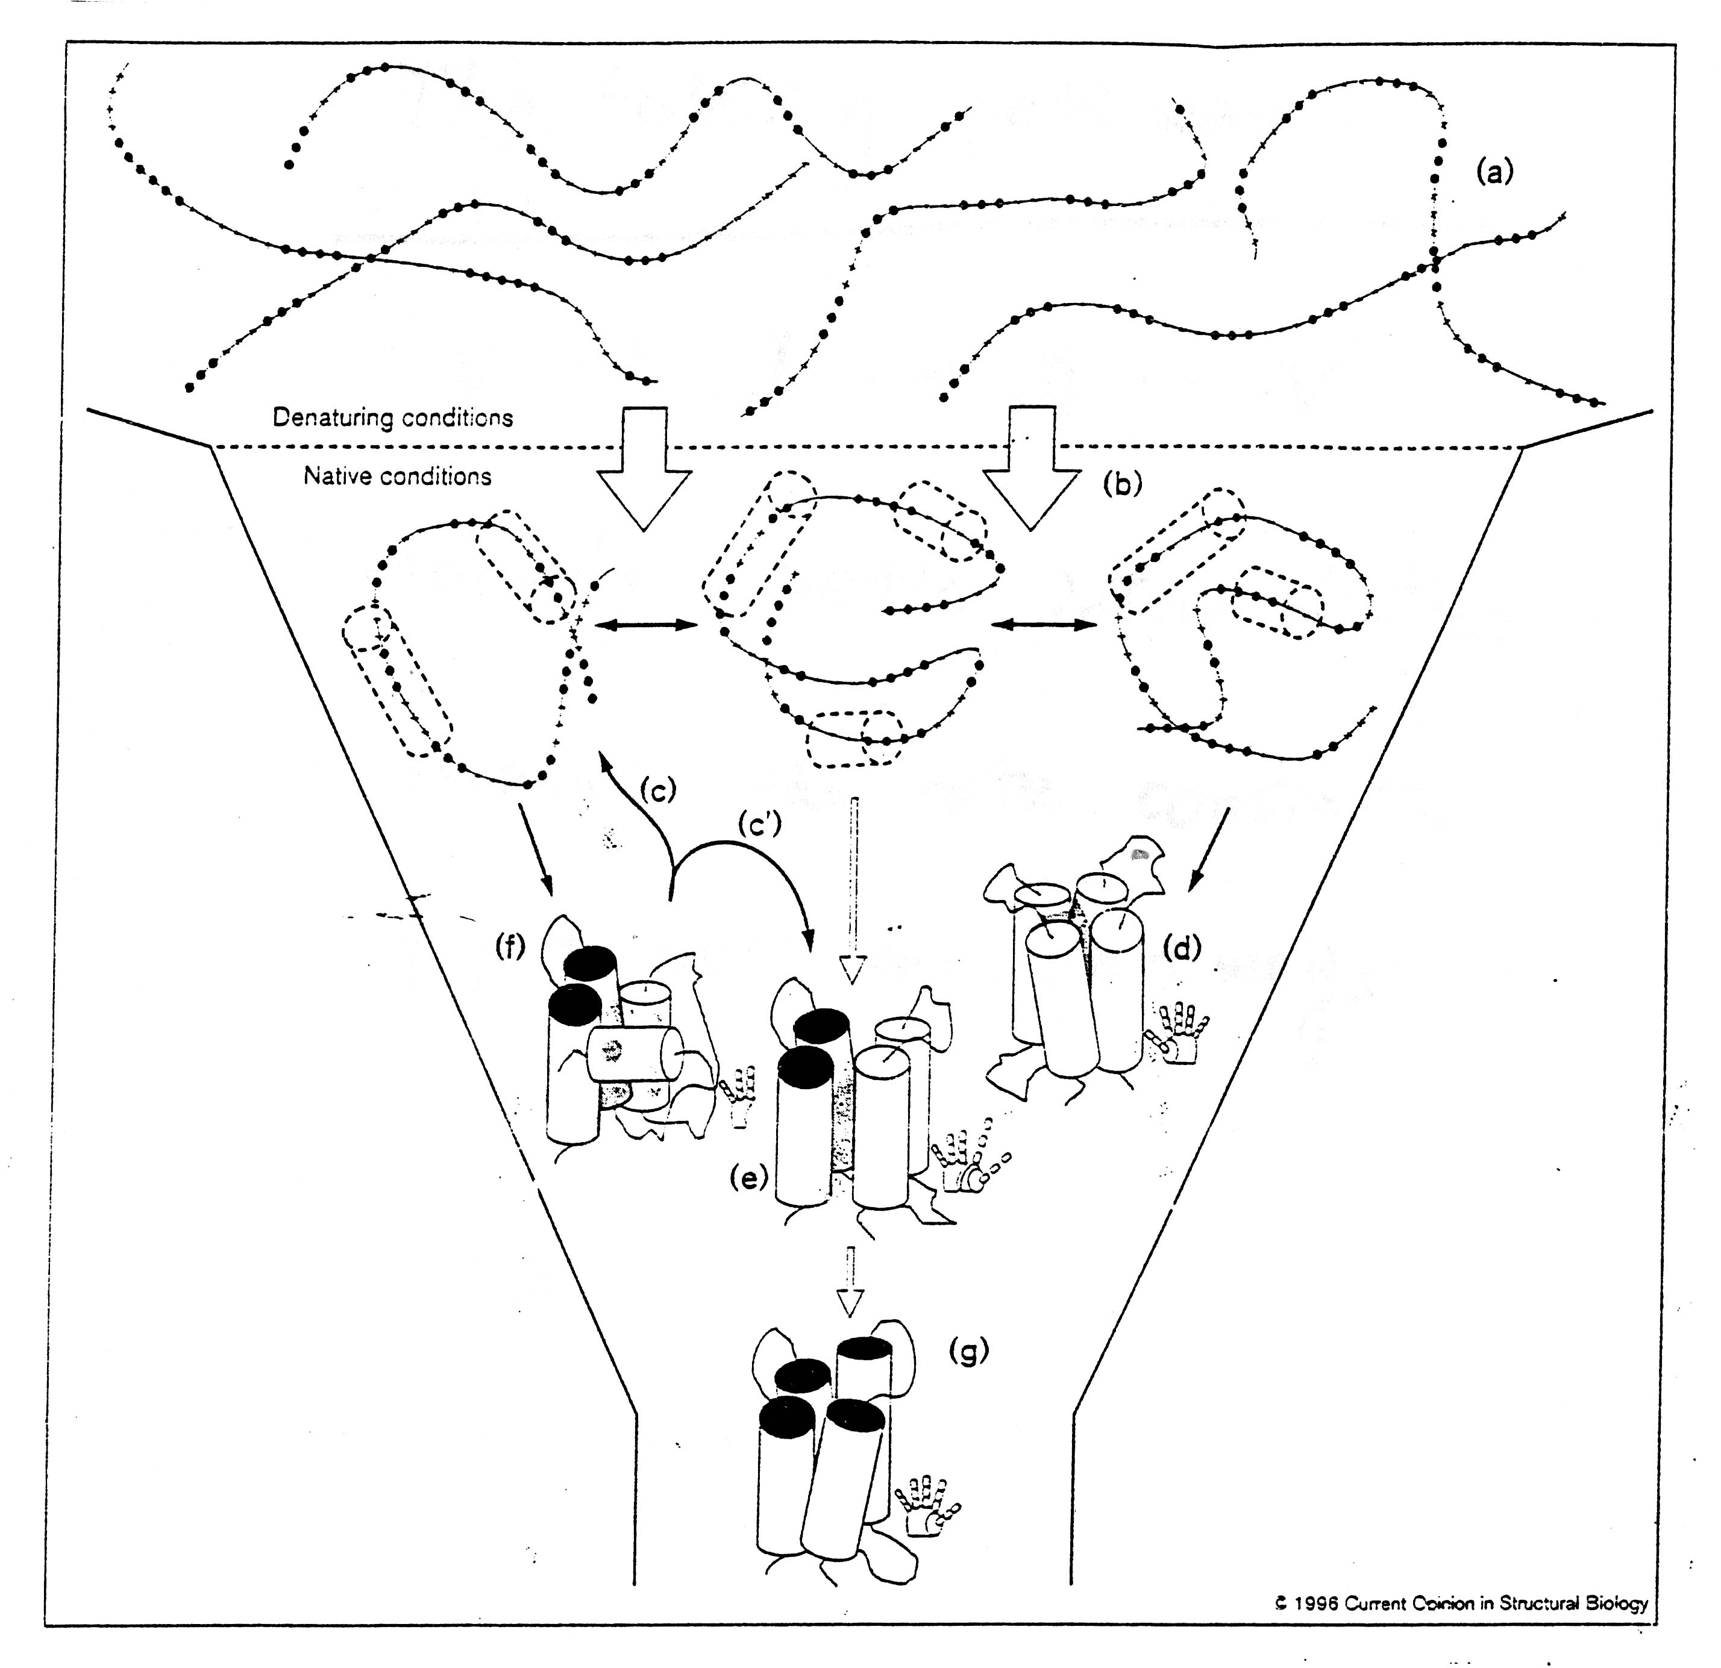

Slide 21
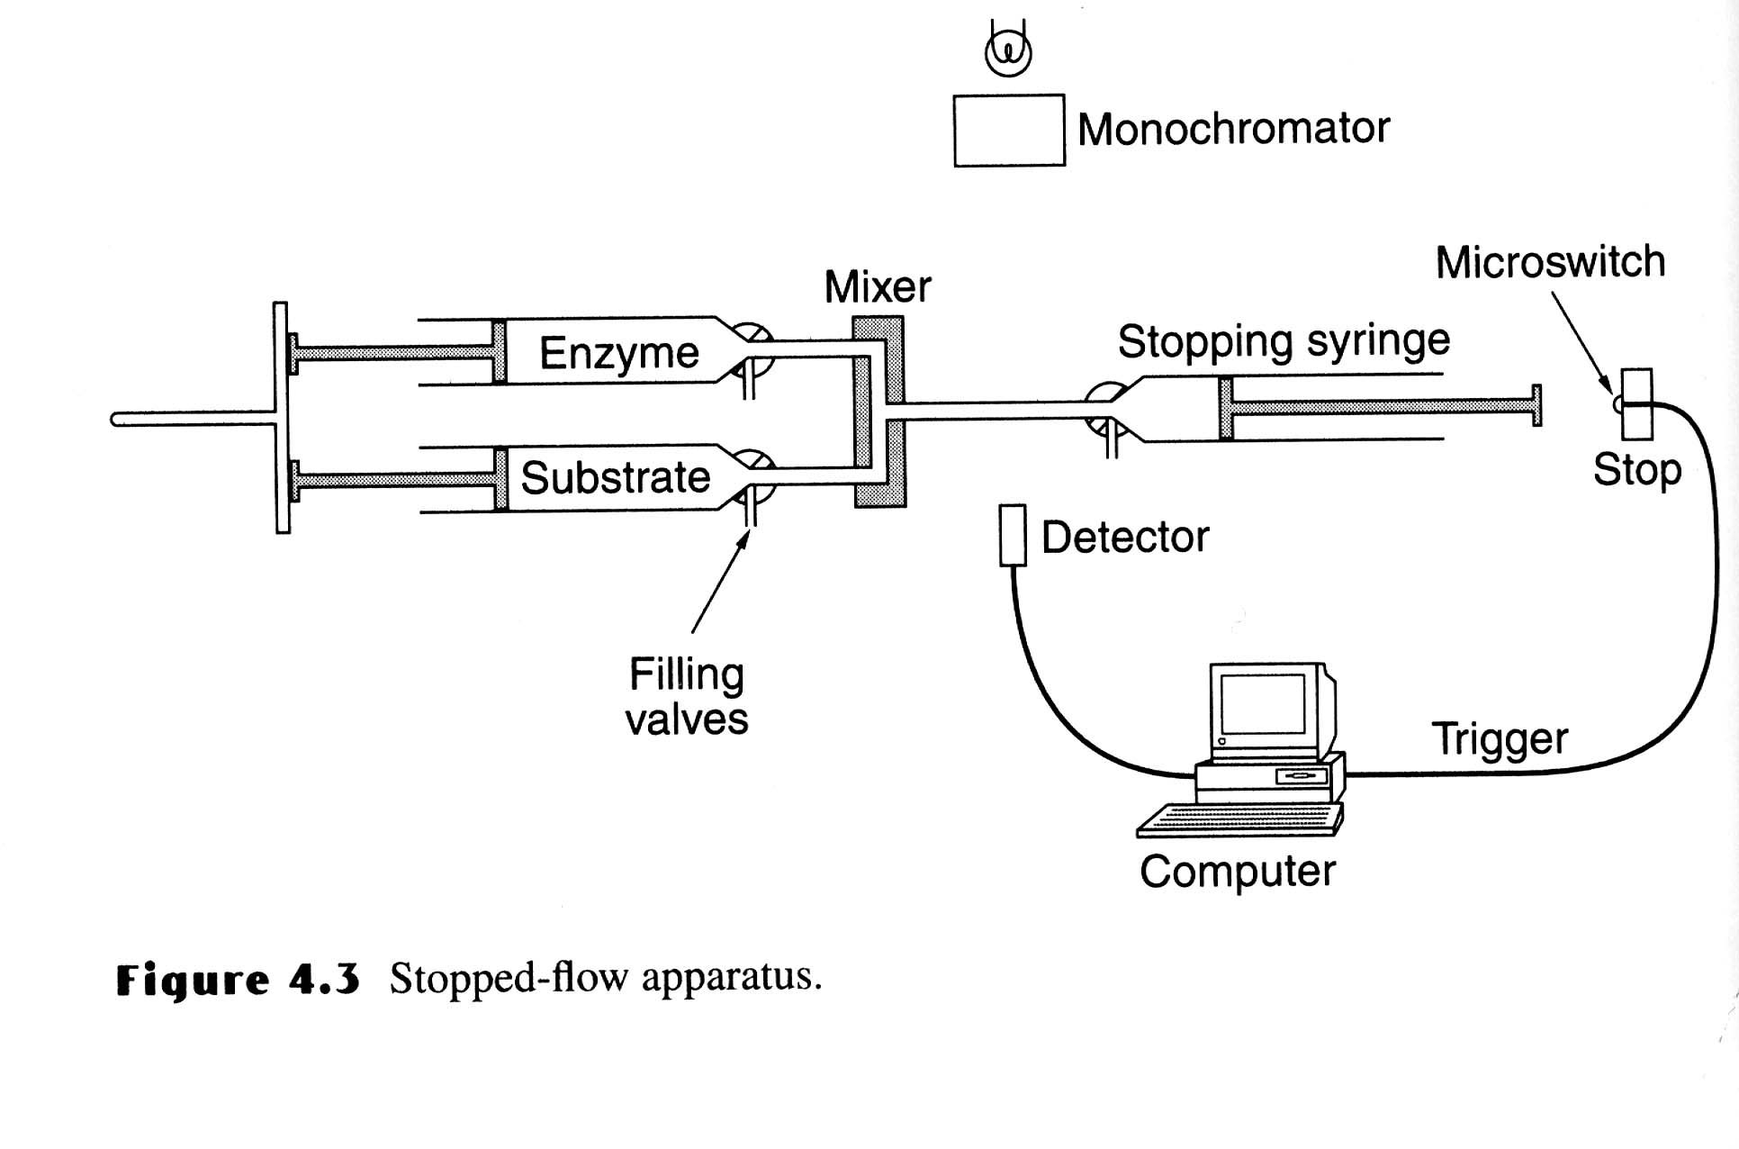
Stopped-Flow Technique
Unfolded proteins in denaturant and buffer are placed in two syringes and mixed to allow protein folding at lower concentration of denaturants and mechanically stopped. The recording of the optical signal changes during the folding and is initiated by the macro-switch attached to the stop button.

Slide 22
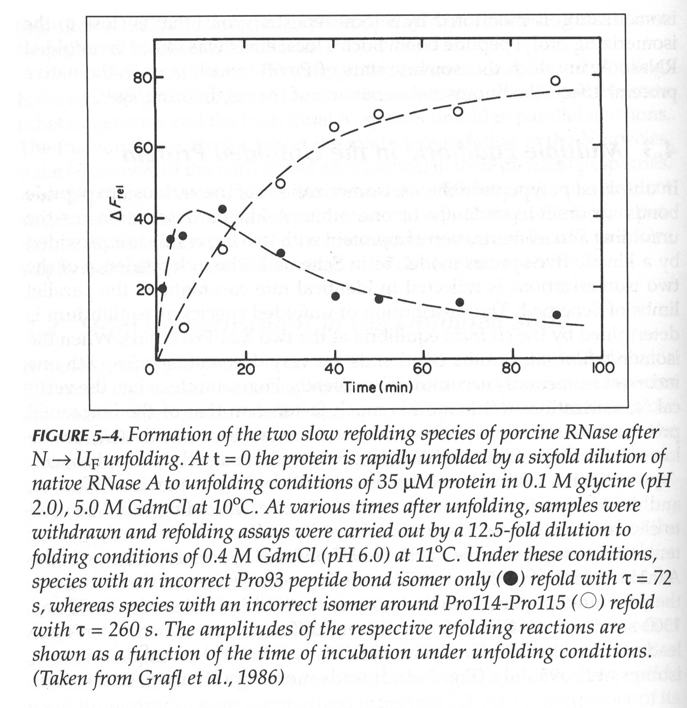
Cis-trans pro

Slide 23
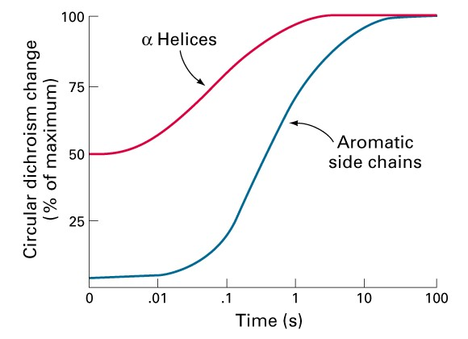
Folding of Cytochrome c
α−helix formation is more rapid than tertiary structure rearrangements of aromatic sidechains in the folding of cytochrome c.
The kinetics of these changes were determined by CD at 222 and 289 nm

Slide 24
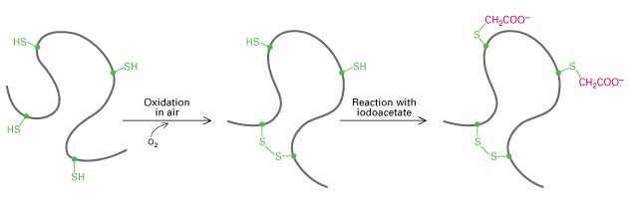
Trapping of Disulfide-bound Intermediate
The sequence of formation of disulfide bonds in proteins can be determined by trapping free cysteine residues with iodoacetate (alkylating agent).
The S-carboxymethyl derivative of cysteine is stable, which be determined using chromatographic separation.

Slide 25
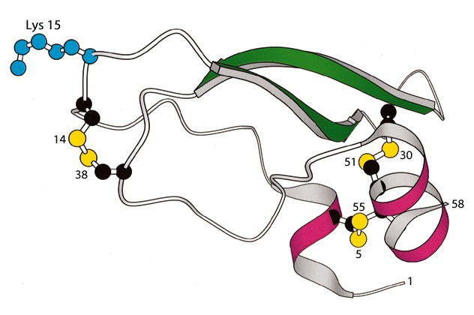
Structure of BPTI
Bovine pancreatic typsin inhibitor (BPTI) has three disulfide bonds.
BPTI inhibits trypsin by inserting Lys-15 into the specificity pocket of the enzyme.

Slide 26
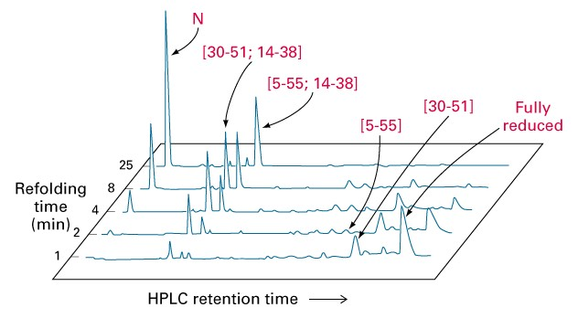
Folding of BPTI
Disulfide bond formation was quenched at the indicated times by addition of an acid. The identities of the HPLC peaks were determined after free sulfhydryls were reacted with iodoacetate to prevent rearrangements.
Only native disulfide bonds are present in the major peaks.

Slide 27
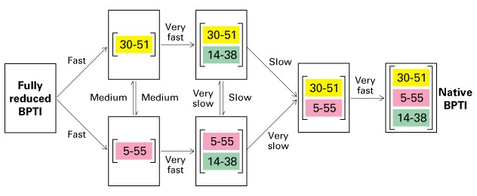
Folding of BPTI
The very fast reactions occur in milliseconds, whereas the very slow ones occur in months. The species contain 5 - 55, 14 - 38 disulfide bonds are kinetically trapped in the absence of enzymes.

Slide 28
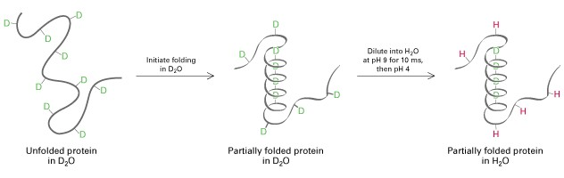
Pulsed-labeled NMR
A protein is unfolded in a D₂O-denaturant solution to change amide NH groups to ND groups. Refolding is then initiated by diluting the sample in D₂O to lower the concentration of denaturant. Then diluted into H₂O at pH 9.0 for 10 ms and then pH 4.0. The formation of secondary and tertiary structures protects the ND group from exchange to NH. NMR is used to detect the exchanged NH groups.

Slide 29
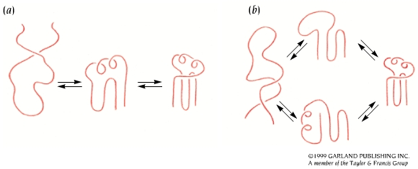
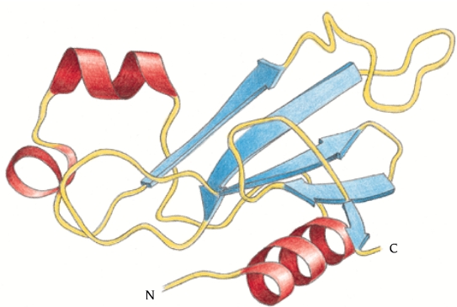
Folding of Barnase
Barnase folds through a major pathway

Slide 30
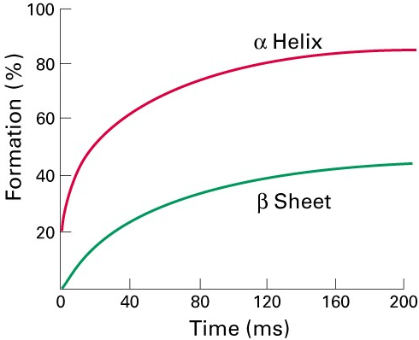
Folding of Lysozyme
In the refolding of lysozyme, the helix domain is formed before the β-sheet.
Proton exchangeability was measured at different times after the initiation of folding.

Slide 31
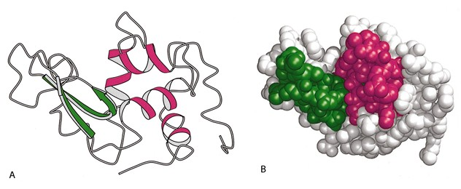
Folding of Lysozyme
The alpha helix domain is folded faster than the beta domain.

Slide 32
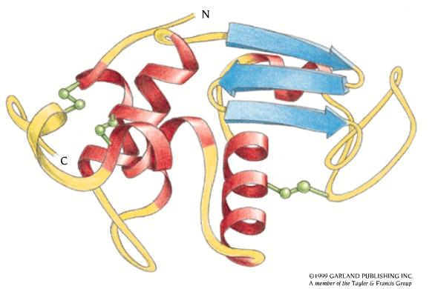
Parallel Pathways for the Folding of Lysozyme

Slide 33
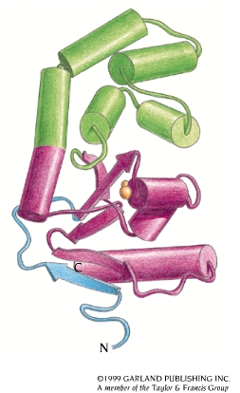
Protein Disulfide Isomerase (PDI)
The formation of correct disulfide pairings in nascent proteins is catalyzed by PDI.
PDI preferentially binds with peptides that containing Cys residues. It has a broad substrate specificity for the folding of diverse disulfide-containing proteins
By shuffling disulfide bonds, PDI enables proteins to quickly find the thermodynamically most stable pairing those that are accessible.

Slide 34
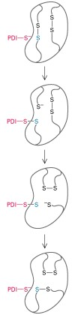
Protein Disulfide Isomerase
PDI contains two Cys-Gly-His-Cys sequences. The thiols of these Cys are highly active because of their lower pKa (7.3) than most thiols in proteins (8.5), and are very active at physiological pH.
PDI is especially important in accelerating disulfide inter-change in kinetically trapped folding intermediate.

Slide 35
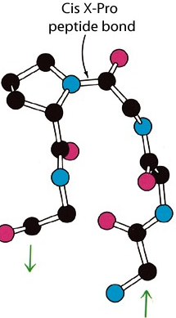
Peptidyl Prolyl Isomerase (PPI)
Peptide bonds in proteins are nearly always in the trans configuration, but X-pro peptide bonds are 6% cis.
Prolyl isomerization is the rate-limiting in the folding of many proteins in vitro.
PPI accelerates cis-trans isomerization more than 300 fold by twisting the peptide bond so that the C,O, and N atoms are no longer planar.

Slide 36
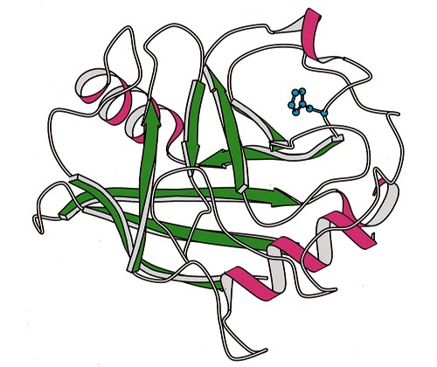
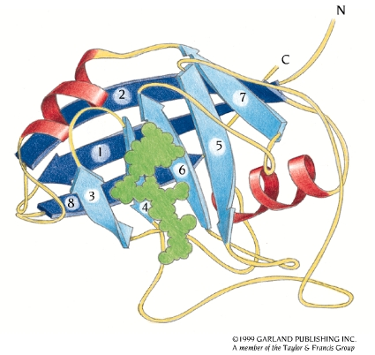
Peptidyl Prolyl Isomerase (PPI)

Slide 37
Molecular Chaperones
Nascent polypeptides come off the ribosome and fold spontaneously, molecular chaperones are involved in their folding in vivo, and are related to heat shock proteins (hsp).
The main hsp families are:
"Small hsp's" - Diverse "family" 10,000 - 30,000 MW (hsp26/27 - crystallins (eye lens))
hsp40
hsp60 (e.g. GroEL in E. coli)
hsp70 (DnaK in E. coli)
hsp90
hsp100

Slide 38
Function of Heat Shock Proteins
Minimize heat and stress damage to proteins (renaturation/degradation)
Facilitate correct folding of proteins by minimizing aggregation and other misfolding
Bind to nascent polypeptides to prevent premature folding
Facilitate membrane translocation/import by preventing folding prior to membrane translocation
Facilitate assembly/disassembly of multiprotein complexes

Slide 39
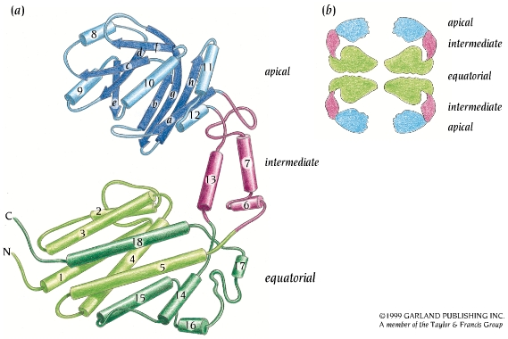
One Subunit of GroEL

Slide 40
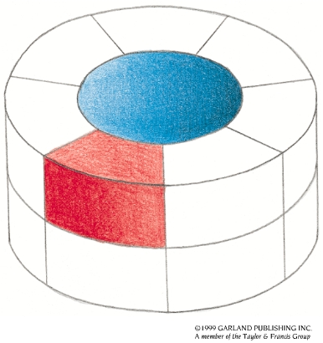
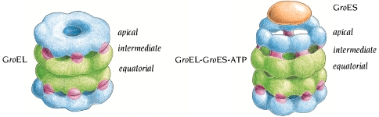
Proteins can Fold/unfold Inside Chaperonins
A large conformational change of GroEL occurs when GroES and ATP are bound. The GroES molecule binds to one of the GroEL rings and closes off the central cavity. The GroEL ring becomes larger and the cavity inside that part of the cylinder becomes wider.

Slide 41
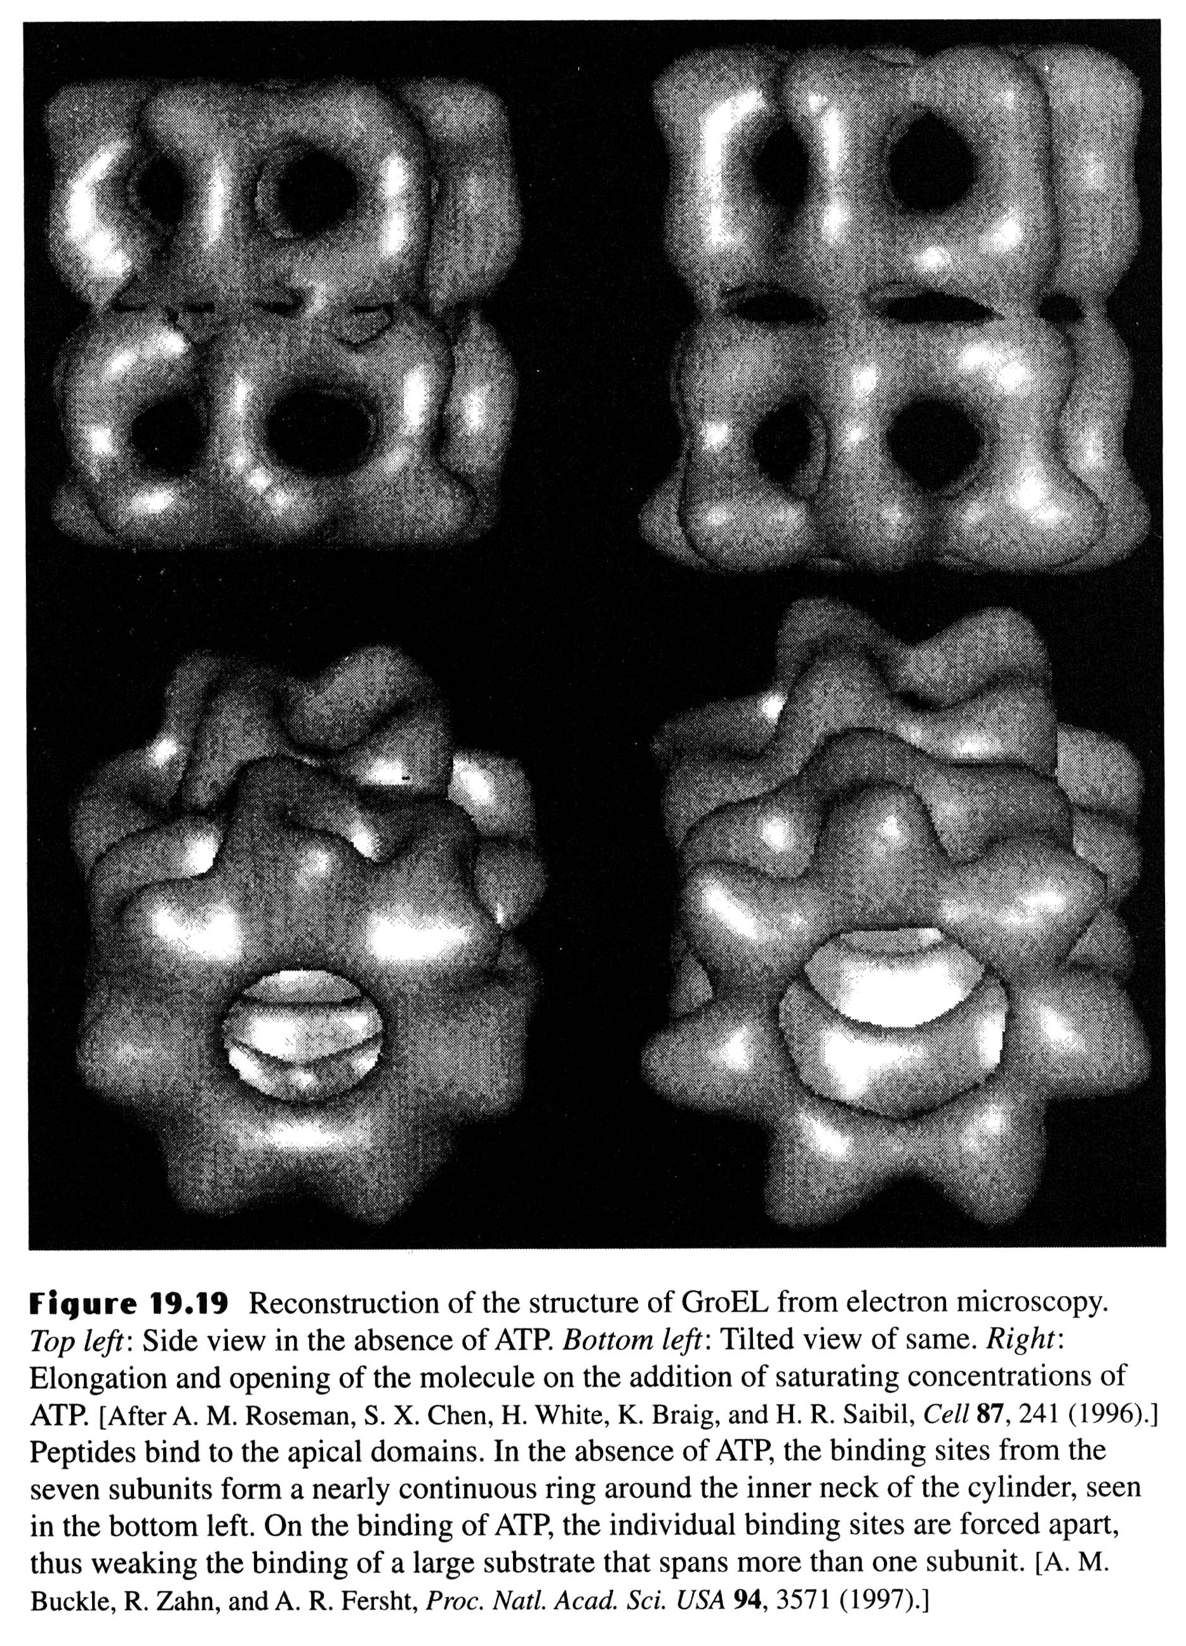

Slide 42
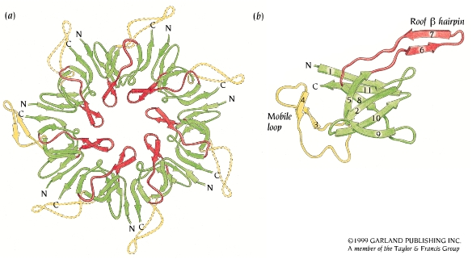
GroES Closes Off One End of the GroEL Cylinder

Slide 43
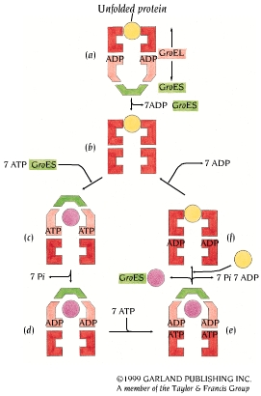
Functional Cycle of GroEL-GroES
As shown in (a), an unfolded protein
molecule (yellow) binds to one end
of the GroEL-ADP complex (red)
with bound GroES (green) at the
other end. In (b) and (c), GroES is
released from the trans-position and
rebound together with ATP at the
cis-position (light red) of GroEL. In
(d), ATP hydrolysis occurs as the
protein is folding or unfolding inside
the central cavity. In (e), ATP
binding and hydrolysis in the trans-
position is required for release of
GroES and the protein molecule.
Finally, in (f), a new unfolded
protein molecule can now bind to
GroEL.

Slide 44
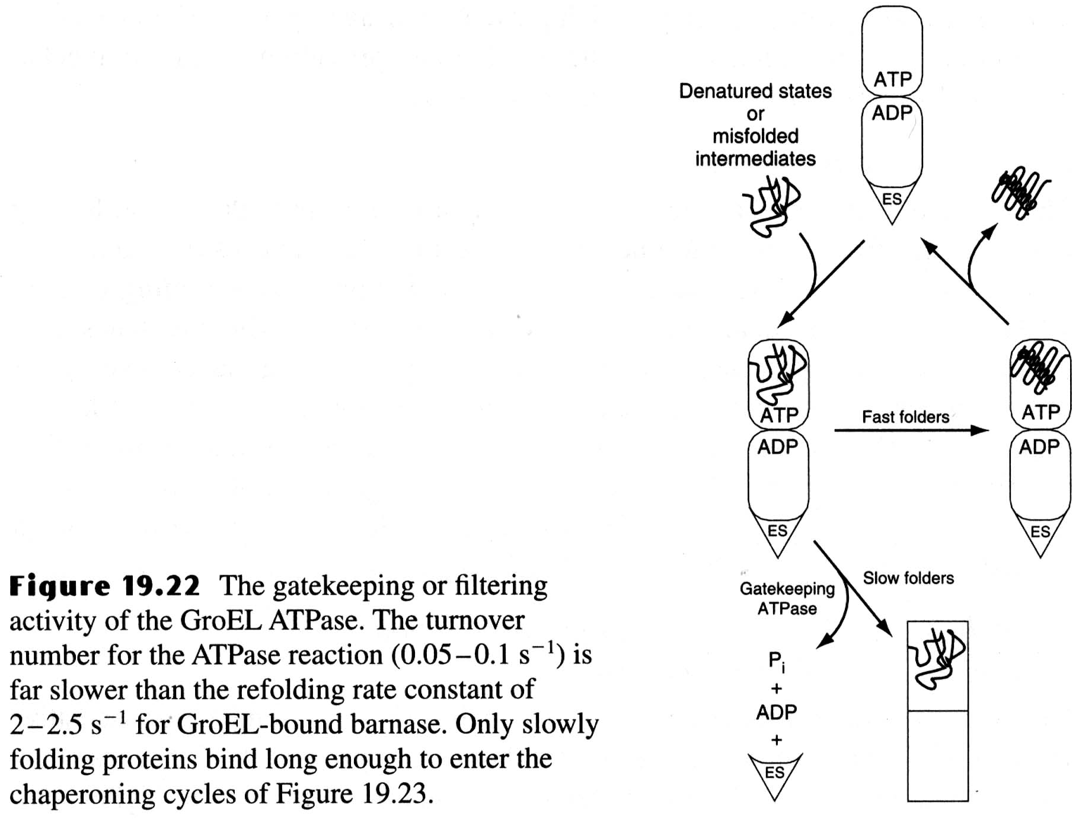

Slide 45
